Slide 1
Graphs: Basic Definitions and Properties
Make sure to read book material!

Slide 2
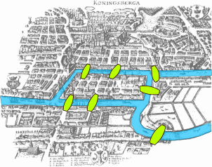
Origins of Graph Theory
The city of Königsberg in Prussia (now Kaliningrad, Russia) was set on both sides of the Pregel River, and included two large islands which were connected to each other and the mainland by 7 bridges.
Problem: can one find a walk through the city that crosses each bridge exactly once.

Slide 3
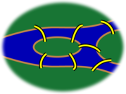
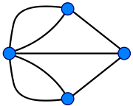
Origins of Graph Theory

Slide 4
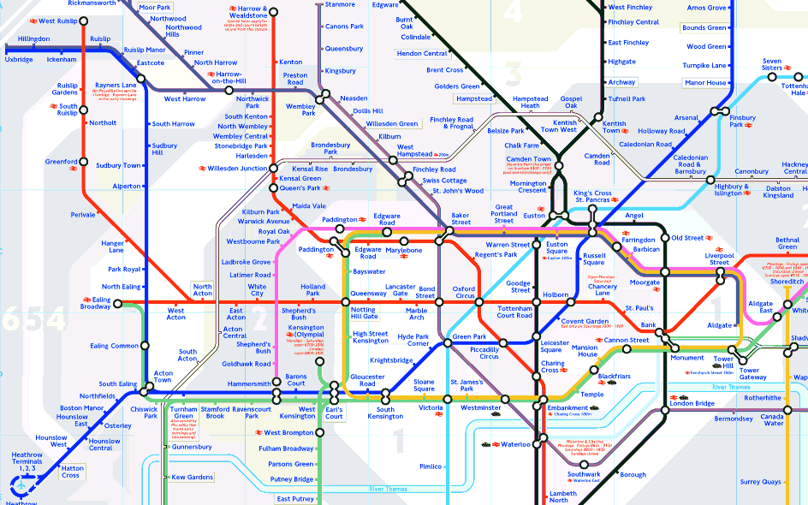

Slide 5
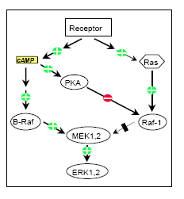
Biochemical Networks

Slide 6
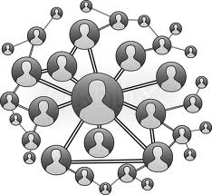
Social Networks

Slide 7
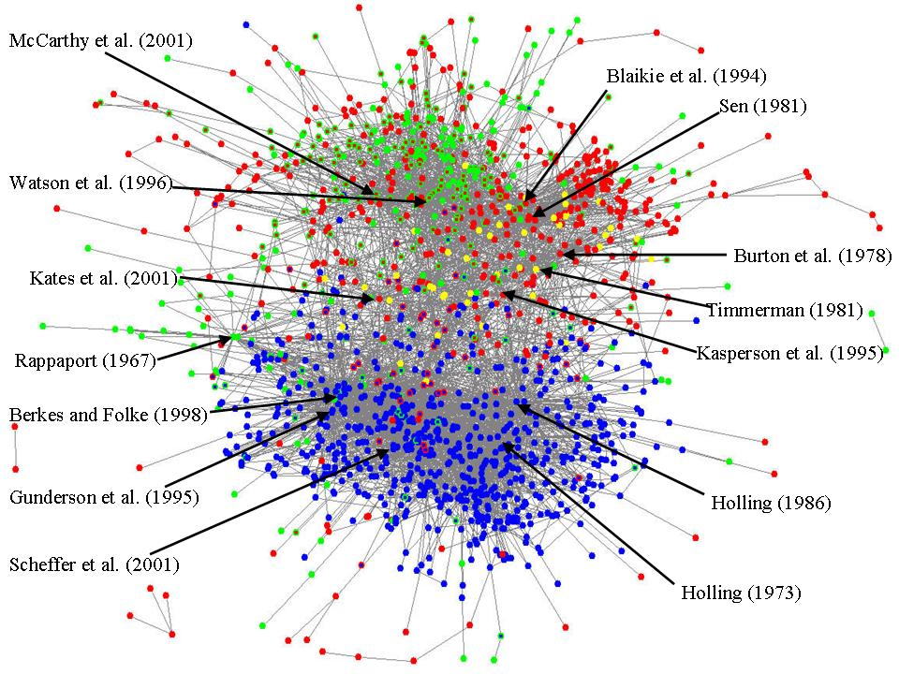
Citation Graph

Slide 8
Graphs
A graph is a collection of vertices (also called nodes, shown by dots) connected by edges (also called arcs, shown by straight or curved lines).
There is a rich mathematical theory about graphs (Graph Theory). Great for exercising/applying discrete math skills.
Graphs are a common abstract data type in CS

Slide 9
Graphs
A simple graph is a graph with no “self loops” and at most one edge between any two vertices.
We will be primarily concerned with simple graphs.

Slide 10
Graphs
Formally a graph G is a specified by a pair (V,E) where V is a finite set of vertices and E is a set of edges. Each edge
species a pair of vertices that it connects.
b
c
V = {a, b, c, d, e}
E = {(a,b), (b,c), (c,e), (e,b)}
a
e
d
Order not matter (a,b) = (b,a)

Slide 11
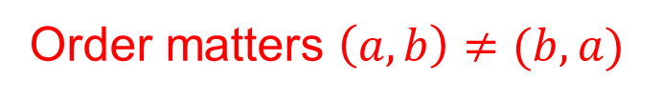
Directed Graphs
A directed graph (V,E) specifies a set of vertices V and directed edges E. A directed edge is an ordered pair of vertices (a,b) denoting an edge “going from” vertex a to vertex b (shown as arrow from a to b).
b
c
V = {a, b, c, d, e}
E = {(a,b), (c,b), (c,e), (b,e)}
a
e
d
Order matters $\left(a,b\right)≠(b,a)$
Graphs without directed arcs will be called undirected graphs.

Slide 12
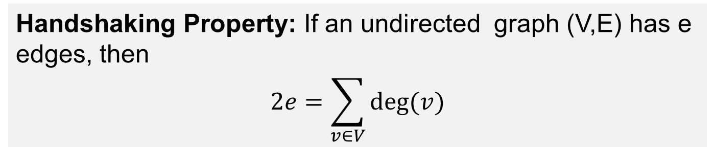
Vertex Degree
The degree of a vertex v (denoted deg(v)) in an undirected graph is the number of edges adjacent to v.
b
c
deg(a)=1, deg(b)=3, deg(c)=2
deg(d)=0, deg(e)=2
a
e
d
Handshaking Property: If an undirected graph (V,E) has e edges, then
$$2e=\sum_{v∈V}{\text{deg}(v)}$$

Slide 13
Interesting Property
Theorem: Any undirected graph must have an even number of vertices with odd degree. (zero is considered as even)
b
c
2 vertices with odd degree
a
e
d
Why?

Slide 14
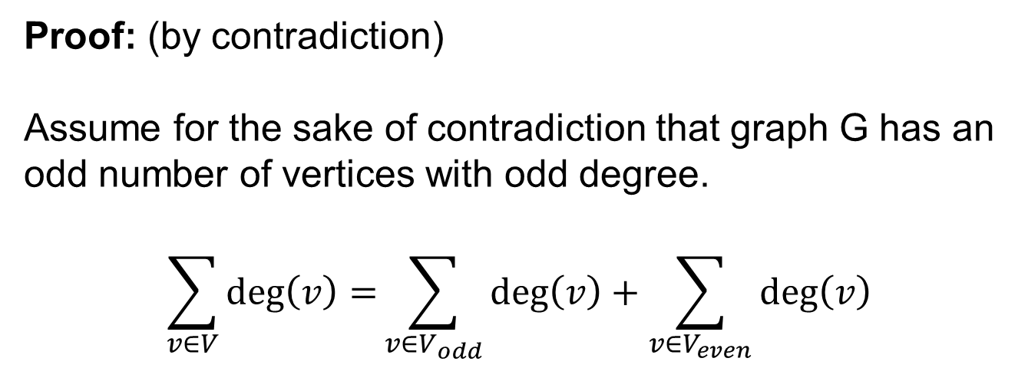
Interesting Property
Theorem: Any undirected graph must have an even number of vertices with odd degree. (zero is considered as even)
Proof: (by contradiction)
Assume for the sake of contradiction that graph G has an
odd number of vertices with odd degree.
$$\sum_{v∈V}{\text{deg}\left(v\right)=}\sum_{v∈V_{odd}}{\text{deg}\left(v\right)}+\sum_{v∈V_{even}}{\text{deg}\left(v\right)}$$
odd + even = odd
Contradicts handshaking property which says sum is even.

Slide 15
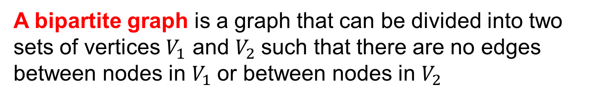
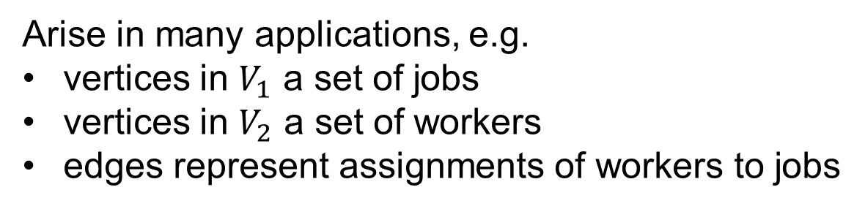


Bipartite Graphs
A bipartite graph is a graph that can be divided into two sets of vertices $V_{1}$ and $V_{2}$such that there are no edges between nodes in $V_{1}$or between nodes in $V_{2}$
$$V_{1}$$
$$V_{2}$$
Arise in many applications, e.g.
vertices in $V_{1}$ a set of jobs
vertices in $V_{2}$ a set of workers
edges represent assignments of workers to jobs

Slide 16
Bipartite Graphs
How can we tell if a graph is bipartite?
A two coloring of a graph is an assignment of one of
Two colors to each vertex
Theorem: A graph is bipartite if and only if it has a
two coloring such that no two vertices connected by an
edge have the same color.

Slide 17
Bipartite Graphs
How can we tell if a graph is bipartite?
a
b
c
bipartite
No way to color {a,b,c}
Not bipartite.
Theorem: A graph is bipartite if and only if it has a
two coloring such that no two vertices connected by an
edge have the same color.

Slide 18
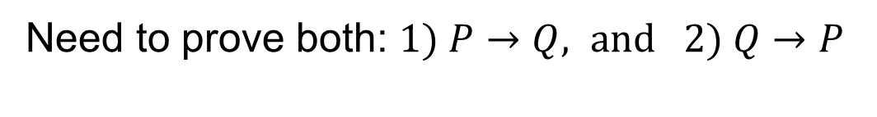
Proof
Theorem: A graph G is bipartite if and only if G has a
two coloring such that no two vertices connected by an
edge have the same color.
P = “graph G is bipartite”
Q = “G has 2-coloring without edges between same color nodes”
Need to prove both: $1) P→Q, \text{and} 2) Q→P$

Slide 19
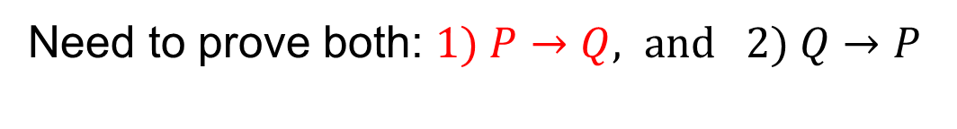


Proof
Theorem: A graph G is bipartite if and only if G has a
two coloring such that no two vertices connected by an
edge have the same color.
P = “graph G is bipartite”
Q = “G has 2-coloring without edges between same color nodes”
Need to prove both: $1) P→Q, \text{and} 2) Q→P$
Assume P is true.
$$V_{1}$$
$$V_{2}$$

Slide 20

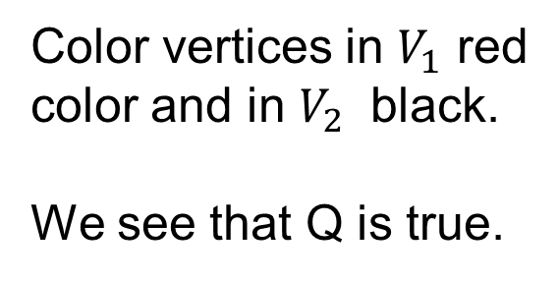
Proof
Theorem: A graph G is bipartite if and only if G has a
two coloring such that no two vertices connected by an
edge have the same color.
P = “graph G is bipartite”
Q = “G has 2-coloring without edges between same color nodes”
Need to prove both: $1) P→Q, \text{and} 2) Q→P$
Assume P is true.
Color vertices in $V_{1}$ red color and in $V_{2}$ black.
We see that Q is true.
$$V_{1}$$
$$V_{2}$$

Slide 21
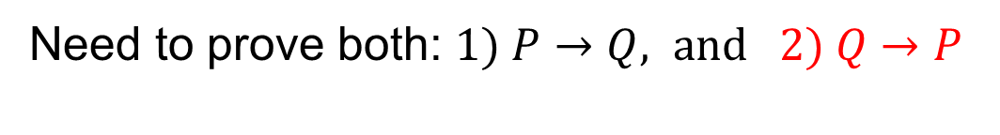
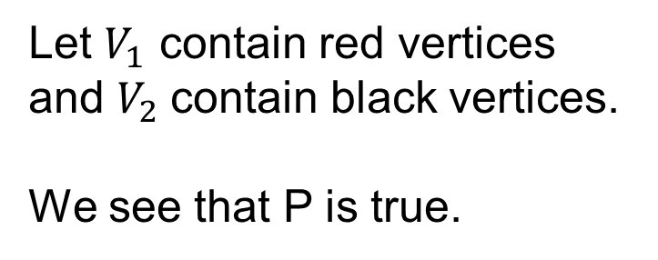
Proof
Theorem: A graph G is bipartite if and only if G has a
two coloring such that no two vertices connected by an
edge have the same color.
P = “graph G is bipartite”
Q = “G has 2-coloring without edges between same color nodes”
Need to prove both: $1) P→Q, \text{and} 2) Q→P$
Assume Q is true.
Let $V_{1}$ contain red vertices and $V_{2}$contain black vertices.
We see that P is true.

Slide 22
Learning Objective
Understand how to represent different types of data as graphs (examples in lecture and book)
Understand the basic terminology and properties covered
Understand how to prove the formal properties covered in lectures and the reading

