Slide 1
Graphs: Connectivity
Make sure to read book material!

Slide 2
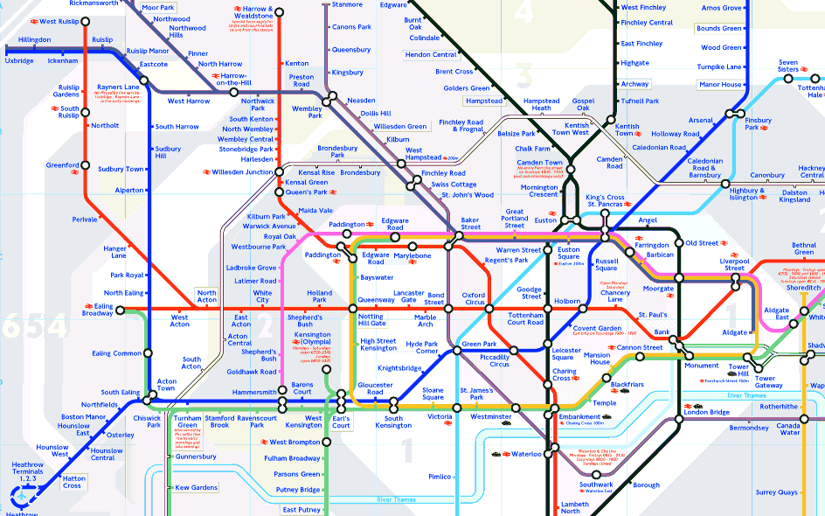
Can we get from here to there?

Slide 3

Social Networks
Is there a relationship link between two people?
What “connected” groups does a person belong to?

Slide 4
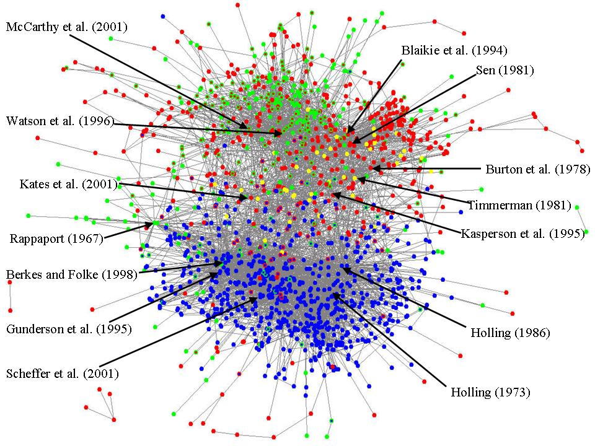
Citation Graph
Was one scientific paper influenced by another?

Slide 5
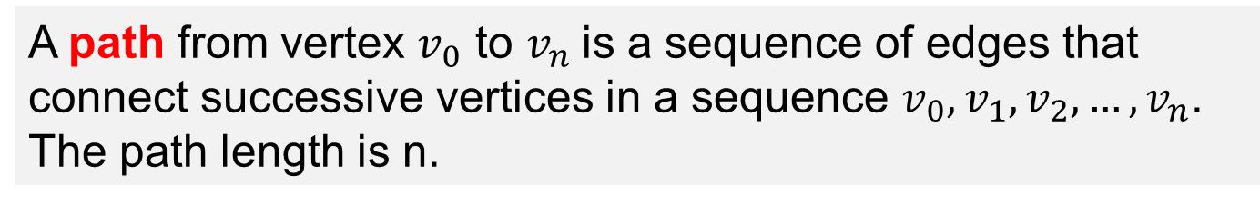
Paths
A path from vertex $v_{0}$ to $v_{n}$is a sequence of edges that connect successive vertices in a sequence $v_{0}, v_{1}, v_{2}, …, v_{n}$. The path length is n.
b
c
a
d
f
e
Paths from a to e: 1) (a,b), (b,c), (c,e)
2) (a,b), (b,c), (c,e), (e,b), (b,c), (c,e)

Slide 6
Paths
A path from vertex $v_{0}$ to $v_{n}$is a sequence of edges that connect successive vertices in a sequence $v_{0}, v_{1}, v_{2}, …, v_{n}$. The path length is n.
b
c
A path is simple if it does not have repeated edges.
a
d
f
e
Paths from a to e: 1) (a,b), (b,c), (c,e)
2) (a,b), (b,c), (c,e), (e,b), (b,c), (c,e)

Slide 7
Circuits
A path from vertex $v_{0}$ to $v_{n}$is a sequence of edges that connect successive vertices in a sequence $v_{0}, v_{1}, v_{2}, …, v_{n}$. The path length is n.
b
c
A circuit is a path that starts and ends with the same vertex.
a
d
f
e
Simple Circuit: (b,c), (c,e), (e,b)
Non-Simple Circuit: (b,c), (c,e), (e,b), (b,c), (c,e), (e,b)

Slide 8
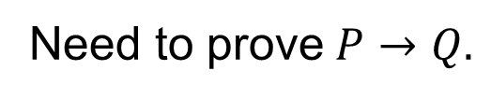
Simple Path Lemma
Lemma: If there is a path between vertices u and v in a graph, then there is a simple path between u and v.
P = “there is a path between u and v”
Q = “there is a simple path between u and v”
Need to prove$P→Q.$
Assume that P is true.
Case 1: Path is simple. Then Q is true.
Case 2: Path is not simple.

Slide 9
Simple Path Lemma
Lemma: If there is a path between vertices u and v in a graph, then there is a simple path between u and v.
P = “there is a path between u and v”
Q = “there is a simple path between u and v”
Need to prove$P→Q.$
Assume that P is true.
Case 1: Path is simple. Q is trivially true.
Case 2: Path is not simple.

Slide 10
Simple Path Lemma
Lemma: If there is a path between vertices u and v in a graph, then there is a simple path between u and v.
P = “there is a path between u and v”
Q = “there is a simple path between u and v”
Case 2: Path is not simple.
a
v
u
b
(u,a), (a,v), (v,b), (b,a), (a,v)

Slide 11
Simple Path Lemma
Lemma: If there is a path between vertices u and v in a graph, then there is a simple path between u and v.
P = “there is a path between u and v”
Q = “there is a simple path between u and v”
Case 2: Path is not simple.
Path includes 1 or more circuits.
Remove the circuits from path.
Is now simple and connects u and v.
a
v
u
b
(u,a), (a,v), (v,b), (b,a), (a,v)
circuit

Slide 12
Connectedness
An undirected graph is called connected if there is a path between every pair of distinct vertices in the graph.
b
c
Not connected.
a
d
f
e
b
c
a
Connected.
d
f
e

Slide 13
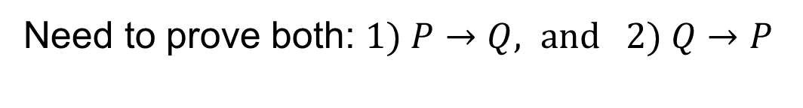
Connectedness Theorem
Theorem: Undirected graph G is connected if and only if there is a simple path between each pair of vertices in G.
P = “G is connected”
Q = “simple path between each pair of distinct vertices in G”
Need to prove both: $1) P→Q, \text{and} 2) Q→P$

Slide 14
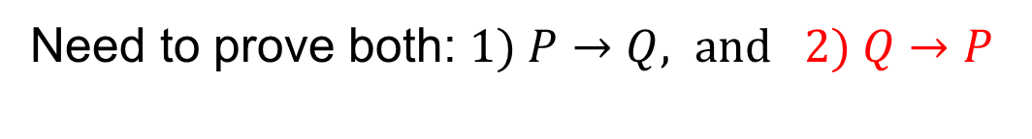
Connectedness Theorem
Theorem: Undirected graph G is connected if and only if there is a simple path between each pair of vertices in G.
P = “G is connected”
Q = “simple path between each pair of distinct vertices in G”
Need to prove both: $1) P→Q, \text{and} 2) Q→P$
Assume that Q is true.
Then there is a simple path (and hence path) between each pair of vertices.
So P is true by definition.

Slide 15
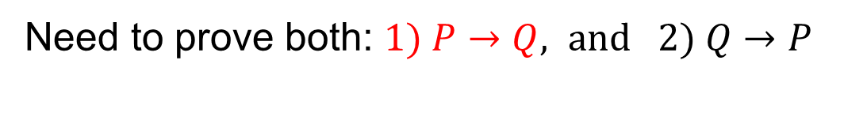
Simple Paths Theorem
Theorem: Undirected graph G is connected if and only if there is a simple path between each pair of vertices in G.
P = “G is connected”
Q = “simple path between each pair of distinct vertices in G”
Need to prove both: $1) P→Q, \text{and} 2) Q→P$
Assume that P is true. Thus, there is a path between each pair of vertices.
Thus, by simple path Lemma, each pair has a simple path
Q is true.

Slide 16
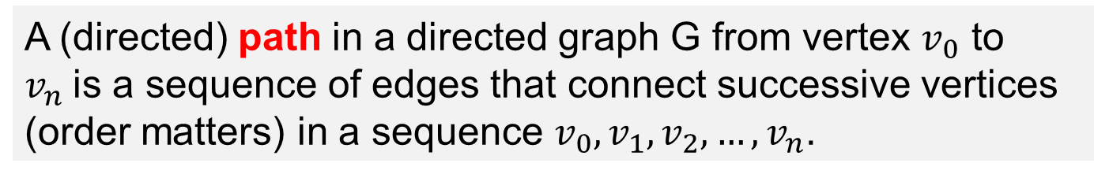
Directed Graphs
A (directed) path in a directed graph G from vertex $v_{0}$ to $v_{n}$is a sequence of edges that connect successive vertices (order matters) in a sequence $v_{0}, v_{1}, v_{2}, …, v_{n}$.
b
c
a
e
d
Directed paths from a to e: (a,b), (b,e)
No directed path from a to c.
No directed path from e to any vertex.

Slide 17
Directed Graphs
A directed graph is strongly connected if for each pair of
vertices there is a directed path from u to v and from v to u.
b
b
c
c
a
a
d
d
e
Not strongly connected.
Strongly connected.
Indicators of communities in social networks.

Slide 18
Learning Objective
Understand the basic definitions of paths, circuits, and connectedness.
Understand how to prove the formal properties covered in lectures and the reading

