Slide 1
Graphs: Dijkstra’s Algorithm
Make sure to read book material!

Slide 2
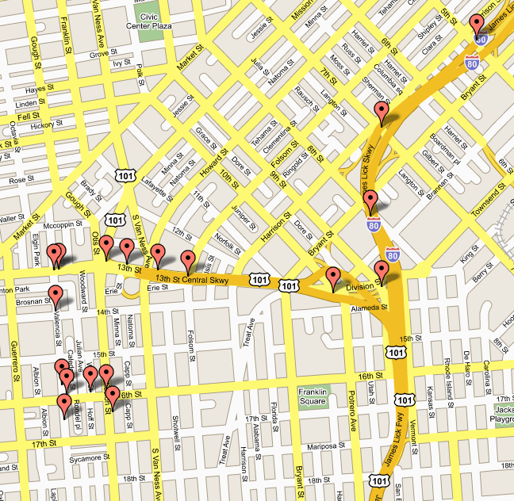
What is the shortest route from here to there?

Slide 3

Social Networks
What is the shortest path of friend relationships between two people?

Slide 4
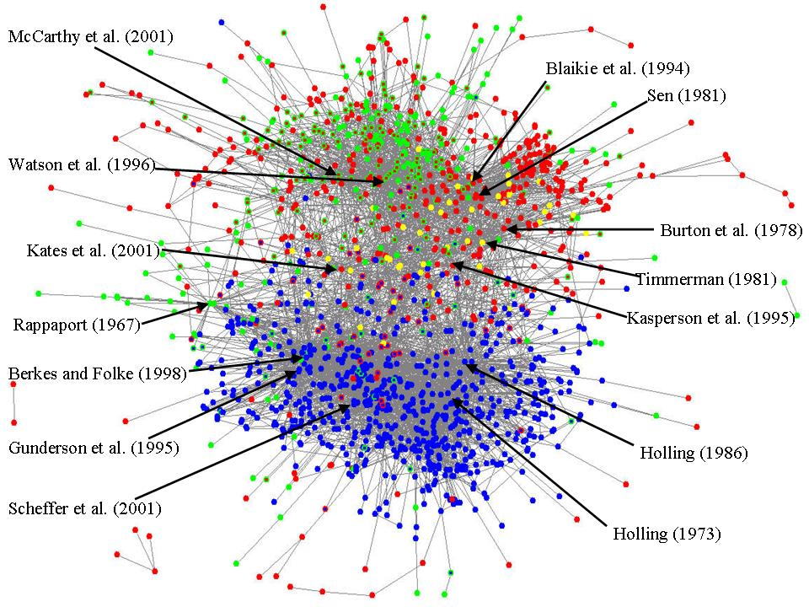
Citation Graph
What is the shortest citation path between two papers?

Slide 5
Citation Graph
What is the shortest citation path between two papers?

Slide 6
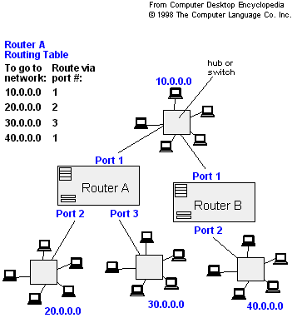
Network Routing
What is the shortest path between two computers in a network?

Slide 7
Weighted Graphs
A weighted graph is a graph with a numeric weight associated with each edge.
Usually edge weight is interpreted as a distance or cost of moving between vertices.
b
1.5
5
c
a
4.5
2.5
d
The length of a path is the sum of its edge weights.

Slide 8
Weighted Graphs
A weighted graph is a graph with a numeric weight associated with each edge.
Usually edge weight is interpreted as a distance or cost of moving between vertices.
b
1.5
Can also have weighted directed graphs.
5
c
a
4.5
2.5
d
The length of a path is the sum of its edge weights.

Slide 9
Vertices = locations, Edges = roads
Weights = travel time or distance

Slide 10
Shortest Path Problem
Given: A weighted graph G and two vertices s and t.
Return: A shortest path from s to t in G.
a
1.5
5
b
s
4.5
2.5
t
Length = 5 + 1.5 + 2.5 = 9

Slide 11
Shortest Path Problem
Given: A weighted graph G and two vertices s and t.
Return: A shortest path from s to t in G.
Is the shortest path between s and t always unique?
2
1
t
s
1
No.
2

Slide 12
Finding Shortest Paths
Brute Force Enumeration: generate each possible sequence of edges and check each one to see if it is a path from s to t and compute its length
Return the path from s to t of smallest length.
Recall: Given e edges there are e! paths.
Not practical.

Slide 13
Dijkstra's algorithm
Dijkstra's Algorithm: is an efficient solution to the shortest path problem
Works on both directed and undirected graphs. However, all edges must have nonnegative weights.
Basic Output: Lengths of shortest paths from a given source vertex s to all other vertices (including t)
Easily modified to also keep track of and return shortest paths.

Slide 14
Dijkstra's algorithm
High-Level Steps
Maintains a set of “solved vertices” S
Those vertices for which we know the shortest path from s
Initially S = {s}
Maintain a “distance label” L(v) for each vertex v
Estimate of shortest path length
Each iteration adds to S the vertex in V-S with smallest distance label
When a node is added to S, its distance label is the true shortest path length

Slide 15
Dijkstra's Shortest Path Algorithm
Find shortest path from s to t.
2
24
3
9
s
18
14
6
6
2
30
4
19
11
15
5
5
6
20
16
7
t
44

Slide 16
Dijkstra's Shortest Path Algorithm
S = { }
V-S = { s, 2, 3, 4, 5, 6, 7, t }
∞
∞
2
24
3
0
9
s
∞
18
14
6
6
2
∞
30
∞
4
19
11
15
5
5
6
20
16
7
t
44
distance label
∞
∞

Slide 17
Dijkstra's Shortest Path Algorithm
S = { }
V-S = { s, 2, 3, 4, 5, 6, 7, t }
min
∞
∞
2
24
3
0
9
s
∞
18
14
6
6
2
∞
30
∞
4
19
11
15
5
5
6
20
16
7
t
44
distance label
∞
∞

Slide 18
Dijkstra's Shortest Path Algorithm
S = { s }
V-S = { 2, 3, 4, 5, 6, 7, t }
decrease distance label
∞
∞
9
X
2
24
3
0
9
s
∞
14
18
14
X
6
6
2
∞
30
∞
4
19
11
15
5
5
6
20
16
7
t
44
distance label
∞
15
∞
X

Slide 19
Dijkstra's Shortest Path Algorithm
S = { s }
V-S = { 2, 3, 4, 5, 6, 7, t }
min
∞
∞
9
X
2
24
3
0
9
s
∞
14
18
14
X
6
6
2
∞
30
∞
4
19
11
15
5
5
6
20
16
7
t
44
distance label
∞
15
∞
X

Slide 20
Dijkstra's Shortest Path Algorithm
S = { s, 2 }
V-S = { 3, 4, 5, 6, 7, t }
∞
∞
9
X
2
24
3
0
9
s
∞
14
18
14
X
6
6
2
∞
30
∞
4
19
11
15
5
5
6
20
16
7
t
44
∞
15
∞
X

Slide 21
Dijkstra's Shortest Path Algorithm
S = { s, 2 }
V-S = { 3, 4, 5, 6, 7, t }
decrease distance label
∞
33
∞
X
9
X
2
24
3
0
9
s
∞
14
18
14
X
6
6
2
∞
30
∞
4
19
11
15
5
5
6
20
16
7
t
44
∞
15
∞
X

Slide 22
Dijkstra's Shortest Path Algorithm
S = { s, 2 }
V-S = { 3, 4, 5, 6, 7, t }
∞
33
∞
X
9
X
2
24
3
0
9
min
s
∞
14
18
14
X
6
6
2
∞
30
∞
4
19
11
15
5
5
6
20
16
7
t
44
∞
15
∞
X

Slide 23
Dijkstra's Shortest Path Algorithm
S = { s, 2, 6 }
V-S = { 3, 4, 5, 7, t }
32
∞
33
∞
X
X
9
X
2
24
3
0
9
s
∞
14
18
14
X
6
6
2
44
∞
∞
4
30
X
19
11
15
5
5
6
20
16
7
t
44
∞
15
∞
X

Slide 24
Dijkstra's Shortest Path Algorithm
S = { s, 2, 6 }
V-S = { 3, 4, 5, 7, t }
32
∞
33
∞
X
X
9
X
2
24
3
0
9
s
∞
14
18
14
X
6
6
2
44
∞
∞
4
30
X
19
11
15
5
5
6
20
16
7
t
44
∞
15
min
∞
X

Slide 25
Dijkstra's Shortest Path Algorithm
S = { s, 2, 6, 7 }
V-S = { 3, 4, 5, t }
32
∞
33
∞
X
X
9
X
2
24
3
0
9
s
∞
14
18
14
X
6
6
2
44
35
∞
X
∞
4
30
X
19
11
15
5
5
6
20
16
7
t
44
59
∞
∞
15
X
X

Slide 26
Dijkstra's Shortest Path Algorithm
S = { s, 2, 6, 7 }
V-S = { 3, 4, 5, t }
min
32
∞
33
∞
X
X
9
X
2
24
3
0
9
s
∞
14
18
14
X
6
6
2
44
35
∞
X
∞
4
30
X
19
11
15
5
5
6
20
16
7
t
44
59
∞
∞
15
X
X

Slide 27
Dijkstra's Shortest Path Algorithm
S = { s, 2, 3, 6, 7 }
V-S = { 4, 5, t }
32
∞
33
∞
X
X
9
X
2
24
3
0
9
s
∞
14
18
14
X
6
6
2
44
35
34
∞
X
X
∞
4
30
X
19
11
15
5
5
6
20
16
7
t
44
51
59
∞
∞
15
X
X
X

Slide 28
Dijkstra's Shortest Path Algorithm
S = { s, 2, 3, 6, 7 }
V-S = { 4, 5, t }
32
∞
33
∞
X
X
9
X
2
24
3
0
9
s
∞
14
18
14
X
6
6
2
44
35
34
∞
X
X
∞
4
30
X
19
11
15
5
5
6
20
min
16
7
t
44
51
59
∞
∞
15
X
X
X

Slide 29
Dijkstra's Shortest Path Algorithm
S = { s, 2, 3, 5, 6, 7 }
V-S = { 4, t }
32
∞
33
∞
X
X
9
X
2
24
3
0
9
s
∞
14
18
14
X
6
6
2
35
34
45
∞
44
X
X
X
∞
4
30
X
19
11
15
5
5
6
20
16
7
t
44
50
51
59
∞
∞
15
X
X
X
X

Slide 30
Dijkstra's Shortest Path Algorithm
S = { s, 2, 3, 5, 6, 7 }
V-S = { 4, t }
32
∞
33
∞
X
X
9
X
2
24
3
0
9
s
∞
14
18
14
X
6
6
2
35
34
45
∞
44
X
X
X
∞
4
30
X
19
11
15
5
min
5
6
20
16
7
t
44
50
51
59
∞
∞
15
X
X
X
X

Slide 31
Dijkstra's Shortest Path Algorithm
S = { s, 2, 3, 4, 5, 6, 7 }
V-S = { t }
32
∞
33
∞
X
X
9
X
2
24
3
0
9
s
∞
14
18
14
X
6
6
2
35
34
45
∞
44
X
X
X
∞
4
30
X
19
11
15
5
5
6
20
16
7
t
44
50
51
59
∞
∞
15
X
X
X
X

Slide 32
Dijkstra's Shortest Path Algorithm
S = { s, 2, 3, 4, 5, 6, 7 }
V-S = { t }
32
∞
33
∞
X
X
9
X
2
24
3
0
9
s
∞
14
18
14
X
6
6
2
35
34
45
∞
44
X
X
X
∞
4
30
X
19
11
15
5
5
6
20
16
7
t
44
min
50
51
59
∞
∞
15
X
X
X
X

Slide 33
Dijkstra's Shortest Path Algorithm
S = { s, 2, 3, 4, 5, 6, 7, t }
V-S = { }
32
∞
33
∞
X
X
9
X
2
24
3
0
9
s
∞
14
18
14
X
6
6
2
35
34
45
∞
44
X
X
X
∞
4
30
X
19
11
15
5
5
6
20
16
7
t
44
50
51
59
∞
∞
15
X
X
X
X

Slide 34
Dijkstra's Shortest Path Algorithm
S = { s, 2, 3, 4, 5, 6, 7, t }
V-S = { }
32
∞
33
∞
X
X
9
X
2
24
3
0
9
s
∞
14
18
14
X
6
6
2
35
34
45
∞
44
X
X
X
∞
4
30
X
19
11
15
5
5
6
20
16
7
t
44
50
51
59
∞
∞
15
X
X
X
X

Slide 35
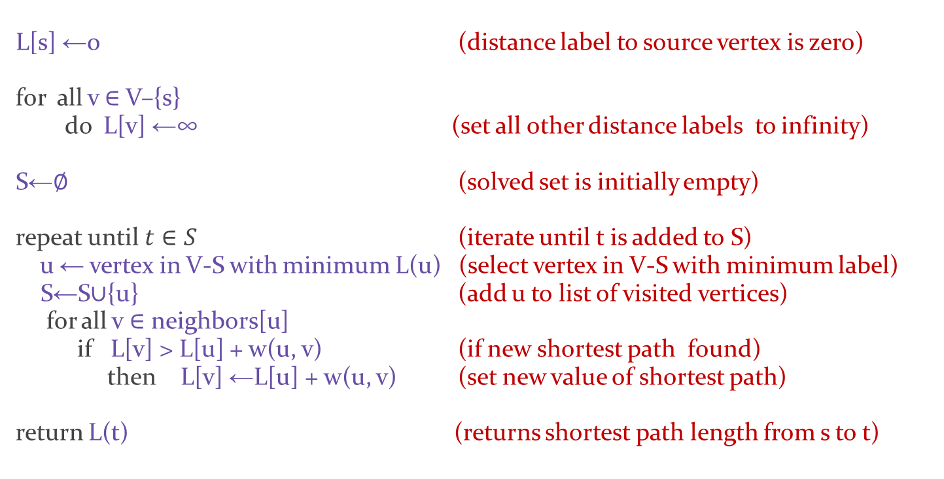
Dijkstra's algorithm - Pseudocode
L[s] ←0 (distance label to source vertex is zero)
for all v ∈ V–{s} do L[v] ←∞ (set all other distance labels to infinity)
S←∅ (solved set is initially empty)
repeat until $t∈S$ (iterate until t is added to S) u ← vertex in V-S with minimum L(u) (select vertex in V-S with minimum label) S←S∪{u} (add u to list of visited vertices) for all v ∈ neighbors[u] if L[v] > L[u] + w(u, v) (if new shortest path found) then L[v] ←L[u] + w(u, v) (set new value of shortest path)
return L(t) (returns shortest path length from s to t)
Terminates after at most |V| iterations.

Slide 36
Learning Objective
Understand the basic definition and uses of weighted graphs.
Understand the definition and uses of the shortest path problem.
Understand Dijkstra’s shortest path algorithm and be able to simulate it by hand.
Understand the basic idea behind its proof of correctness.

