Slide 1
TCP/IP Communication in Action
Tracing what happens when a user opens a secure website (https://x.com)
TEAM-08 | WADF105 | FCDF-COHORT-11 | Level 1, Semester 1
International Cybersecurity & Digital Forensics Academy (ICDFA)
Adeoti Suliat Adedamola (Team Lead) · Eyinade Adegoke · Kenneth Ukata · Mustapha Abubakar · Samina Parveen

Slide 2
Introduction and scenario
Adeoti Suliat Adedamola
Scenario: opening https://x.com, traced from the sending device to the destination and back.
We cover:
The four TCP/IP layers and TCP/IP to OSI mapping
Encapsulation, decapsulation and network devices
IP addresses, MAC addresses, port numbers and protocols
TCP vs UDP
One communication failure and its troubleshooting
Evidence comes from real Wireshark captures on our own lab machines. Lab networks differ, so addresses differ, but the protocol behaviour is the same. Each slide names its capture.
Member | Section
Adeoti Suliat Adedamola (Team Lead) | Introduction, conclusion, coordination
Eyinade Adegoke | TCP/IP layers, OSI, mapping
Kenneth Ukata | Packet journey, devices, encapsulation and decapsulation
Mustapha Abubakar | Protocols, IP/MAC addressing, ports, analysis table
Samina Parveen | TCP vs UDP, failure, troubleshooting
TEAM-08 | TCP/IP Communication in Action
1
Notes:
Good day. I'm Adeoti Suliat Adedamola, Team Lead of TEAM-08, Level 1 Semester 1, FCDF-COHORT-11. Our team traced what happens when a user opens https://x.com, using real packet captures. I'll introduce the scenario, then each member will present their section.

Slide 3
The TCP/IP model: four layers
Eyinade Adegoke
Application
Provides network services to applications.
Examples: HTTP, FTP, SMTP, DNS
Transport
Provides end-to-end communication and reliability.
Examples: TCP, UDP
Internet
Handles IP addressing and routing of packets.
Examples: IPv4, IPv6, ICMP
Network Access
Handles communication over the physical network and hardware.
Examples: Ethernet, Wi-Fi
Easy way to describe it: Application → Transport → Internet → Network Access
TEAM-08 | TCP/IP Communication in Action
2

Slide 4
OSI model and TCP/IP to OSI mapping
Eyinade Adegoke
The OSI (Open Systems Interconnection) Model is a 7-layer framework that standardizes how data moves between computers over a network.
# | Layer | Simple explanation | Examples
7 | Application | Provides network services directly to users/applications | HTTP, FTP, SMTP, DNS
6 | Presentation | Translates, encrypts, decrypts, and compresses data | JPEG, SSL/TLS, ASCII
5 | Session | Establishes, manages, and terminates communication sessions | Session management
4 | Transport | Provides reliable data delivery and controls data flow | TCP, UDP
3 | Network | Handles logical addressing and routing | IP, routers
2 | Data Link | Handles frames, MAC addresses, and local network delivery | Ethernet, switches
1 | Physical | Transmits raw bits through cables, radio, or other physical media | Cables, fiber, radio
Easy mapping
TCP/IP Application
→ OSI Application + Presentation + Session
TCP/IP Transport
→ OSI Transport
TCP/IP Internet
→ OSI Network
TCP/IP Network Access
→ OSI Data Link + Physical
Key point: The TCP/IP model combines some of the OSI layers, making it a simpler practical model for understanding Internet communication.
TEAM-08 | TCP/IP Communication in Action
3

Slide 5
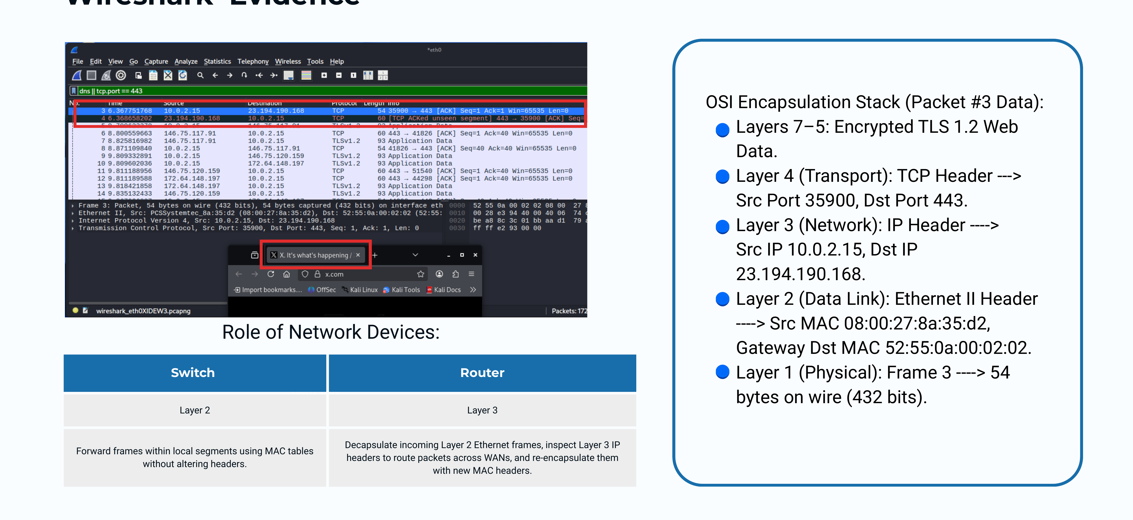
Packet journey: encapsulation and decapsulation
Kenneth Ukata
TEAM-08 | TCP/IP Communication in Action | Evidence: Kenneth's capture (opening https://x.com)
4

Slide 6
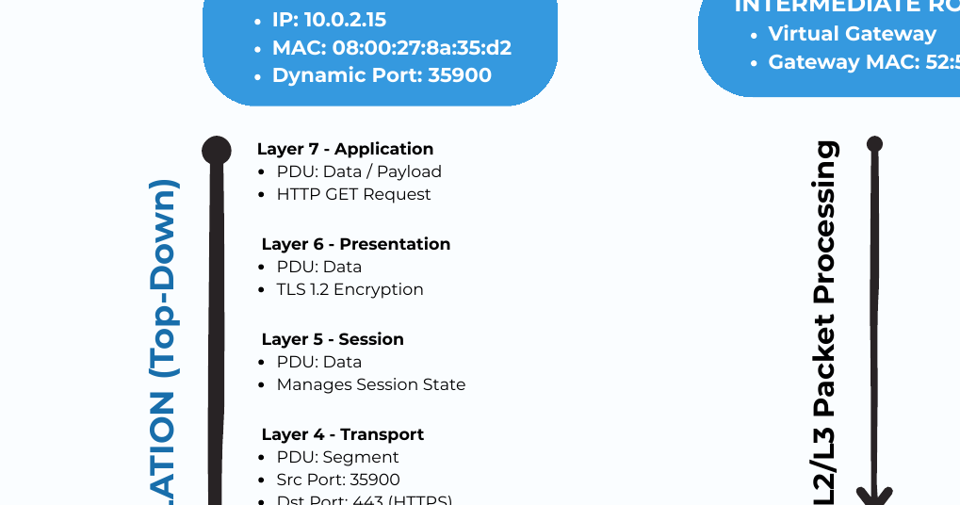
Network devices and Wireshark evidence
Kenneth Ukata
OSI encapsulation stack (Packet #3 data)
Layers 7–5: Encrypted TLS 1.2 Web Data.
Layer 4 (Transport): TCP Header → Src Port 35900, Dst Port 443.
Layer 3 (Network): IP Header → Src IP 10.0.2.15, Dst IP 23.194.190.168.
Layer 2 (Data Link): Ethernet II Header → Src MAC 08:00:27:8a:35:d2, Gateway Dst MAC 52:55:0a:00:02:02.
Layer 1 (Physical): Frame 3 → 54 bytes on wire (432 bits).
Role of network devices
Switch | Router
Layer 2 | Layer 3
Forward frames within local segments using MAC tables without altering headers. | Decapsulate incoming Layer 2 Ethernet frames, inspect Layer 3 IP headers to route packets across WANs, and re-encapsulate them with new MAC headers.
TEAM-08 | TCP/IP Communication in Action | Evidence: Kenneth's capture
5

Slide 7
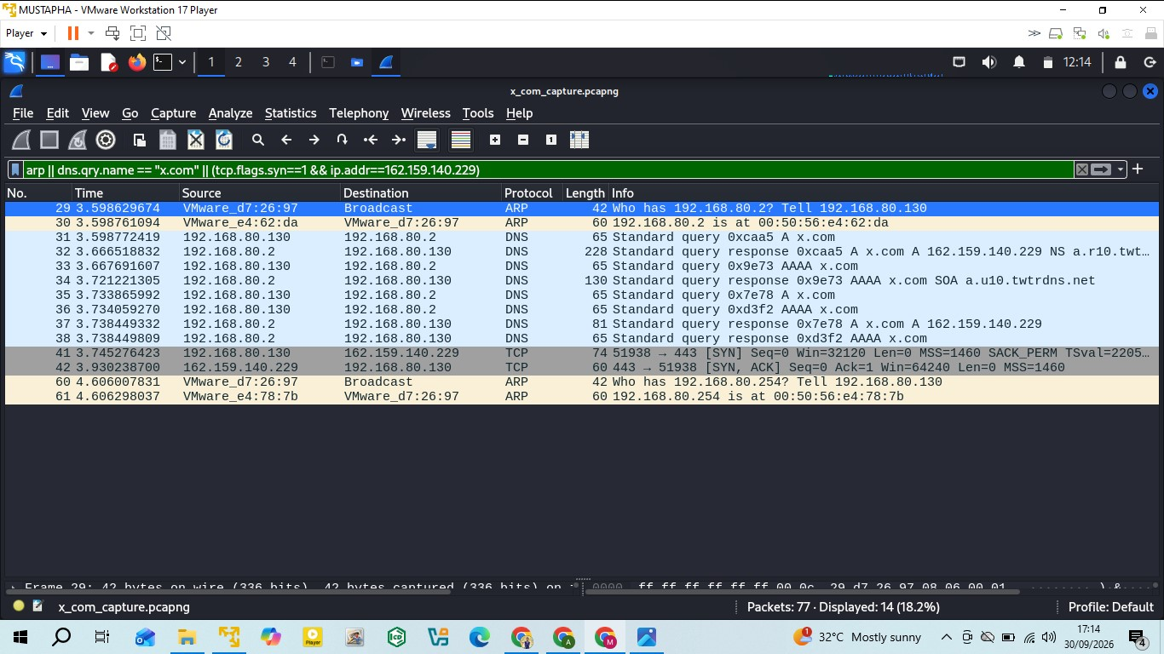
Protocols and addressing: opening x.com
Mustapha Abubakar
Protocol order
ARP: asks "who has 192.168.80.2?" and the gateway replies with its MAC.
DNS (UDP 53): x.com resolved to 162.159.140.229.
TCP (port 443): three-way handshake SYN, SYN-ACK, ACK.
TLS 1.3 and HTTP/2: connection encrypted, then the request is answered with 200.
MAC address
Local link, changes at each hop
00:0c:29:d7:26:97 → 00:50:56:e4:62:da (Kali → gateway)
IP address
End to end, stays the same
192.168.80.130 → 162.159.140.229
Port number
Identifies the application
Temporary source port 51938 → 443 (HTTPS). DNS: 35292 → 53
TEAM-08 | TCP/IP Communication in Action | Evidence: Mustapha's capture (Kali VM, VMware)
6
Notes:
Four groups of protocols worked in order: ARP, DNS, TCP, then TLS 1.3 and HTTP/2. Every packet uses three kinds of addressing. MAC addresses identify devices on the local link and change at every hop. IP addresses are end to end and stay the same. Port numbers identify the application: a temporary source port, 51938, to the fixed HTTPS port, 443. Each layer adds its own header: TCP adds ports, IP adds addresses, Ethernet adds MAC addresses.

Slide 8
Protocol analysis table
Mustapha Abubakar
TCP/IP layer | Protocol | PDU | Addressing information | Purpose
Application | DNS | Message | UDP 35292 → 53 | Resolves x.com to an IP address
Application | HTTP/2 over TLS 1.3 | Message | TCP 51938 → 443 | Encrypted web request and response
Transport | UDP | Datagram | Source and destination ports | Fast, connectionless delivery (DNS)
Transport | TCP | Segment | Ports, sequence and ACK numbers | Reliable, ordered delivery (HTTPS)
Internet | IPv4 | Packet | 192.168.80.130 → 162.159.140.229 | End-to-end addressing and routing
Internet | ICMP | Packet | 192.168.80.130 → 192.168.80.2 | Connectivity test (ping to gateway)
Network Access | Ethernet II | Frame | 00:0c:29:d7:26:97 → 00:50:56:e4:62:da | Delivery on the local link
Network Access | ARP | Frame | Broadcast: who has 192.168.80.2? | Finds the gateway MAC address
TEAM-08 | TCP/IP Communication in Action | Evidence: Mustapha's capture
7
Notes:
This table summarises each layer with its protocol, PDU, addressing and purpose. Every row comes from my capture and is linked to a figure in my report.

Slide 9
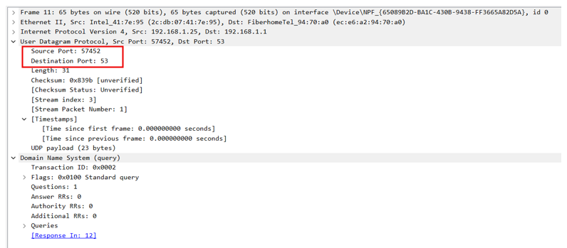
TCP vs UDP
Samina Parveen | C11/26/FCDF/17139
Two transport protocols, both seen in one secure website visit
Feature | TCP | UDP
Connection | Handshake first | None, sends at once
Reliability | ACKs + retransmission | No guarantee
Ordering | Sequence numbers | No ordering
Header / PDU | 20+ bytes / segment | 8 bytes / datagram
Speed | Slower, more overhead | Fast, low overhead
In my capture | HTTPS, port 443 | DNS, port 53
UDP: DNS query, source port 57452 to port 53, length 31
58.3%
packets were TCP (HTTPS/TLS)
3.1%
packets were UDP (DNS)
TCP session to 172.66.0.227:443: SYN, SYN-ACK, ACK, then TLS Client Hello (SNI = x.com).
TEAM-08 | TCP/IP Communication in Action | Evidence: Samina's capture
8
Notes:
Good day everyone. I'm [your name], registration number [your reg. number], from TEAM-08. My part covers TCP versus UDP, application examples, one communication failure and the troubleshooting procedure.
TCP and UDP both work at the Transport layer. TCP is connection-oriented: it does a three-way handshake, acknowledges data, retransmits losses and keeps order, so it has a larger header and more overhead. UDP is connectionless with just an eight-byte header and no guarantees, so it is fast and light.
Both appear in my capture of opening x.com. The DNS query went out as one UDP datagram from port 57452 to port 53, length 31 bytes. Then the web session used TCP port 443: SYN, SYN-ACK, ACK and the TLS Client Hello. Wireshark shows about 58 percent of packets were TCP and about 3 percent UDP DNS.

Slide 10
Application examples
Samina Parveen
The right protocol depends on what the application can tolerate
TCP · Reliability first
UDP · Speed first
Secure web (HTTPS, 443)
every byte must arrive in order
Email (SMTP, IMAP)
messages must not be lost
File transfer (FTP, SFTP)
one missing block corrupts the file
Remote access (SSH, RDP)
commands must be exact
DNS lookups (53)
one small question, one small answer
Video meetings, VoIP
a late packet is useless
Live streaming, gaming
current data beats retransmission
DHCP, NTP
short request and reply
TEAM-08 | TCP/IP Communication in Action | Evidence: Samina's capture
9
Notes:
Choose the protocol by what the application can tolerate. TCP suits reliability-first applications: secure web browsing on port 443, email, file transfer and remote access like SSH, because a lost byte can corrupt a file or a command. UDP suits speed-first applications: DNS lookups on port 53, video meetings and VoIP, live streaming and gaming, plus DHCP and NTP. There, a late packet is useless, so skipping it is better than waiting. Our own website visit used both.

Slide 11
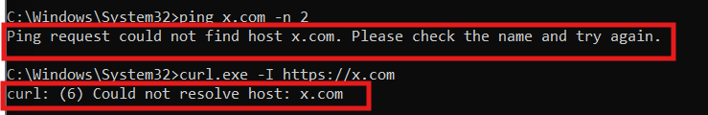
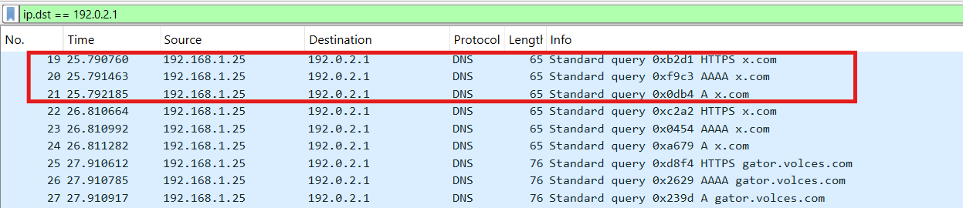
Communication failure: DNS not responding
Samina Parveen
Website cannot be opened, but the network is healthy
Symptom: "Could not resolve host: x.com"
Cause: DNS server set to 192.0.2.1, where nothing answers
Layer: Application (DNS over UDP port 53)
Key clue: ping 8.8.8.8 still works, so IP and routing are fine
Wireshark: repeated DNS queries to 192.0.2.1, no reply
Second test, port 444 blocked: SYN sent and retransmitted 4 times, never answered. A firewall is likely dropping it.
TEAM-08 | TCP/IP Communication in Action | Evidence: Samina's capture
10
Notes:
My failure is a DNS problem. I set the DNS server to 192.0.2.1, an address where nothing answers. The website would not open and the tools reported could not resolve host. In Wireshark the PC keeps repeating DNS queries with no reply. This shows the UDP trade-off: no built-in retransmission, so the application has to retry. The key clue is that pinging 8.8.8.8 still worked, so the network was fine and only name resolution was broken. I also tested port 444: the SYN was retransmitted four times with no answer, which points to a firewall blocking that port.

Slide 12
Troubleshooting procedure
Samina Parveen
Bottom-up: test one layer at a time, then fix and verify
1
Record the symptom
Website fails with "Could not resolve host"
2
ping 8.8.8.8
Replies: internet and routing work
3
nslookup x.com
Fails: name resolution is the fault
4
ipconfig /all
DNS server is 192.0.2.1, not the router
5
Wireshark capture
DNS queries sent, no replies
6
Fix and verify
Reset DNS to 192.168.1.1, flush cache, retest
Verified: gateway ping, 8.8.8.8 ping, nslookup, port 443 test, tracert (8 hops), curl HTTP 200 OK
TEAM-08 | TCP/IP Communication in Action | Evidence: Samina's capture
11
Notes:
My method is bottom-up. One, record the symptom. Two, ping 8.8.8.8: it works, so the internet layer is fine. Three, nslookup fails, so the fault is name resolution. Four, ipconfig shows the wrong DNS server. Five, Wireshark confirms queries with no replies. Six, reset DNS to the router, flush the cache and verify every layer: the gateway, 8.8.8.8, nslookup, port 443, tracert with eight hops, and curl returning HTTP 200 OK.
In summary, TCP gives reliability, UDP gives speed, and a DNS fault can look like a total outage while IP and TCP are healthy. Thank you, I'm happy to take questions.

Slide 13
Conclusion
Adeoti Suliat Adedamola
Opening x.com is a chain: ARP → DNS (UDP 53) → TCP handshake → TLS → HTTP, each step depending on the one before it.
Each layer adds its own header: ports (TCP/UDP), IP addresses (end to end), MAC addresses (hop by hop).
TCP gives reliability; UDP gives speed. One website visit uses both.
A DNS fault can look like a total outage while IP and TCP are healthy. Test layer by layer, bottom-up.
Every claim in this presentation is backed by packet evidence.
Thank you. We are happy to take questions.
TEAM-08 | TCP/IP Communication in Action
12

Slide 14
Team contribution record
TEAM-08
Member | Role | Completed work
Adeoti Suliat Adedamola | Team Lead | Introduction, conclusion, review, submission
Eyinade Adegoke | TCP/IP and OSI | TCP/IP layers, OSI model, mapping
Kenneth Ukata | Packet journey | Packet journey diagram, devices, encapsulation and decapsulation
Mustapha Abubakar | Protocols and addressing | Protocols, IP/MAC, ports, analysis table, 15-figure report, Wireshark capture, deck compilation
Samina Parveen | TCP vs UDP, troubleshooting | TCP vs UDP, examples, DNS failure, troubleshooting steps
Each member's individual evidence link is recorded in their own contribution declaration on the portal.
AI use declaration: Artificial intelligence tools were used by team members for drafting, design and compilation assistance. The team reviewed all content for accuracy and remains responsible for it.
TEAM-08 | TCP/IP Communication in Action
13

Slide 15
References
IETF. RFC 9293: Transmission Control Protocol (TCP). rfc-editor.org/rfc/rfc9293
IETF. RFC 768: User Datagram Protocol (UDP). rfc-editor.org/rfc/rfc768
IETF. RFC 791: Internet Protocol (IPv4). rfc-editor.org/rfc/rfc791
IETF. RFC 826: Address Resolution Protocol (ARP). rfc-editor.org/rfc/rfc826
IETF. RFC 1035: Domain Names, Implementation and Specification. rfc-editor.org/rfc/rfc1035
IETF. RFC 8446: TLS Version 1.3. rfc-editor.org/rfc/rfc8446
Cisco Networking Academy. Introduction to Networks (CCNA). netacad.com
Wireshark Foundation. Wireshark User's Guide. wireshark.org/docs
TEAM-08 | TCP/IP Communication in Action
14

