Slide 1
Healthcare Patient Churn Analysis
Identifying Key Drivers of Patient Attrition and Revenue Risk
Prepared by: MUSTAPHA FATIHA

Slide 2
Overview
Contents We’ll Be Covering For This Report:
Analyze patient churn patterns in healthcare.
Identify key drivers of patient attrition.
Quantify financial impact and revenue at risk.
Segment patients by churn risk.
Provide actionable retention recommendations.
Project Objectives;
Dataset Description;
Dataset size: 2,000 patient records
Data categories: (Demographics, Service utilization, Satisfaction metrics, Engagement behavior and Financial indicators)
Target variable: Churned (0 = Retained, 1 = Churned)

Slide 3
Methodology and Tools
This project adopted the following:
Content;
Data cleaning & preprocessing (Python)
Exploratory data analysis (EDA)
Feature engineering & risk profiling
Visualization & dashboarding
Tools Used;
Python (Pandas, Matplotlib, Seaborn)
Streamlit
Google docs

Slide 4
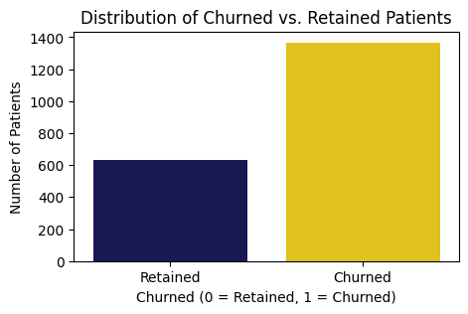
Key Findings
Overall Churn Overview
Key Metrics:
Total patients: 2,000
Churned patients: 1,367 (68.35%)
Retained patients: 633 (31.65%)

Slide 5
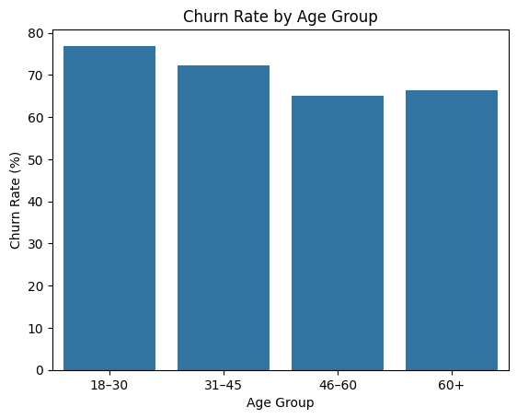
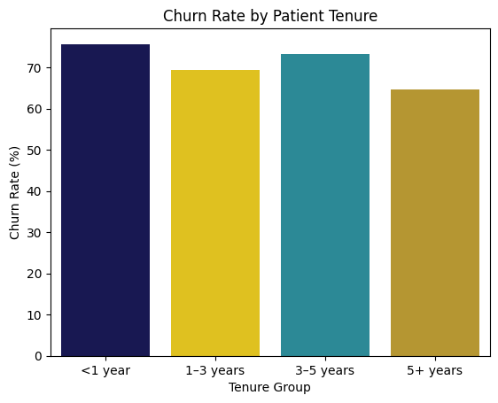
Demographics & Tenure Insights
Highest churn among 18–30 age group (76.9%)
Slightly elevated churn among the 60+ age group(66.4%)
Short-tenure patients (<1 year) churn the most (75.6%)
Longer tenure = lower churn

Slide 6
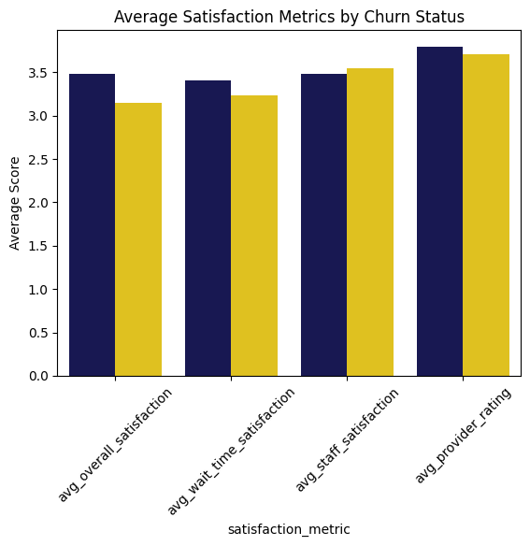
Satisfaction & Experience Drivers
Churned patients report lower:
Overall satisfaction
Wait-time satisfaction
Provider ratings.
Churn increases sharply at low satisfaction levels

Slide 7
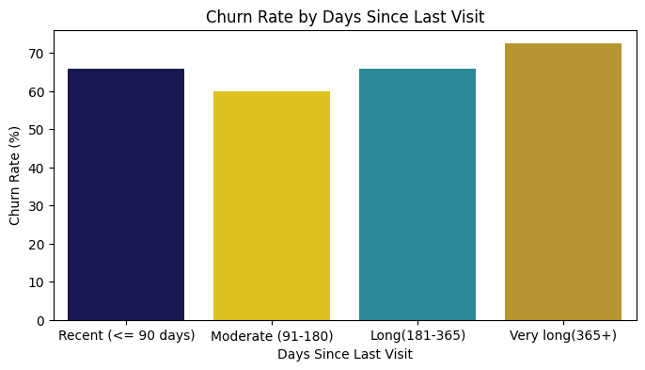
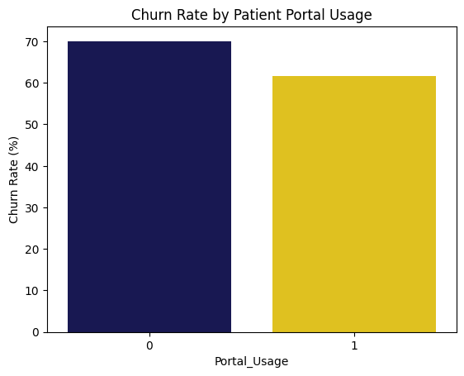
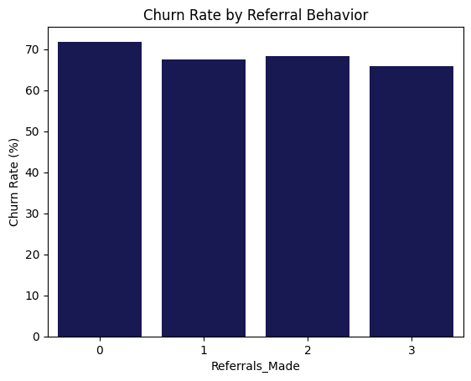
Engagement & Behavioral Drivers
Higher churn among patients:
Inactive for long periods (365+ days)
Not using patient portals
With no referral behavior
Engagement = loyalty

Slide 8
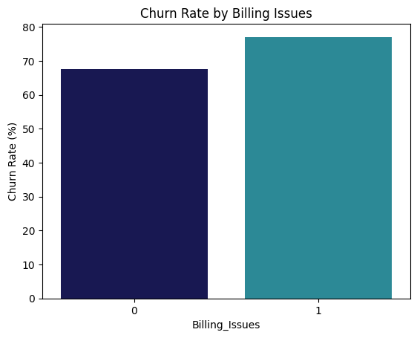
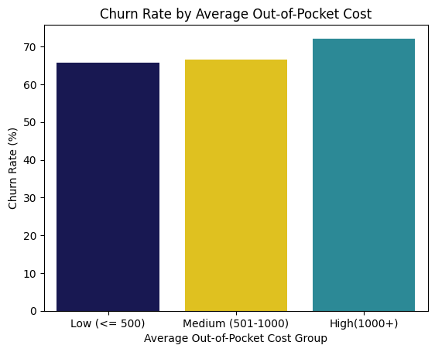
Financial Drivers & Revenue at Risk
Higher churn among patients with:
Billing issues (77.1% churn)
Higher out-of-pocket costs
Estimated revenue at risk: $1,174,452

Slide 9
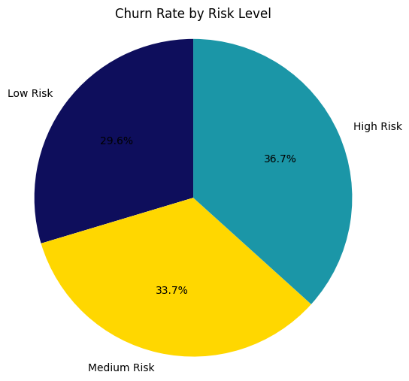
High-Risk Patient Profile
High-risk patients typically have:
Low satisfaction scores
Long inactivity periods
Billing issues
High personal costs
Low digital engagement
Outcome: Higher Churn rate.

Slide 10
Recommendations and Conclusion
Recommendations:
Proactive outreach to inactive patients
Improve wait times & overall interactions
Promote patient portal usage
Resolve billing issues faster
Focus retention on medium and high-risk segments
Conclusion:
Churn is driven by experience, engagement, and financial friction.
Targeted, data-driven interventions can reduce attrition and protect revenue.
THANK YOU!

