Slide 1
CS 452 Machine Learning Ashesi University Course Introduction Dennis Asamoah Owusu
Slides are from Lorenzo Torresani
(with some modifications)

Slide 2
Plan for today
Course Overview: objectives, requirements and policies
What is machine learning?
Preview of machine learning and applications

Slide 3
Course Objectives
Provide mathematical and practical knowledge
to apply ML methods to your areas of interests
to start doing ML research ( if you wish to do so)

Slide 4
Resources
Course syllabus in CAMU
Textbooks and other reference materials:
Christopher M. Bishop, Pattern Recognition and Machine Learning, Spring 2011
Ian Goodfellow ,Yoshua Bengio and Aaron Courville, Deep Learning, MIT Press 2016 ( freely available online in digital form)

Slide 5
Lecture Attendance
Considered essential to learn the course material
In class, please obey our no-texting, no laptop policy
Lab hours will be used as extra office hours or lectures as needed

Slide 6
Grading Scheme
No midterm or final exam
Four homework assignments (written answers to technical questions, implementation of algorithms in Python) contributing to 60% of your final grade
Term project, worth 40% of the final grade

Slide 7
Late Homework Policy
3 free late days to be used for homework (not project) submissions
After the free late days are used, homework submissions will be penalized 25% per additional late day
No exceptions aside medical emergencies!
Homework/project schedule is available in the course syllabus

Slide 8
Python
The programming portions of the homework assignments will require implementation of algorithms in Python
Introduction to Python
Intro to Python for Data Science, free course by DataCamp
Python Numpy Tutorial, by Justin Johnson (Stanford University)

Slide 9
Term project
Teams of 4-5 students
Apply machine learning to solve a problem
Topic selection
pick something close to your interest
talk to me
Review the “project guidelines” document for useful tips

Slide 10
Project Submissions
Proposal (15% of project grade):
write up + “spotlight” presentation, due on Feb 4th
what problem do you want to solve?
what methods will you implement?
what training data will you be using?
Milestone (25% of project grade):
write up + in-class presentation, due on March 18th
a check-point to verify you are making good progress
an opportunity to gather feedback
Closing submission (60% of project grade): closing presentation and write up due on April 24th

Slide 11
Prerequisites
Introduction to programming
Linear algebra, numerical optimization
You should be familiar with:
methods to solve systems of linear equations and least square systems
basic linear algebra concepts ( e.g. eigenvalues, rank, determinant, properties of positive semi-definite or symmetric matrices)
You may want to brush up on your knowledge of linear algebra using the following Khan Academy’s class: https://www.khanacademy.org/math/linearalgebra

Slide 12
Academic Integrity
Homework
student discussion is encouraged
... but your submission must be entirely your work
you cannot use external software (not even as an example or a template for your implementation!)
Project
you can use external code for parts of your work
your project must involve some new code written by you
applying homework code to your problem is not enough

Slide 13


What is Machine Learning?
Arthur Samuel (1959):
“Field of study that gives computers the
ability to learn without being explicitly
programmed.”
Tom Mitchell (1997):
“A computer program is said to learn from
experience E with respect to some class of
tasks T and performance measure P,
if its performance at tasks T, improves
with experience E.”

Slide 14





Application Successes of Machine Learning
Often hand-programming is too difficult or not possible
Spam filtering
Speech recognition
Handwriting recognition
Recommender systems
Computer vision

Slide 15
Stages of learning methods
Training:
A model is learned from training data
Application:
The learned model is used to make decisions about new test data

Slide 16
Types of Machine Learning
Supervised learning:
learning models from examples labeled with the correct answer
classification: outputs are discrete labels (e.g. spam vs non-spam)
regression: outputs are real-valued (e.g. used car prices)

Slide 17
Types of Machine Learning
Unsupervised learning:
learning structure within unlabeled data
Examples:
dimensionality reduction
clustering
source separation

Slide 18
Examples of unsupervised learning: dimensionality reduction
Applications:
Compression
scientific visualization
feature extraction for classification

Slide 19
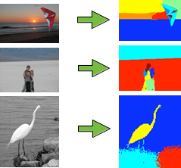
Examples of unsupervised learning: clustering
Image segmentation:
from [Andreetto et al., ICCV 2007]

Slide 20
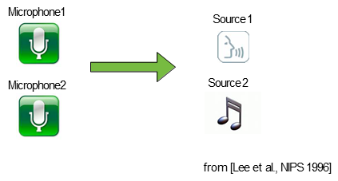
Examples of unsupervised learning: source separation
The cocktail party effect:

Slide 21
Types of Machine Learning
Reinforcement learning:
an agent (e.g. a robot or controller) learns actions from success (reward) and failure (punishment)

