Slide 1
CS 452 Machine Learning Ashesi University Lecture 2 Least-square Regression

Slide 2
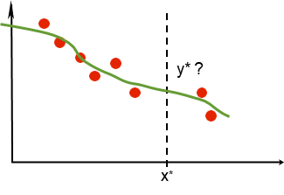
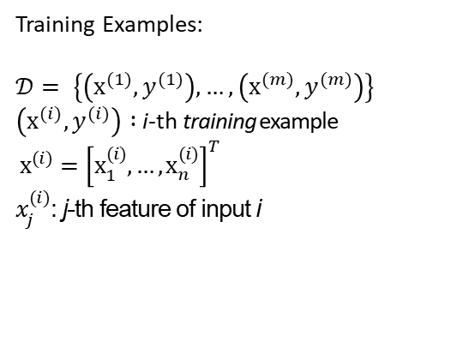
Regression
y: output (e.g. used car price)
Training Examples:
$𝒟= \left\{\left({\text{x}}^{(1)}, y^{(1)}\right),…,\left({\text{x}}^{(m)}, y^{(m)}\right)\right\}$ $\left({\text{x}}^{(i)}, y^{(i)}\right) :$i-th training example
${\text{x}}^{(i)}={\left[{\text{x}}_{1}^{(i)},…,{\text{x}}_{n}^{(i)}\right]}^{T}$
$x_{j}^{(i)}$: j-th feature of input i
f(x)
x: input (e.g. mileage, original price tag, etc.)
Learn f s.t. “y = f(x)”
Given: new input x*
Want: output prediction y*

Slide 3
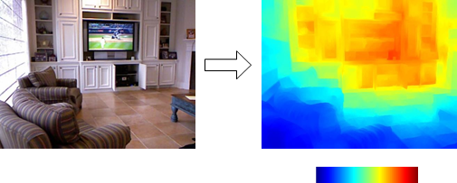
Application: Depth Estimation from Single Image
Given
Want
close
far

Slide 4






Regression for depth estimation
Given labeled RGBD training set of m examples:
Goal: learn f : R^{Px3} → R^{P} s.t. f(x) = y
X(1) y(1) x(2) y(2) x(m) y(m)
…
Where R^{pz3} and R^{p}
are images and depth maps estimated using a sensor
RGB image
Depth map

Slide 5
Regression: design choices
Goal: learn f s.t. y = f(x)
How do we parameterize the function?
→ choosing the model
What learning objective do we use?
→ choosing the error criterion
How do we optimize the objective?
→ defining the learning algorithm
Simple Regression Example:
Mother’s level of education and Child GPA (credit: Joel Steele)

Slide 6

Regression: the model
1. How do we parameterize the function?
Linear model:
f_{θ}(x)= θ₀ + θ₁x₁ + ... + θ_{n}x_{n}
where x = [x₁, ..., x_{n}]^{T} n: # features
= [θ₀, ..., θ_{n}]^{T}
Defining x₀ ≡ 1:
$$f_{θ}(x)=\sum_{j= 0}^{n}{θjxj =θTx}$$

Slide 7
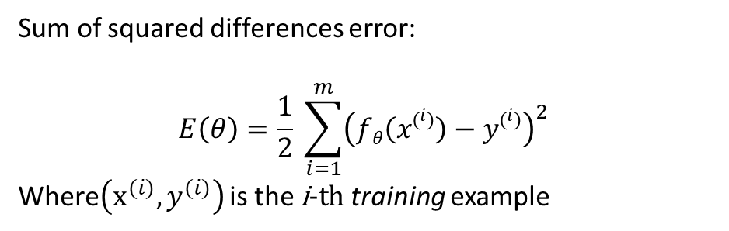
Regression: the error
2. What learning objective do we use?
Sum of squared differences error:
$$E\left(θ\right)=\frac{1}{2} \sum_{i=1}^{m}{{\left(fθ\left(x\left(i\right)\right)−y\left(i\right)\right)}^{2} }$$
Where$\left({\text{x}}^{(i)}, y^{(i)}\right)$ is the $\text{i}\text{−}\text{th}$training example

Slide 8
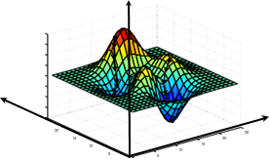


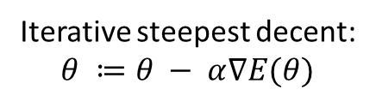



Regression: the learning algorithm
3. How do we optimize the objective?
$$E(θ)$$
_{gradient = direction of}
_{steepest decent}
$$∇E\left(θ\right)=\left[\frac{∂E(θ)}{∂θ0} , ….,\frac{∂E(θ)}{∂θn}\right]$$
Iterative steepest decent:
$$θ ≔θ − α∇E(θ)$$
$$−∇E(θ)$$
$$θ0$$
$$θ1$$

Slide 9
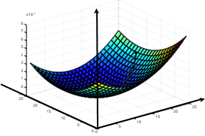



Regression: the learning algorithm
3. How do we optimize the objective?
$$E(θ)$$
Our error is a convex quadratic functions: guaranteed to converge to a global minimum!
$$θ0$$
$$θ1$$

Slide 10


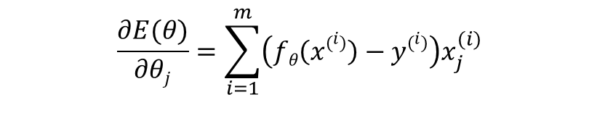
Gradient
Model:
$$fθ\left(x\right)=\sum_{k=0}^{n}{θkxk=θTx}$$
Error:
$$E\left(θ\right)=\frac{1}{2} \sum_{i=1}^{m}{\left(fθ\left(x\left(i\right)\right)−y\left(i\right)\right)2 }$$
$$\frac{∂E(θ)}{∂θj}=\sum_{i=1}^{m}{\left(fθ\left(x\left(i\right)\right)−y\left(i\right)\right)x_{j}^{(i)} }$$

Slide 11

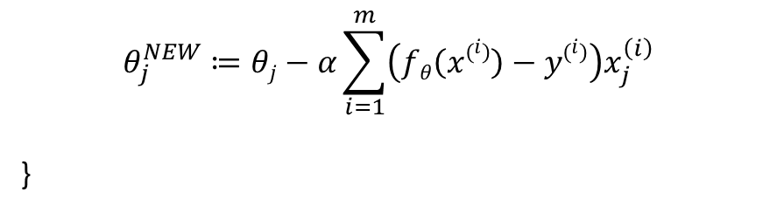
Your first learning algorithm
Linear regression via batch gradient descent
Repeat until convergence {
for j = 0 to n { //loop over features
$$θ_{j}^{NEW}≔θj−α\sum_{i=1}^{m}{\left(fθ\left(x\left(i\right)\right)−y\left(i\right)\right)x_{j}^{\left(i\right)} }$$
}
$$θ← θ^{NEW}$$
}

Slide 12
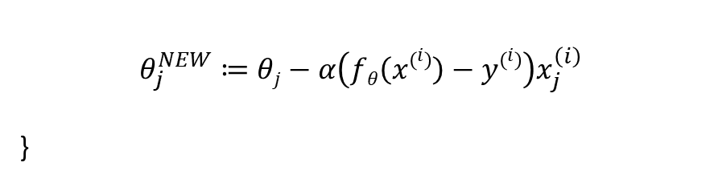
A more efficient training method (when the training data is large)
Linear regression via incremental (or stochastic) gradient descent:
Repeat until convergence {
for I = 1 to m { //loop over examples
for j = 0 to n { //loop over features
$$θ_{j}^{NEW}≔θj−α\left(fθ\left(x\left(i\right)\right)−y\left(i\right)\right)x_{j}^{\left(i\right)}$$
}
$$θ← θ^{NEW}$$
}

