Slide 1
CS 452 Machine Learning Ashesi University Lecture 4 Closed-form least-square regression

Slide 2
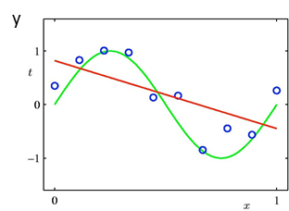
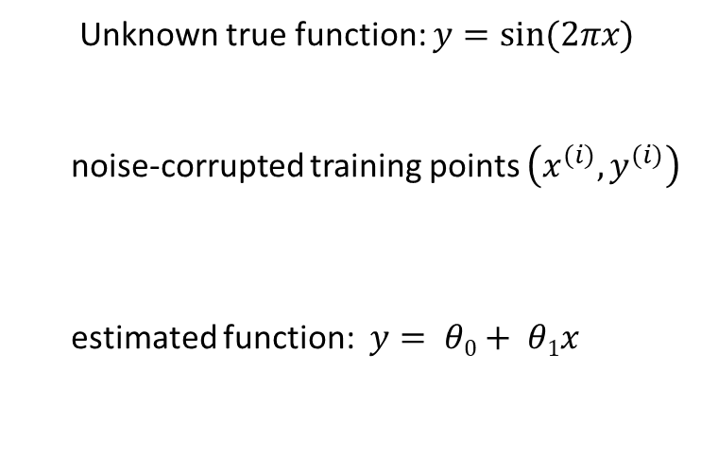
Underfitting
Unknown true function: $y=sin⁡(2πx)$
noise-corrupted training points $\left(x^{(i)}, y^{(i)}\right)$
estimated function: $y= θ0+ θ1x$

Slide 3
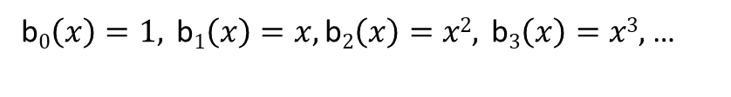
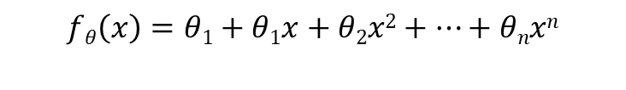
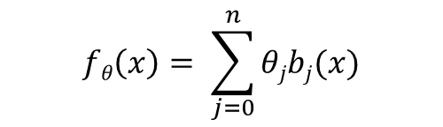
Non-linear regression
$$fθ\left(x\right)=θ1+θ1x+θ2x2+…+θnxn$$
b$0\left(x\right)=1, \text{b}1\left(x\right)=x, \text{b}2\left(x\right)=x2, \text{b}3\left(x\right)=x3,$ …
Basis-function model (linear in $θ)$:
$$fθ\left(x\right)= \sum_{j=0}^{n}{θjbj(x)}$$
$$=θTb\left(x\right) b\left(x\right)={\left[b0\left(x\right), …, bn\left(x\right)\right]}^{T}$$

Slide 4

Non-linear least-square regression
$$E\left(θ\right)=\frac{1}{2}\sum_{i=1}^{m}{ {\left[y\left(i\right)−\sum_{j=0}^{n}{θjbj(x\left(i\right))}\right]}^{2}}$$
Quadratic error function can be globally optimized as before

Slide 5
Closed-form solution to non-linear least-square regression
$$\left(BTB\right)θ=BTy$$
where $B=\left[b\left(x\left(1\right)\right), …, b(x\left(m\right))\right]T$
and $y=\left[y\left(1\right), …, y\left(m\right)\right]T$

Slide 6
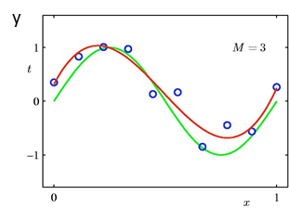
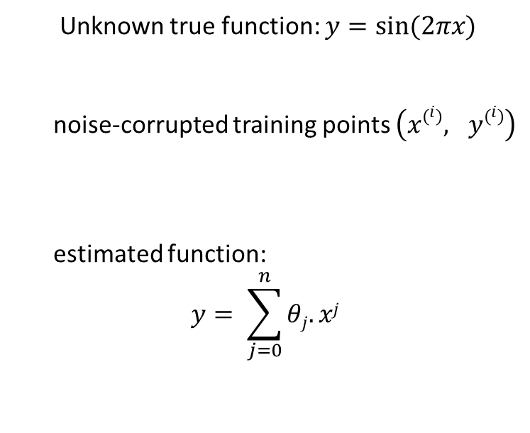
3rd order polynomial
Unknown true function: $y=sin⁡(2πx)$
noise-corrupted training points $\left(x\left(i\right), y\left(i\right)\right)$
estimated function:
$$y= \sum_{j=0}^{n}{θj.xj}$$
n=3

Slide 7
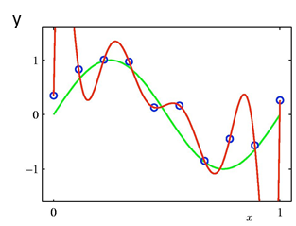

9th order polynomial
Unknown true function: $y=sin⁡(2πx)$
noise-corrupted training points $\left(x\left(i\right), y\left(i\right)\right)$
estimated function:
$$y= \sum_{j=0}^{n}{θj.xj}$$
$$n=9$$

Slide 8
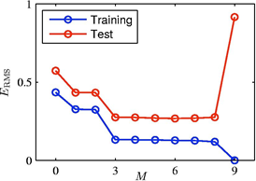
Overfitting
Root-Mean Square (RMS) Error $E_{RMS}= \sqrt{2E(θ^{∗})/m}$

Slide 9
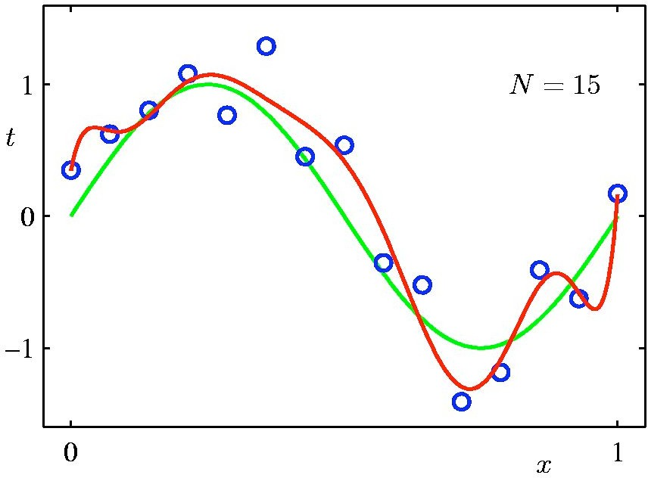
Training set size
9th order polynomial
y
#training points:
m = 15

Slide 10
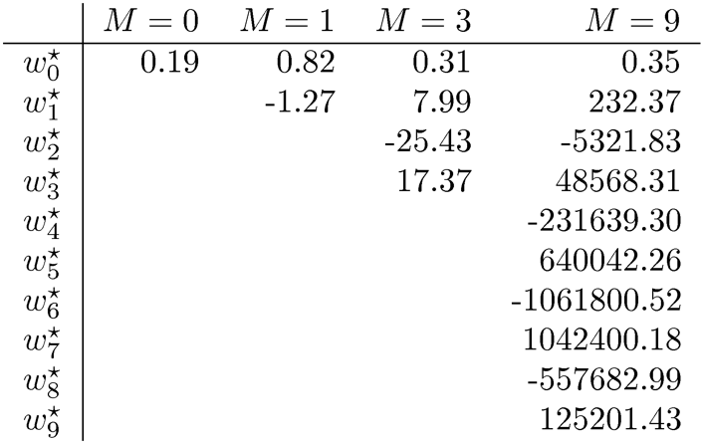
Polynomial coefficients

Slide 11
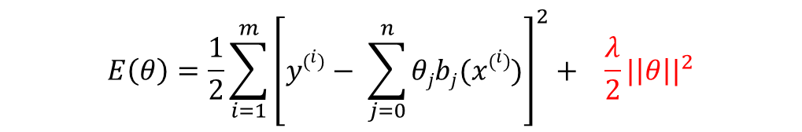
Regularization
$$E\left(θ\right)=\frac{1}{2}{\sum_{i=1}^{m}{\left[y\left(i\right)− \sum_{j=0}^{n}{θjbj(x\left(i\right))}\right]}}^{2}+ {\frac{λ}{2}|\left|θ\right||}^{2}$$
data term
smoothness term
$${|\left|θ\right||}^{2}= θ_{0}^{2}+ …+θ_{n}^{2}$$

Slide 12


Closed-form solution to regularized least-square regression
$$\left(BTB+ λI\right)θ=BTy$$
where $B={\left[b\left(x^{(i)}\right), …, b\left(x^{(m)}\right)\right]}^{T}$
and $y={\left[y^{(1)}, …, y^{(m)}\right]}^{T}$

Slide 13
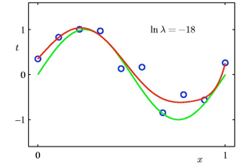
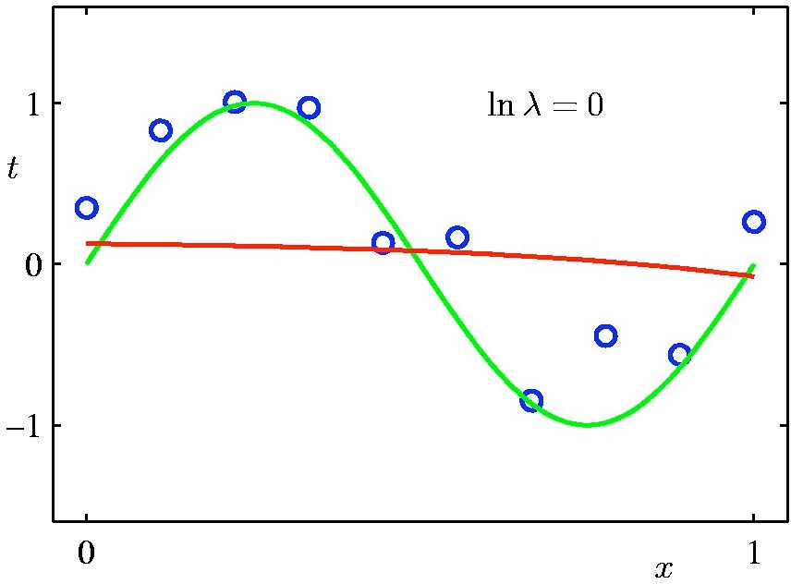


9th order polynomial with regularization
y
y
$$lnλ=−18$$
$$lnλ=0$$

Slide 14
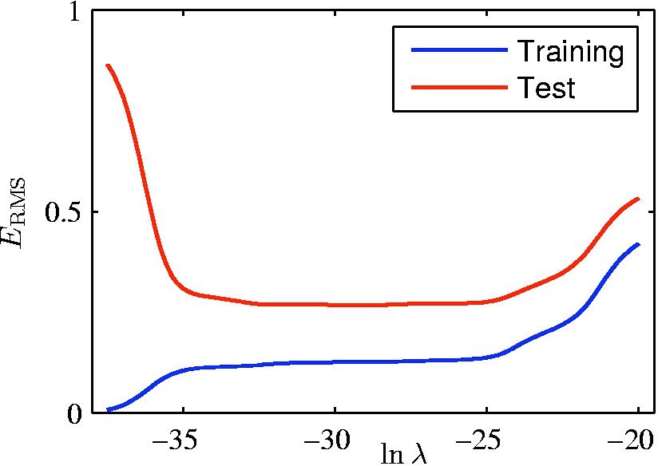
Regularization: E_{RMS} VS. ln λ
overfitting
underfitting

