Slide 1

Follow: www.twitter.com/dev_inately
Github: github.com/dev-inately

Slide 2
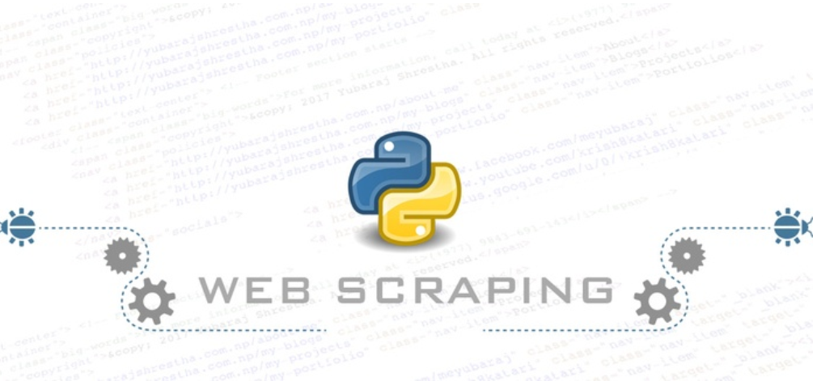
TITLE WeB SCRAPING WITH PYTHON
Prerequisites:
Python
Basic HTML KnOWLedge

Slide 3
INTRODUCTION
What is Python? Python is an multipurpose interpreted , object-oriented high level programming language dynamic semantic. Probably the easiest language to learn with emphasis on high readability. S[1]
What is HTML? HyperText Markup Language describes the structure of Web pages using markup. It’s the language of the web. S[2]
What is Web Scraping? Same as Web Harvesting, or Web data extraction is the process of extracting data from a website. There is more information on the Internet than any human can absorb in a lifetime. What you need is not access to that information, but a scalable way to collect, organize, and analyze it. Web scraping automatically extracts data and presents it in a format you can easily make sense of.
HTTP?: The communication protocol

Slide 4
Processes of web scraping
Retrieving HTML data from a domain name
Parsing that data for target information
Storing the target information
Move to another page to repeat the process

Slide 5
ALRIGHT, LET’s DIVE RIGHT IN
First thing first, assuming python3.x is already install on your system you need to install requests http library and BeautifulSoup module. Install requests and bs4 $ pip install requests $ pip install bs4
$ pip install jupyter (optional: It allows us to code and test right in our browser)
Let’s inspect the website we intend to scrape. For the purpose of this tutorial, we will be scraping products from JUMIA (https://ww.jumia.com.ng). The requests library is our http library (think of it like an ‘headless browser’)
Before we start jumping into the code, let’s understand the basics of HTML tags If you already understand HTML tags, feel free to skip the next slide

Slide 6
<!DOCTYPE html> <html> <head>
<title> My first web scraping page</title> </head> <body> <h1> First Scraping </h1> <p> Hello World </p> <body> </html>
This is the basic syntax of an HTML webpage. Every <tag> serves a block inside the webpage: 1. <!DOCTYPE html> : HTML documents must start with a type declaration. 2. The HTML document is contained between <html> and </html> . 3. The meta and script declaration of the HTML document is between <head> and </head> . 4. The visible part of the HTML document is between <body> and </body> tags. 5. Title headings are defined with the <h1> through <h6> tags. 6. Paragraphs are defined with the <p> tag. Other useful tags include <a> for hyperlinks, <table> for tables, <tr> for table rows, and <td> for table columns. Also, HTML tags sometimes come with id or class attributes. The id attribute specifies a unique id for an HTML tag and the value must be unique within the HTML document. The class attribute is used to define equal styles for HTML tags with the same class. We can make use of these ids and classes to help us locate the data we want. For more information on HTML tags, id and class, please refer to W3Schools Tutorials.

Slide 8
CODE of CONDUCT: Scraping is illegal in some cases. Please read the terms and condition before proceeding.
Be reasonable: Scrape like a humn, do not spam.
Check if they have an API before Scraping.

