Slide 1
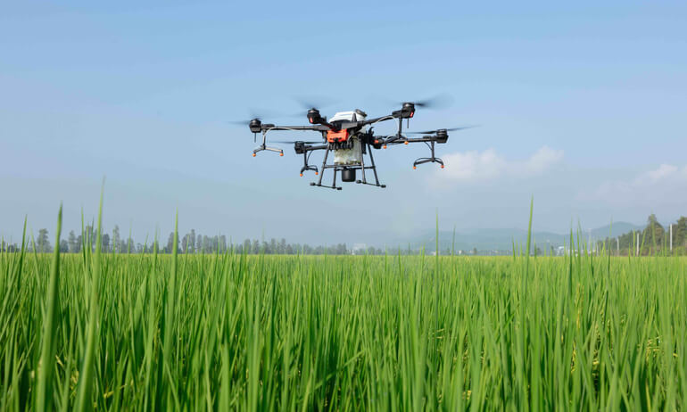
UAV
Unmanned Aerial Vehicle

Slide 2
Outline
Hull design
Propulsion system
Navigation system and control
Data collection
Data transmission
Power management

Slide 3
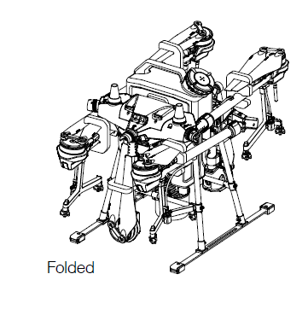
Hull design
Foldable frame
Quick-release spray tank and
flight battery

Slide 4
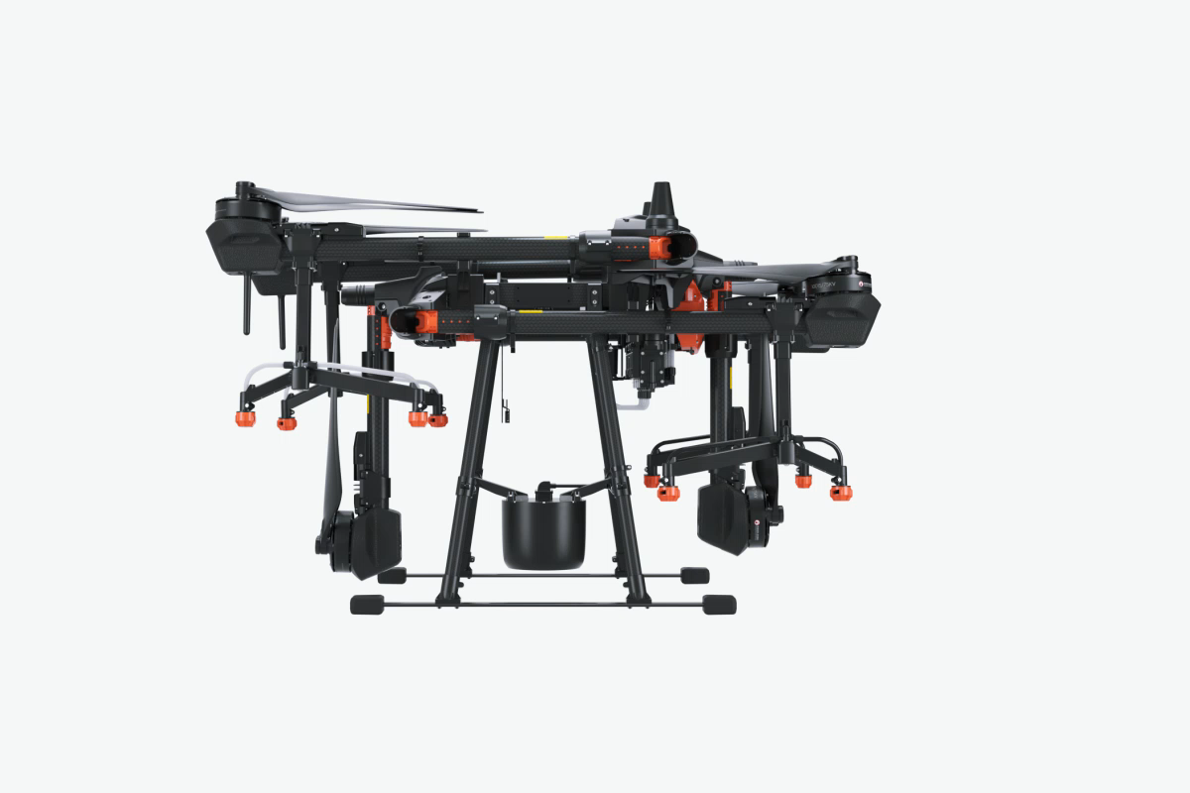

Slide 5
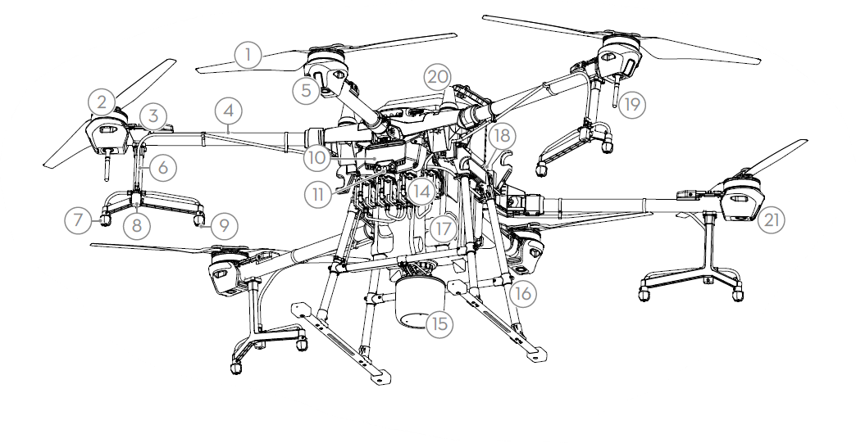

Slide 6
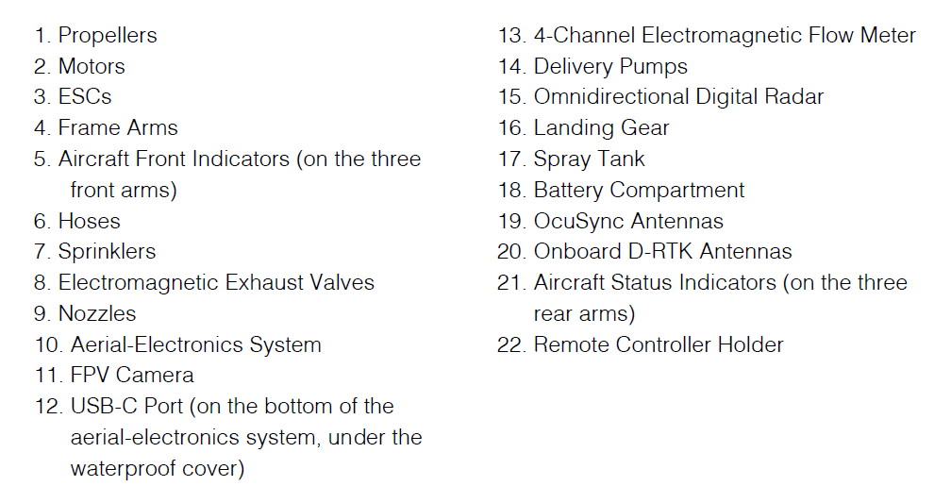

Slide 7

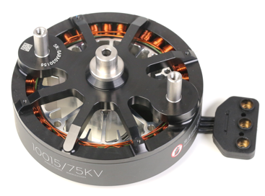
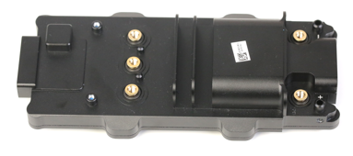
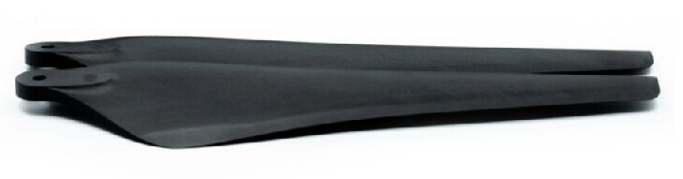
Propulsion system
Motor
Electronic Speed Control (ESC)
Propeller

Slide 8
Motor
Specifications based on:
Stator size
Noted as <Stator Width in mm><Stator Height in mm>
KV rating
The rotational speed per input voltage
1 KV = 1 rpm/V

Slide 9
Propellers
Specifications based on:
Diameter
Pitch
The vertical distance travelled per one revolution
No. of propellers to rotate clockwise = No. of propellers to rotate counter-clockwise

Slide 10
Electronic Speed Control (ESC)
Specifications based on:
Maximum continuous working current
Maximum working voltage
Maximum LiPo battery cells needed

Slide 11
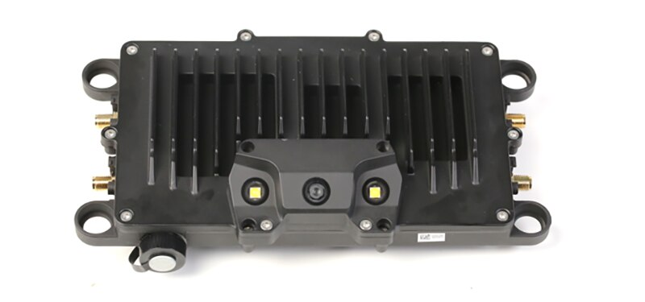
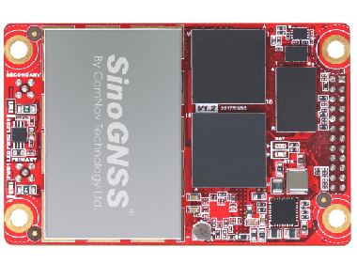
Navigation system and control
Flight controller / avionics module
Global Navigation Satellite System (GNSS)

Slide 12
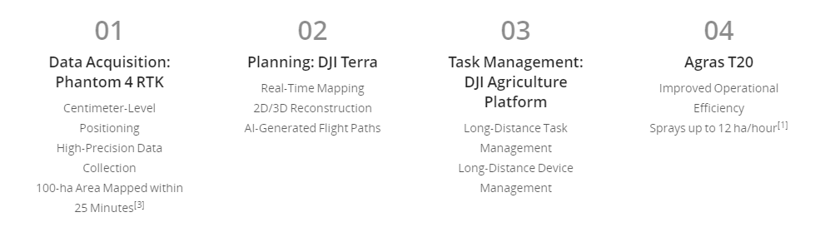
Data collection

Slide 14
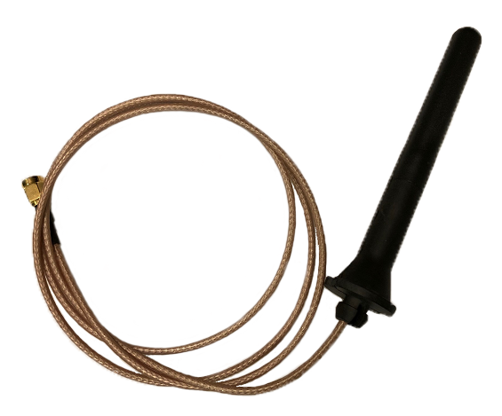
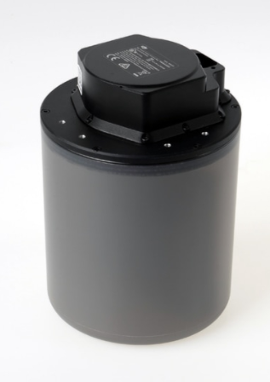
Data transmission
Antenna
RADAR

Slide 15
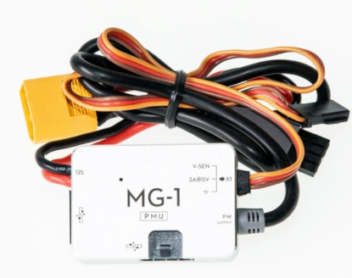
Power management
Power management unit (PMU)

