Slide 1

Safety Curtain

Slide 2
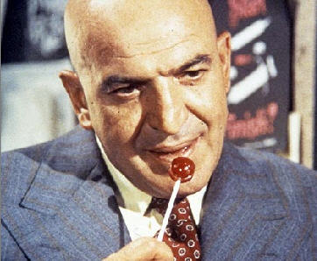
Team Kojak Presents

Slide 3
‘Three’ Your Data
Unifying Your Databases Using Triples

Slide 4
Featuring ….

Slide 5
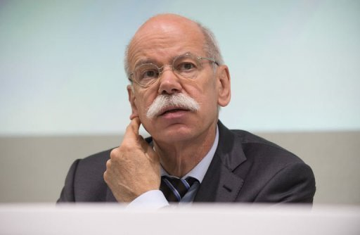
Jochen from the Boardroom

Slide 6
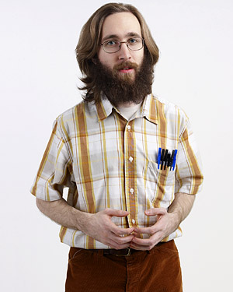
Ken from Legacy IT

Slide 7

Adam From the Future*
*Or the Present, if you’re using MarkLogic 7

Slide 8
It’s an Ordinary Monday Morning …
Jochen, CEO of National Kensington Bank has just acquired New Insurance Co.
There’s a job he’d like Ken to do for him by Monday lunchtime …

Slide 9

Later that Morning …

Slide 10
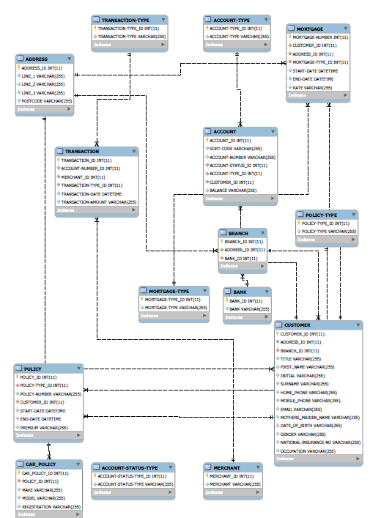
National Kensington Bank Schema

Slide 11
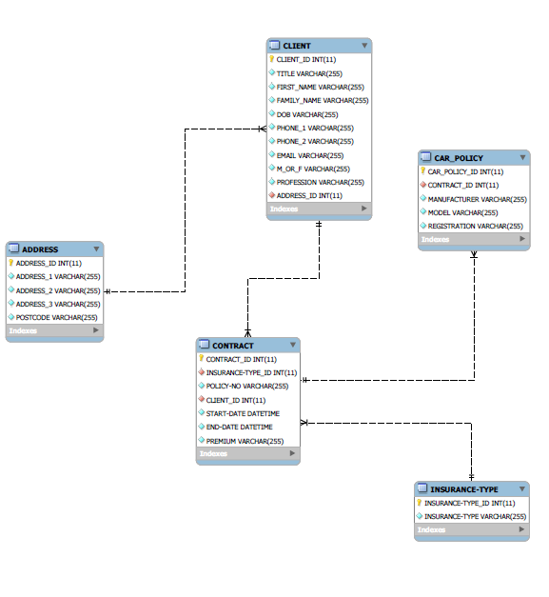
New Insurance Co Schema

