Slide 1
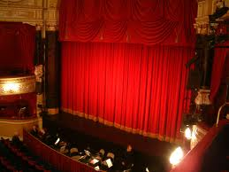
Safety Curtain

Slide 2
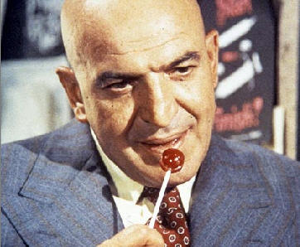
Team Kojak* Presents
*Ko J(ochen) A(dam) K(en)

Slide 3
‘Three’ Your Data
Unifying Your Databases Using Triples

Slide 4
Featuring ….

Slide 5
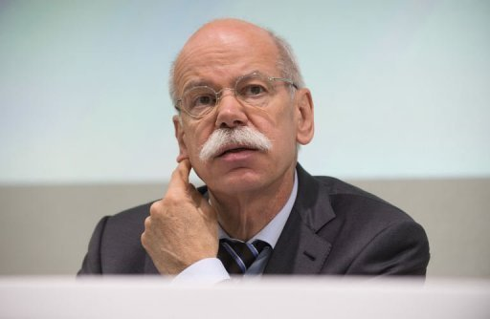
Jochen from the Boardroom

Slide 6
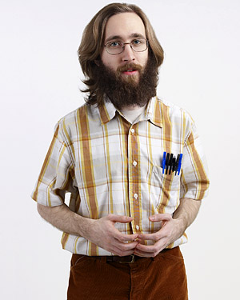
Ken from Legacy IT

Slide 7

Adam From the Future*
*Or the Present, if you’re using MarkLogic 7

Slide 8
It’s an Ordinary Monday Morning …
Jochen, CEO of National Kensington Bank has just acquired New Insurance Co.
There’s a job he’d like Ken to do for him by Monday lunchtime …

Slide 9

Later that Morning …

Slide 10
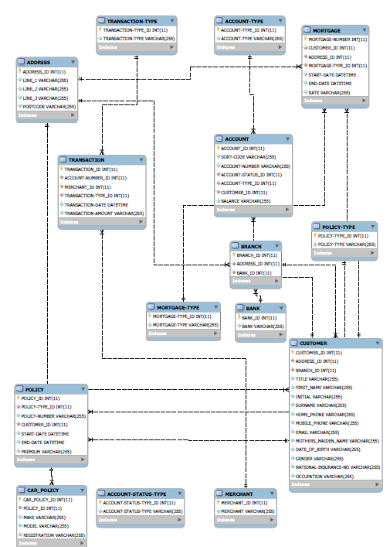
National Kensington Bank Schema

Slide 11
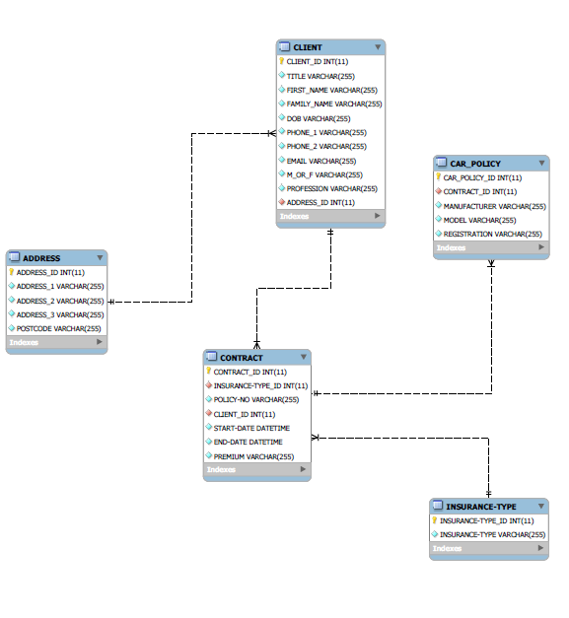
New Insurance Co Schema

Slide 12


Jochen’s Office, 11:50am

Slide 13
Credits
Jochen from the Boardroom Jochen Joerg
Ken from Legacy Systems Ken Tune
Adam from the Future Adam Fowler
Narration ???
Digital Platform MarkLogic Corporation
This was an EMEA Production

