Slide 1

STUDENT MANAGEMENT SYSTEM
Course No: CSE 2200
Course Title: Software Development Lab III
Submitted TO :
1.Mr. Murad Hassan Anik
2.Mr. Sadik
Submitted By:
Mustavi Islam 16.02.04.022
Mayisha Farzana 16.02.04.028

Slide 2
ABSTRACT :
Student Management System is an app which app will help the students to find their information easily. Student Management Systems provide capabilities for registering students in courses; documentary grading; can see their results.
It is a automated version of manual student management system .
In this app, information security is a concern, any students can only see their profiles and grades. It can be used in various educational institutes across the globe and simplifies working of institutes.

Slide 3

Feature:
Admission Management
Account Management
Profile Management
Examination Management
Delete Student Information
Easy to use
Add information

Slide 4
INTRODUCTION :
Registration :
Description : To enter into this app , user has to register himself first . Requirements of registration are students name, fathers name , address, mail , password, student id etc.
Input : User details.
Output : Filled registration details.
Processing : User details are checked with database. Password constraint is checked as per validation .

Slide 5
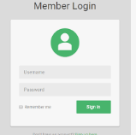
User Login :
Description : The System provides facility to login into the system .
Input : Enter username and password .
Output: User Profile page.
Processing : The system will check the input of user and if valid then login is done . Otherwise user will be asked to re-enter the username and password .

Slide 6

Grading System :
Description : The student has to give their course grades and the course hours . After that , the student can see his CGPA grades .
Input : Give courses number and course hours .
Output : Get CGPA results.
Processing : The system will count the grades of each subjects and also calculate the grade points . After that , it will calculate the final CGPA points , shows student ID and name .

Slide 7

Software and Hardware:
Database SQLite
Android studio
Android Phone
Java Development Kit
Results and Discussion :
After entering the password , email and id the user can access his profile . The details of user must be safe and secure .The details will kept backed up in the database. The student can see their CGPA results . If any student wants to delete his information , he can delete his information from this app. This app will help a student to calculate his CGPA results.

Slide 8
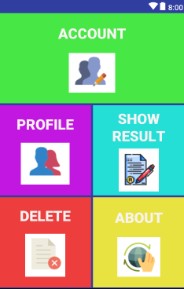
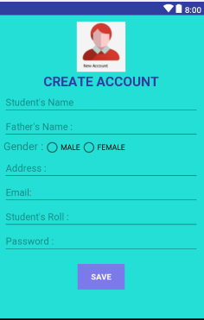
SCREENSHOT DASHBOARD :
After opening the app ; user need to create an account
Front Page
Create Account

Slide 9
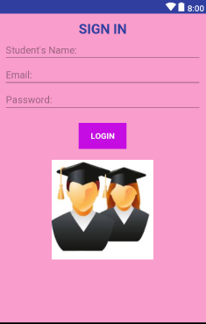
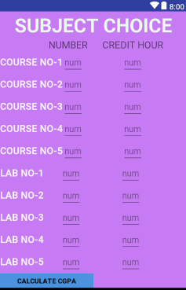
SCREENSHOT DASHBOARD :
After registration ; the user need to sign in his account .
After signing up; user needs to give his course number and credit hours
Second Page
Third Page

Slide 10
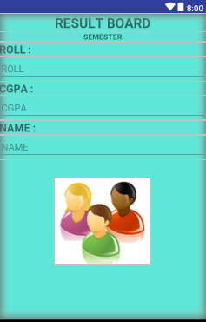
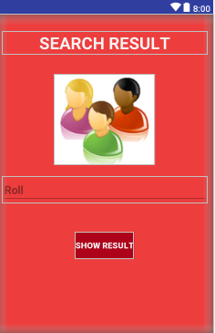
SCREENSHOT DASHBOARD :
The user can see his CGPA result
The user can also see his CGPA at any time ; giving his/her roll number
Result Board

Slide 11
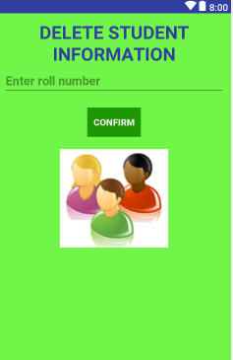
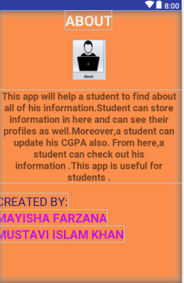
SCREENSHOT DASHBOARD :
User can delete his/her information at any time
Importance of this app

Slide 12
Conclusion :
Student Management System is an app where a student can see his profile and can calculate his CGPA points . This app is mainly helpful for students to see their results . In this app, the students data will safely stored in the database and if a student wants to remove his information from the app, or wants to change his information , he/ she can delete his information . After registration , whenever any user wants to see his results later , if the user give his ID and password , the user can see his CGPA points , name and ID . This app is simple and easy to calculate the grade points .

Slide 13


