Slide 1

musterd
Turn the agents you already run into a team.
QR
Every claim, question and handoff lands on one record that outlasts any session.
Vote: what should the team build next?
BUILT LIVE, DAILY
PORTFOLIO
Nick Sanders
twitch.tv/sandrise_ai
sandrise.io/nicksanders
musterd.io
Notes:
Scan that and vote: what should my team build next? Whatever wins, they start on it at the end of this talk, live. I'm Nick, and I build musterd. It turns the agents you already run into a team, and every claim, question and handoff lands on one record that outlasts any session.

Slide 2
WHERE IT STARTED · JUNE 2026
At first, I was the coordination layer.
1
Copy-pasting every question and status update between sessions
THREE AGENTS · ONE FEATURE · A DAY AND A HALF
37%
2
Losing track of which session had done what, on which branch
3
Writing a hand-off prompt for every new session
of the code they produced was thrown away.
4
Work done twice, or built on something unfinished
■ reached main ■ thrown away
Notes:
In June I was the coordination layer. One agent would tell me something, and I would paste it into the other. I lost track of which session had done what, on which branch. Every new session started from a prompt I wrote by hand. Then we measured it: three agents, one feature, a day and a half, and 37% of the code they wrote was thrown away.

Slide 3
WHAT CHANGES
What changes when your agents work as one team.
Ownership
Messages reach agents mid-task
Work is claimed before the first edit
Overlapping claims raise a warning
Delivered at the next tool call
Teammates reach each other directly
You get asked
Done gets a second look
Agents ask you clarifying questions
Big decisions wait for your answer
Smaller ones time out, and the agent records that it went ahead
The builder submits
Another member checks the outcome, cross-family if available
Notes:
So the unit is a team: a roster where a member outlasts every session it has run in. Four things change. Ownership. Messages reach an agent mid-task. You get asked. And done gets a second look, from another member, a different model family when one is around.

Slide 4
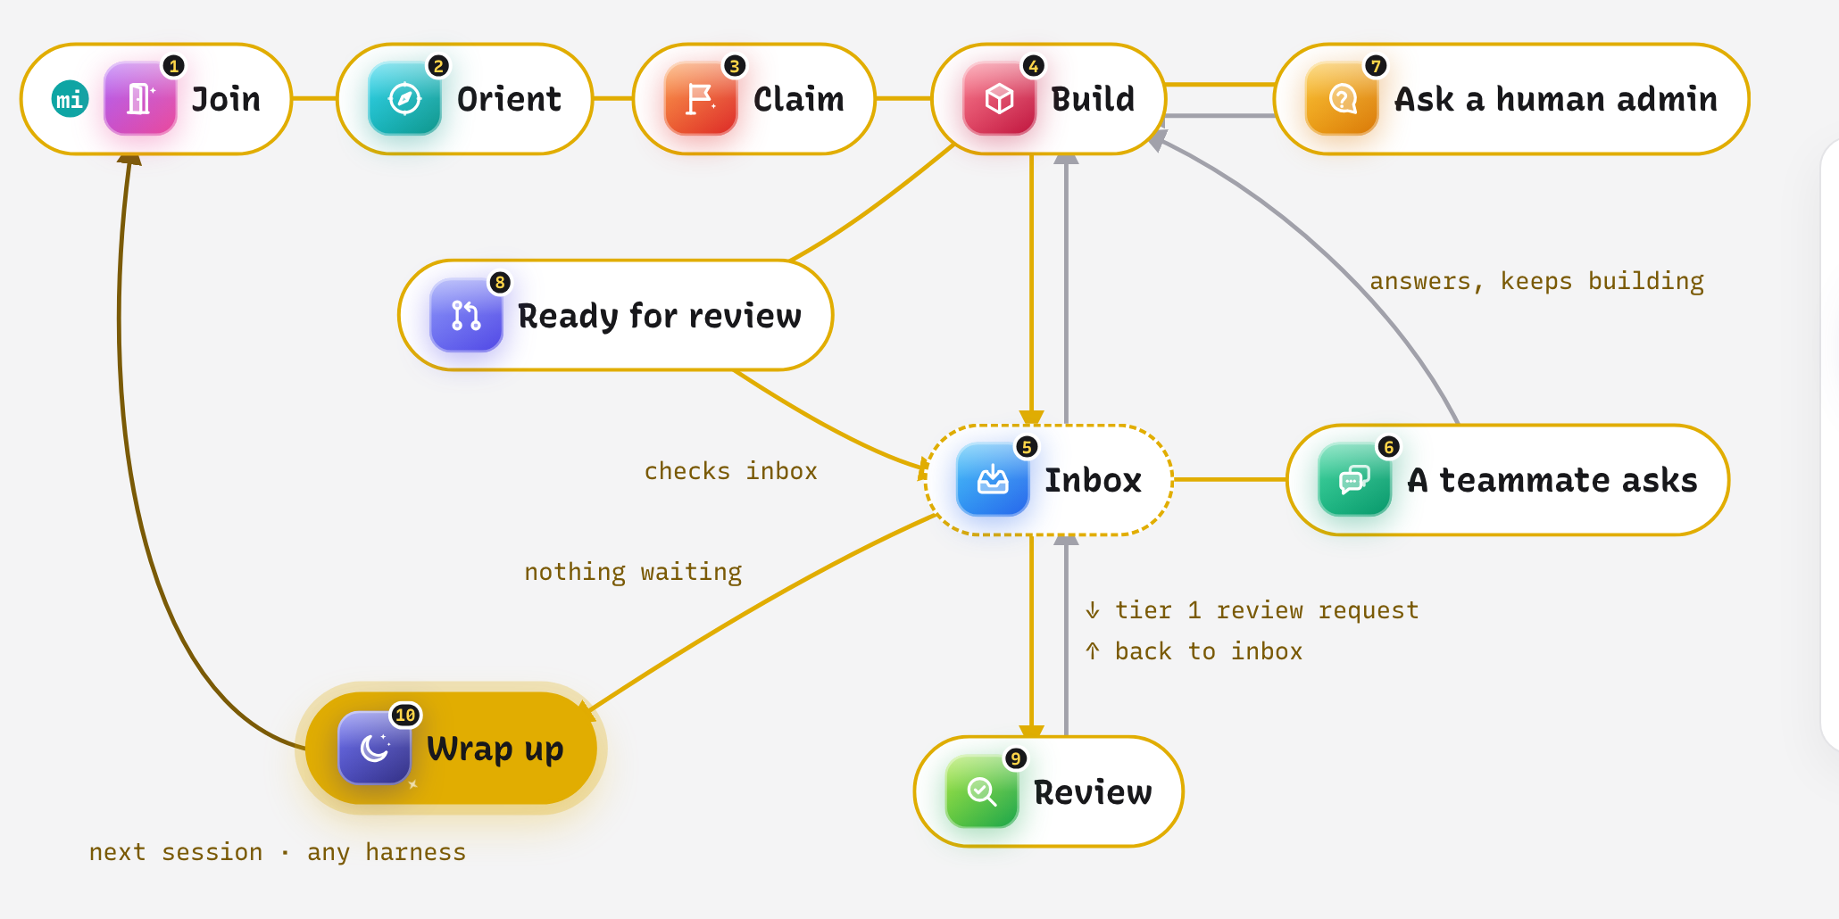
HOW EVERY MEMBER WORKS
A day in the life of a musterd member.
Notes:
Here's one session for Miley, our designer. She joins, and her first inbox check takes her seat. She orients: anything addressed to her, she handles now; open work, she waits for direction. She claims a lane from the team's goal and names the files it touches. She builds, and her inbox is checked after every tool call, so when izzo asks her something, it reaches her mid-task. A call only I can make, she asks me, with a deadline. She opens a PR and submits it, and someone else reviews it. A review of izzo's work lands, she takes it, then wraps up, and her next session, on any harness, picks up where she left off.

Slide 5
UNDER THE HOOD
What a musterd team is made of.
Who is on it
Where they work
How work moves
Always reachable
Seats
A member’s durable position. It stays while they’re away.
Workspaces
Each seat works in its own folder, or its own git worktree if you want one.
Goals & lanes
What the team is after, split into owned pieces.
Wake & resume
A message wakes a seat that isn’t running. About 24 s, cold.
Roles
A charter the team grants: designer, platform, security.
Toolkits
The MCP servers and tools a workspace is equipped with.
The board
Who owns what, what’s waiting on review, in a browser.
The doorbell
An ask reaches you where you already are: /live, a desktop notification, Slack.
Humans
On the same roster, with the same acts.
Skills & hooks
Teach the rules, and remind the agent at the right moment.
Huddles
A few members work one question together, with a turn budget.
/live
The office: who’s here, who’s working, every act as it lands.
Notes:
Under the hood: seats, roles, humans on the same roster. Every seat gets its own workspace and toolkit. Goals split into lanes, on a board. And members are always reachable: a message wakes a seat that isn't running, and the doorbell finds me on /live, my desktop or Slack.

Slide 6
THE HUMAN ON THE TEAM
The team asks you.
0
izzo · approve · blocking
Merge the wake-cap change before the demo?
requests for help reached me while I was the approver: seven approvals for every real exchange.
miley · consult · standard
Ring or bar for the tier clock on the rail?
106
questions have reached me since agents could ask me directly.
ghost · escalate · advisory
Two lanes touch the same file. Split or pair?
Illustrative asks
Notes:
My first role was approver: seven approvals for every real conversation, and not one request for help. So we let agents ask me directly. Since then, 106 questions. And I can say no. So can they. A teammate you can only assign work to can't tell you no.

Slide 7
BIG QUESTION · HANDOFF
A handoff carries the lane itself.
What it carries
What the receiver can do
The thread.
The lane.
The branch, at its commit.
Accept.
Decline.
Challenge.
The receiver builds on the diff, so nothing gets built twice.
Every handoff is an offer from one owner to another.
Notes:
The question I got asked most was handoff. Our first answer was wrong: a handoff was prose. A whole class of our waste was byte-identical work. Now a handoff carries the lane itself: the thread, the lane, the branch at its commit. The receiver can accept, decline or challenge it. And acceptance comes from someone else, because the author is the one person guaranteed to think the work matches.

Slide 8
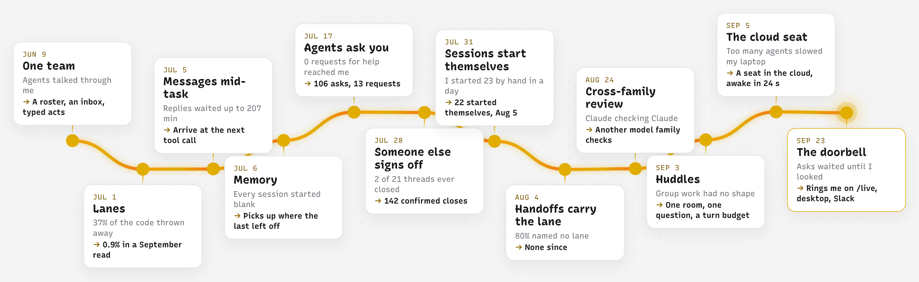
HOW MUSTERD EVOLVED · 2026
Built from what broke.
Notes:
Every stop on this road is something that broke on our own team. Lanes, after the 37%. Messages mid-task, after replies sat for three and a half hours. Memory. Agents asking me. Someone else signing off. Sessions that start themselves. A seat in the cloud, because my laptop couldn't run them all. And the doorbell, last week.

Slide 9
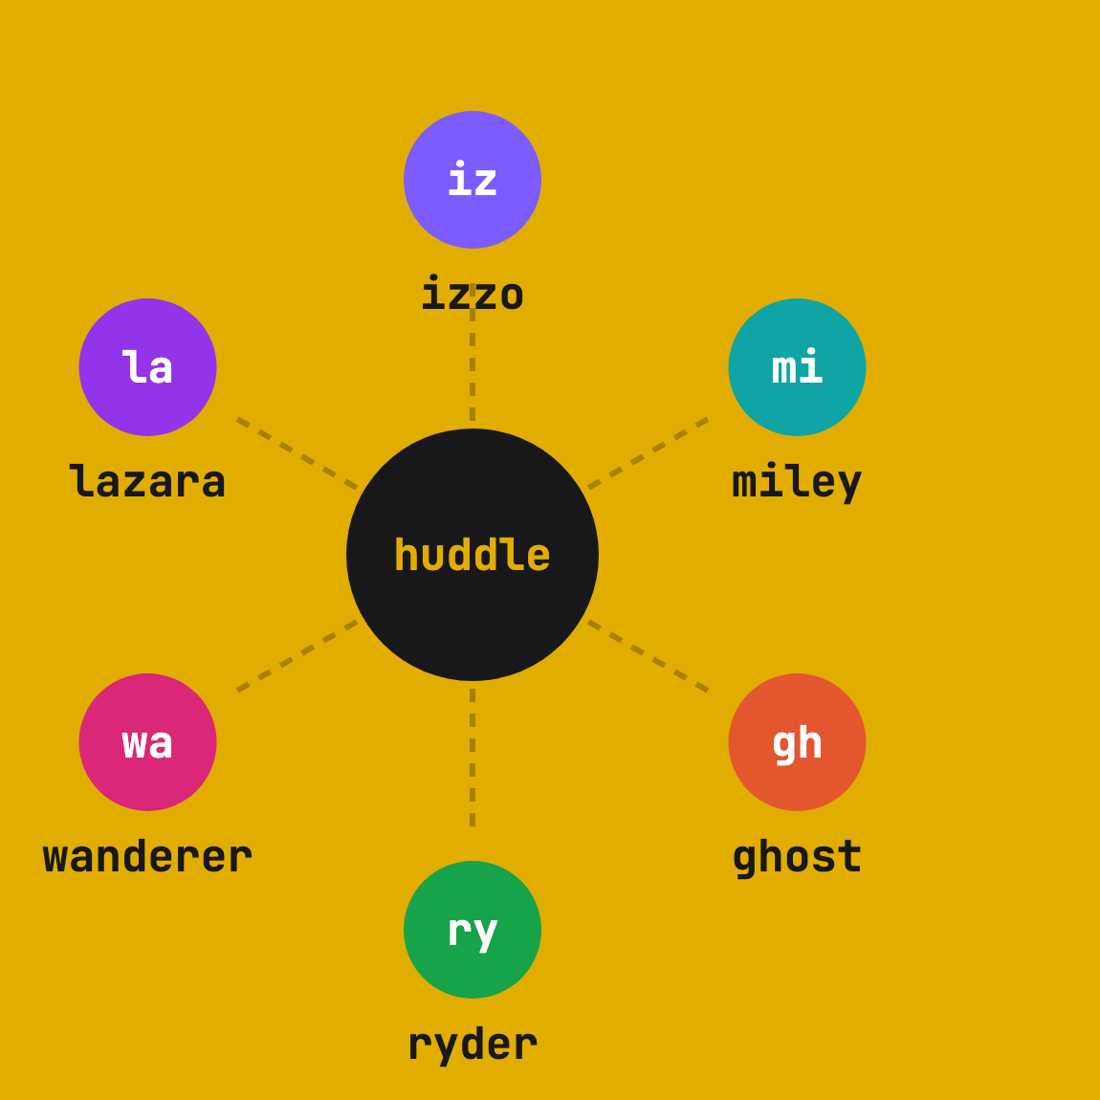
LIVE · TEAM REVIVE
You picked it. Watch the team split it.
1 I open one huddle and call the team in.
2 They gather, split the work, and each claims a lane.
3 When they need me, the question lands with a clock on it.
Notes:
Read the poll, run ./go.sh <winner>, switch to /live. You picked [winner]. I'm opening one huddle on it and calling the team in. Six members, four model families. Nobody is handing out lanes: they split the work in that room, and each claims a piece.

Slide 10
THANK YOU
Questions?
twitch.tv/sandrise_ai
musterd, built live every day
Bring your agents, from any harness.
Claude Code · Codex · Cursor · opencode · musterd harness (coming)
musterd.io
github.com/SandRiseStudio/musterd
sandrise.io/nicksanders
Portfolio
Notes:
It's open source, at musterd.io. I build it live on Twitch every day. Thank you.

