Slide 1

VOL. VII — NO. 26
PINNACLE RELIABILITY · HYDERABAD DISPATCH
AUGUST 2026
MECHANICAL INTEGRITY & RELIABILITY DISPATCH
Quantitative Reliability Optimization
Empowering Better Reliability Decisions for Industrial Facilities
THE FRAMEWORK
THE MANDATE
THE OUTCOME
An advanced, multi-variate operational framework uniting Asset Risk Analysis, Lifetime Variability Curves, Markov-chain availability simulation, and value-driven task optimization.
Model every facet of plant reliability dynamically, updated in near-real-time as fresh inspection and sensor telemetry emerges from the field.
Highest reliability performance at the lowest possible cost — every maintenance dollar ranked by quantified Benefit-Cost Ratio and bounded by hard HSE ceilings.
PRESENTED BY MUSTHAQUE ALI
★ PINNACLE RELIABILITY ★
Mechanical Integrity Engineer · Reliability Data Analyst

Slide 2

AGENDA
PINNACLE RELIABILITY · QRO DISPATCH
Table of Contents & Curriculum Agenda
Master outline of 8 technical modules covering Quantitative Reliability Optimization.
01
02
Introduction & QRO Overview
SLIDES 03–08
Reliability 101 Foundations
SLIDES 09–20
Definition, Capabilities, Sensor Telemetry
Availability, MTBF, MTTF, MDT, MTTR
03
04
Probability & Statistics
SLIDES 21–35
QRO Core Methodology
SLIDES 36–46
Weibull (Beta, Eta, Gamma) & Bathtub Curve
Asset Risk Analysis (ARA) & Lifetime Variability Curves
05
06
Availability Forecasting
SLIDES 47–58
Task Optimization Engine
SLIDES 59–69
Exchanger/Pump Case Studies & Markov Chains
Benefit-Cost Ratio, Task Grouping & QTE
07
08
CML Optimization
SLIDES 70–76
Master Formulary & Summary
SLIDES 77–80
Pareto 90/15, Sample Optimization & EVA Tail
Complete Mathematical Formulary & Executive Findings
MUSTHAQUE ALI · PINNACLE RELIABILITY · QRO METHODOLOGY DISPATCH
No. 02 / 80

Slide 3



MODULE 01 — INTRODUCTION & QRO OVERVIEW
PINNACLE RELIABILITY · QRO DISPATCH
What is QRO? Formal Engineering Definition
Intelligently modeling every facet of plant reliability to evergreen facility performance.
CORE ENGINEERING MANDATE & FORMULATION
1. Better & Faster Decisions
Quantitative Reliability Optimization (QRO): The empirical framework by which every facet of plant reliability is dynamically modeled and continuously updated as new inspection and sensor data emerges.
Strategic Multi-Objective Frontier: Solves the simultaneous optimization balance across Availability, OPEX Cost, and HSE Risk.
Data-Driven Evergreening: Eliminates static, periodic re-assessments in favor of near-real-time living reliability models.
Replaces subjective consensus meetings with Bayesian algorithms.
Ranks every maintenance dollar by quantified Benefit-Cost Ratio.
2. Strategic Cost Reduction
Eliminates non-value-added PMs on low-consequence systems.
Reduces recurring turnaround inspection scopes by up to 30%.
3. High-Confidence Safety
Enforces hard HSE risk ceilings to guarantee zero containment loss.
Validates asset integrity with formal statistical confidence bounds.
AVAILABILITY
OPEX COST
HSE RISK
MUSTHAQUE ALI · PINNACLE RELIABILITY · QRO METHODOLOGY DISPATCH
No. 03 / 80

Slide 4
MODULE 01 — INTRODUCTION & QRO OVERVIEW
PINNACLE RELIABILITY · QRO DISPATCH
QRO Architecture & Decision Triad
Ingesting multi-source engineering data to balance HSE risk, OPEX cost, and production uptime.
FIG · QRO ARCHITECTURE: RISK-BASED INPUTS, ENGINE & DECISION TRIAD
Risk-Based Inspection
HSE Risk
Reliability Centered Maintenance
Quantitative
Reliability
Optimization
Better and Faster Decisions
Improved Reliability and Safety
Reduced Reliability Spend
Optimized
Reliability
Reliability Availability Maintainability
Multi-Variate Machine Learning
Cost
Availability
Quantitative Reliability Optimization (QRO) is the method by which every facet of system reliability is intelligently modeled and dynamically updated as new data is available, allowing operators to understand how every data point and activity impacts facility performance, resulting in a continually evergreened reliability plan focused on maximizing return on reliability investment through achieving a strategic balance of availability, cost, and risk.
Ingestion Layer: Consolidates RBI, RCM, RAM, and sensor telemetry into a single mathematical formulation.
OPTIMIZATION MANDATE
Balance HSE Risk, OPEX Cost & Availability
MUSTHAQUE ALI · PINNACLE RELIABILITY · QRO METHODOLOGY DISPATCH
No. 04 / 80

Slide 5
MODULE 01 — INTRODUCTION & QRO OVERVIEW
PINNACLE RELIABILITY · QRO DISPATCH
Reliability Model Comparison Matrix
Rigorous benchmarking against FMEA, RCM, RBI, ML, PHA, and RAM methodologies.
CAPABILITIES | FMEA | RCM | RBI | ML | PHA | RAM | QRO
Loss of Containment Mitigation | ✗ | ✗ | ✓ | ✗ | ✓ | ✗ | ✓
Functional Failure Relative Risk Mitigation | ✓ | ✓ | ✗ | ✗ | ✗ | ✗ | ✓
Critical Equipment Early Failure Detection | ✗ | ✗ | ✗ | ✓ | ✗ | ✗ | ✓
Purely Quantitative Formulation | ✗ | ✗ | ✓ | ✓ | ✗ | ✓* | ✓
Reliability-Based Design Optimization | ✗ | ✗ | ✗ | ✗ | ✗ | ✓ | ✓
Facility-Wide Optimization of Spend vs Impact | ✗ | ✗ | ✗ | ✗ | ✗ | ✗ | ✓
Complex Simulations Driven Directly by Live Data | ✗ | ✗ | ✗ | ✗ | ✗ | ✓* | ✓
EXECUTIVE COMPARISON INSIGHTS
Only QRO covers both loss-of-containment mitigation (RBI) and functional failure downtime (RCM/RAM).
Purely Quantitative: Eliminates subjective qualitative risk matrices in favor of exact statistical distributions.
Dynamic Simulations: Driven directly by live DCS historians and CML telemetry rather than static tables.
MUSTHAQUE ALI · PINNACLE RELIABILITY · QRO METHODOLOGY DISPATCH
No. 05 / 80

Slide 6


MODULE 01 — INTRODUCTION & QRO OVERVIEW
PINNACLE RELIABILITY · QRO DISPATCH
The Strategic Value Triad of QRO
Synthesizing quantitative modeling, reliability forecasting, and budgetary optimization.
I. QUANTITATIVE
II. RELIABILITY
III. OPTIMIZATION
Understand Uncertainty
Improve Plant Performance
Best Use of Budgets
Integrate data from all inspection, process, and vibration streams into a unified analytics engine to drive consolidated failure prediction across units and facilities.
Simulate hypothetical maintenance strategies and operational changes to forecast their quantitative impact on asset health and goal-seek target system availability.
Use your data to establish optimized task intervals and turnaround scopes across all asset types based on a single benefit-to-cost decision (BCR).
Digital Twin: Real-time asset modeling
Predictive: Accurate P-F curve positioning
Value-Driven: Spend targeted directly to risk
Resource Leveling: Turnaround grouping
MUSTHAQUE ALI · PINNACLE RELIABILITY · QRO METHODOLOGY DISPATCH
No. 06 / 80

Slide 7
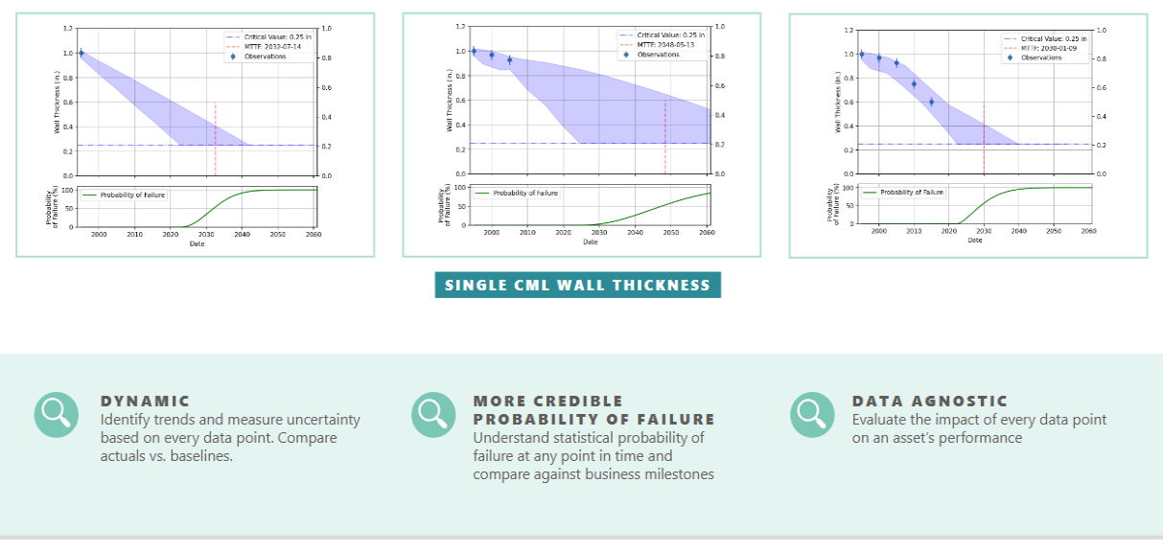
MODULE 01 — INTRODUCTION & QRO OVERVIEW
PINNACLE RELIABILITY · QRO DISPATCH
Uncertainty-Driven Degradation Modeling
How QRO moves beyond straight-line deterministic corrosion rates.
Single CML Wall Thickness & POF Evolution
FIG · SINGLE CML WALL THICKNESS: UNCERTAINTY ENVELOPES
Traditional methods draw a static straight line through wall thickness readings. QRO recognizes that every inspection reading carries measurement error and process fluctuation:
1
Dynamic Bayesian Updating: With each new UT measurement, the confidence envelope contracts, shifting the mean MTTF.
2
Critical Limit Threshold: Identifies when the lower 95% confidence boundary crosses the structural retirement thickness (t_crit).
3
POF S-Curve: Directly derives the cumulative failure probability curve from the uncertainty distribution.
MUSTHAQUE ALI · PINNACLE RELIABILITY · QRO METHODOLOGY DISPATCH
No. 07 / 80

Slide 8
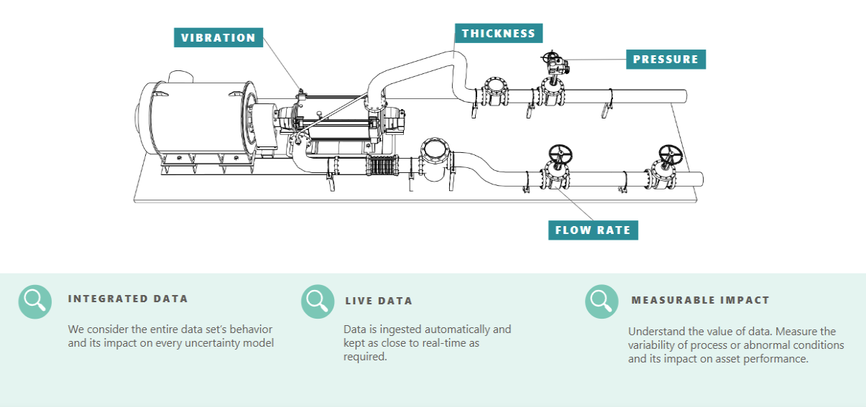
MODULE 01 — INTRODUCTION & QRO OVERVIEW
PINNACLE RELIABILITY · QRO DISPATCH
Connected Systems & Multi-Stream Sensor Telemetry
Breaking down industrial silos by consolidating disparate sensor feeds into a live dynamic model.
FIG · CONNECTED SYSTEMS: VIBRATION, THICKNESS, PRESSURE & FLOW TELEMETRY
TELEMETRY SYNCHRONIZATION ENGINE
1
Vibration & Rotating
2
Ultrasonic Thickness
3
Process P, T & Flow
High-frequency telemetry fed directly into P-F interval degradation models.
Direct wall readings continually contracting Bayesian LVC confidence bands.
Real-time operational data tracking thermal stress and accelerated creep.
MUSTHAQUE ALI · PINNACLE RELIABILITY · QRO METHODOLOGY DISPATCH
No. 08 / 80

Slide 9

SECTION II
No. 02
Reliability 101
Core Mathematical Formulations, Availability Engineering & Failure Rate Metrics
AVAILABILITY
FAILURE RATE Λ
MTBF
MTTF · MDT · MTTR
MUSTHAQUE ALI · PINNACLE RELIABILITY · QRO METHODOLOGY DISPATCH
No. 09 / 80

Slide 10
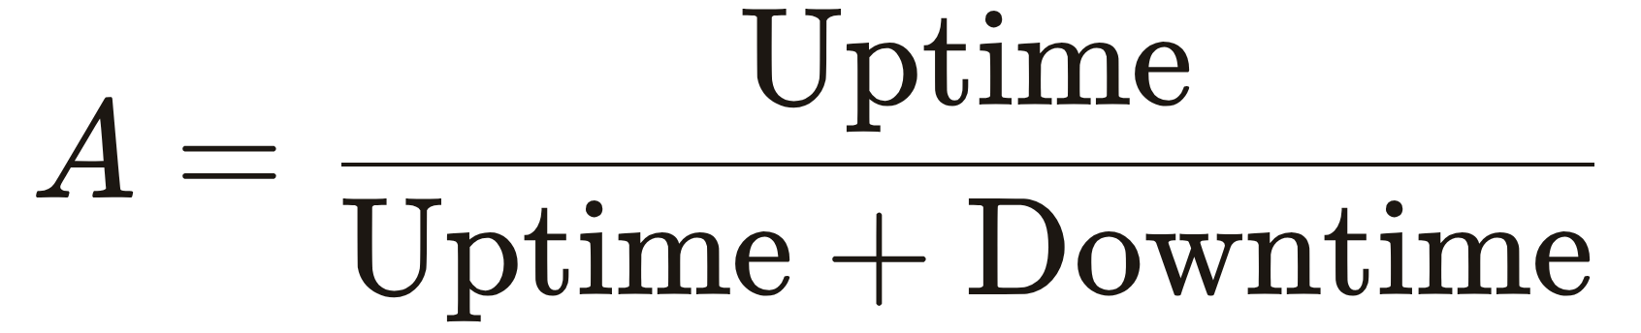
MODULE 02 — RELIABILITY 101 FOUNDATIONS
PINNACLE RELIABILITY · QRO DISPATCH
What is Availability? Technical Formulation
The percentage of time an asset is functional when demanded.
Formal Engineering Definition: The proportion of operating time an asset successfully performs its intended functions when demanded within a defined evaluation horizon, regardless of the run rate or yield.
Uptime (Functional Time)
[ HOURS / DAYS ]
Total operating duration the asset is energized and successfully executing its design function.
Downtime (Outage Time)
[ HOURS / DAYS ]
GOVERNING RATIO
Total duration the asset is non-operational due to planned PMs, turnarounds, or emergency corrective repairs.
Mission Time (Uptime + Downtime)
[ HOURS ]
Total calendar evaluation horizon over which asset performance is measured (e.g., 5-year operating cycle = 43,800 hrs).
Reliability Dimension
Maintainability Dimension
Governed by how frequently an asset fails (Failure Rate λ). Maximized by eliminating root cause defects.
Governed by how quickly function is restored after a shutdown (Mean Downtime MDT). Maximized by logistics & spare parts.
MUSTHAQUE ALI · PINNACLE RELIABILITY · QRO METHODOLOGY DISPATCH
No. 10 / 80

Slide 11

MODULE 02 — RELIABILITY 101 FOUNDATIONS
PINNACLE RELIABILITY · QRO DISPATCH
Reliability ≠ Availability: The Core Distinction
Probability of survival across time versus proportion of demand time in operable state.
RELIABILITY
AVAILABILITY
A Time-Decaying Probability
An Operational Time Ratio
Reliability R(t) is the mathematical probability (bounded between 0% and 100%) that an asset will operate without experiencing failure across a specified mission duration t.
Availability A is the percentage of demand time the equipment is in an operable state, accounting for outage recovery.
An asset can exhibit low reliability (e.g. trips every two weeks) yet achieve high availability if the crew restores it within 5 minutes.
Conversely, an asset can exhibit high reliability (runs continuously for 5 years without a single trip) yet suffer poor availability if repairing a subsequent failure takes 6 months of downtime.
Reliability continuously decays over time as operating hours accumulate and components suffer irreversible physical damage.
QRO Engineering Principle: Maximizing facility profit requires balancing both dimensions simultaneously rather than optimizing one blindly.
MUSTHAQUE ALI · PINNACLE RELIABILITY · QRO METHODOLOGY DISPATCH
No. 11 / 80

Slide 12




MODULE 02 — RELIABILITY 101 FOUNDATIONS
PINNACLE RELIABILITY · QRO DISPATCH
Maintainability: Anatomy of Downtime Events
Classifying downtime categories and analyzing governing operational factors.
Maintainability: The time required to restore the condition of the asset so it can perform its intended functions. It represents the cumulative downtime attributed to an event or series of events.
DOWNTIME EVENT CLASSIFICATIONS
GOVERNING DOWNTIME FACTORS
1
Planned Corrective Maintenance: Addressed during a scheduled window before failure occurs.
Asset Characteristics: Isolation valves, drainage, purging, and weight.
2
Unplanned Corrective Maintenance: Emergency trip or loss-of-containment requiring immediate shutdown.
Spare Parts Availability: Stock on hand vs. long-lead international delivery.
3
Preventive Maintenance (PM): Routine servicing, filter changes, and lubrication.
Logistics & Rigging: Heavy cranes, scaffolding, specialized rigging, decontamination.
4
Intrusive Inspection: Teardowns, vessel internal entry, and hydrostatic testing.
Crew Availability: Shift staffing, specialty millwrights, certified welders.
MUSTHAQUE ALI · PINNACLE RELIABILITY · QRO METHODOLOGY DISPATCH
No. 12 / 80

Slide 13
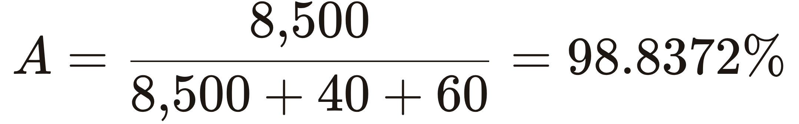
MODULE 02 — RELIABILITY 101 FOUNDATIONS
PINNACLE RELIABILITY · QRO DISPATCH
Simulator: Live Asset Availability Calculator
Real-time calculation of operational availability and downtime penalties.
OPERATING PARAMETER ADJUSTER
LIVE
Annual Operating Uptime
8,500 hrs
5,000
8,760
Planned Downtime (PM / Servicing)
40 hrs
0
300
Unplanned Downtime (Emergency Trips)
60 hrs
0
600
LIVE CALCULATED AVAILABILITY
98.8372 %
Total Outage Downtime: 100 Hours (4.2 Days)
Notice how even a small increase in unplanned corrective hours severely drives availability below the 99% industrial benchmark.
Mathematical Law: Availability (%) = 1 − [ Σ(Planned DT) + Σ(Unplanned DT) ] / Total Mission Time
MUSTHAQUE ALI · PINNACLE RELIABILITY · QRO METHODOLOGY DISPATCH
No. 13 / 80

Slide 14
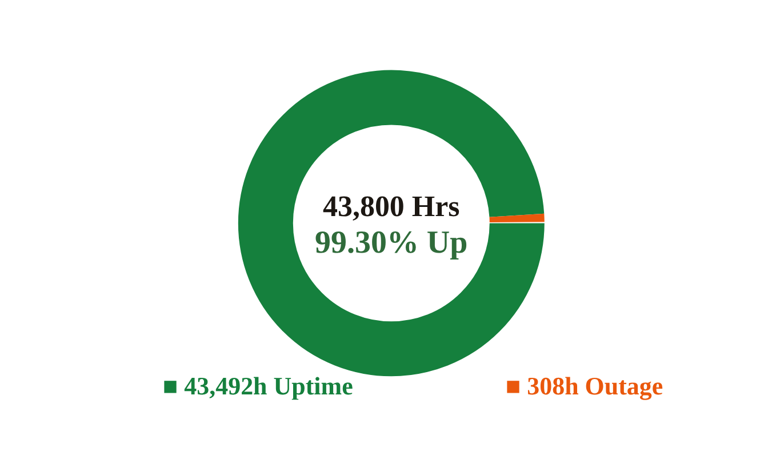
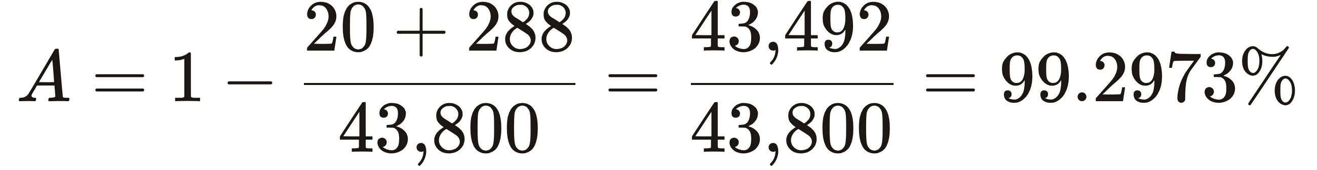
MODULE 02 — RELIABILITY 101 FOUNDATIONS
PINNACLE RELIABILITY · QRO DISPATCH
Availability Case Study 1: Centrifugal Slurry Pump
Rigorous calculation for an isolatable rotating process asset.
OPERATIONAL PARAMETER | OPERATING ASSUMPTIONS & HISTORY | CALCULATED OUTAGE IMPACT
Mission Evaluation Cycle | 5 Calendar Years = 1,825 Days | 43,800 Hours Total Exposure
Asset Isolation Feasibility | Equipped with suction & discharge block valves | CAN be isolated during normal operation
Planned Event (PM) | Routine oil change (5 events in 5 years; 4 hours per event) | 5 × 4 = 20 Hours Planned Outage
Unplanned Failure (Corrective) | Bearing failure (3 occurrences in 5 years; 4 days per failure) | 3 × (4 × 24) = 288 Hours Unplanned Outage
Total Cumulative Downtime | 20 Hours (Planned) + 288 Hours (Unplanned) | 308 Hours Total Outage (12.8 Days)
FIG · OUTAGE PARTITION: 5-YEAR CYCLE
CALCULATED AVAILABILITY
99.2973 %
CALCULATION
43,492 of 43,800 hours available
MUSTHAQUE ALI · PINNACLE RELIABILITY · QRO METHODOLOGY DISPATCH
No. 14 / 80

Slide 15
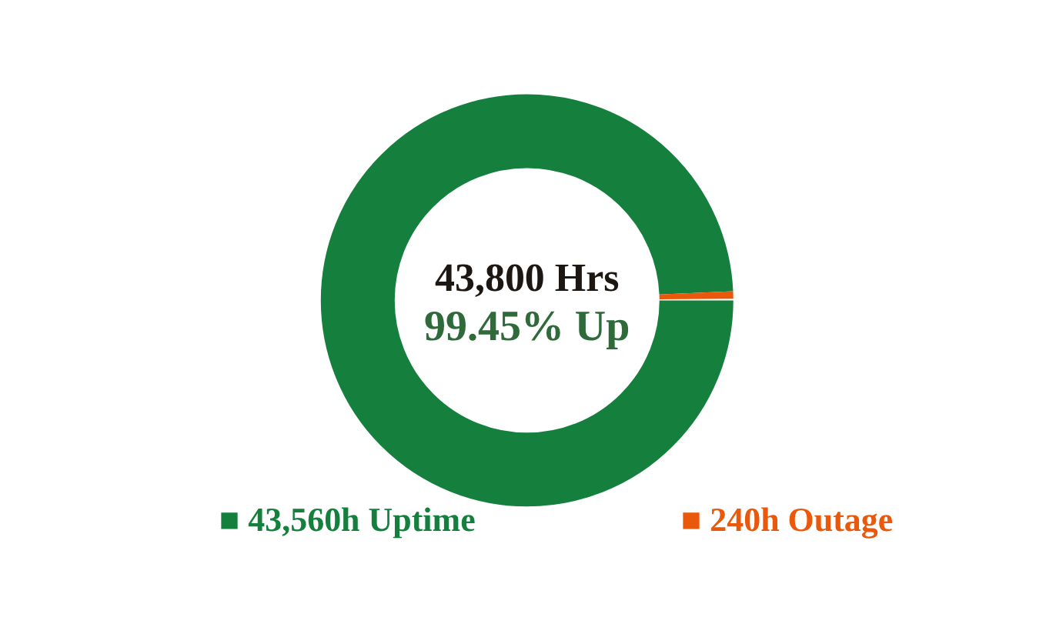
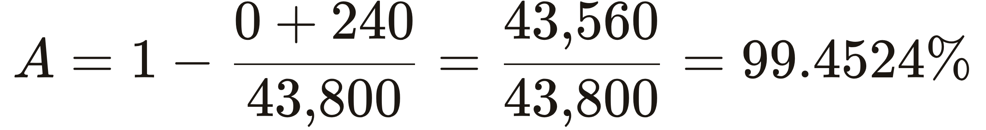
MODULE 02 — RELIABILITY 101 FOUNDATIONS
PINNACLE RELIABILITY · QRO DISPATCH
Availability Case Study 2: Crude Unit Desalter Vessel
Evaluation of a non-isolatable critical pressure vessel.
OPERATIONAL PARAMETER | OPERATING ASSUMPTIONS & HISTORY | CALCULATED OUTAGE IMPACT
Mission Evaluation Cycle | 5 Calendar Years = 1,825 Days | 43,800 Hours Total Exposure
Asset Isolation Feasibility | Vessel has no bypass; trip shuts down distillation column | CANNOT be isolated online
Planned Inspection (NDT) | Non-intrusive external ultrasonic thickness survey (online) | 0 Hours (Executed without unit shutdown)
Unplanned Failure (Emergency) | Flange loss of containment (1 event in 5 years; 10 days total) | 1 × (10 × 24) = 240 Hours Unplanned Outage
Total Cumulative Downtime | 0 Hours (Planned) + 240 Hours (Unplanned) | 240 Hours Total Outage (10.0 Days)
FIG · OUTAGE PARTITION: 5-YEAR CYCLE
CALCULATED AVAILABILITY
99.4524 %
CALCULATION
43,560 of 43,800 hours available
MUSTHAQUE ALI · PINNACLE RELIABILITY · QRO METHODOLOGY DISPATCH
No. 15 / 80

Slide 16
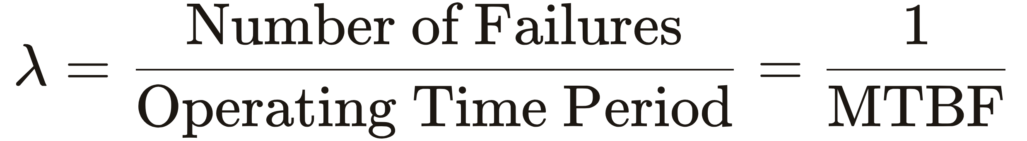
MODULE 02 — RELIABILITY 101 FOUNDATIONS
PINNACLE RELIABILITY · QRO DISPATCH
Failure (Hazard) Rate Fundamentals
Mathematical definition, operational exposure time, and the fundamental hazard formulation.
Failure Rate (λ): The frequency with which an engineered component, asset, or system fails per unit of operational exposure time.
GOVERNING FORMULATION: HAZARD RATE (λ)
Engineering Interpretation
Population vs. Asset-Level Rates
Denominator Sensitivity: Must represent true operating hours (exposure time), excluding standby and turnaround.
Reciprocal Identity: For constant failure rates, λ = 1 / MTBF and MTBF = 1 / λ.
Fleet Aggregation: Expressed as failures per fleet-year (e.g. 0.20 failures/pump-year across 50 pumps).
Bayesian Prior: Serves as the baseline prior distribution before sensor telemetry updates.
MUSTHAQUE ALI · PINNACLE RELIABILITY · QRO METHODOLOGY DISPATCH
No. 16 / 80

Slide 17
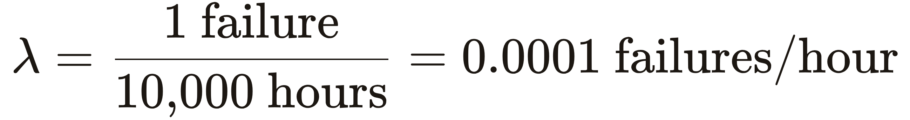
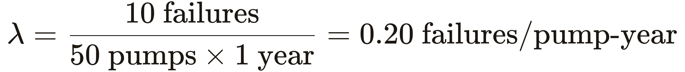
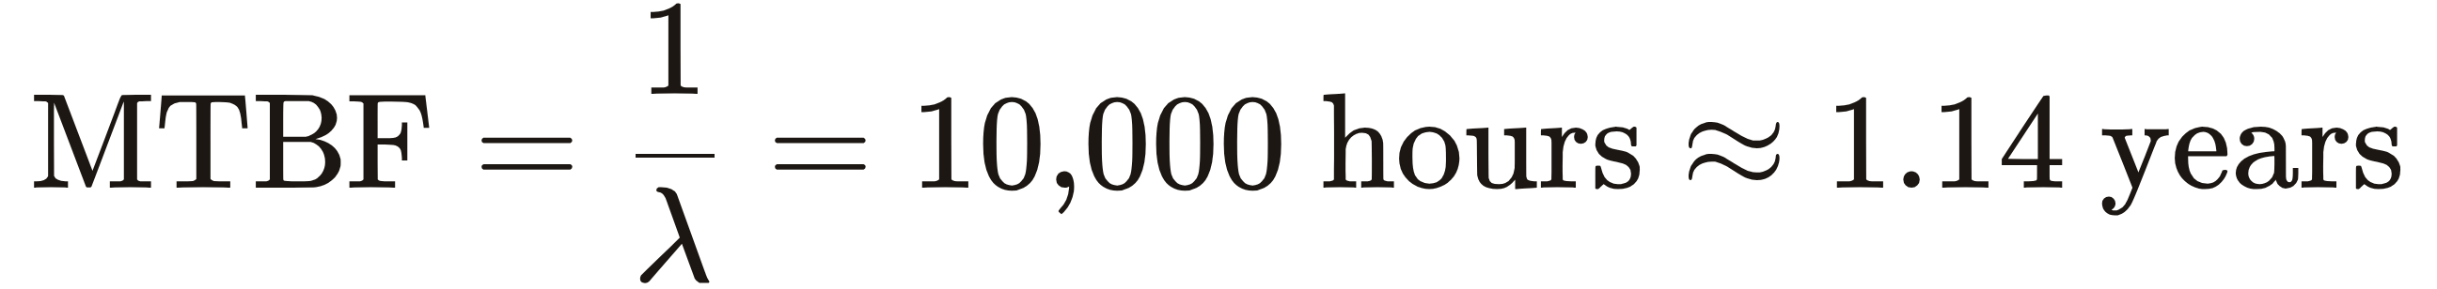

MODULE 02 — RELIABILITY 101 FOUNDATIONS
PINNACLE RELIABILITY · QRO DISPATCH
Failure Rate Worked Engineering Case Studies
Step-by-step calculations for single operating assets and multi-unit plant populations.
WORKED EXAMPLE 1
WORKED EXAMPLE 2
Single Continuous Asset
Fleet Population (50 Pumps)
An item operates continuously for 10,000 hours and experiences 1 failure.
A population of 50 pumps operates for 1 year and experiences 10 failures total.
MTBF EQUIVALENCY
FLEET MTBF
Key Takeaway: In homogeneous fleets, pooling operational hours across assets increases statistical sample size and dampens random variance.
MUSTHAQUE ALI · PINNACLE RELIABILITY · QRO METHODOLOGY DISPATCH
No. 17 / 80

Slide 18

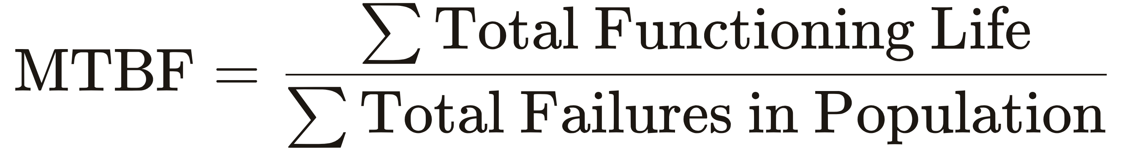
MODULE 02 — RELIABILITY 101 FOUNDATIONS
PINNACLE RELIABILITY · QRO DISPATCH
Mean Time Between Failure (MTBF)
Single asset tracking versus population fleet benchmarking.
Single Asset Formulation
Fleet Population Formulation
Used when tracking individual tag-level history in a CMMS (e.g. Boiler Feed Pump BFP-101 running 24,000 hours with 3 failure trips → MTBF = 8,000 hrs).
Used for asset class benchmarking (e.g. 100 fin-fan motors running 8,000 hrs each with 16 total failures → MTBF = 800,000 / 16 = 50,000 hrs).
THE FUNDAMENTAL INVERSE RELATIONSHIP: MTBF = 1 / λ
MUSTHAQUE ALI · PINNACLE RELIABILITY · QRO METHODOLOGY DISPATCH
No. 18 / 80

Slide 19
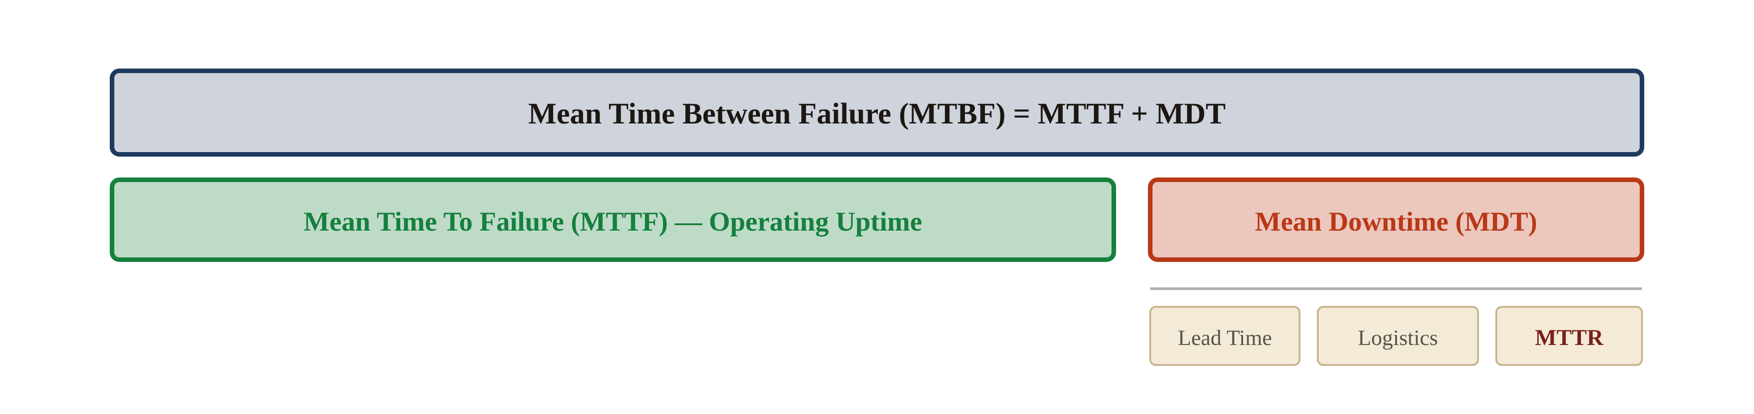
MODULE 02 — RELIABILITY 101 FOUNDATIONS
PINNACLE RELIABILITY · QRO DISPATCH
Mean Time Timeline: MTBF, MTTF, MDT, MTTR
Dissecting the chronological timeline from startup to full restoration.
FIG · ARCHITECTURE: MEAN TIME TIMELINE
MTTF
Pure operational uptime accumulated prior to failure trip.
For non-repairable parts, MTTF represents total lifecycle span.
MDT
Total elapsed clock time from trip event to 100% full-rate restart.
Includes diagnostic delay, parts logistics, wrench time, and startup.
MTTR
Net mechanical hands-on wrench time required by technicians.
Isolates maintenance efficiency independent of supply chain delays.
MUSTHAQUE ALI · PINNACLE RELIABILITY · QRO METHODOLOGY DISPATCH
No. 19 / 80

Slide 20
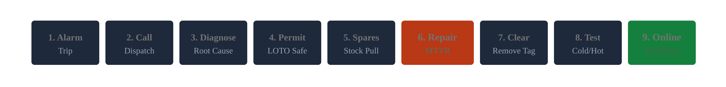
MODULE 02 — RELIABILITY 101 FOUNDATIONS
PINNACLE RELIABILITY · QRO DISPATCH
MDT 9-Stage Cycle & Worked Fan Example
The comprehensive 9-stage restoration cycle from trip to restart.
FIG · PIPELINE: 9-STAGE RESTORATION CYCLE
THE 9 CRITICAL RESTORATION STAGES
WORKED INDUCED DRAFT FAN CALCULATION
01 Request Repairs
06 Execute Repair (MTTR)
02 Dispatch Crew
07 Remove Lockout / Tags
03 Troubleshoot Root Cause
08 Cold & Hot Testing
04 LOTO & Work Permits
09 Restart Unit to Full Production Rate
4 bearing temperature trips caused 6.0 hours cumulative outage → MDT = 1.5 hrs.
05 Pull Warehouse Spares
MUSTHAQUE ALI · PINNACLE RELIABILITY · QRO METHODOLOGY DISPATCH
No. 20 / 80

Slide 21
SPECIAL DISPATCH SECTION III
No. III
Probability & Reliability Statistics
Weibull Parameter Dynamics, Bathtub Curves, Work Order Regressions & Financial Risk
WEIBULL Β Η Γ
EXPONENTIAL
BATHTUB CURVE
RISK = POF × COF
MUSTHAQUE ALI · PINNACLE RELIABILITY · QRO METHODOLOGY DISPATCH
No. 21 / 80

Slide 22

MODULE 03 — PROBABILITY & STATISTICS
PINNACLE RELIABILITY · QRO DISPATCH
Probability of Failure (POF) S-Curves
The cumulative failure distribution and the fundamental duality POF + R = 1.0.
NATURE OF THE POF FUNCTION
COMPLEMENTARY PARTITION LAW
Strictly Quantitative: A bounded real number: 0.00% ≤ POF(t) ≤ 100.00%.
Cumulative Probability: Probability that failure occurs on or before future date t.
Non-Decreasing S-Curve: For wear-out modes, POF accelerates near characteristic life.
Dynamic Recalibration: In QRO, the curve shifts left if corrosion accelerates or right if operating conditions improve.
At any point in time, an asset has either failed or survived. The two outcomes form a complete, mutually exclusive probability partition of the sample space.
Survival and failure probabilities always sum to unity across the mission horizon.
MUSTHAQUE ALI · PINNACLE RELIABILITY · QRO METHODOLOGY DISPATCH
No. 22 / 80

Slide 23


MODULE 03 — PROBABILITY & STATISTICS
PINNACLE RELIABILITY · QRO DISPATCH
Exponential Distribution (Constant Hazard Rate)
The memoryless property governing random industrial failures.
The Memoryless Property
Industrial Applicability
An asset following an Exponential distribution does not age. An asset that has survived 10 years has the exact same probability of failing in the next hour as a brand-new asset just installed.
Applies to electronic cards, microchips, pressure relief valves, and assets subjected to purely random external shocks such as lightning strikes and power-grid dips.
MUSTHAQUE ALI · PINNACLE RELIABILITY · QRO METHODOLOGY DISPATCH
No. 23 / 80

Slide 24
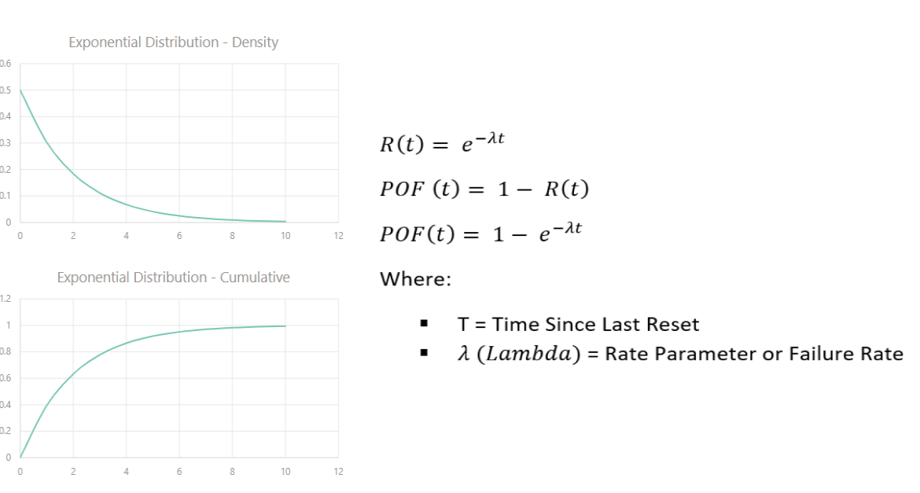
MODULE 03 — PROBABILITY & STATISTICS
PINNACLE RELIABILITY · QRO DISPATCH
Developing Exponential Distributions from Work Orders
Extracting empirical failure rates from CMMS work order history.
1
Query Work Orders
FIG · EXPONENTIAL DISTRIBUTION: DENSITY & CUMULATIVE POF
Extract completed CMMS corrective work orders.
Tabulate true operating runtime between consecutive failures.
2
Calculate MTTF
Compute arithmetic mean operating lifespan.
Validates whether hazard exhibits memoryless behavior.
3
Invert for λ
Invert MTTF to obtain annual hazard rate: λ = 1 / MTTF.
Establishes baseline failure intensity for RAM models.
MUSTHAQUE ALI · PINNACLE RELIABILITY · QRO METHODOLOGY DISPATCH
No. 24 / 80

Slide 25
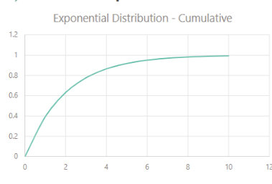
MODULE 03 — PROBABILITY & STATISTICS
PINNACLE RELIABILITY · QRO DISPATCH
Developing Exponential Distribution from Work Order History
Extracting empirical failure rates from CMMS work order history to parameterize λ.
FIG · CMMS FAILURE HISTORY TO EXPONENTIAL DISTRIBUTION WORKFLOW
Failure History
Calculate Failure Rate
Generate Distribution
Asset | Life (Years)
Asset 101 | 5.7
Asset 101 | 3.2
Asset 101 | 9.1
... | ...
1. Calculate Mean Time to Failure
MTTF = Σ (Operating Life) / Total Events
2. Calculate Failure Rate (λ)
Failure Rate (# Events/Year) = 1 / MTTF
CMMS Work Orders:
Queries logged maintenance records to measure elapsed runtime between unscheduled outages.
Constant Hazard Assumption:
λ remains constant over operating duration, modeling memoryless failure mechanisms.
Cumulative CDF:
F(t) = 1 - exp(-λt). Predicts cumulative failure probability over 1 to 12 years.
MUSTHAQUE ALI · PINNACLE RELIABILITY · QRO METHODOLOGY DISPATCH
No. 25 / 80

Slide 26
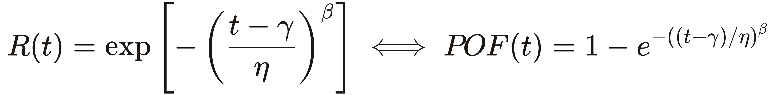
MODULE 03 — PROBABILITY & STATISTICS
PINNACLE RELIABILITY · QRO DISPATCH
Weibull Distribution: 3-Parameter Formulation
The universal distribution governing physical degradation and wear-out.
η
Eta — Scale / Life
β
Beta — Shape
γ
Gamma — Location
Characteristic Life. The time at which 63.2% of the population will have failed.
Defines the failure mode: β<1 infant mortality; β=1 random; β>1 wear-out.
Failure-free life. Minimum threshold time before which zero failures can physically occur.
Why Weibull is King: By simply varying β, the Weibull distribution can mathematically mimic the Exponential (β = 1), the Normal / Gaussian (β ≈ 3.5), or skewed lognormal distributions — making it universal for all physical assets.
MUSTHAQUE ALI · PINNACLE RELIABILITY · QRO METHODOLOGY DISPATCH
No. 26 / 80

Slide 27
MODULE 03 — PROBABILITY & STATISTICS
PINNACLE RELIABILITY · QRO DISPATCH
Simulator: Weibull Shape (Beta) Dynamics
How the hazard-rate curve changes behavior as the shape parameter β varies.
WEIBULL SHAPE CONTROLLER
Weibull Beta (β)
β = 1.00
0.5 Infant
3.5 Wear-out
Active Behavior: Random Shocks / Exponential (Constant Hazard Rate)
1
β < 1.0 — Infant Mortality
Decreasing failure rate. Time-based overhauls introduce assembly errors. Focus on burn-in & install QA.
2
β = 1.0 — Random Shocks
Constant failure rate. Overhauls do not extend life. Focus on condition monitoring & redundancy.
3
β > 1.0 — Wear-Out
Increasing failure rate: wear, erosion, corrosion. Scheduled overhaul / replacement is highly effective.
MUSTHAQUE ALI · PINNACLE RELIABILITY · QRO METHODOLOGY DISPATCH
No. 27 / 80

Slide 28
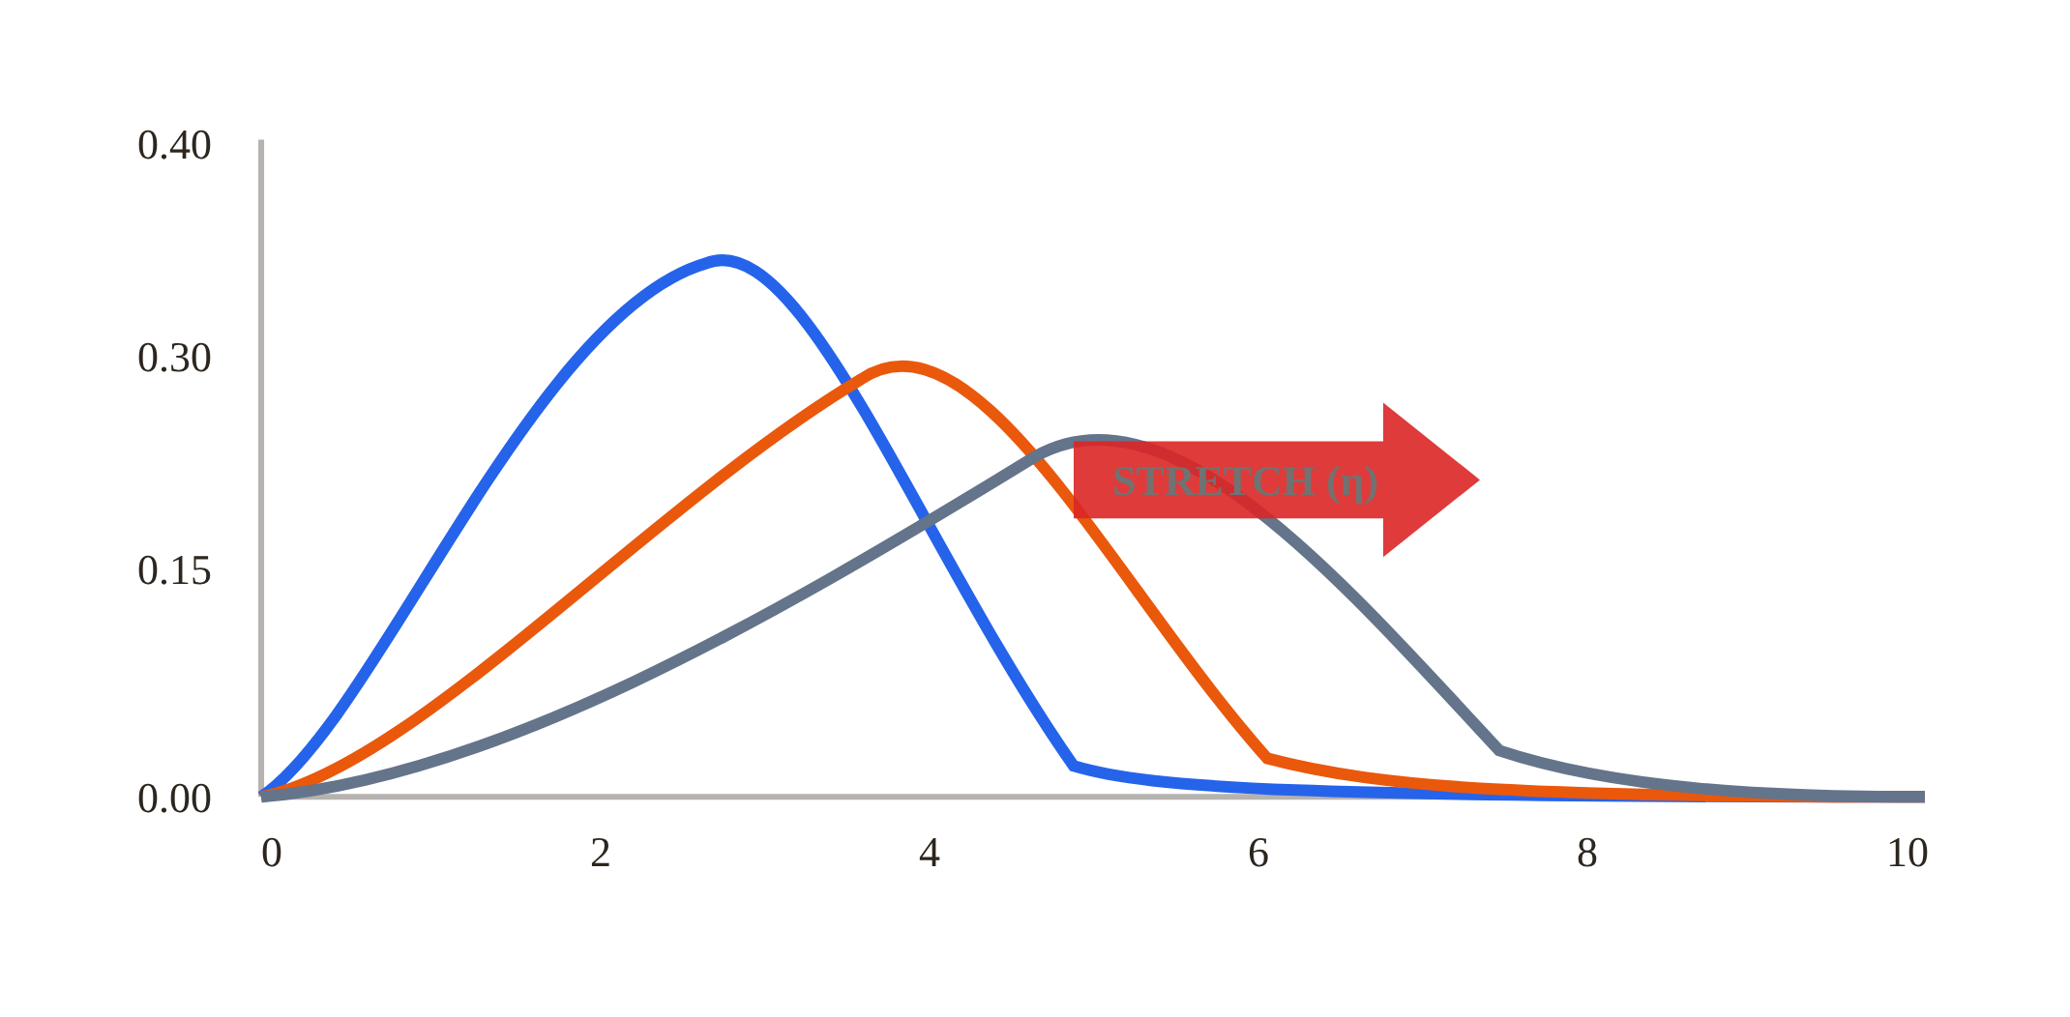
MODULE 03 — PROBABILITY & STATISTICS
PINNACLE RELIABILITY · QRO DISPATCH
Effects of Changing Eta (Scale Parameter η)
Characteristic life determines the horizontal spread of the failure distribution.
FIG · ETA (SCALE PARAMETER Η)
ENGINEERING INSIGHT
Increasing η shifts the distribution peak to the right and stretches the curve, representing extended operating life resulting from superior metallurgy or cleaner lubrication.
SIGNIFICANCE OF ETA (η)
Characteristic Life: Time t = η where F(η) = 1 − e⁻¹ = 63.2% of all assets fail, regardless of β.
Scale Stretching: Increasing η stretches the curve rightward, modeling improved metallurgy or maintenance.
Dimensional Units: η carries the same physical units as time (hours, cycles, revolutions).
η = 3 Years (Narrower Spread)
η = 4 Years (Intermediate Scale)
η = 5 Years (Extended Life)
MUSTHAQUE ALI · PINNACLE RELIABILITY · QRO METHODOLOGY DISPATCH
No. 28 / 80

Slide 29
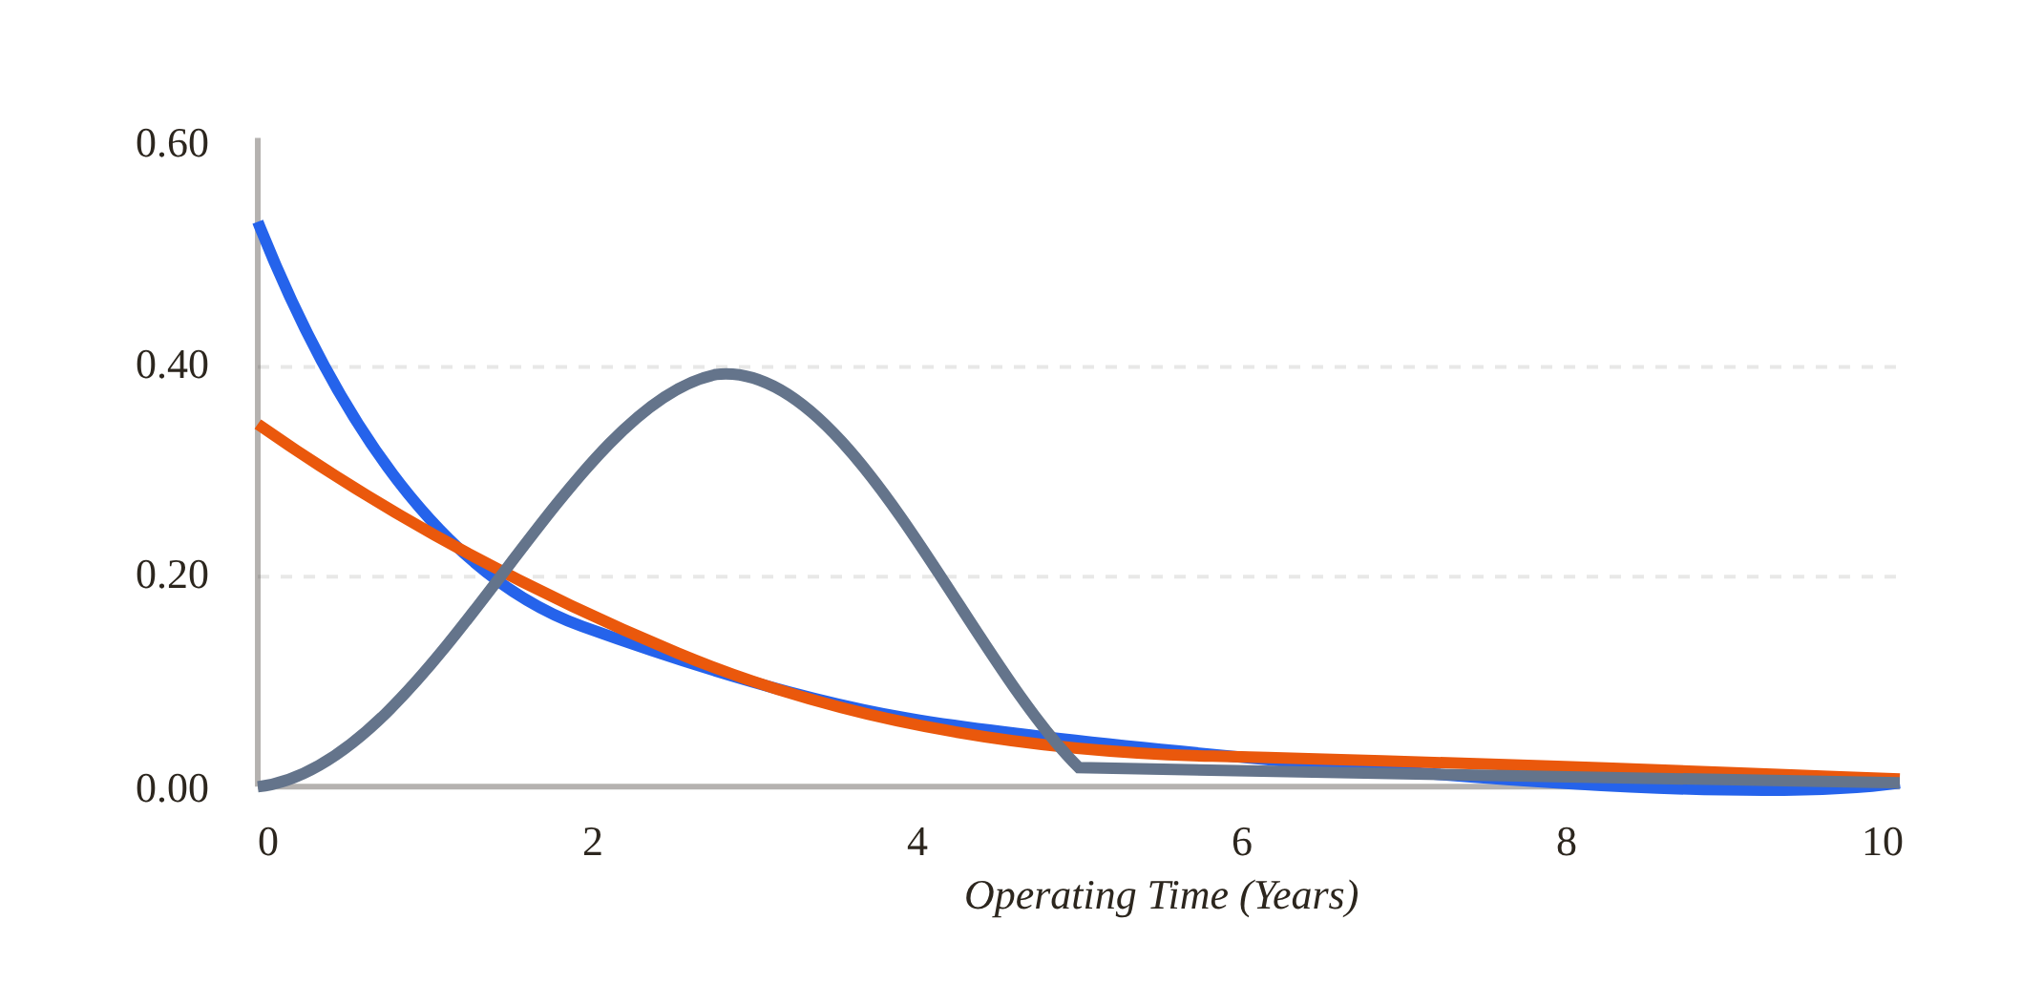
MODULE 03 — PROBABILITY & STATISTICS
PINNACLE RELIABILITY · QRO DISPATCH
Effects of Changing Beta (Shape Parameter β)
The shape parameter dictates whether failure is infant mortality, random, or wear-out.
FIG · BETA (SHAPE PARAMETER Β)
ENGINEERING INSIGHT
Transitioning from β<1 (steep early drop) to β=1 (smooth exponential) to β>1 (bell-shaped wear-out peak) radically alters the appropriate maintenance strategy.
THE THREE OPERATIONAL REGIMES
β < 1 (Infant Mortality): Decreasing rate; manufacturing defects, poor installation, commissioning errors.
β = 1.0 (Random): Constant rate; external shocks, electrical surges, foreign-object ingestion.
β > 1 (Wear-Out): Increasing rate; β≈1.5 moderate fatigue, β≥3.4 approaches Gaussian.
β < 1.0: Infant Mortality (Decreasing Rate)
β = 1.0: Random Exponential (Constant Rate)
β > 1.0: Wear-Out (Increasing Rate)
MUSTHAQUE ALI · PINNACLE RELIABILITY · QRO METHODOLOGY DISPATCH
No. 29 / 80

Slide 30
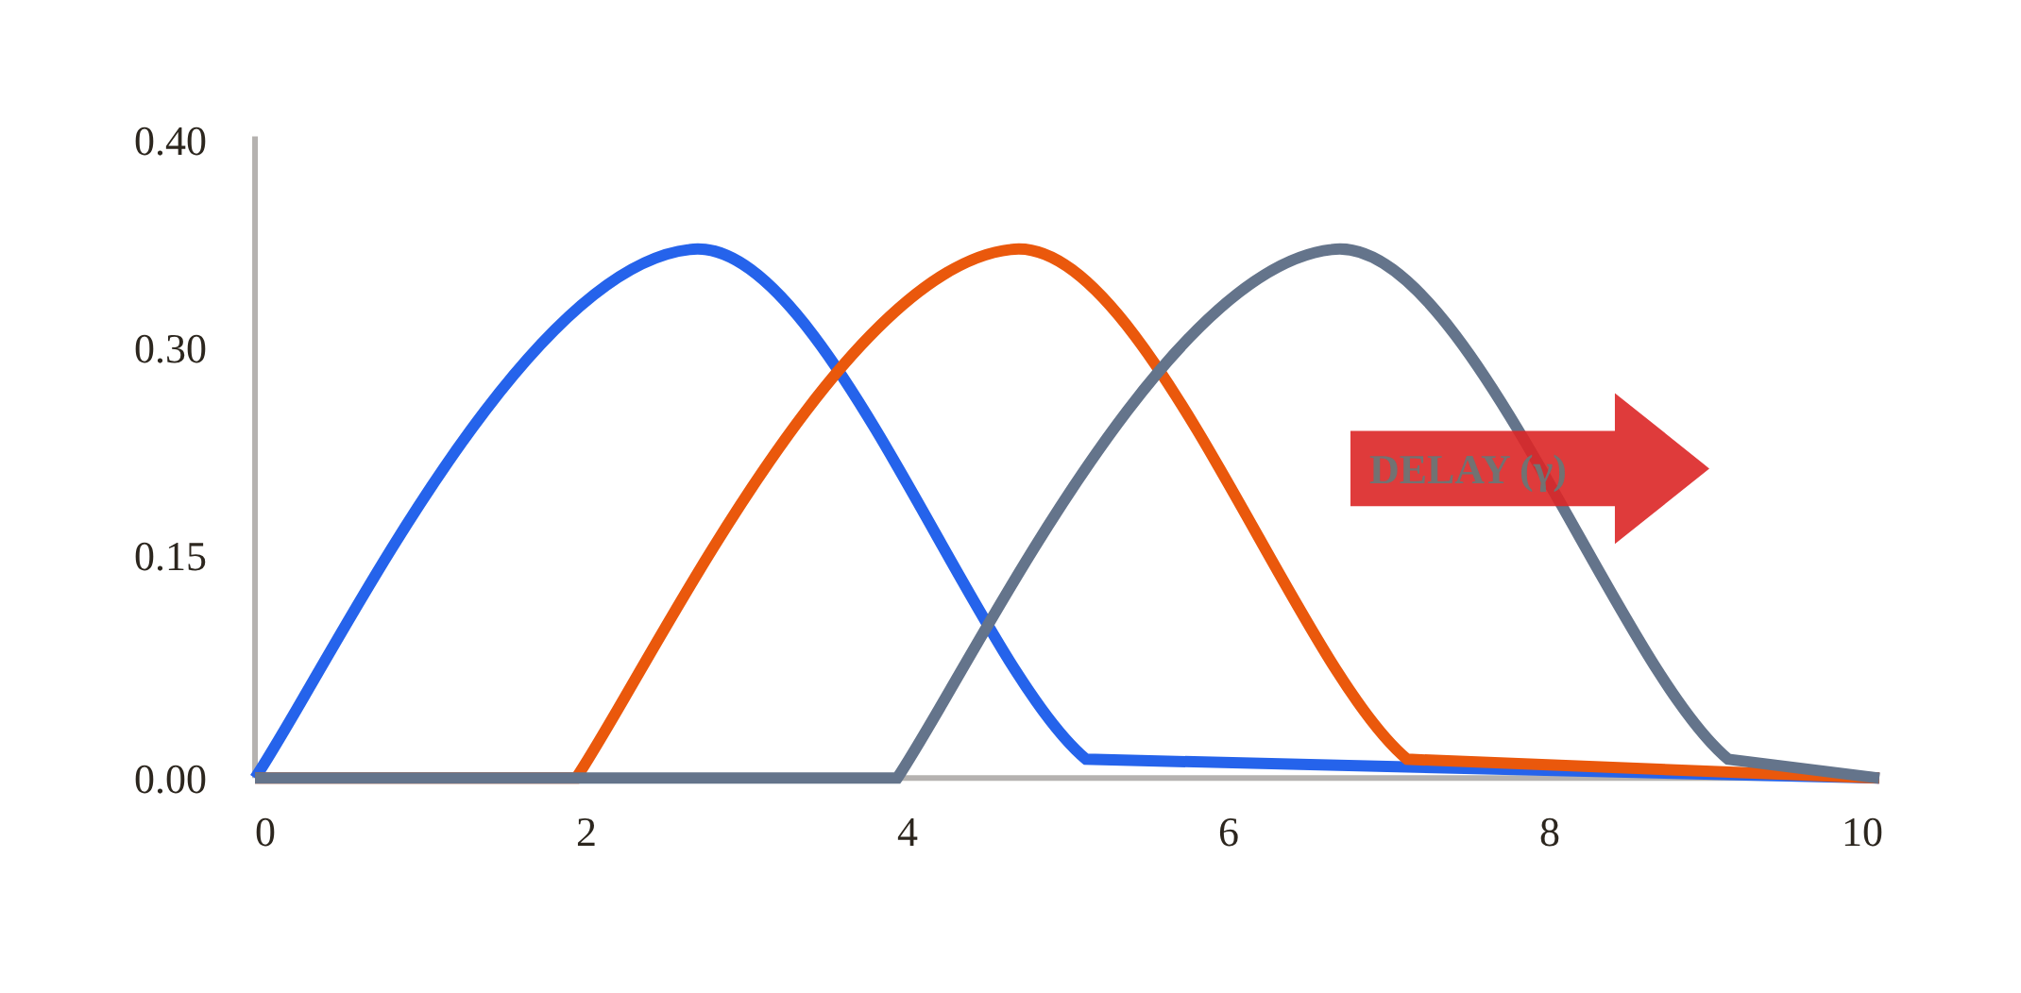
MODULE 03 — PROBABILITY & STATISTICS
PINNACLE RELIABILITY · QRO DISPATCH
Effects of Changing Gamma (Location Parameter γ)
Guaranteed failure-free operating life and corrosion allowance delay.
FIG · GAMMA (LOCATION PARAMETER Γ)
ENGINEERING INSIGHT
γ is the location parameter. Failures cannot occur physically before t = γ. In piping, heavy nominal walls guarantee zero failure risk during early operating years.
FAILURE-FREE LIFE (γ)
Absolute Zero Probability: When t < γ, P(Failure) = 0. Degradation cannot cause loss before γ.
Protective Barriers: Models coatings, corrosion inhibitors, or minimum corrosion allowances before metal attack.
Rigid Translation: Shifting γ moves the distribution bodily along the time axis without changing width or shape.
γ = 0 Years (Failures Can Begin At Startup)
γ = 2 Years (Guaranteed Failure-Free)
γ = 4 Years (Corrosion Allowance Delay)
MUSTHAQUE ALI · PINNACLE RELIABILITY · QRO METHODOLOGY DISPATCH
No. 30 / 80

Slide 31
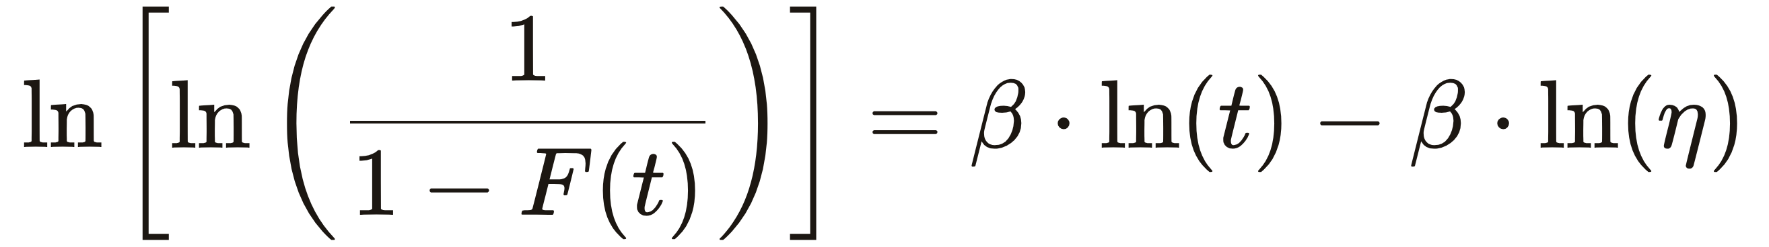
MODULE 03 — PROBABILITY & STATISTICS
PINNACLE RELIABILITY · QRO DISPATCH
Weibull Regression from Work Order History
Linearizing the Weibull cumulative equation via double natural logarithm.
Slope = Shape Parameter (β)
The gradient of the best-fit line directly yields β, revealing the empirical failure mechanism from field data.
X-Intercept = Scale (η)
Horizontal Intercept: Directly calculates characteristic life η from the linearized regression fit line.
MUSTHAQUE ALI · PINNACLE RELIABILITY · QRO METHODOLOGY DISPATCH
No. 31 / 80

Slide 32
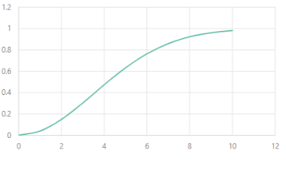
MODULE 03 — PROBABILITY & STATISTICS
PINNACLE RELIABILITY · QRO DISPATCH
Developing Weibull Distribution from Work Order History
Transforming historical time-to-failure observations into cumulative Weibull parameters.
FIG · WEIBULL PARAMETER ESTIMATION WORKFLOW FROM WORK ORDER HISTORY
Failure History
Regression Analysis
Weibull Distribution
Asset | Life (Years)
Asset 101 | 5.7
Asset 101 | 3.2
Asset 101 | 9.1
... | ...
Double Natural Log Linearization
ln(-ln(1 - F(t))) = β·ln(t) - β·ln(η)
Estimated Parameters:
• Slope = Shape (β): Dictates wear-out rate
• Intercept = Scale (η): Characteristic life
• R² Correlation: Goodness-of-fit metric
Historical Lifespans:
Chronological operating runtime observed between consecutive corrective maintenance interventions.
Cumulative S-Curve:
F(t) = 1 - exp(-(t/η)^β). Governs wear-out acceleration and predictive replacement timing.
MUSTHAQUE ALI · PINNACLE RELIABILITY · QRO METHODOLOGY DISPATCH
No. 32 / 80

Slide 33

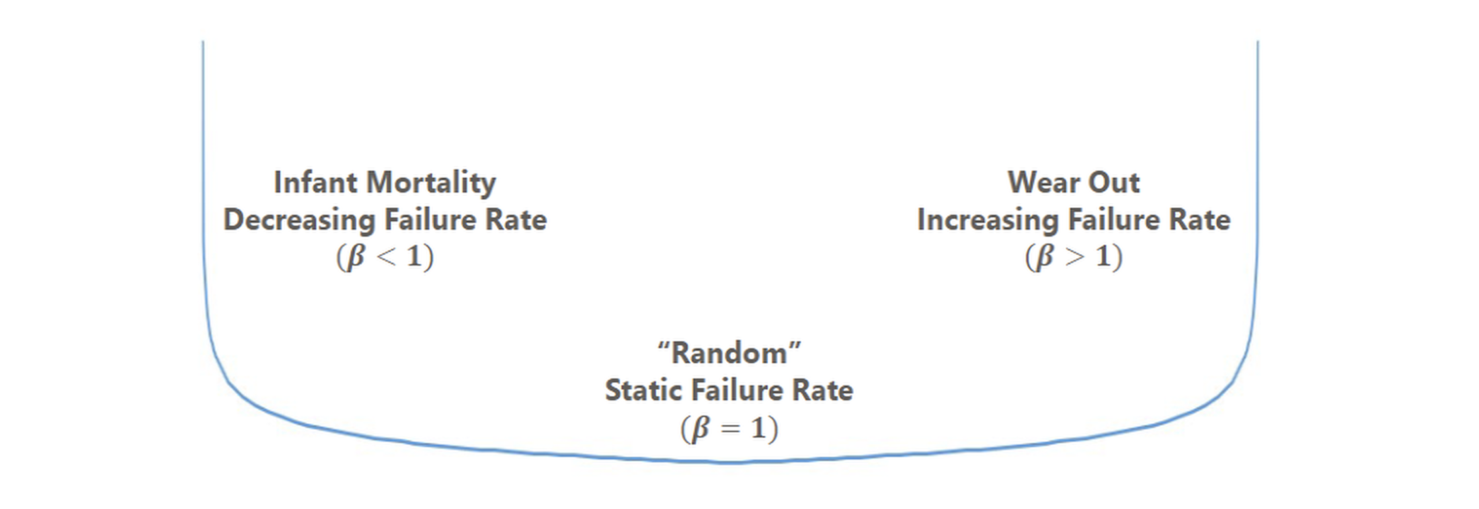
MODULE 03 — PROBABILITY & STATISTICS
PINNACLE RELIABILITY · QRO DISPATCH
The Classical Bathtub Curve & Associated Beta Values
Three distinct physical failure regions across the equipment operating lifecycle.
FIG · THE CLASSICAL BATHTUB CURVE
The QRO Reality: Nowlan & Heap aviation studies proved only ~11% of equipment follows classical wear-out; 89% exhibits random or infant-mortality patterns.
ACTIONABLE PROTOCOLS BY ZONE
Zone I (Burn-In): Factory acceptance testing, strict installation checklists, enhanced first-30-day vibration monitoring.
Zone II (Useful Life): Periodic condition monitoring, lube sampling, operating within design envelopes.
Zone III (Wear-Out): Planned overhaul, seal replacement, capital retubing timed before exponential risk escalation.
ZONE I
Burn-In
ZONE II
Useful Life
ZONE III
Wear-Out
MUSTHAQUE ALI · PINNACLE RELIABILITY · QRO METHODOLOGY DISPATCH
No. 33 / 80

Slide 34
MODULE 03 — PROBABILITY & STATISTICS
PINNACLE RELIABILITY · QRO DISPATCH
Quantified Financial Risk: Risk = POF × COF
Real-time calculation of annualized monetized risk against corporate ceilings.
RISK MATRIX ENGINE
LIVE
Probability of Failure (POF)
15.0 %
0.1%
100%
Consequence of Failure (COF)
$500,000
$10k
$1M
✓ Within Acceptable Operating Risk Ceiling
ANNUALIZED MONETARY RISK
$ 75,000
MUSTHAQUE ALI · PINNACLE RELIABILITY · QRO METHODOLOGY DISPATCH
No. 34 / 80

Slide 35
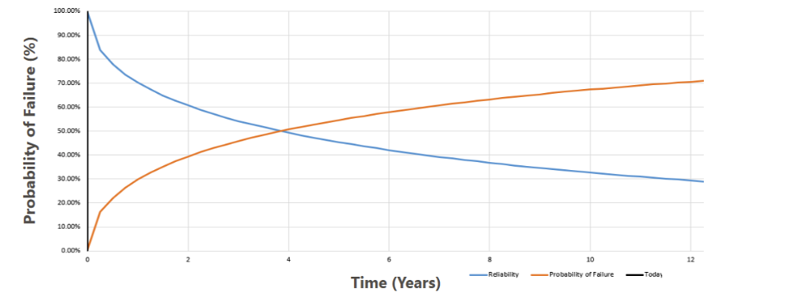
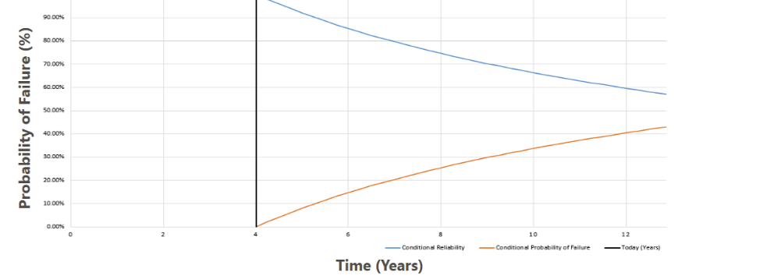
MODULE 03 — PROBABILITY & STATISTICS
PINNACLE RELIABILITY · QRO DISPATCH
Conditional Reliability
Dynamic reassessment of failure probabilities given proven asset survival to time t.
• Sometimes we want to know the expected reliability for an asset, given it has successfully and verifiably functioned properly for some period time already, or its Conditional Reliability.
• This is particularly useful in the case of infant mortality mentioned earlier, as once a certain amount of time has passed, the likelihood of failure drops significantly providing a more realistic estimate of the asset's probability of failure going forward.
FIG · BASELINE RELIABILITY & PROBABILITY OF FAILURE (FROM T=0)
FIG · CONDITIONAL RELIABILITY REASSESSED AT TODAY (T=4 YEARS)
MUSTHAQUE ALI · PINNACLE RELIABILITY · QRO METHODOLOGY DISPATCH
No. 35 / 80

Slide 36
SPECIAL DISPATCH SECTION IV
No. IV
QRO Core Methodology
Asset Risk Analysis (ARA), Lifetime Variability Curves (LVC) & Bayesian Prior Integration
ARA WORKFLOW
LVC ARCHITECTURE
BAYESIAN UPDATING
COF QUANTIFICATION
MUSTHAQUE ALI · PINNACLE RELIABILITY · QRO METHODOLOGY DISPATCH
No. 36 / 80

Slide 37




MODULE 04 — QRO CORE METHODOLOGY
PINNACLE RELIABILITY · QRO DISPATCH
The Four Fundamental Pillars of QRO
The overarching operational framework for plant-wide reliability optimization.
1. Asset Risk Analysis
2. Quantifying Uncertainty
Quantitative FMEA: Maps component degradation to functional failure modes.
Telemetry Ingestion: Connects to process historians & vibration streams.
Consequence Modeling: Quantifies business loss across production, HSE, repair.
LVC Stochastic Models: Replaces static lines with probabilistic envelopes.
Extreme Value Analysis: Models localized tail risks for pinhole leaks.
Bayesian Updating: Recalculates remaining life as NDE inspections arrive.
3. Availability Forecasts
4. Task Optimization
Markov State Machines: Simulates operating, degraded, trip & repair states.
Dynamic Uptime Engine: Predicts availability across 1, 3 & 5-year cycles.
Bottleneck Isolation: Quantifies unspared system dependencies.
Benefit-Cost Ratio: Justifies every dollar of inspection & PM spend.
Task Effectiveness (QTE): Calibrates how work orders modify η & β.
Turnaround Grouping: Clusters compatible tasks into scheduled outages.
MUSTHAQUE ALI · PINNACLE RELIABILITY · QRO METHODOLOGY DISPATCH
No. 37 / 80

Slide 38
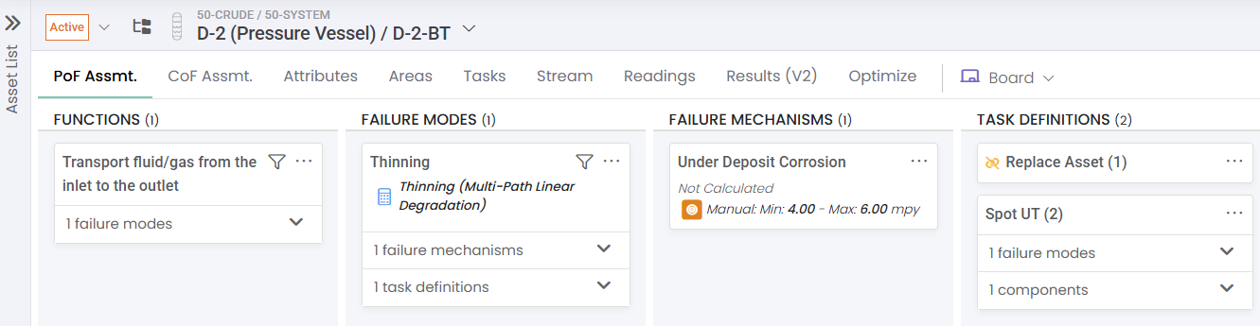
MODULE 04 — QRO CORE METHODOLOGY
PINNACLE RELIABILITY · QRO DISPATCH
Pillar 1: Asset Risk Analysis (ARA) Workflow
The 5-tier quantitative hierarchy connecting telemetry to maintenance decisions.
FIG · ASSET RISK ANALYSIS (ARA) — NEWTON SOFTWARE
1
2
3
4
5
Tier 1: Asset Functions
Tier 2: Failure Modes
Tier 3: Damage Mechanisms
Tier 4: Telemetry & CML
Tier 5: Maintenance Tasks
Defines operating envelope (e.g. deliver 450 m³/hr at 65 bar).
Total loss of flow, internal recirculation, or containment breach.
Root physical degradation: cavitation erosion, acid corrosion, fatigue.
DCS spectra (1X/2X vibration) and UT thickness readings.
Impeller overhaul, chemical wash injection automation.
Core Engineering Rule: Every CMMS maintenance task must tie directly to an active Tier 3 damage mechanism and a measurable Tier 4 telemetry stream.
MUSTHAQUE ALI · PINNACLE RELIABILITY · QRO METHODOLOGY DISPATCH
No. 38 / 80

Slide 39
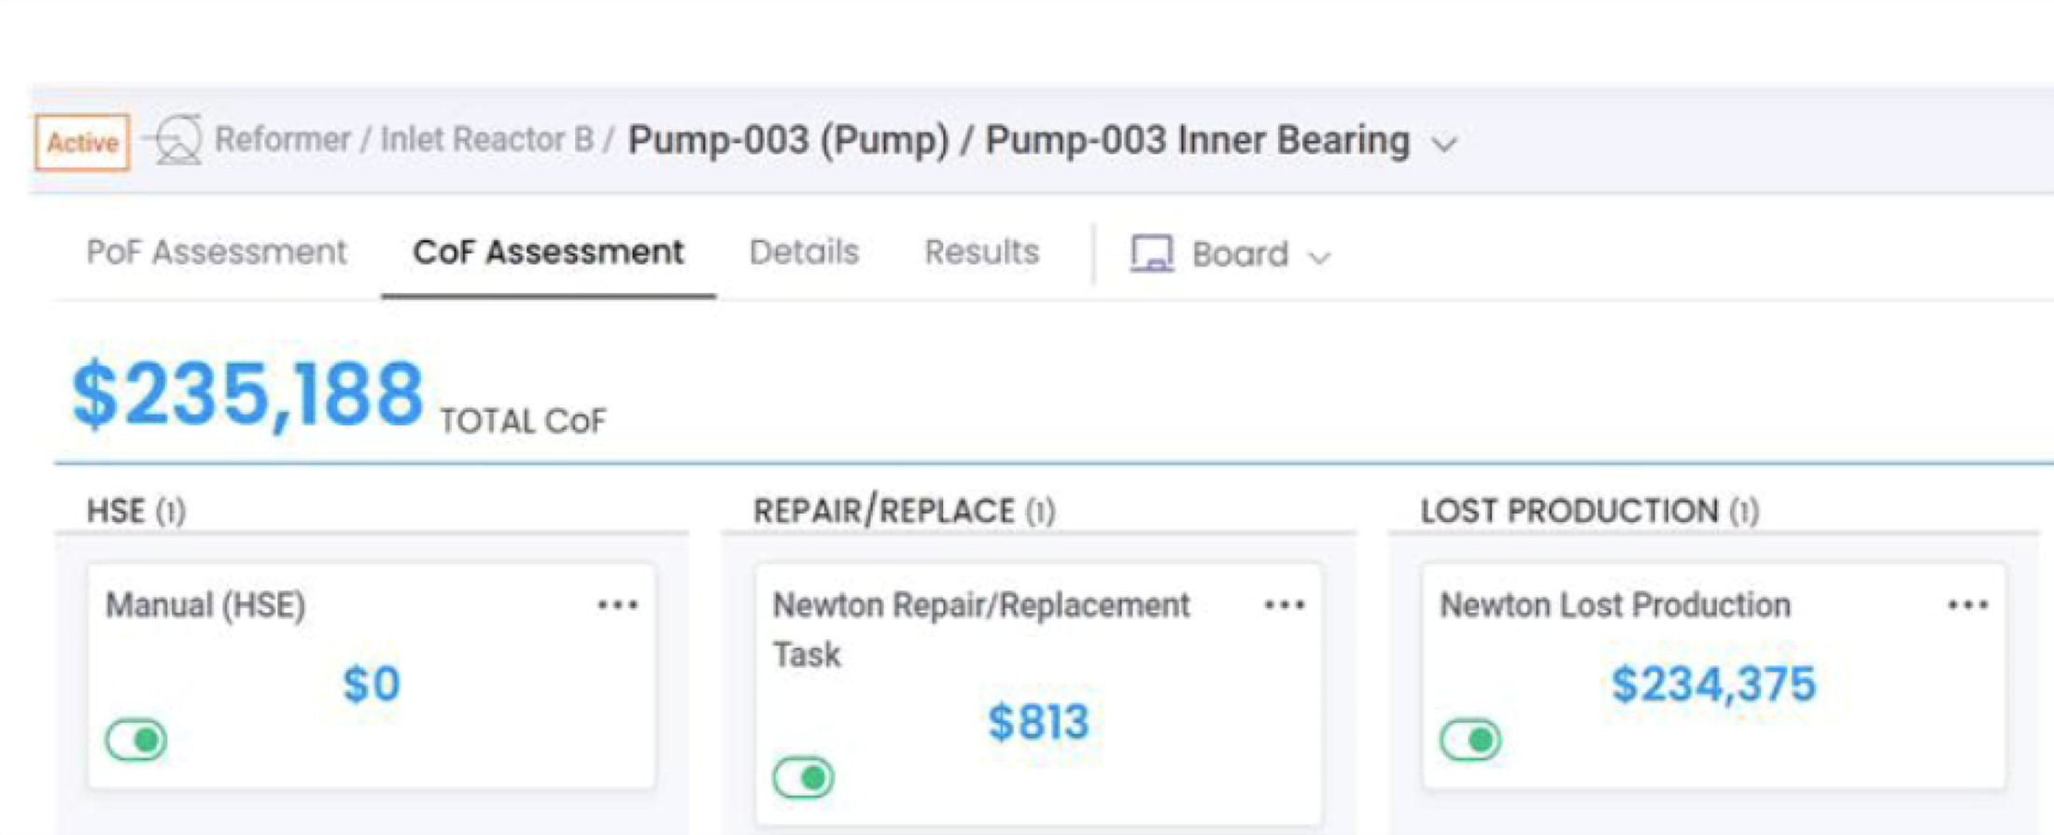
MODULE 04 — QRO CORE METHODOLOGY
PINNACLE RELIABILITY · QRO DISPATCH
Consequence of Failure (COF): Financial Quantification
Dissecting the 5 cost drivers in the worked $235,188 case study.
TOTAL MONETIZED CONSEQUENCE
FIG · NEWTON COF ASSESSMENT — TOTAL $235,188
$ 235,188
Lost Production Margin
$234,375 (99.7%)
Hardware Replacement Parts
$813 (0.3%)
Safety & Environmental (HSE)
$0 (No breach)
MUSTHAQUE ALI · PINNACLE RELIABILITY · QRO METHODOLOGY DISPATCH
No. 39 / 80

Slide 40
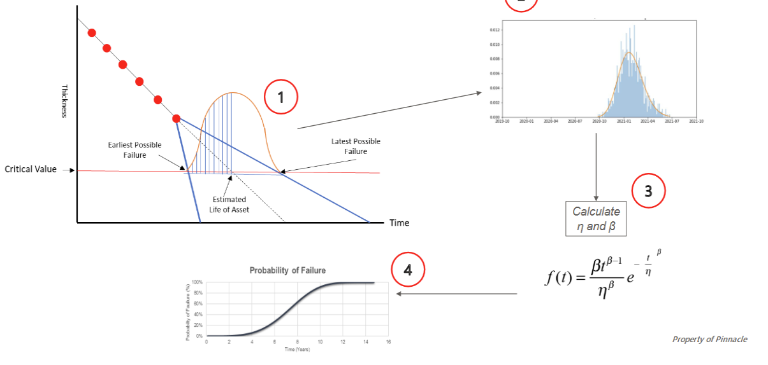
MODULE 04 — QRO CORE METHODOLOGY
PINNACLE RELIABILITY · QRO DISPATCH
Pillar 2: Lifetime Variability Curve (LVC) Architecture
Stochastic degradation modeling with dynamic Bayesian confidence envelopes.
FIG · LVC CONCEPT: THINNING UNCERTAINTY & POF DERIVATION
LVC Principle: As UT readings arrive, the uncertainty band narrows, dynamically updating the POF S-curve and shifting the true MTTF.
MECHANICS & BAYESIAN UPDATING
1
Expanding Uncertainty Cone: Degradation uncertainty naturally expands with forward time if no new telemetry is gathered.
2
Retirement Limit Intersection: Date where the lower confidence bound intersects t_crit = 0.19 in defines earliest risk breach.
3
Bayesian Contraction: Each new thickness measurement collapses the distribution variance, moving MTTF out by years.
MUSTHAQUE ALI · PINNACLE RELIABILITY · QRO METHODOLOGY DISPATCH
No. 40 / 80

Slide 41
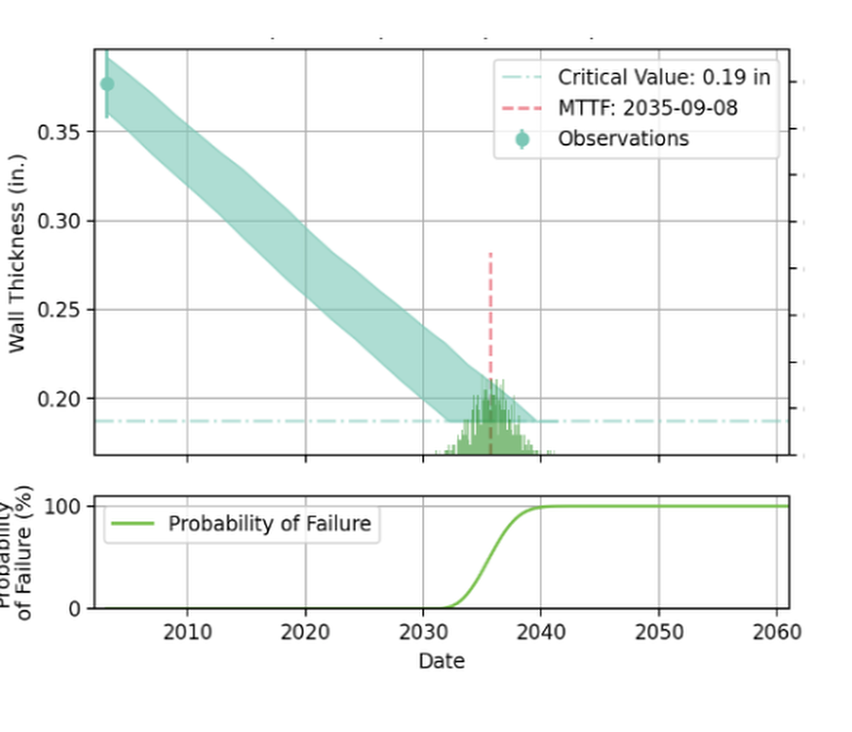
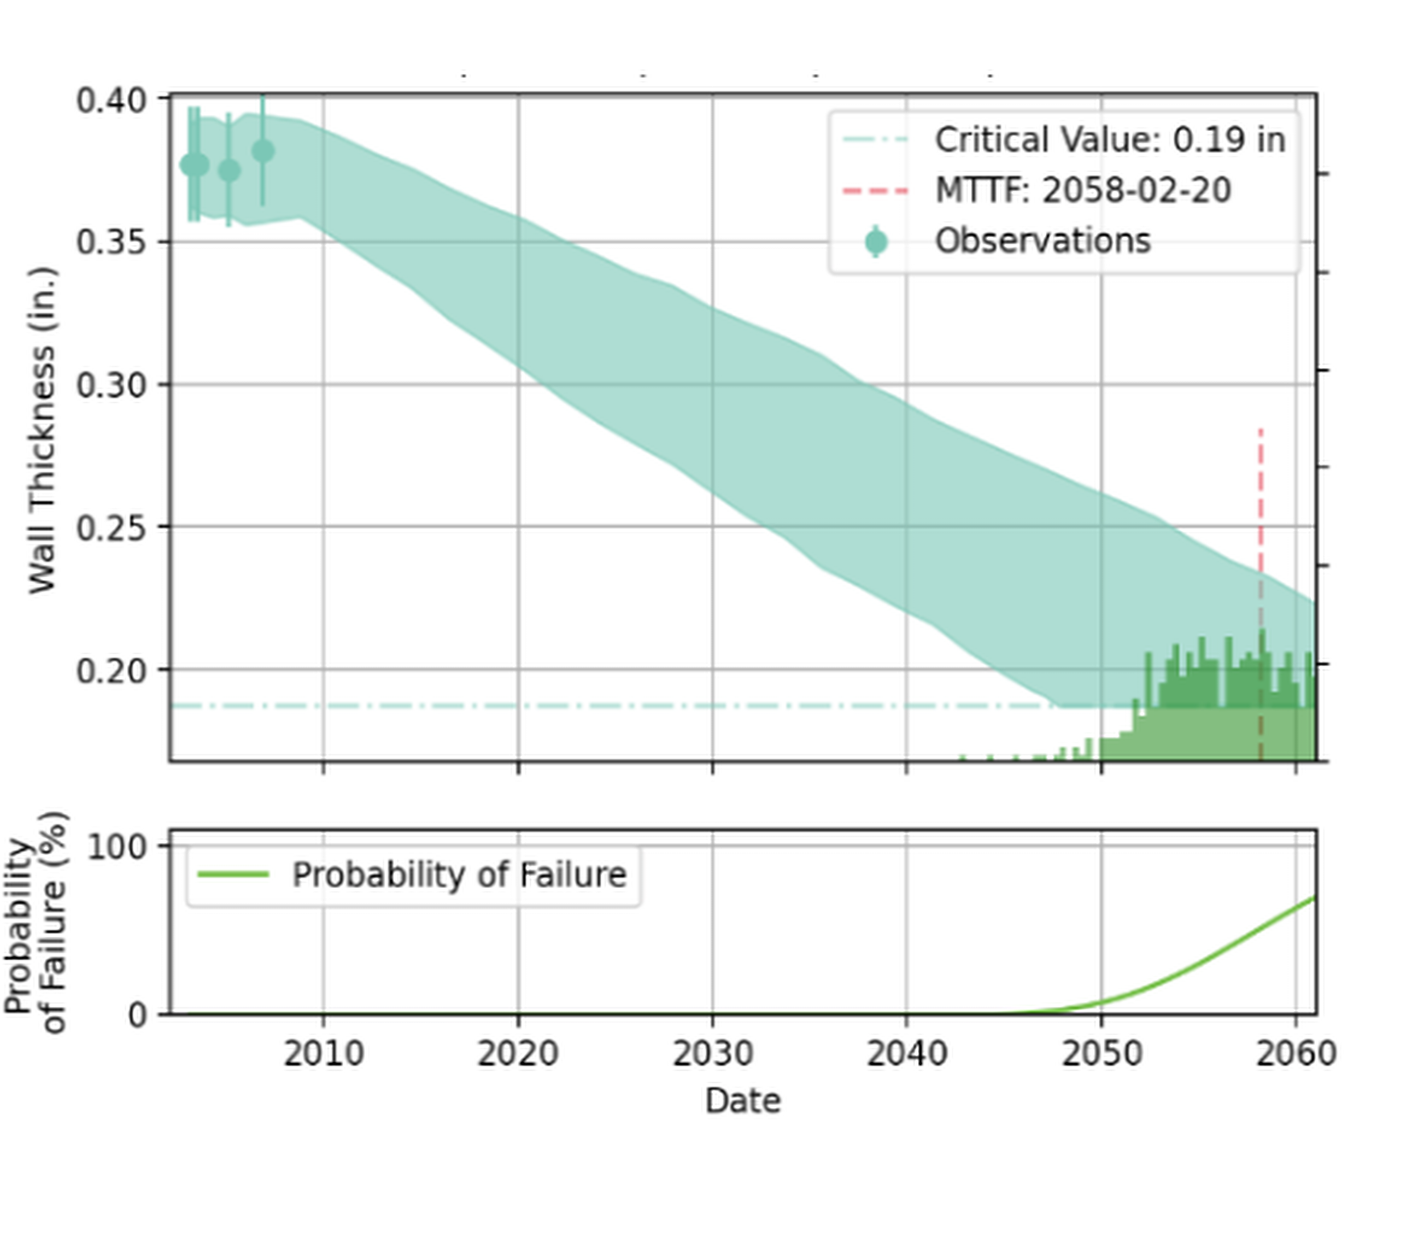
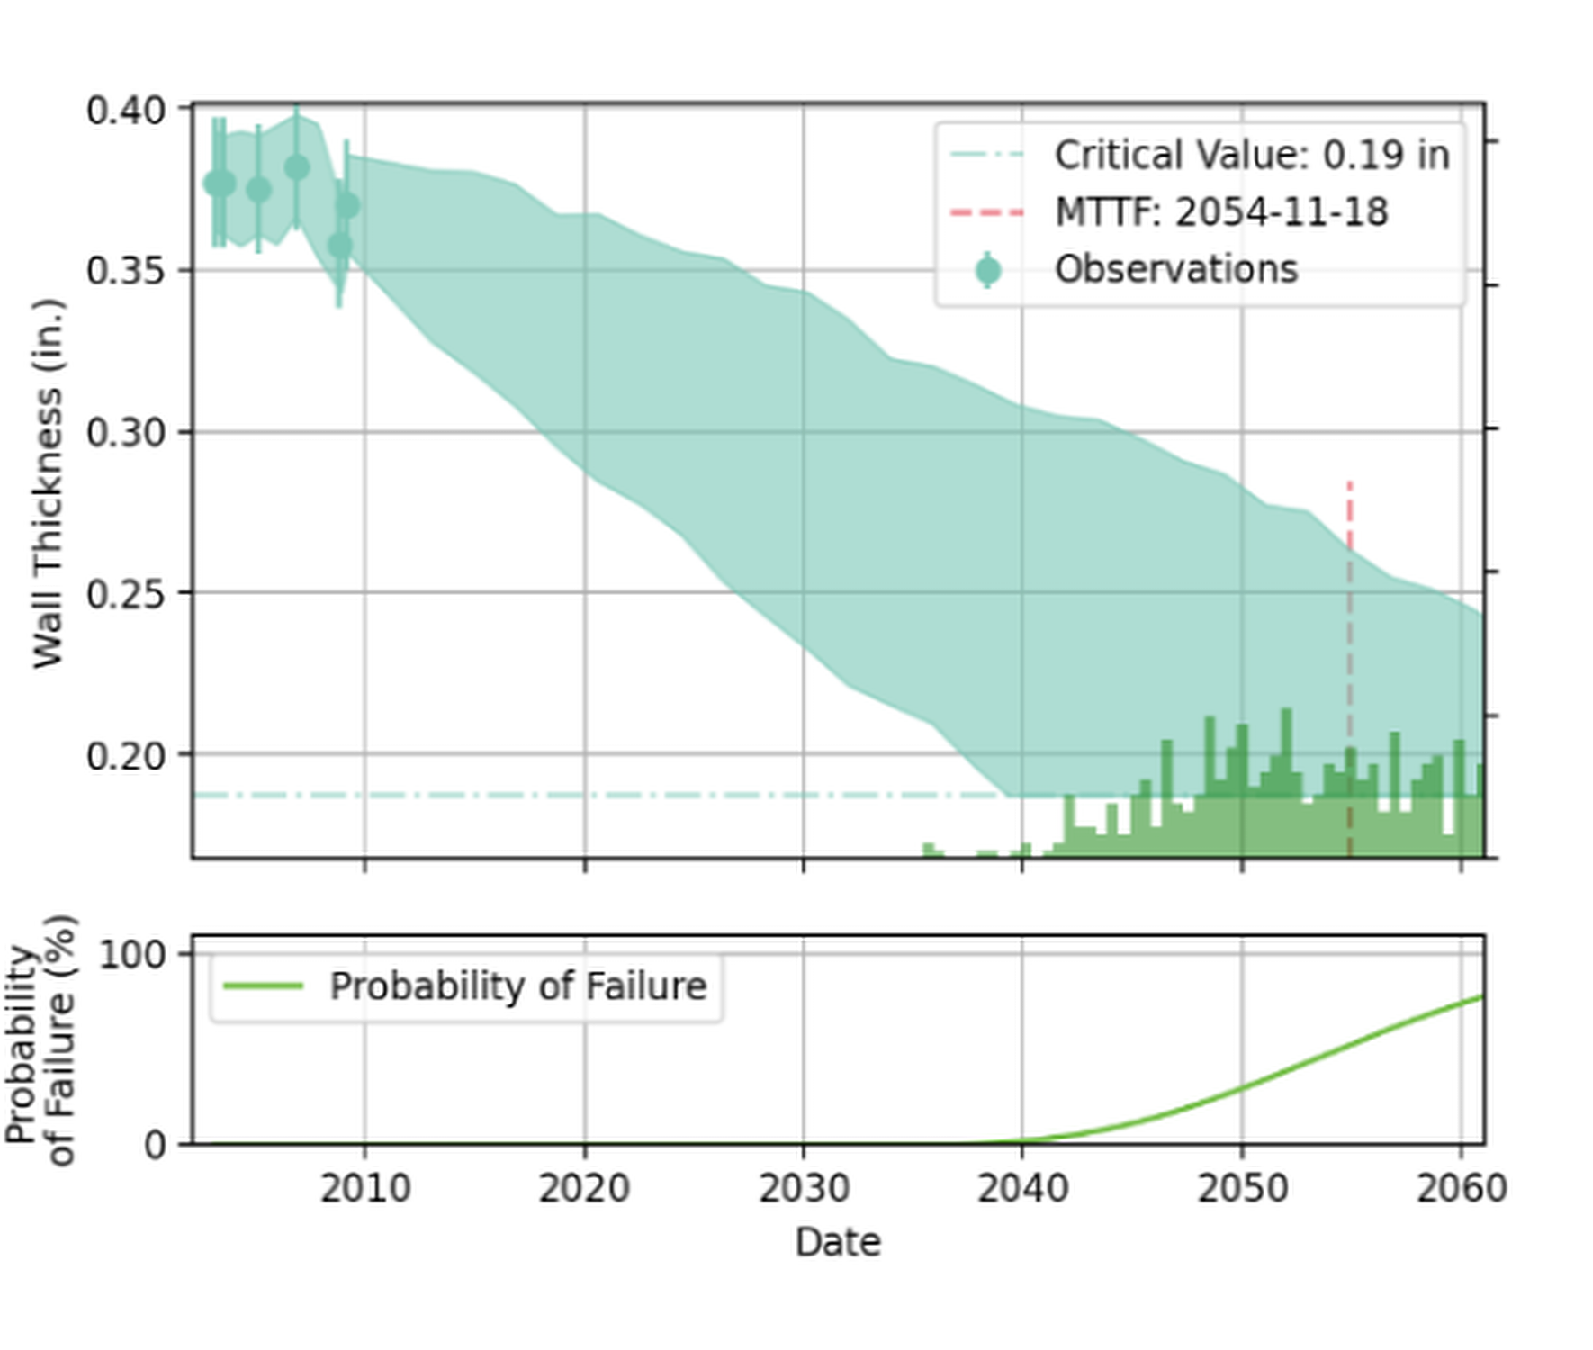
MODULE 04 — QRO CORE METHODOLOGY
PINNACLE RELIABILITY · QRO DISPATCH
LVC Case Studies: CML Thinning Data Evolution
Observing MTTF extension as additional ultrasonic data points are recorded.
1. Baseline
2. New Reading
3. Confirmed Mild
MTTF: 2035-09-08
MTTF: 2058-02-20
MTTF: 2054-11-18
Wide initial uncertainty band from nominal wall and one baseline UT point.
Slope recalibrates; uncertainty contracts, extending safe operating life.
Corrosion confirmed milder than design, safely deferring turnaround entry.
MUSTHAQUE ALI · PINNACLE RELIABILITY · QRO METHODOLOGY DISPATCH
No. 41 / 80

Slide 42
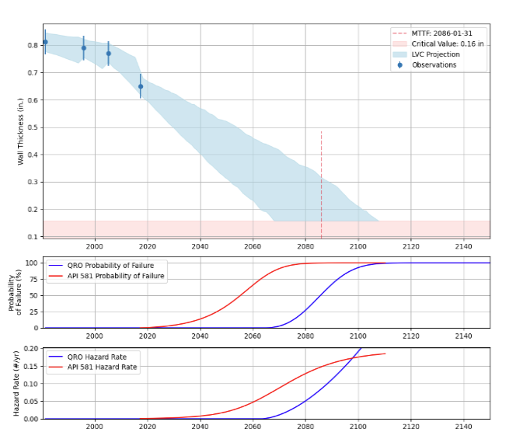
MODULE 04 — QRO CORE METHODOLOGY
PINNACLE RELIABILITY · QRO DISPATCH
Comparative Benchmark: API 581 RBI vs. QRO Dynamic POF
Contrasting tabulated generic damage factors against dynamic telemetry modeling.
FIG · API 581 VS. QRO POF & HAZARD RATE (MTTF 2086)
API 581 SEMI-QUANTITATIVE RBI
Tabulated Damage Factors: Pre-canned generic look-up tables of historical averages.
Step-Wise Risk Jumps: Risk stays flat, then jumps abruptly when an inspection interval expires.
Conservative Over-Inspection: Forces unnecessary turnaround inspections on benign circuits.
QRO DYNAMIC TELEMETRY MODELING
Purely Empirical & Statistical: Derives degradation parameters from live telemetry & CMMS history.
Continuous Smooth Curves: Generates smooth POF curves reflecting real operating hours.
Operational Responsiveness: Immediately captures inhibitor dosing & feedstock changes.
MUSTHAQUE ALI · PINNACLE RELIABILITY · QRO METHODOLOGY DISPATCH
No. 42 / 80

Slide 43
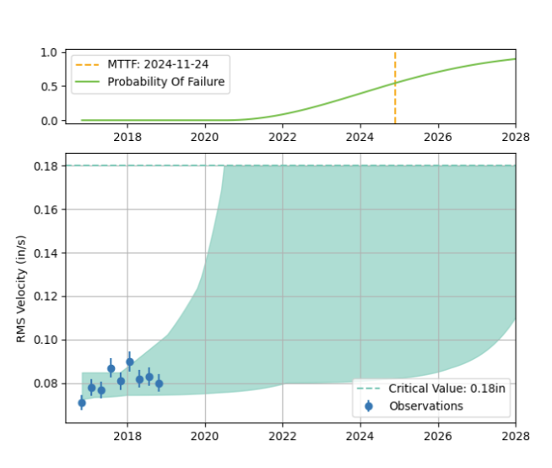
MODULE 04 — QRO CORE METHODOLOGY
PINNACLE RELIABILITY · QRO DISPATCH
LVC for Condition Monitoring: Vibration RMS Velocity
Transforming vibration spectra into stochastic P-F interval forecasts.
FIG · REAL LVC: VIBRATION RMS VELOCITY VS. TRIP LIMIT
QUANTIFIED POSITION ON P-F CURVE
Vibration monitoring is frequently treated merely as a high-alarm threshold. QRO transforms vibration into a stochastic degradation curve:
1
Trend Analysis: Projects bands of uncertainty through overall velocity (in/s RMS) readings.
2
Failure History Integration: Blends current telemetry with historical bearing life distributions.
3
Critical Value Breach: Predicts the exact calendar date when vibration crosses trip thresholds (e.g. 0.18 in/s).
MUSTHAQUE ALI · PINNACLE RELIABILITY · QRO METHODOLOGY DISPATCH
No. 43 / 80

Slide 44


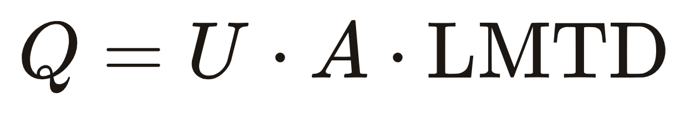
MODULE 04 — QRO CORE METHODOLOGY
PINNACLE RELIABILITY · QRO DISPATCH
LVC for Process Telemetry (U-Factor) & Creep Rupture
Ingesting thermal coefficients and Larson-Miller creep parameters.
Heat Exchanger U-Factor Tracking
High-Temperature Creep Rupture Life
Process sensors (temperatures, mass flows) compute the overall heat transfer coefficient U:
For fired-heater tubes and high-pressure steam headers operating above 800°F:
Larson-Miller Parameter: Combines metal temperature, pressure stress, and wall thickness into a single life index.
Excursion Impact: Automatically calculates the hours of rupture life consumed by thermal spikes.
Filters out flow fluctuations to isolate true thermal fouling decay, forecasting when bundle cleaning yields net fuel savings.
MUSTHAQUE ALI · PINNACLE RELIABILITY · QRO METHODOLOGY DISPATCH
No. 44 / 80

Slide 45
SPECIAL DISPATCH SECTION IV-B
No. IV-B
LVC EXAMPLES — CREEP ANALYSIS
Time-Series Telemetry Ingestion, Larson-Miller Formulations & Stochastic Rupture Forecasting
MUSTHAQUE ALI · PINNACLE RELIABILITY · QRO METHODOLOGY DISPATCH
No. 45 / 80

Slide 46
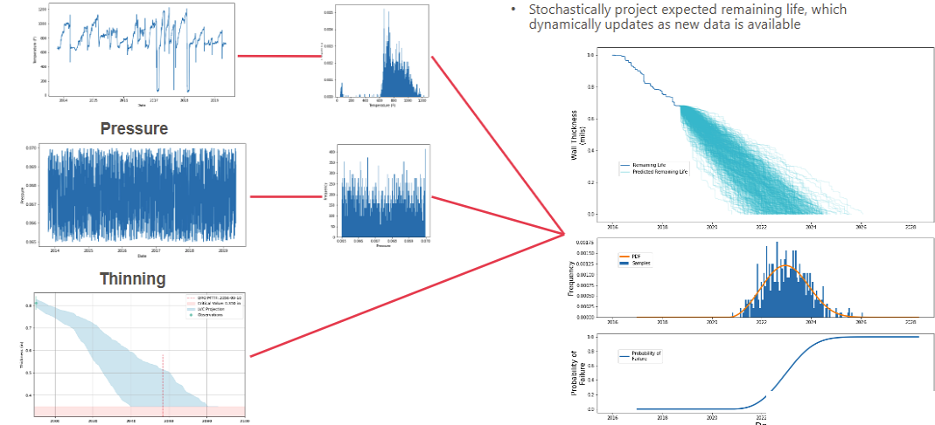
MODULE 04 — QRO CORE METHODOLOGY
PINNACLE RELIABILITY · QRO DISPATCH
Creep Lifetime Variability Curve (LVC)
Quantifying high-temperature damage accumulation via dynamic Larson-Miller parameters.
• Quantify lost life using time series data (temperature, pressure, thickness) and Larson Miller/Omega formulations.
• Statistically estimate operating condition distributions, including excursion likelihood & duration across plant lifecycle.
• Stochastically project expected remaining life, which dynamically updates as new operating telemetry becomes available.
FIG · CREEP LVC: SENSOR TELEMETRY TO STOCHASTIC WALL THICKNESS & PROBABILITY OF FAILURE
MUSTHAQUE ALI · PINNACLE RELIABILITY · QRO METHODOLOGY DISPATCH
No. 46 / 80

Slide 47
SPECIAL DISPATCH SECTION V
No. V
Asset & System Availability Forecasting
Fixed & Rotating Equipment Multi-Failure Modeling, Boundaries & Markov Chains
EXCHANGER MODES
PUMP SUB-ASSEMBLIES
COMPONENTIZATION
MARKOV CHAINS
MUSTHAQUE ALI · PINNACLE RELIABILITY · QRO METHODOLOGY DISPATCH
No. 47 / 80

Slide 48

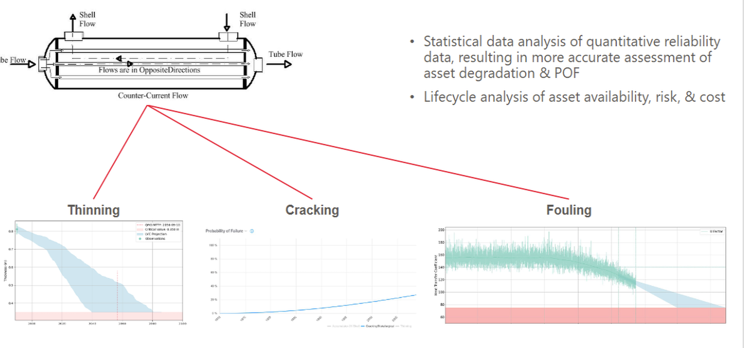

MODULE 05 — AVAILABILITY FORECASTING
PINNACLE RELIABILITY · QRO DISPATCH
Fixed Equipment: Heat Exchanger Multi-Failure
Concurrent modeling of internal thinning, cracking, and fouling.
FIG · HEAT EXCHANGER: THINNING, CRACKING & FOULING LVCS
THREE CONCURRENT DAMAGE MECHANISMS
1. Internal Thinning
Ultrasonic CMLs track shell course and channel-head wall loss caused by acid corrosion and CO₂ attack.
2. Environmental Cracking
Stress corrosion cracking (SCC) and tube-to-tubesheet joint fatigue driven by thermal cycling.
3. Process Fouling
Thermal U-factor degradation caused by crude deposition, restricting heat transfer.
MUSTHAQUE ALI · PINNACLE RELIABILITY · QRO METHODOLOGY DISPATCH
No. 48 / 80

Slide 49
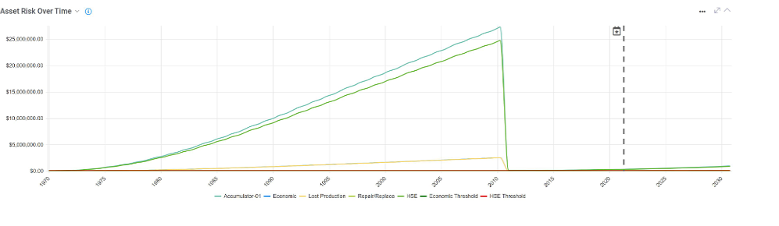
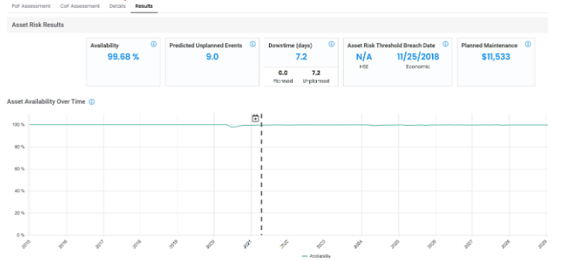
MODULE 05 — AVAILABILITY FORECASTING
PINNACLE RELIABILITY · QRO DISPATCH
Heat Exchanger Multi-Failure: Asset Risk & Availability Results
Synthesizing concurrent thinning, cracking, and fouling into monetized risk trajectories.
Availability
99.68 %
5-Year Average
Predicted Outages
9.0 Events
Unplanned Trips
Downtime
7.2 Days
Unplanned
Breach Date
11/25/2018
Economic Ceilings
Planned Maintenance
$11,533
Budgeted Tasks
FIG · ASSET RISK OVER TIME (ACCUMULATOR-01)
FIG · ASSET AVAILABILITY OVER TIME & RESULTS
MUSTHAQUE ALI · PINNACLE RELIABILITY · QRO METHODOLOGY DISPATCH
No. 49 / 80

Slide 50
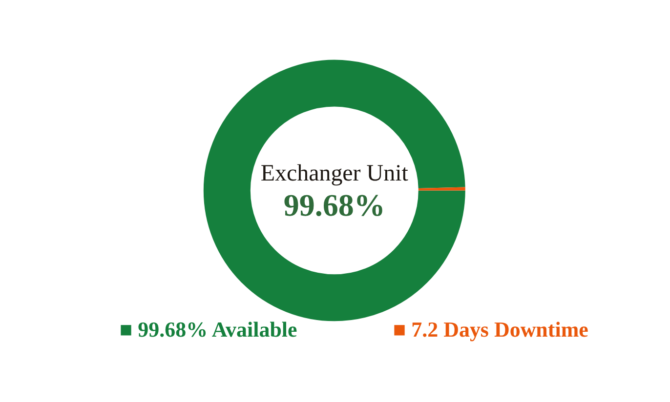
MODULE 05 — AVAILABILITY FORECASTING
PINNACLE RELIABILITY · QRO DISPATCH
Heat Exchanger Case Study Results
Synthesizing failure mechanisms into an asset-level availability forecast.
99.68 %
9.0 Events
7.2 Days
Availability
Predicted Trips
Cumulative Outage
5-Year Operating Cycle
Pinhole Leaks / Minor Outages
Over 5 Operating Years
FIG · EXCHANGER AVAILABILITY GAUGE
MUSTHAQUE ALI · PINNACLE RELIABILITY · QRO METHODOLOGY DISPATCH
No. 50 / 80

Slide 51
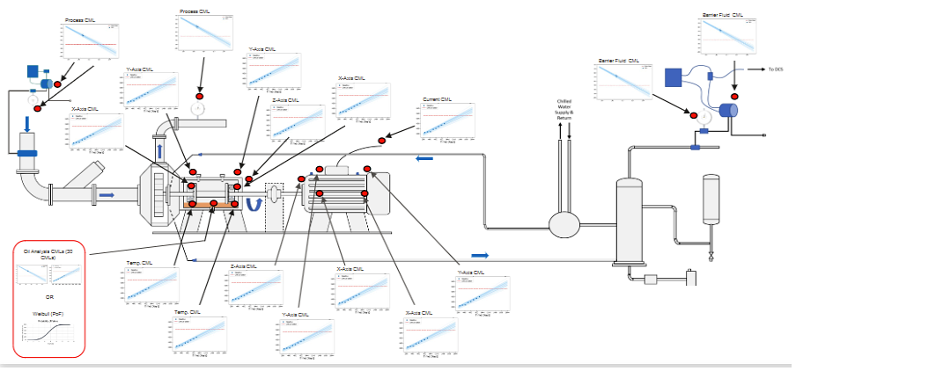
MODULE 05 — AVAILABILITY FORECASTING
PINNACLE RELIABILITY · QRO DISPATCH
Rotating Equipment: Centrifugal Pump Multi-Failure
Sub-assembly interactions and cumulative asset risk trajectories.
FIG · CENTRIFUGAL PUMP ANALYSIS — QRO P&ID
SUB-ASSEMBLY FAILURE MECHANISMS
Mechanical Seals
Face wear, flush contamination, and dry-run trips.
Radial & Thrust Bearings
Fatigue spalling and lubrication breakdown.
Impeller & Wear Rings
Erosive slurry thinning and cavitation pitting.
Casing & Flanges
High consequence of failure due to catastrophic loss of containment.
MUSTHAQUE ALI · PINNACLE RELIABILITY · QRO METHODOLOGY DISPATCH
No. 51 / 80

Slide 52
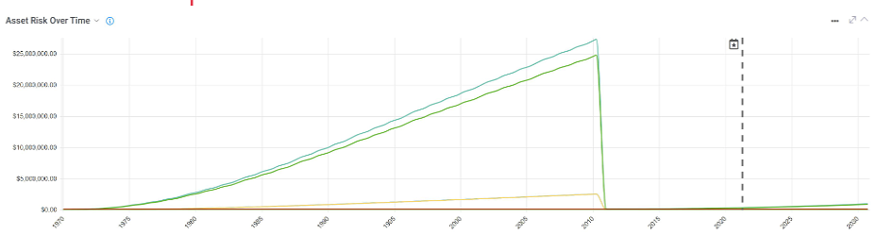
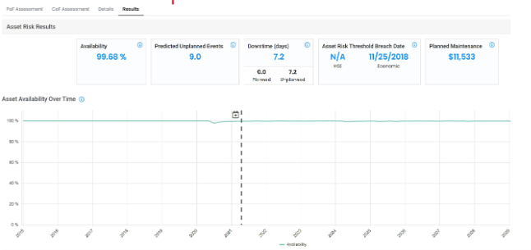
MODULE 05 — AVAILABILITY FORECASTING
PINNACLE RELIABILITY · QRO DISPATCH
Centrifugal Pump: Cumulative Risk & Availability Trajectory
Multi-component reliability synthesis across mechanical seals, bearings, and impellers.
Rotating Equipment Availability Synthesis: Dynamic risk curves combine mechanical seal face wear, bearing fatigue spalling, and casing loss-of-containment into an integrated plant availability model with verified financial threshold dates.
FIG · CENTRIFUGAL PUMP ASSET RISK OVER TIME
FIG · CENTRIFUGAL PUMP ASSET AVAILABILITY OVER TIME & RESULTS
MUSTHAQUE ALI · PINNACLE RELIABILITY · QRO METHODOLOGY DISPATCH
No. 52 / 80

Slide 53





MODULE 05 — AVAILABILITY FORECASTING
PINNACLE RELIABILITY · QRO DISPATCH
Asset Risk Analysis: 6 Core Deliverables
The operational outputs generated by an Asset Risk Analysis project.
1. Availability %
2. Predicted Failures
3. Planned vs Unplanned
Predicts exact system uptime across 1, 3, and 5-year horizons.
Generates integer count of expected equipment trip events.
Itemizes planned PM outage hours vs. emergency trip downtime.
4. Risk Breach Dates
5. Maintenance Spend
6. Availability Curves
Identifies calendar dates when risk breaches corporate thresholds.
Forecasts itemized budgets for labor, parts, and scaffolding.
Visualizes operable probability curves across all time steps.
MUSTHAQUE ALI · PINNACLE RELIABILITY · QRO METHODOLOGY DISPATCH
No. 53 / 80

Slide 54
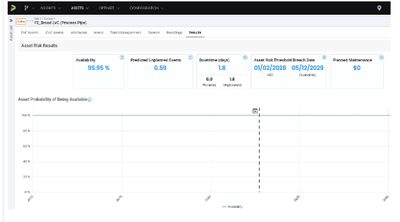
MODULE 05 — AVAILABILITY FORECASTING
PINNACLE RELIABILITY · QRO DISPATCH
Asset Risk Analysis (ARA) Results: Core Operational Deliverables
Quantified uptime metrics, trip frequency, and scheduled vs. unscheduled maintenance hours.
FIG · NEWTON ARA SOFTWARE INTERFACE
• Availability: Average availability projected across the defined operational timeframe.
• Predicted Unplanned Events: Stochastically calculated count of expected trip and outage events.
• Downtime Breakdown: Quantifies planned PM outage hours vs. unscheduled emergency trip downtime.
• Asset Risk Threshold Breach Dates: Exact calendar dates when monetized risk crosses corporate HSE or Economic ceilings.
• Planned Maintenance ($): Monetized budget for PM tasks, turnaround interventions, and spare parts.
• Asset Probability of Being Available: Continuous operable probability curves mapped across all operating intervals.
MUSTHAQUE ALI · PINNACLE RELIABILITY · QRO METHODOLOGY DISPATCH
No. 54 / 80

Slide 55
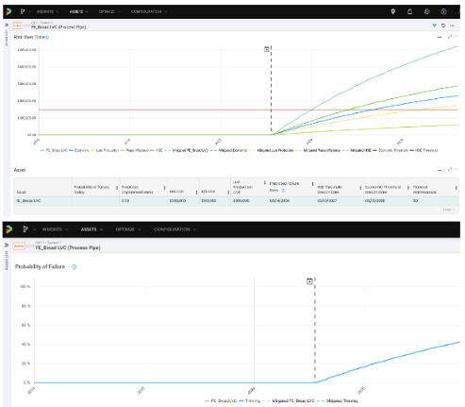
MODULE 05 — AVAILABILITY FORECASTING
PINNACLE RELIABILITY · QRO DISPATCH
Asset Risk Analysis (ARA) Results: Risk & POF Trajectories
Multi-category monetized risk breakdowns and component failure probabilities.
FIG · MONETIZED RISK AND POF CURVES
• Risk Over Time: Displays unmitigated vs. mitigated risk trajectories across plant lifecycle.
• Breakdown by Category: Separates total dollar risk into Economic, HSE, Lost Production, and Repair/Replace cost drivers.
• Breakdown by Component: Identifies the specific sub-assembly (e.g. impellers vs. mechanical seals) driving the steepest slope.
• Component Results: Tabulates Probability of Failure Today alongside consequence severity.
• Predicted Failure Dates: Determines the precise date of functional breach based on degradation confidence limits.
• Probability of Failure Over Time: Dynamic POF projection with flexibility to toggle into annualized Events/Year frequency.
MUSTHAQUE ALI · PINNACLE RELIABILITY · QRO METHODOLOGY DISPATCH
No. 55 / 80

Slide 56
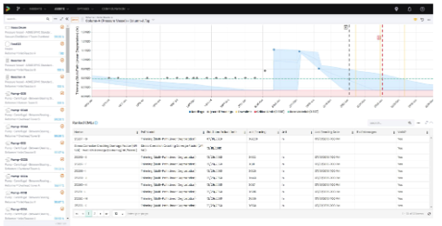
MODULE 05 — AVAILABILITY FORECASTING
PINNACLE RELIABILITY · QRO DISPATCH
Lifetime Variability Curve (LVC) & Ranked CML List
Prioritizing critical condition monitoring locations by predicted failure dates.
FIG · LVC DEGRADATION ENVELOPE & RANKED CML LIST
• Lifetime Variability Curve (LVC): Projects degradation paths surrounded by dynamic Bayesian confidence envelopes, synthesizing historical inspection thickness data.
• Continuous Updating: Every new UT thickness gauge or sensor telemetry point dynamically recalculates the remaining wall thickness projection.
• Ranked CML List: Automatically prioritizes all monitored points across the asset, ranked strictly by Predicted Failure Date.
• Cross-Failure Mode Synthesis: Unifies internal thinning, localized pitting, and environmental cracking into a single prioritized inspection schedule.
• Actionable Targeting: Eliminates random blanket inspections by guiding NDT technicians directly to the most critical locations before risk threshold breach.
MUSTHAQUE ALI · PINNACLE RELIABILITY · QRO METHODOLOGY DISPATCH
No. 56 / 80

Slide 57
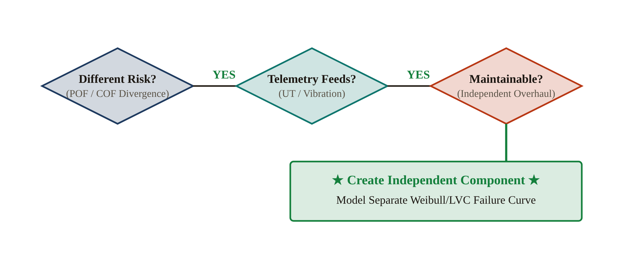
MODULE 05 — AVAILABILITY FORECASTING
PINNACLE RELIABILITY · QRO DISPATCH
Asset Boundaries & Componentization Guidelines
Rules governing when to break an industrial asset into discrete sub-components.
FIG · 3 CRITERIA FOR COMPONENTIZATION
THREE CRITERIA FOR COMPONENTIZATION
1
Significantly Different Risk
Sub-elements exhibit vastly divergent POF or COF profiles (e.g. cheap seal leak vs. catastrophic casing rupture).
2
Telemetry Availability
Dedicated inspection data or sensor feeds exist to substantiate an independent model.
3
Independent Maintainability
The component can be rebuilt or replaced in the field without scrapping the parent asset.
MUSTHAQUE ALI · PINNACLE RELIABILITY · QRO METHODOLOGY DISPATCH
No. 57 / 80

Slide 58
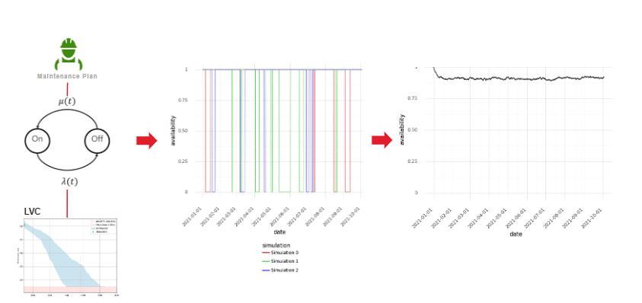
MODULE 05 — AVAILABILITY FORECASTING
PINNACLE RELIABILITY · QRO DISPATCH
Instantaneous Availability — QRO
Continuous-time Markov chains incorporating dynamic LVC curves and planned maintenance.
• Probability of availability at any point in time.
• Calculated for each individual asset and system across entire operational envelopes.
• Uses a Markov chain, incorporating LVC results as well as planned maintenance tasks.
FIG · MARKOV CHAIN SIMULATION & INSTANTANEOUS AVAILABILITY A(t)
MUSTHAQUE ALI · PINNACLE RELIABILITY · QRO METHODOLOGY DISPATCH
No. 58 / 80

Slide 59
SPECIAL DISPATCH SECTION VI
No. VI
Task Optimization & Decision Science
Corrective Mechanics, Digital Twin What-Ifs, Benefit-Cost Ratio & QTE
TASK CATEGORIES
LIFE RESTORATION
BCR
QTE EFFECTIVENESS
MUSTHAQUE ALI · PINNACLE RELIABILITY · QRO METHODOLOGY DISPATCH
No. 59 / 80

Slide 60




MODULE 06 — TASK OPTIMIZATION
PINNACLE RELIABILITY · QRO DISPATCH
Maintenance Task Categorization & Simulated Effects
The four operational task categories recognized within QRO engines.
Predictive Tasks
Preventive Tasks
Corrective Tasks
Statutory Tasks
UT readings, vibration spectra, and oil analysis.
Reduces degradation uncertainty and rolls back POF.
Lubrication, filter replacement, and calibration.
Tracked for direct labor spend and scheduled downtime.
Overhauls, bundle retubing, and component replacement.
Directly restores operating life and rolls back hazard curve.
PSV recertification, emissions audits, and inspections.
Strictly tracked to ensure 100% regulatory compliance.
MUSTHAQUE ALI · PINNACLE RELIABILITY · QRO METHODOLOGY DISPATCH
No. 60 / 80

Slide 61



MODULE 06 — TASK OPTIMIZATION
PINNACLE RELIABILITY · QRO DISPATCH
Corrective Maintenance: Life Restoration Mechanics
As-Good-As-New full replacements, partial repairs, and temporary patches.
Full Replacement
Partial Repair
Temporary Repair
As Good As New (AGAN)
Proportional Age Rollback
Engineered Clamp / Patch
Complete physical replacement of asset or sub-assembly across all failure modes. Resets operating age to t = 0; POF drops to 0%.
Restores a specific fraction (0–100%) of equipment life. E.g. replacing pump bearings rolls back bearing POF while retaining aged impeller life.
Prevents immediate shutdown until the next major turnaround. Can model active degradation under patch (POF jump) or arrested degradation.
MUSTHAQUE ALI · PINNACLE RELIABILITY · QRO METHODOLOGY DISPATCH
No. 61 / 80

Slide 62
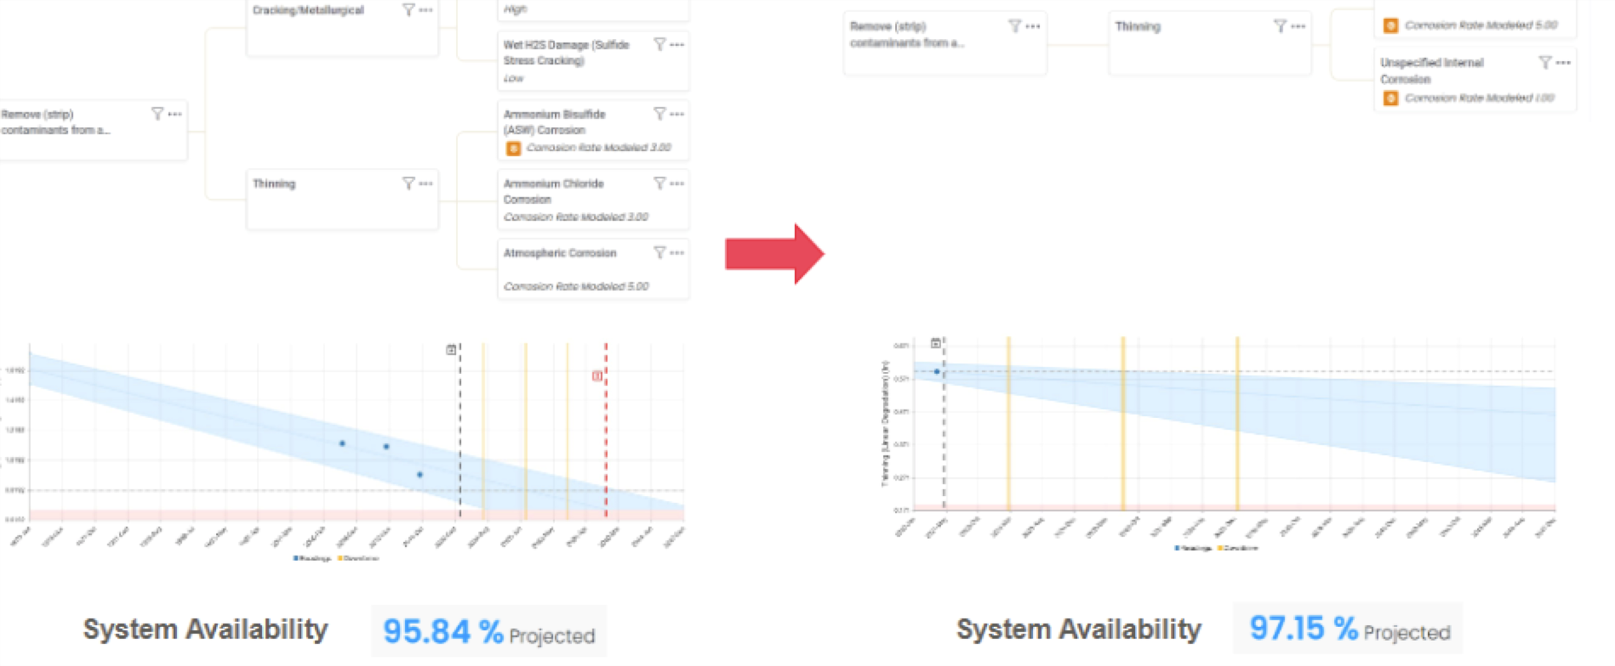

MODULE 06 — TASK OPTIMIZATION
PINNACLE RELIABILITY · QRO DISPATCH
What-If Scenarios: Metallurgy Upgrade Case Study
Simulating digital-twin alternatives to justify capital alloy upgrades.
FIG · WHAT-IF: METALLURGY UPGRADE 95.84% → 97.15%
Return on Investment
+1.31%
Facility-Wide Availability Gain
Mathematically proves the return on investment for the capital alloy retubing expense — an estimated $380,000/yr value accretion from improved uptime.
Carbon Steel
Alloy Upgrade
95.84 %
97.15 %
Corrosion: 3.0 mpy
Corrosion: 1.0 mpy
MUSTHAQUE ALI · PINNACLE RELIABILITY · QRO METHODOLOGY DISPATCH
No. 62 / 80

Slide 63
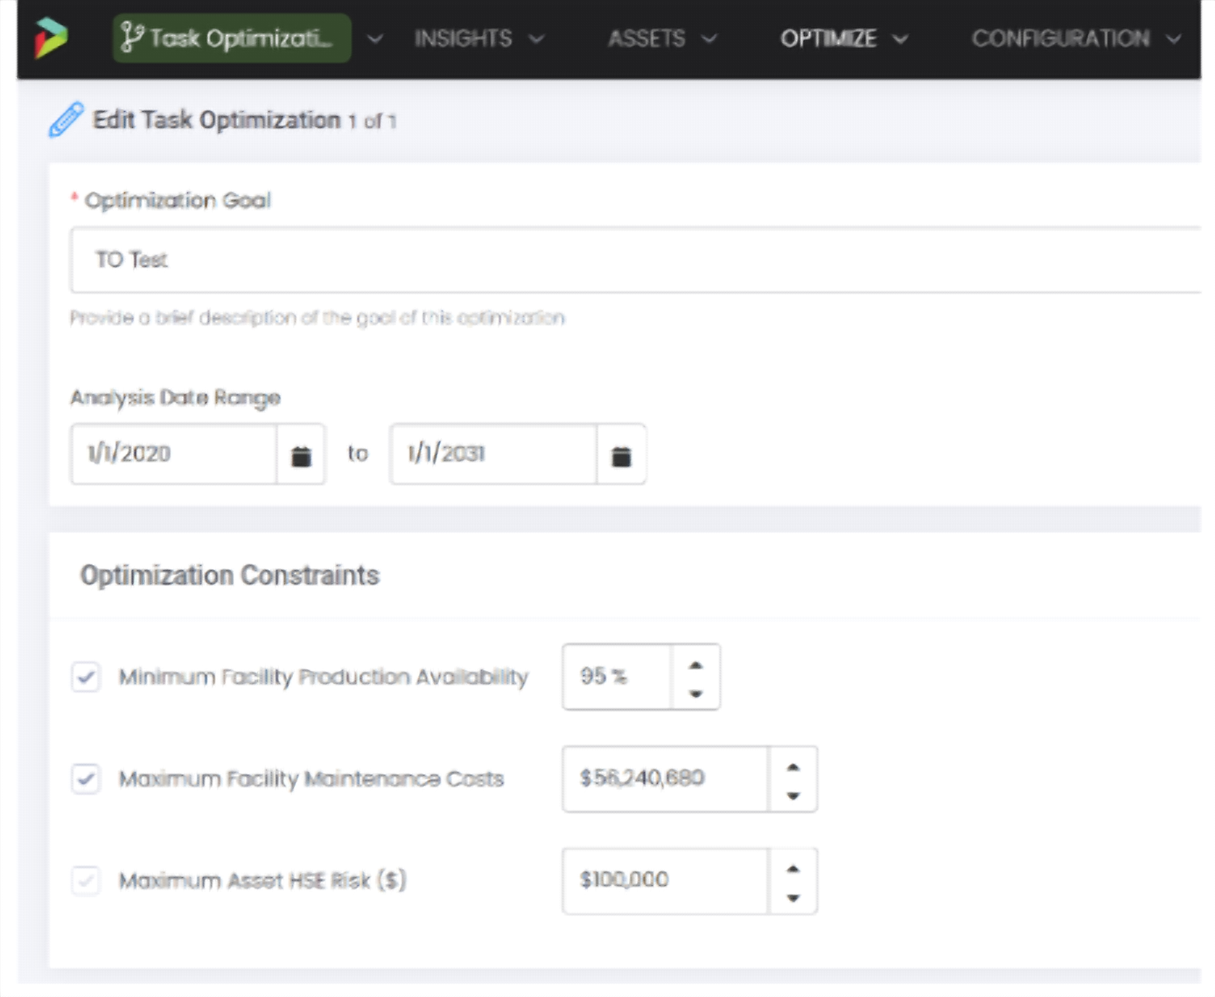


MODULE 06 — TASK OPTIMIZATION
PINNACLE RELIABILITY · QRO DISPATCH
Task Optimization Engine & Boundary Constraints
Simulating thousands of possible maintenance plans to discover the optimal schedule.
FIG · TASK OPTIMIZATION — NEWTON CONSTRAINT SOLVER
THREE HARD OPERATIONAL CONSTRAINTS
1. Minimum Required Availability
E.g. Plant must achieve ≥ 98.5% uptime across the evaluation horizon.
2. Maximum Maintenance Budget
Fixed operational expenditure cap constraining total task spend.
3. Maximum Allowable HSE Risk
Absolute zero-tolerance ceiling for safety and containment breaches.
MUSTHAQUE ALI · PINNACLE RELIABILITY · QRO METHODOLOGY DISPATCH
No. 63 / 80

Slide 64

MODULE 06 — TASK OPTIMIZATION
PINNACLE RELIABILITY · QRO DISPATCH
Task Optimization & Goal-Seeking Reliability
Simulating asset management plans to balance availability, HSE risk, and maintenance budget.
FIG · NEWTON TASK OPTIMIZATION ENGINE
• Maximize reliability return-on-investment (ROI), reaching the ideal balance across conflicting metrics of availability, risk, and cost.
• By connecting asset data, predicted failure dates, field execution, and system availability we can now goal-seek reliability.
• Optimization algorithm simulates thousands of possible asset management plans, their effect, and projected facility performance.
Algorithm Constraints:
– Minimum Facility Production Availability %
– Maximum Facility Maintenance Costs $
– Maximum Allowable Asset HSE Risk $
Optimization Outputs:
– Recommended Tasks & Calendar Execution Dates
– Quantified Benefit-Cost Ratio (BCR) per Maintenance Dollar
– Projected Facility Availability and Risk Trajectories
MUSTHAQUE ALI · PINNACLE RELIABILITY · QRO METHODOLOGY DISPATCH
No. 64 / 80

Slide 65


MODULE 06 — TASK OPTIMIZATION
PINNACLE RELIABILITY · QRO DISPATCH
Simulating Future Tasks & Benefit-Cost Ratio (BCR)
The fundamental decision-science metric governing maintenance execution.
BCR > 1.0 — Value Accretive
BCR < 1.0 — Value Destructive
The financial value gained from avoided downtime and mitigated risk exceeds the cost to perform the maintenance task. Executing the task is economically justified.
The task costs more money than the risk it reduces (e.g. over-inspecting a benign circuit). QRO advises deferring or eliminating the task from the schedule.
MUSTHAQUE ALI · PINNACLE RELIABILITY · QRO METHODOLOGY DISPATCH
No. 65 / 80

Slide 66

MODULE 06 — TASK OPTIMIZATION
PINNACLE RELIABILITY · QRO DISPATCH
Task Grouping & Informational Pre-Requisites
Synchronizing maintenance windows to avoid fragmented downtime penalties.
FIG · TASK GROUPING — NEWTON TURNAROUND CLUSTERING
TURNAROUND SYNCHRONIZATION
Executing maintenance in fragmented, isolated windows incurs massive shutdown and startup production penalties.
Task Grouping automatically pulls compatible tasks forward in time.
Compatible tasks are clustered into scheduled turnarounds or strategic mini-outages, achieving up to 80% shutdown-cost avoidance.
MUSTHAQUE ALI · PINNACLE RELIABILITY · QRO METHODOLOGY DISPATCH
No. 66 / 80

Slide 67

MODULE 06 — TASK OPTIMIZATION
PINNACLE RELIABILITY · QRO DISPATCH
Quantitative Task Effectiveness (QTE): Rotating Machinery
Augmented POF curves governing condition-monitoring frequency.
FIG · QTE: AUGMENTED POF VS. TASK EFFECTIVENESS
AUGMENTED POF MECHANICS
Combines two probabilities to calibrate monitoring frequency:
1
Likelihood that internal damage has initiated since the last inspection.
2
How rapidly that damage progresses along the P-F interval to functional trip.
Governed by Detection Eta (η_det) and Detection Beta (β_det). Ensures monitoring frequency is mathematically calibrated to detect developing defects within the P-F interval prior to functional trip.
MUSTHAQUE ALI · PINNACLE RELIABILITY · QRO METHODOLOGY DISPATCH
No. 67 / 80

Slide 68



MODULE 06 — TASK OPTIMIZATION
PINNACLE RELIABILITY · QRO DISPATCH
QTE Task Effectiveness Levels & Adaptive Schedules
100% vs. partial effectiveness and escalating monitoring near wear-out.
FIG · QTE: EFFECTIVENESS LEVELS & AUGMENTED POF
ADAPTIVE LIFECYCLE SCHEDULING
Early Life
Wide inspection intervals when risk is low, conserving OPEX.
Near Wear-Out
Monitoring frequency automatically escalates as equipment nears end of life.
Infant Mortality Phase
Additional monitoring triggered during the first 90 operating days.
MUSTHAQUE ALI · PINNACLE RELIABILITY · QRO METHODOLOGY DISPATCH
No. 68 / 80

Slide 69

MODULE 06 — TASK OPTIMIZATION
PINNACLE RELIABILITY · QRO DISPATCH
QRO Living Program
Closed-loop data ingestion, dynamic simulation, and strategic leadership execution.
FIG · THE THREE-TIER QRO LIVING PROGRAM ARCHITECTURE
As a leader, I can:
• Understand the value of every piece of data collected across inspection, telemetry, and CMMS work orders.
• Drive optimization of all capital and OPEX spend to target specific, quantified reliability improvement.
• Simulate changes in process conditions, economics, or turnaround shifts and quantify their direct impact on reliability strategy.
MUSTHAQUE ALI · PINNACLE RELIABILITY · QRO METHODOLOGY DISPATCH
No. 69 / 80

Slide 70
SPECIAL DISPATCH SECTION VII
No. VII
Condition Monitoring & CML Optimization
The 90/15 Pareto Principle, Risk Targets, General Corrosion & Extreme Value Analysis
90/15 PARETO
CML PRIORITIZATION
SAMPLE OPTIMIZATION
EVA TAIL
MUSTHAQUE ALI · PINNACLE RELIABILITY · QRO METHODOLOGY DISPATCH
No. 70 / 80

Slide 71

MODULE 07 — CML OPTIMIZATION
PINNACLE RELIABILITY · QRO DISPATCH
Evaluating Risk Distribution: The 90/15 Pareto Rule
90% of industrial plant risk resides in only 15% of Condition Monitoring Locations.
FIG · RISK ACROSS EQUIPMENT — 90/15 CONCENTRATION
THE 90/15 PRINCIPLE EXPLAINED
The 90/15 Imbalance: In typical plants, 90% of total facility risk concentrates in just 15% of the asset base.
The 85% Long Tail: 85% of equipment contributes <10% of risk yet consumes 60%+ of maintenance OPEX.
Strategic Optimization: Focus intensive CML and advanced condition monitoring on the critical 15%.
Budget Realignment: Safely de-scope or extend inspection intervals on the remaining 85%.
Executive Impact: Redirects OPEX capital where it yields maximum risk mitigation per dollar.
MUSTHAQUE ALI · PINNACLE RELIABILITY · QRO METHODOLOGY DISPATCH
No. 71 / 80

Slide 72


MODULE 07 — CML OPTIMIZATION
PINNACLE RELIABILITY · QRO DISPATCH
From LVC Models to Strategic CML Prioritization
Eliminating wasteful blanketing of non-degrading metal.
FIG · FROM LVC MODELS TO CML INSPECTION PRIORITIZATION
Eliminating Blanket Inspections
LVC generates an independent remaining-life probability distribution for every CML on every vessel and piping circuit.
Inspectors no longer blast 50 UT readings on an entire line when only 3 elbow CMLs suffer flow-accelerated thinning.
MUSTHAQUE ALI · PINNACLE RELIABILITY · QRO METHODOLOGY DISPATCH
No. 72 / 80

Slide 73

MODULE 07 — CML OPTIMIZATION
PINNACLE RELIABILITY · QRO DISPATCH
CML Risk Targets & Target Inspection Dates
Targeting inspection dates by intersecting rising risk curves with ceilings.
FIG · CML RISK TARGET & TARGET INSPECTION DATES
TARGET INSPECTION DATE METHODOLOGY
1
Set Facility Risk Ceiling
Management defines an acceptable monetary risk threshold per piping circuit (e.g. $100k).
2
Calculate Intersection
The exact date where a CML’s rising risk curve intersects the ceiling becomes its Target Inspection Date.
3
Natural Campaign Groupings
CMLs reaching the threshold in the same month are automatically bundled into single scaffold campaigns.
MUSTHAQUE ALI · PINNACLE RELIABILITY · QRO METHODOLOGY DISPATCH
No. 73 / 80

Slide 74

MODULE 07 — CML OPTIMIZATION
PINNACLE RELIABILITY · QRO DISPATCH
General Degradation: CML Sample Optimization (38 → 7)
Statistical sampling proof reducing inspection points by 81.5% with 95% confidence.
FIG · GENERAL DEGRADATION: 38 CMLS → 7 (95% CONFIDENCE)
81.5%
Reduction in Inspection Points
For uniform spatial corrosion (UIC), readings across the vessel shell correlate heavily. Statistical sample sizing proves that 7 well-spaced CMLs provide complete 95% confidence in minimum thickness.
MUSTHAQUE ALI · PINNACLE RELIABILITY · QRO METHODOLOGY DISPATCH
No. 74 / 80

Slide 75


MODULE 07 — CML OPTIMIZATION
PINNACLE RELIABILITY · QRO DISPATCH
Local Degradation & Extreme Value Analysis (EVA)
Statistical tail modeling predicting uninspected minimum wall thickness.
FIG · EXTREME VALUE ANALYSIS: LOW VS. HIGH VARIANCE TAIL
Tail-Risk Modeling
General corrosion sampling captures the bulk of the wall-thickness distribution — but localized pitting and flow-accelerated corrosion live in the extreme lower tail.
EVA fits a Gumbel / Fréchet extreme-value distribution to predict the true minimum wall thickness among the uninspected population.
MUSTHAQUE ALI · PINNACLE RELIABILITY · QRO METHODOLOGY DISPATCH
No. 75 / 80

Slide 76

MODULE 07 — CML OPTIMIZATION
PINNACLE RELIABILITY · QRO DISPATCH
EVA Case Study: Exchanger Tube Bundle & Living Program
Inspecting 69 / 450 tubes to order the bundle 18 months before failure.
FIG · EVA CASE: EXCHANGER TUBE BUNDLE (69/450 TUBES)
TUBE BUNDLE WORKED CASE STUDY
Sample Scope
Only 69 tubes inspected out of 450 total.
Observed Minimum
Lowest measured tube was 0.052 inches.
Bayesian EVA Prediction
Proves the true minimum among uninspected tubes is 0.045 inches.
Outcome
Replacement bundle ordered 18 months in advance, preventing unplanned unit leak.
MUSTHAQUE ALI · PINNACLE RELIABILITY · QRO METHODOLOGY DISPATCH
No. 76 / 80

Slide 77
SPECIAL DISPATCH SECTION VIII
No. VIII
Master Formula Reference & Glossary
Comprehensive Mathematical Formulary, Definitions & Executive Summary
AVAILABILITY
DISTRIBUTIONS
FINANCIAL RISK
DECISION SCIENCE
MUSTHAQUE ALI · PINNACLE RELIABILITY · QRO METHODOLOGY DISPATCH
No. 77 / 80

Slide 78


MODULE 08 — MASTER REFERENCE
PINNACLE RELIABILITY · QRO DISPATCH
Master Formulary: Availability & Reliability 101
Core formulas governing uptime, outage, and failure rates.
AVAILABILITY RATIO
AVAILABILITY OUTAGE
FAILURE RATE (Λ)
MEAN DOWNTIME (MDT)
MUSTHAQUE ALI · PINNACLE RELIABILITY · QRO METHODOLOGY DISPATCH
No. 78 / 80

Slide 79



MODULE 08 — MASTER REFERENCE
PINNACLE RELIABILITY · QRO DISPATCH
Master Formulary: Distributions & Decision Science
Weibull formulation, financial risk, and benefit-cost optimization.
WEIBULL RELIABILITY FUNCTION
MONETIZED OPERATIONAL RISK
EXPONENTIAL POF
BENEFIT-COST RATIO (BCR)
MUSTHAQUE ALI · PINNACLE RELIABILITY · QRO METHODOLOGY DISPATCH
No. 79 / 80

Slide 80
DISPATCH CLOSING
Reliability Optimization Realized
Highest Reliability Performance at the Lowest Cost Possible — with Data-Driven Confidence
Uncertainty Quantified
Availability Forecasted
Tasks Optimized
Replaces qualitative guesswork with stochastic LVC confidence bounds.
Markov-chain simulations predict live facility uptime in near-real-time.
BCR rankings and grouping ensure every maintenance dollar is justified.
★ PINNACLE RELIABILITY ★
PRESENTED BY MUSTHAQUE ALI · MECHANICAL INTEGRITY ENGINEER (RELIABILITY DATA ANALYST) · NIT CALICUT

