Slide 1


PREPARED BY:

Slide 2

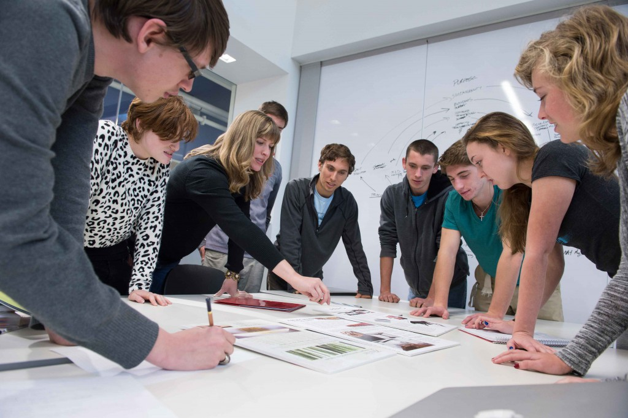
Purpose
SO YOUR GROUP DOES NOT END UP LIKE THIS
BUT LIKE THIS INSTEAD

Slide 3
HOW DOES IT DO THAT?
Using the PPID Algorithm.
Registered Student has a profile with 24 questions (12 answered for themselves and 12 answered for what they are looking for in a partner)
Questions are subdivided into 4 categories – personality, group, grades and miscellaneous.
Each question is answered within a range of 1 to 5 (1 being lowest score and 5 being the highest)
Administrator ranks the categories from 1 to 4 and the PPID uses these ranking, in order, to group the students.
A total for the students own score and what they are looking for is calculated, based on how the questions are answered.

Slide 4
IDEA BEHIND THE PPID ALGORITHM
+-3
Pref: 3, 2, 1 and 4
Student 1 | Personal Score | Partner Score
Set 1 | 17 | 19
Set 2 | 19 | 15
Set 3 | 13 | 11
Set 4 | 2 | 2
Student 2 | Personal Score | Partner Score
Set 1 | 14 | 20
Set 2 | 18 | 16
Set 3 | 13 | 11
Set 4 | 2 | 2
Student 3 | Personal Score | Partner Score
Set 1 | 10 | 13
Set 2 | 9 | 18
Set 3 | 11 | 11
Set 4 | 1 | 2
12 – 18
13 – 19
8 - 14
8 - 14
8 - 14
Student 4 | Personal Score | Partner Score
Set 1 | 16 | 15
Set 2 | 14 | 14
Set 3 | 8 | 5
Set 4 | 3 | 3
Student 5 | Personal Score | Partner Score
Set 1 | 8 | 13
Set 2 | 10 | 16
Set 3 | 15 | 9
Set 4 | 1 | 2
Student 6 | Personal Score | Partner Score
Set 1 | 18 | 14
Set 2 | 15 | 16
Set 3 | 9 | 6
Set 4 | 2 | 3
Student 7 | Personal Score | Partner Score
Set 1 | 19 | 20
Set 2 | 18 | 17
Set 3 | 14 | 8
Set 4 | 3 | 1
Student 8 | Personal Score | Partner Score
Set 1 | 14 | 20
Set 2 | 19 | 16
Set 3 | 13 | 11
Set 4 | 2 | 2
Group made of student 1 & 2…
8 - 14

Slide 5
IDEA BEHIND THE PPID ALGORITHM
+-3
Pref: 3, 2, 1 and 4
Student 1 Student 2 | Personal Score avg | Partner Score avg
Set 1 | 16 | 20
Set 2 | 19 | 16
Set 3 | 13 | 11
Set 4 | 2 | 2
Student 3 | Personal Score | Partner Score
Set 1 | 10 | 13
Set 2 | 9 | 18
Set 3 | 11 | 11
Set 4 | 1 | 2
13– 19
8 – 14
12 – 18
Student 4 | Personal Score | Partner Score
Set 1 | 16 | 15
Set 2 | 14 | 14
Set 3 | 8 | 5
Set 4 | 3 | 3
Student 5 | Personal Score | Partner Score
Set 1 | 8 | 13
Set 2 | 10 | 16
Set 3 | 15 | 9
Set 4 | 1 | 2
Student 6 | Personal Score | Partner Score
Set 1 | 18 | 14
Set 2 | 15 | 16
Set 3 | 9 | 6
Set 4 | 2 | 3
Student 7 | Personal Score | Partner Score
Set 1 | 19 | 20
Set 2 | 18 | 17
Set 3 | 14 | 8
Set 4 | 3 | 1
Student 8 | Personal Score | Partner Score
Set 1 | 14 | 20
Set 2 | 19 | 16
Set 3 | 13 | 11
Set 4 | 2 | 2
Group made of student 1, 2 & 8…
13 – 19
12 – 18

Slide 6
IDEA BEHIND THE PPID ALGORITHM
+-3
Pref: 3, 2, 1 and 4
Student 1 Student 2 Student 8 | Personal Score avg | Partner Score avg
Set 1 | 15 | 20
Set 2 | 19 | 16
Set 3 | 13 | 11
Set 4 | 2 | 2
Student 3 | Personal Score | Partner Score
Set 1 | 10 | 13
Set 2 | 9 | 18
Set 3 | 11 | 11
Set 4 | 1 | 2
8– 14
8 – 14
Student 4 | Personal Score | Partner Score
Set 1 | 16 | 15
Set 2 | 14 | 14
Set 3 | 8 | 5
Set 4 | 3 | 3
Student 5 | Personal Score | Partner Score
Set 1 | 8 | 13
Set 2 | 10 | 16
Set 3 | 15 | 9
Set 4 | 1 | 2
Student 6 | Personal Score | Partner Score
Set 1 | 18 | 14
Set 2 | 15 | 16
Set 3 | 9 | 6
Set 4 | 2 | 3
2 – 8
3– 9
Student 7 | Personal Score | Partner Score
Set 1 | 19 | 20
Set 2 | 18 | 17
Set 3 | 14 | 8
Set 4 | 3 | 1
Group#1 made of student 1, 2, 8 & 3!! Group#2 consists of students 4, 5, 6 & 7
5– 11

