Slide 1

Local Feature Extraction for Noise Detection in Software Requirement Specification Document
Ahmad Mustofa, S.Kom
Daniel Oranova Siahaan, S.Kom, M.Sc, P.D.Eng

Slide 2
Introduction
Noise Detection Model
Experiment Result
Conclusion and Future Works

Slide 3
Background
Requirement specification is the first step in Software Development.
Error in this step will occur automatically in following step.
Bertrand Meyer categorize errors in requirement specification into 7 categories known as Meyer’s seven sin.
Noise is one of Meyer’s seven sin caused by the existence of element in requirement statement with irrelevant information.
Noise in SRS document can only be recognized locally.

Slide 4
Problem
How to extract local feature of requirement statement in SRS document

Slide 5
Introduction
Noise Detection Model
Experiment Result
Conclusion and Future Works

Slide 6
Noise Detection Model

Slide 7
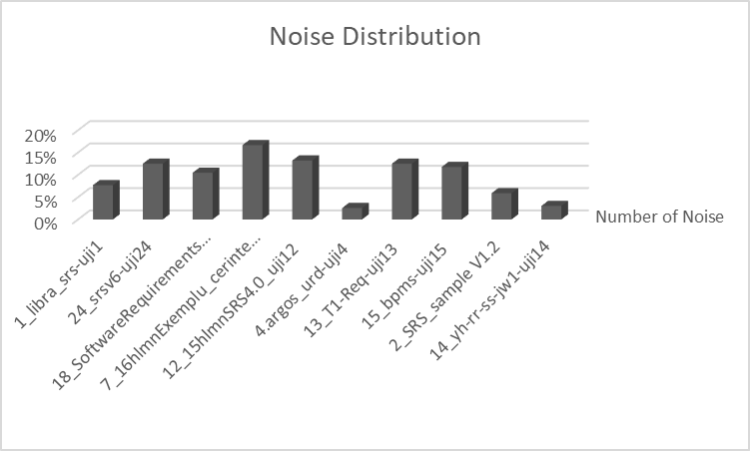
Dataset
10 SRS Document
405 Requirements
41 noises (10.12%)

Slide 8
Data Preprocessing
Stopword Removal
All the conjunction and non-alphabetical element from the text are removed.
Tokenization
Stemming

Slide 9
Data Preprocessing
Stopword Removal
Text is split into some unique token / terms
Tokenization
Stemming

Slide 10
Data Preprocessing
Stopword Removal
Each terms is stemmed in this process
Tokenization
Stemming

Slide 11
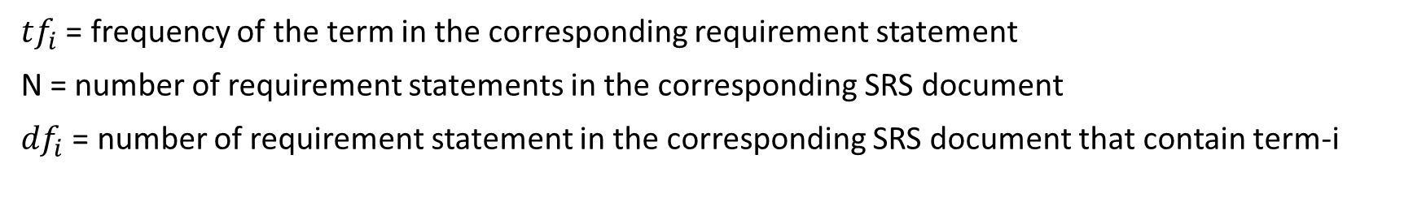
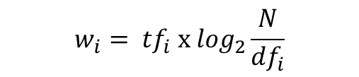
Term Weighting
After preprocessed, each requirement statement will be weighted using TF-IDF.
$$w_{i}= {tf}_{i} x \log_{2}\frac{N}{{df}_{i}}$$
${tf}_{i}$ = frequency of the term in the corresponding requirement statement
N = number of requirement statements in the corresponding SRS document
${df}_{i}$ = number of requirement statement in the corresponding SRS document that contain term-i

Slide 12
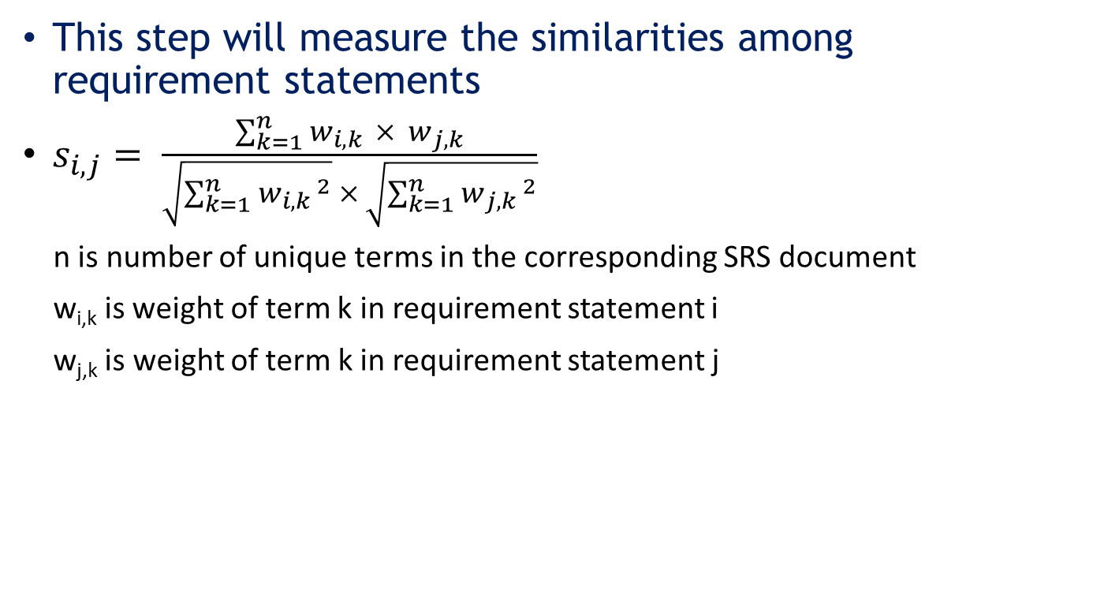
Local Feature Extraction
Similarity Measure
This step will measure the similarities among requirement statements
$s_{i,j}= \frac{\sum_{k=1}^{n}{w_{i,k } × w_{j,k}}}{\sqrt{\sum_{k=1}^{n}{{w_{i,k }}^{2}}} × \sqrt{\sum_{k=1}^{n}{{w_{j,k }}^{2}}}}$
n is number of unique terms in the corresponding SRS document
w_{i,k} is weight of term k in requirement statement i
w_{j,k} is weight of term k in requirement statement j
Extract Statistical Properties

Slide 13
Local Feature Extraction
Similarity Measure
Requirement Statement | 1 | 2 | 3 | 4 | 5 | 6
1 | - | 0.27 | 0.20 | 0.06 | 0.05 | 0.06
2 | 0.27 | - | 0.30 | 0.09 | 0.08 | 0.08
3 | 0.20 | 0.30 | - | 0.29 | 0.25 | 0.06
4 | 0.06 | 0.09 | 0.29 | - | 0.06 | 0.06
5 | 0.05 | 0.08 | 0.25 | 0.06 | - | 0.06
6 | 0.06 | 0.08 | 0.06 | 0.06 | 0.06 | -
Extract Statistical Properties

Slide 14
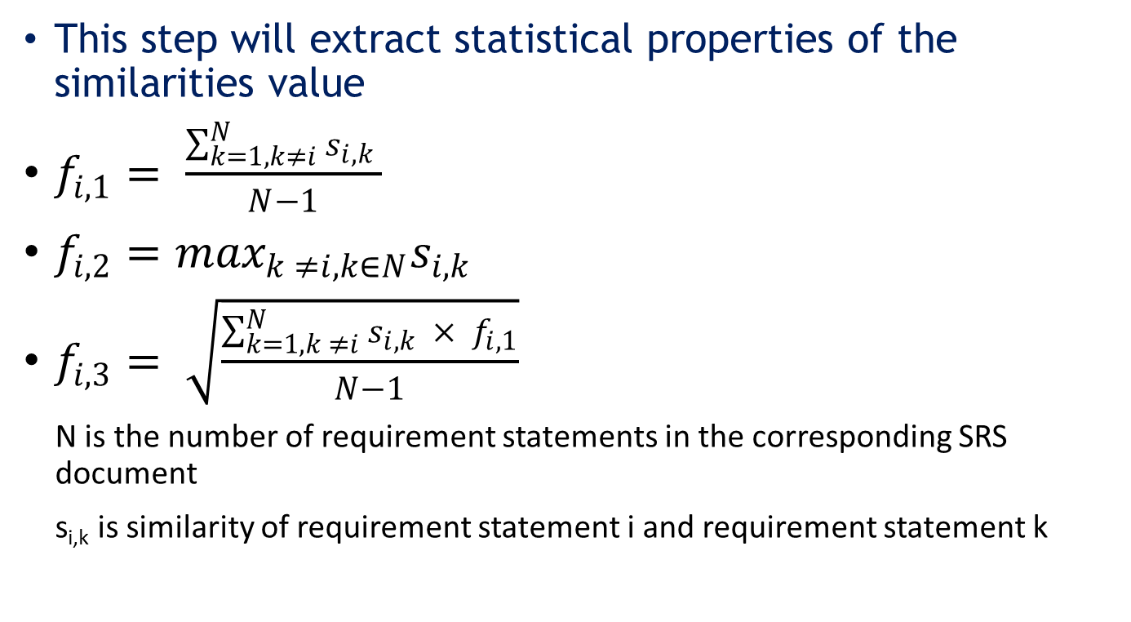
Local Feature Extraction
Similarity Measure
This step will extract statistical properties of the similarities value
$f_{i,1}= \frac{\sum_{k=1, k≠i}^{N}{s_{i,k }}}{N−1}$
$f_{i,2}=\max_{k ≠i, k∈N}s_{i,k}$
$f_{i,3}= \sqrt{\frac{\sum_{k=1, k ≠i}^{N}{s_{i,k } × f_{i,1}}}{N−1}}$
N is the number of requirement statements in the corresponding SRS document
s_{i,k} is similarity of requirement statement i and requirement statement k
Extract Statistical Properties

Slide 15
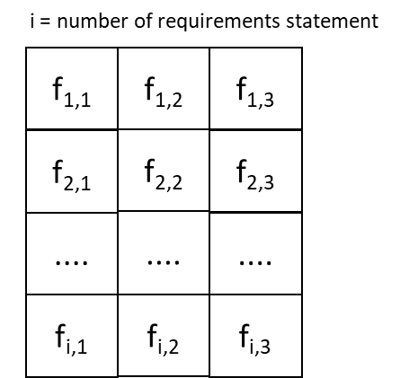
Local Feature Extraction
Similarity Measure
Extract Statistical Properties

Slide 16
Classification
Training
Training data is balanced using SMOTE Algorithm
Train the classification model
Testing

Slide 17
Classification
Training
Use the trained model to classify testing data
Testing

Slide 18
Introduction
Noise Detection Model
Experiment Result
Conclusion and Future Works

Slide 19
Experiment Result
3 classification method is used : SVM, Neural Network, and KNN
10 – folds cross validation is used for validation
Classification Method | Accuracy (%) | TP Rate (%) | TN Rate (%) | F1 Measure (%)
SVM | 82.96 | 73.17 | 84.07 | 46.51
Neural Netwok | 89.63 | 9.76 | 98.63 | 16
K Nearest Neighbor | 87.41 | 9.76 | 96.15 | 13.51

Slide 20
Experiment Result
3 classification method is used : SVM, Neural Network, and KNN
10 – folds cross validation is used for validation
Classification Method | Accuracy (%) | TP Rate (%) | TN Rate (%) | F1 Measure (%)
SVM | 82.96 | 73.17 | 84.07 | 46.51
Neural Netwok | 89.63 | 9.76 | 98.63 | 16
K Nearest Neighbor | 87.41 | 9.76 | 96.15 | 13.51

Slide 21
Introduction
Noise Detection Model
Experiment Result
Conclusion and Future Works

Slide 22
Conclusion
SVM is the most compatible classification method with our extraction feature scenario.
Wrong classification is caused by the failure of the system to recognize semantic similarity and semantic difference between requirement statements

Slide 23
Future Works
Use semantic information to identify different contexts of sentences

Slide 24
Thank You

