Slide 1
Leave Management System
Team
Guided By
Mallikarjun
Muskan
Neelesh Maddi
Nitish Kumar
Anjanayak

Slide 2
Introduction & Problem Statement
What is LMS?
Problems in the manual system
A web application to manage employee leaves
One place for Employee, Manager and HR
Leave request and approval happen online, not on paper
Leave forms filled on paper or sent by mail
Hard to track leave history
Approval takes a long time
Leave balance counted by hand
More chances of mistakes
Leave Management System
2

Slide 3
Objectives
1
Automate the leave application process
2
Separate screens for Employee, Manager and HR
3
Employees can apply for leave and track it
4
Managers can approve or reject requests
5
HR manages employees, leave types and holidays
6
Keep leave balance and leave history
7
Store data safely in MySQL
8
Connect frontend and backend using REST APIs
Leave Management System
3

Slide 4
Technology Stack
Frontend
Backend
Database & Tools
React.js
JavaScript
HTML / CSS
Axios
Java
Spring Boot
Spring Data JPA
Hibernate
Maven
MySQL
Swagger / OpenAPI
Git & GitHub
Eclipse
VS Code
Leave Management System
4

Slide 5
System Architecture
User
↓
In simple words
React Frontend
↓
React shows the screens to the user
Spring Boot has the business logic and REST APIs
JPA / Hibernate connects the app with MySQL
REST APIs
↓
Spring Boot Controller
↓
Service Layer
↓
Repository Layer
↓
JPA / Hibernate → MySQL
Leave Management System
5

Slide 6
Modules & Functionality
Employee
Manager
HR
Login
Apply for leave
View leave balance
View Leave history
Cancel leaves
Notifications
View teams
View leave requests
Approve leave
Reject leave
View all employees
Create leave types
Allocate leave balances
Create holidays
Leave Management System
6

Slide 7
Database & API
Main tables
Sample APIs
Employee
Department
POST /api/login
GET /api/employees
POST /api/employees
POST /api/leaves
GET /api/leaves/{id}
POST /api/manager/leave/{id}/approve
POST /api/manager/leave/{id}/reject
Login / User
Role
Leave Type
Leave Balance
Leave Application
Approval
Holiday
Notification
Audit Log
ORM: JPA / Hibernate | API docs: Swagger / OpenAPI
Leave Management System
7

Slide 8
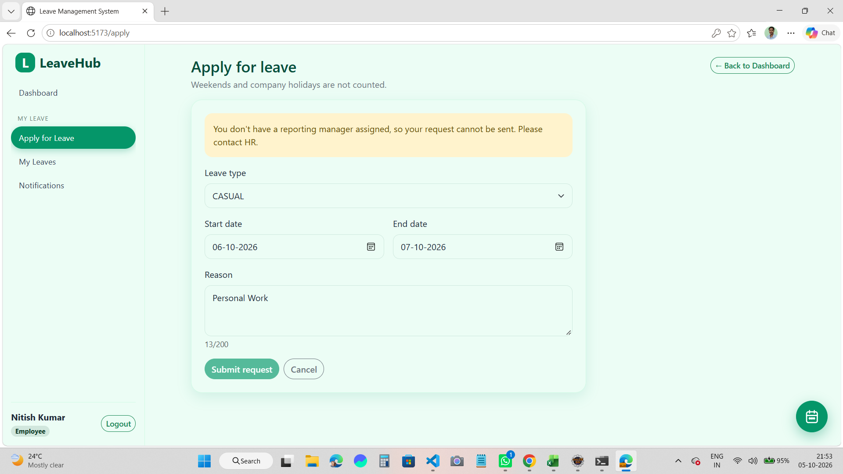
Application Workflow
1
Employee logs in
2
Applies for leave
3
Request goes to Manager
4
Manager approves or rejects
5
Status is updated
Apply for Leave page (employee view)
6
Employee gets notification and balance is updated
Leave Management System
8

Slide 9
Conclusion & Future Scope
Conclusion
Future Scope
Full-stack LMS developed
Frontend and backend work together
Employee, Manager and HR flows done
Data stored in MySQL
Swagger used for API testing
Git/GitHub used for teamwork
Email notifications
Leave reports and charts
Team leave calendar
Mobile app
Deploy on cloud
Thank you!
Leave Management System
9

