Slide 1
FINAL YEAR PROJECT PRESENTATION
PROGRESS STAGE: End of Semester 1
CANDIDATE: Musyani, Samuel Dan
SUPERVISOR: Dr. Hashim Iddi
PROJECT TITLE: Design and Implementation of an Automated ID Card Issuance System

Slide 2
INTRODUCTION
The project aims to ease ID card issuance process for registered students by developing a prototype of an automated system
Registered students will be able to return their expired cards, and retrieve their valid ID cards for that particular academic year

Slide 3
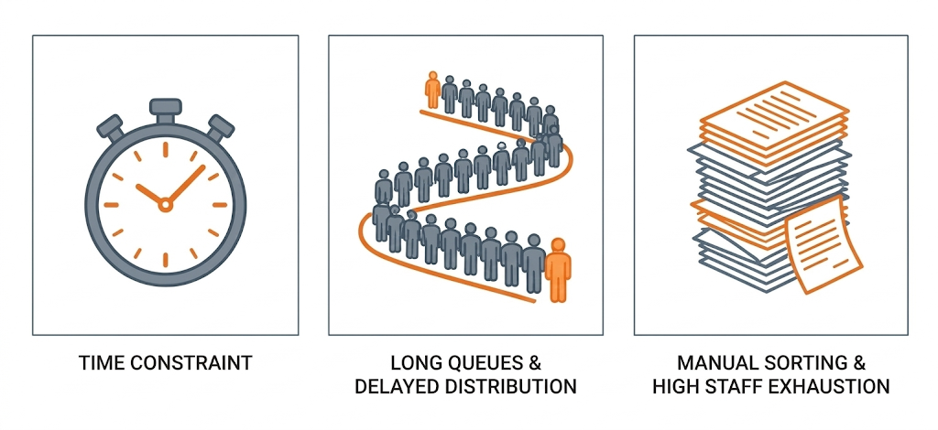
PROBLEM STATEMENT
With high student volumes, narrow administrative working window leads to long queues and delayed distribution

Slide 4
PROPOSED SOLUTIONS
An automated card issuance system, with:
Automated reliable dispensing:
Sorts and distributes cards
24/7 with real-time control
Secure Authentication:
OTP and PIN for student
verification
Computer Vision:
Automated card details verification
for sorting and distribution
Audit logging:
Record all activities happening
for debugging and tracking

Slide 5
OBJECTIVES
Main Objective:
To design and implement an Automated ID card Issuance System
Specific Objectives:
To implement robust authentication
To implement an actuator control system
To enforce security policy and audit logging

Slide 6
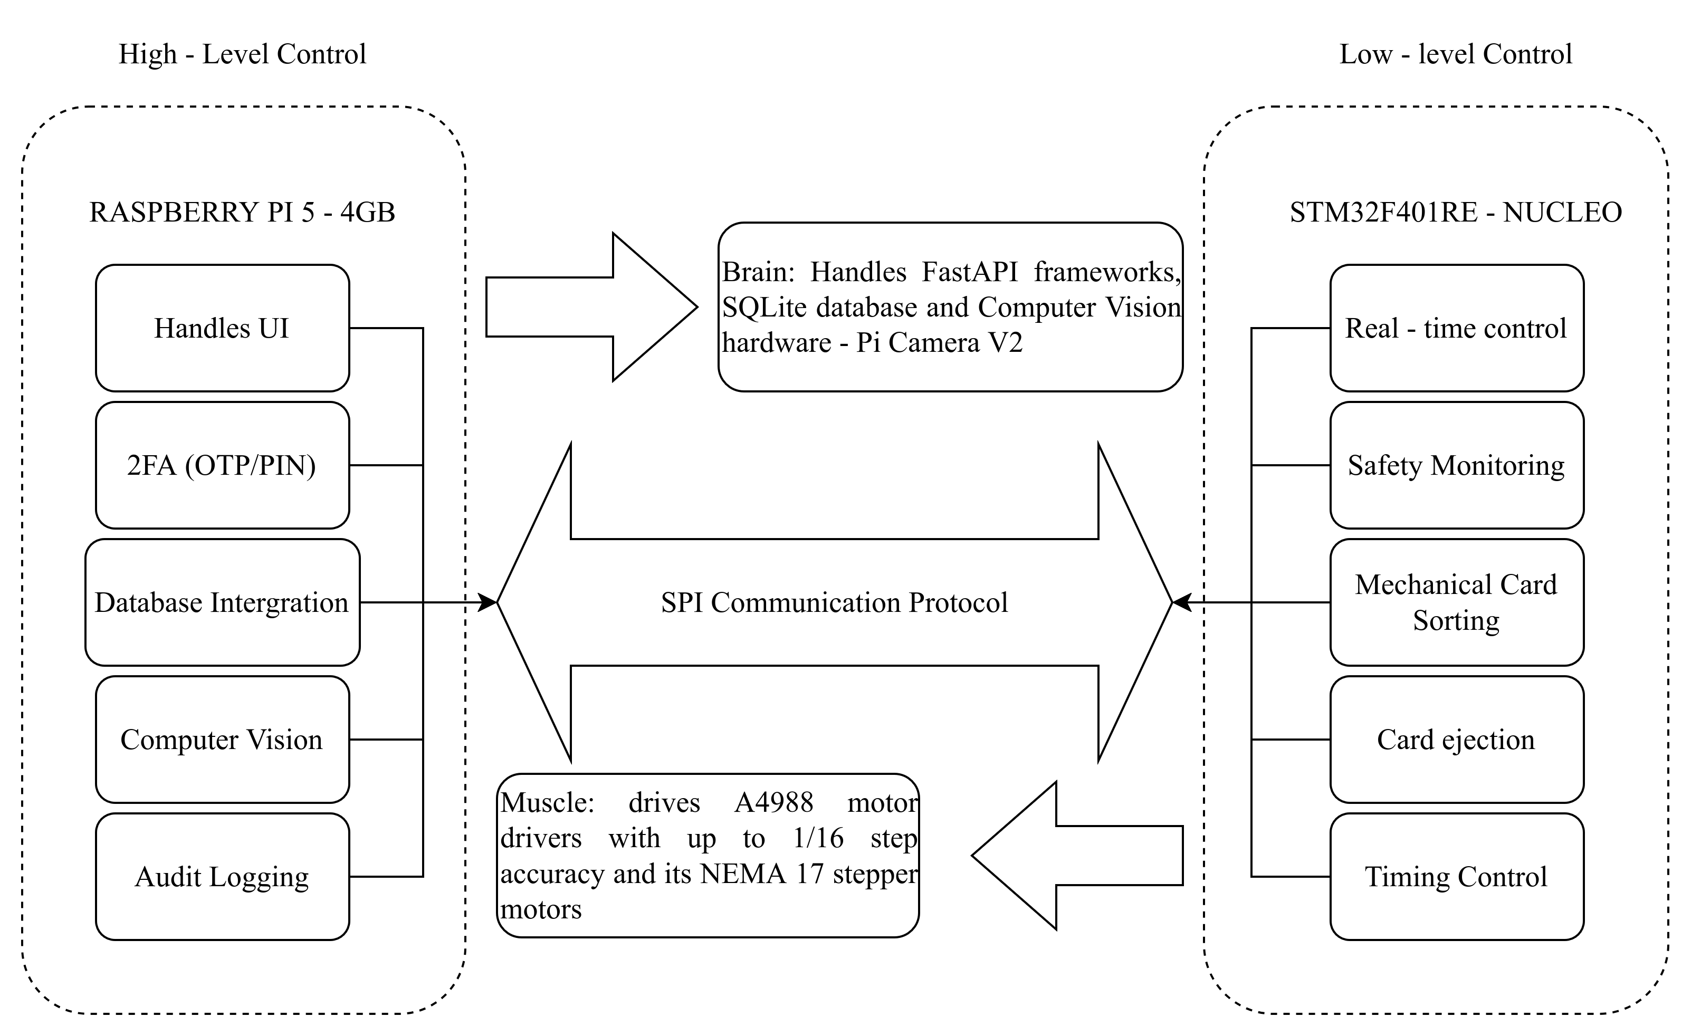
SYSTEM ARCHITECTURE

Slide 7
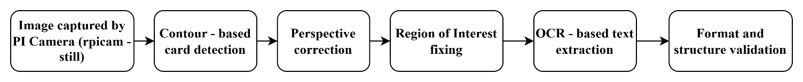
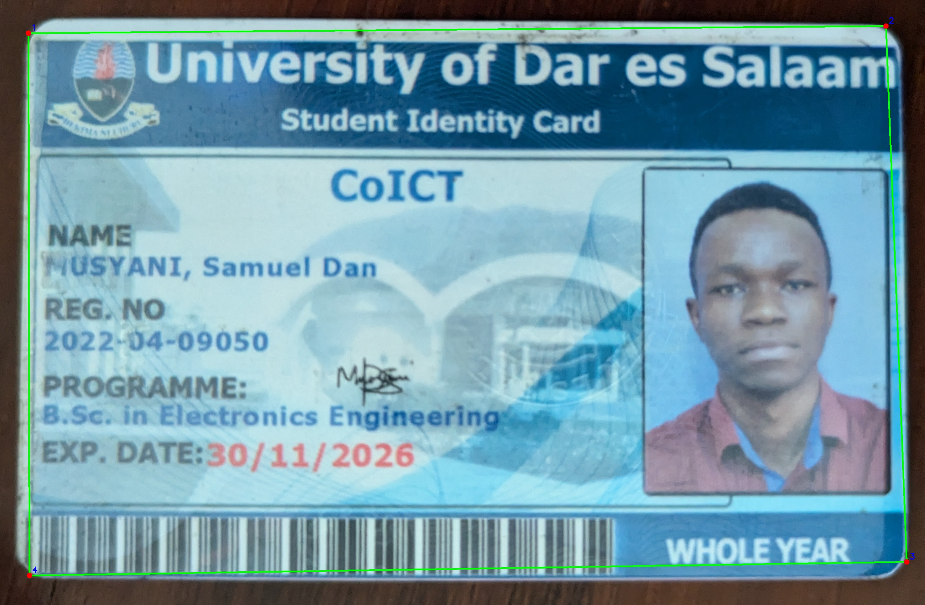
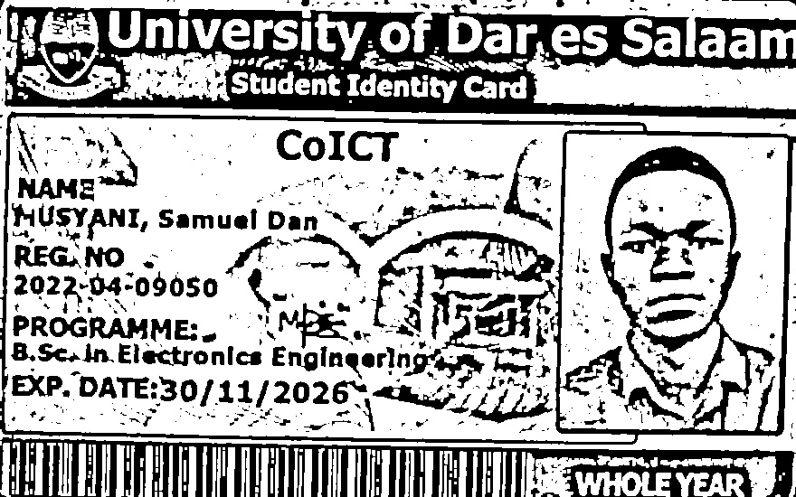
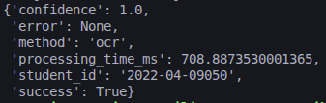
COMPUTER VISION PIPELINE

Slide 8
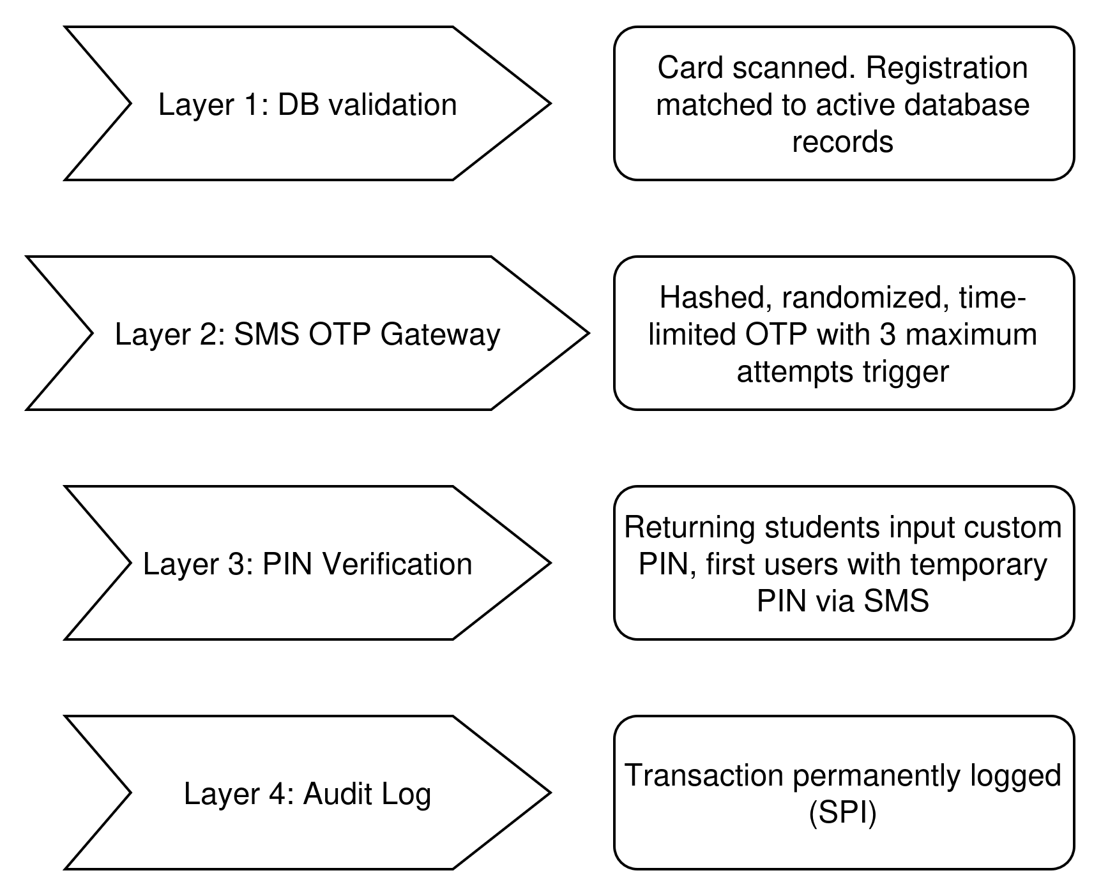
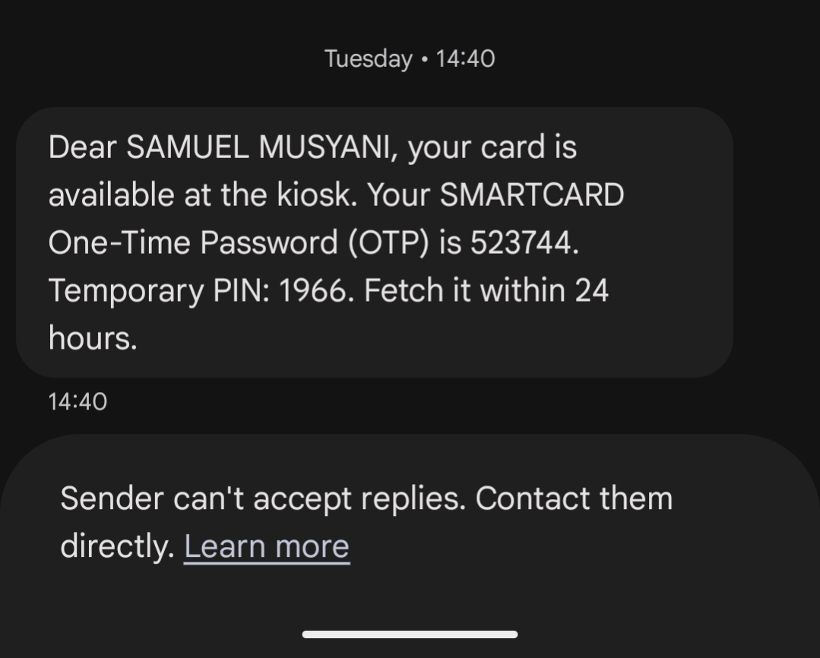
2FA AUTH AND SMS GATEWAY

Slide 9
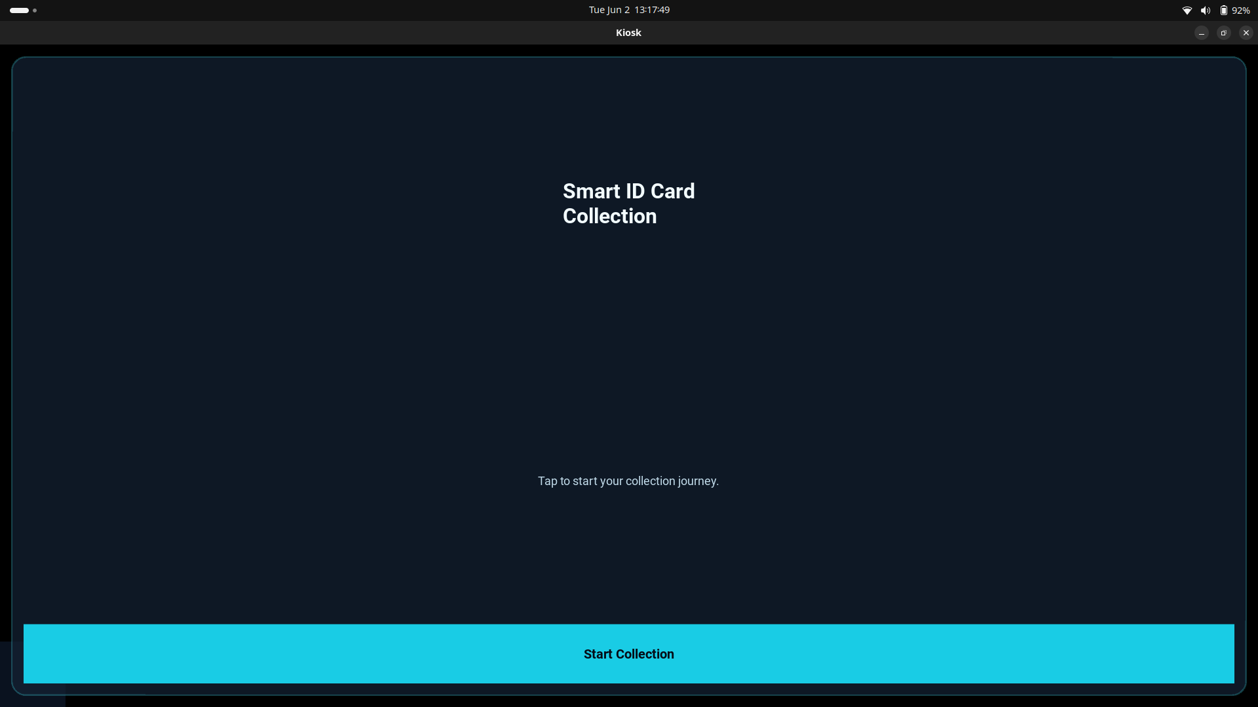
UI Design and State Transitions
Idle Welcome Screen

Slide 10
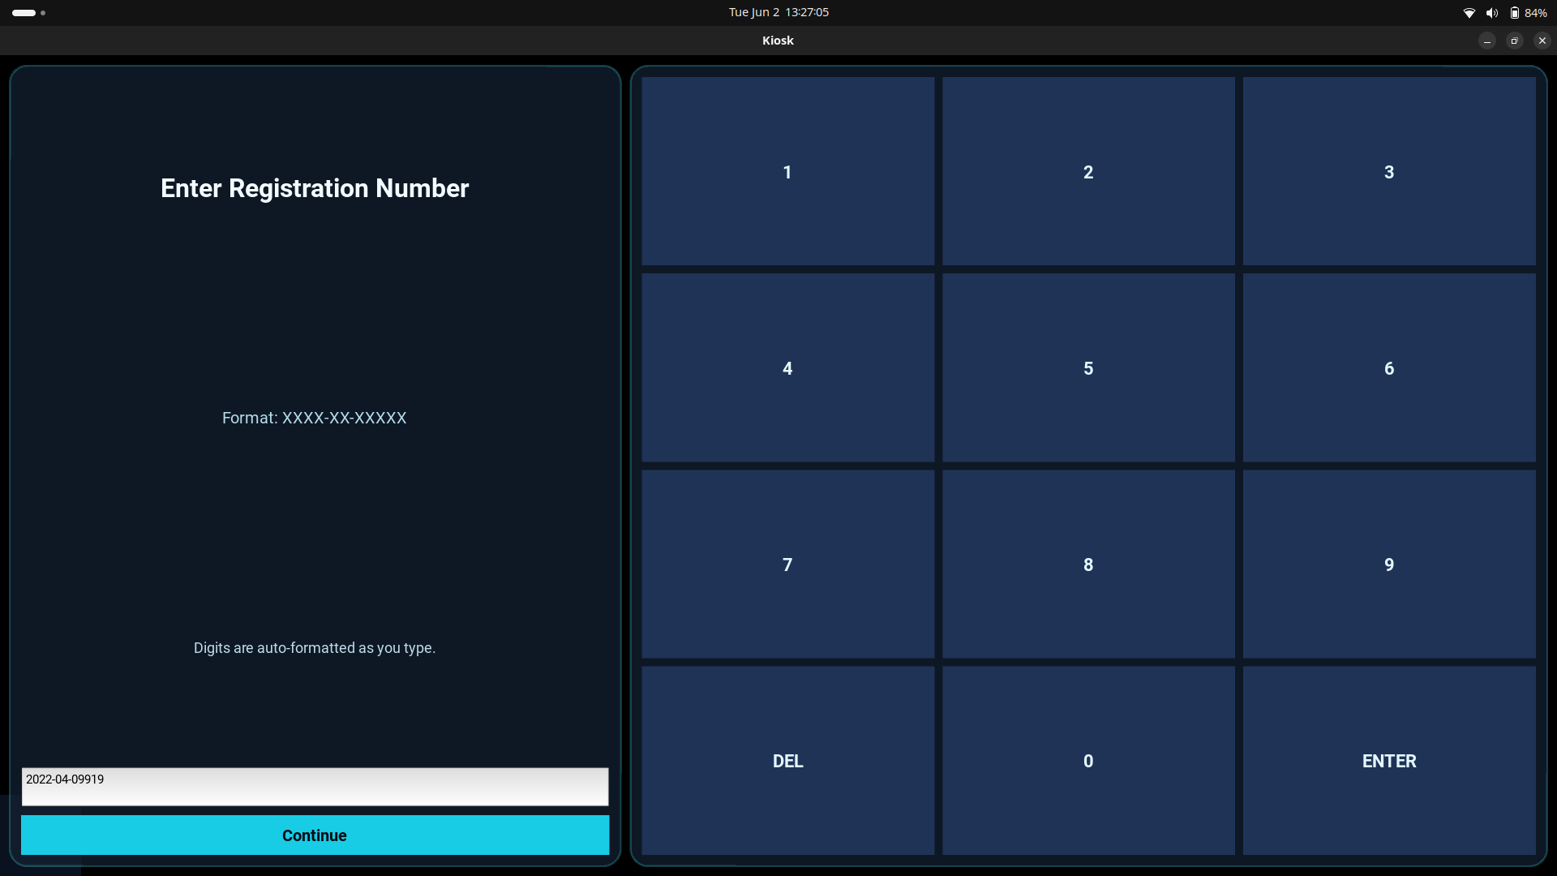
OTP Entry Screen

Slide 11
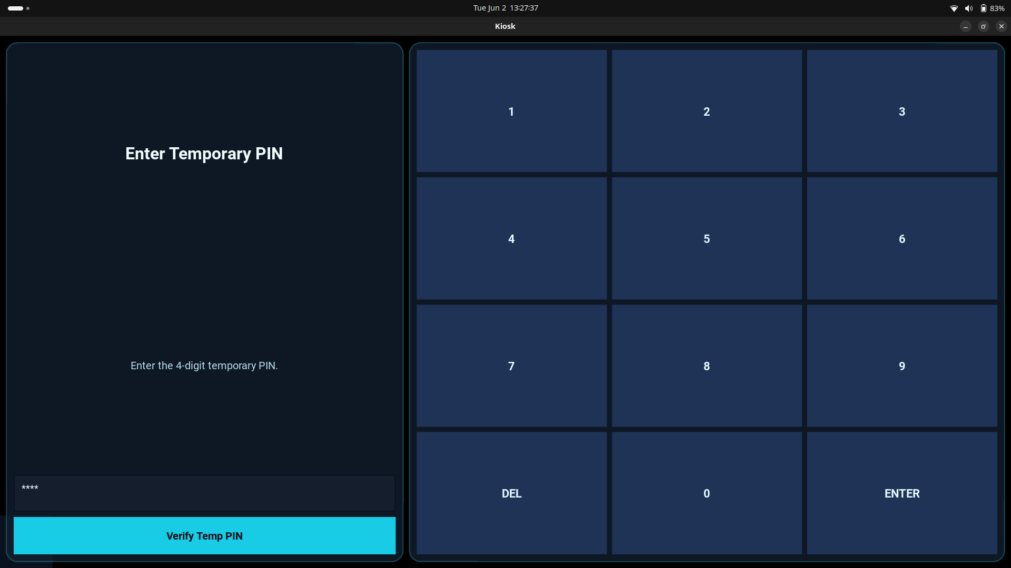
PIN Entry Screen

Slide 12
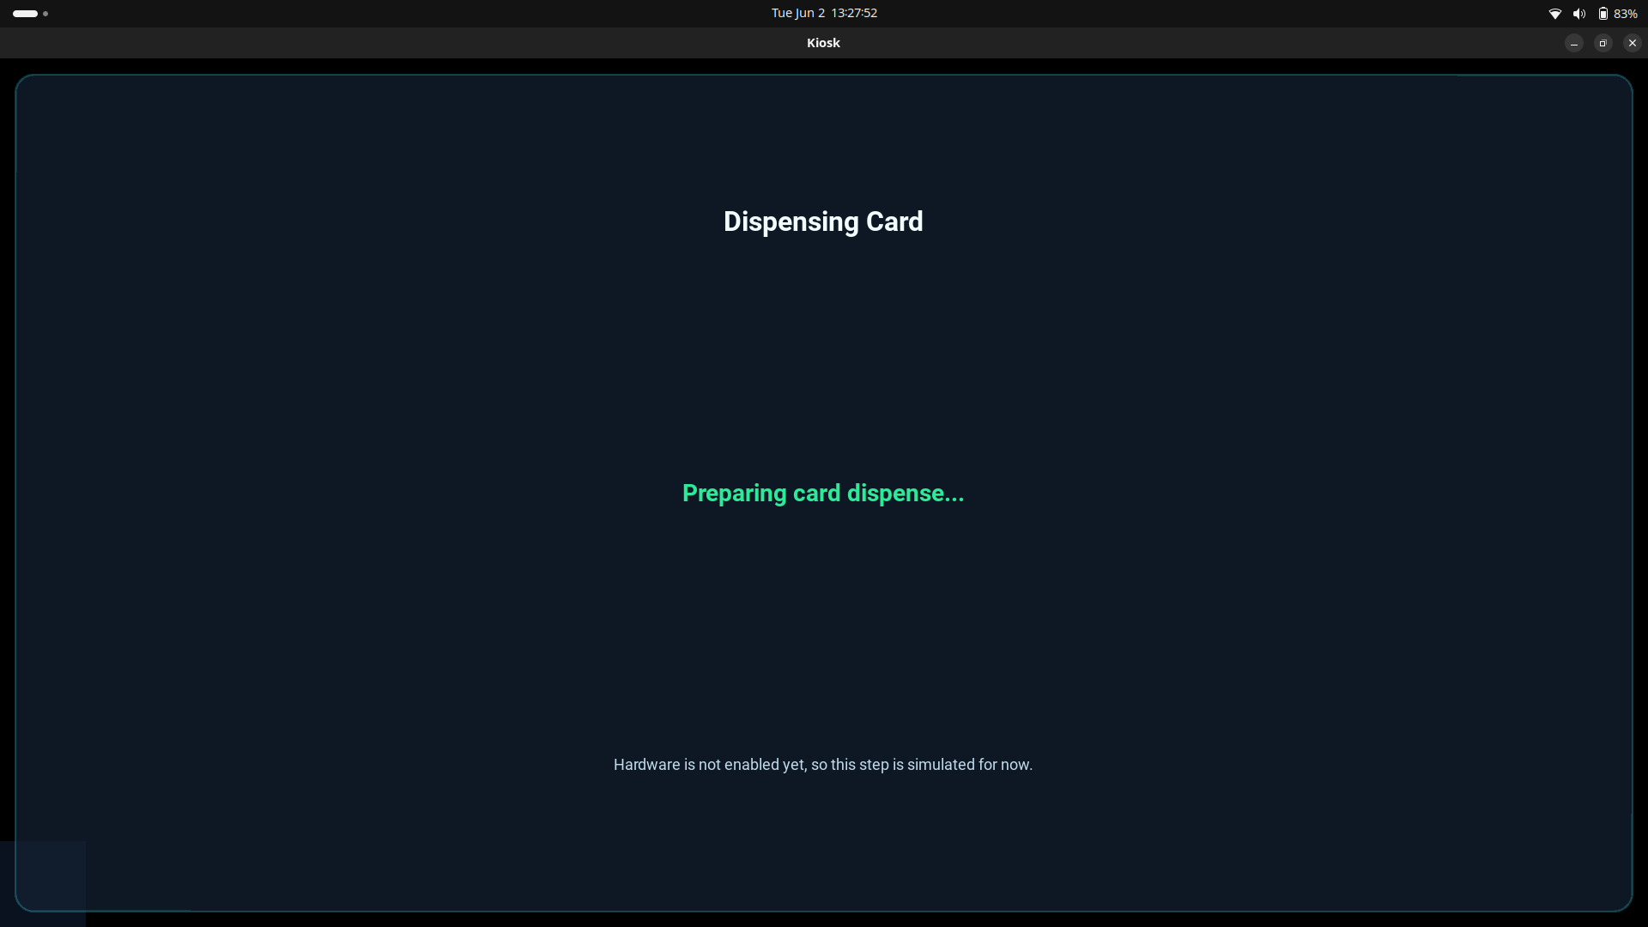
Card Dispensing Screen

Slide 13
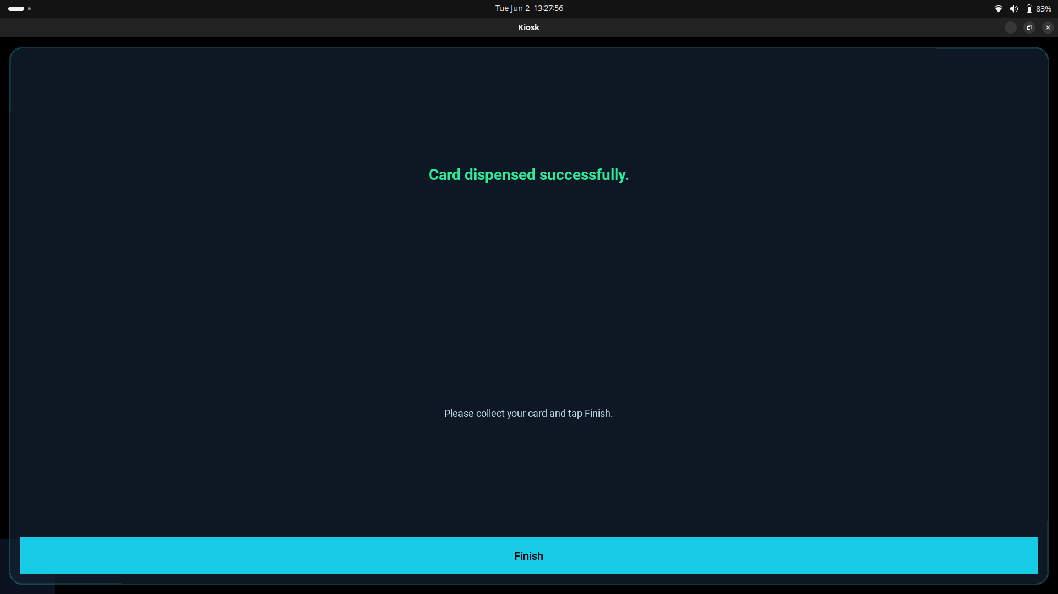
Confirmation Screen

Slide 14

Error Handling Screens
Repeated registration number error

Slide 15

Wrong registration number error

Slide 16
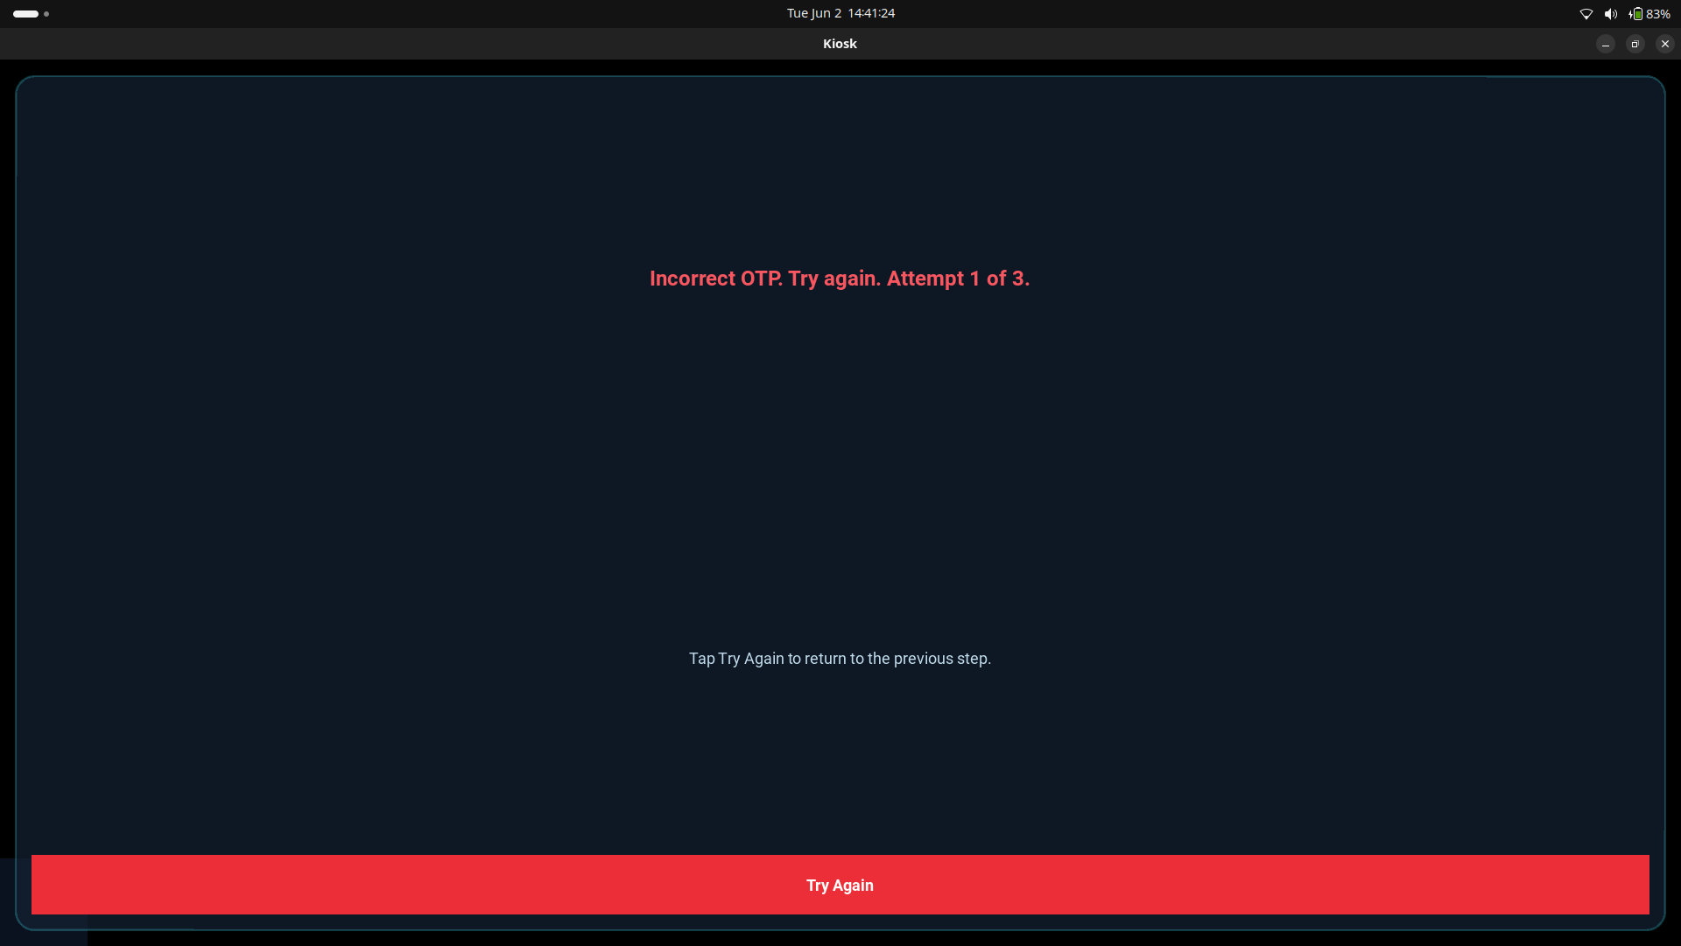
Wrong OTP error

Slide 17

Wrong PIN error

Slide 18
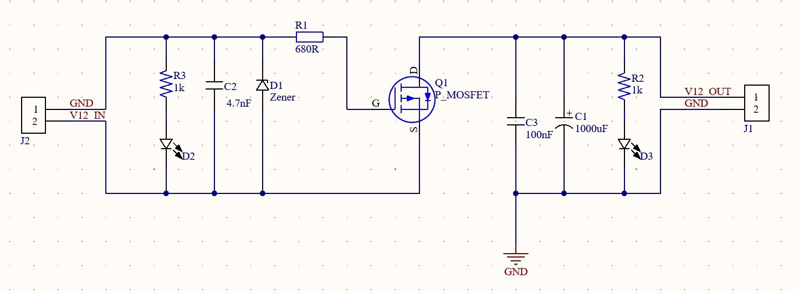
CIRCUIT DESIGN
Reverse polarity circuit

Slide 19
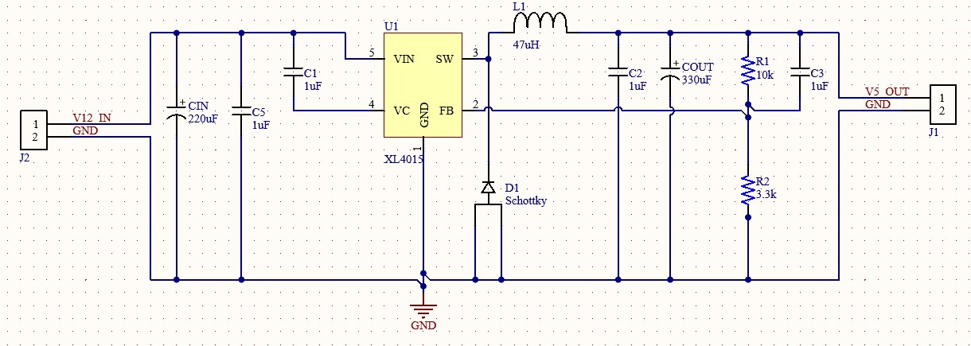
CIRCUIT DESIGN
XL4015 Buck Converter

Slide 20
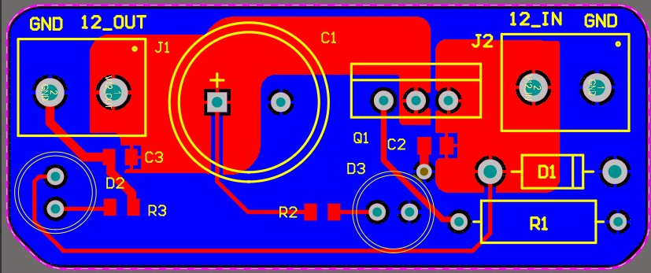
PCB DESIGN
Reverse polarity circuit

Slide 21
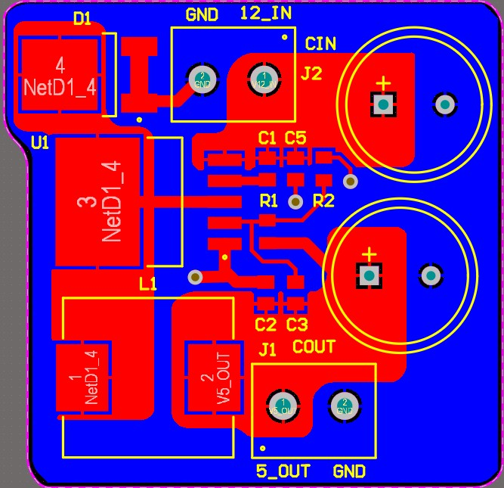
PCB DESIGN
XL4015 Buck Converter

Slide 22
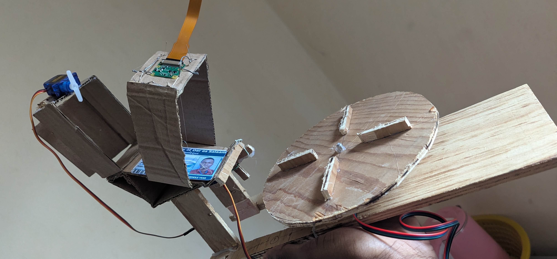
ENCLOSURE DESIGN
The enclosure is still in transformation to a final integrated prototype

Slide 23
Implementation Audit: ~70%
Objective | Status | Percent done
Reliable control systems for actuators | In Progress | 50%
Authentication and database verification | Completed | 100%
Robust transaction logging | Completed | 100%
Security policy (SMS - OTP) | Completed | 100%
Evaluate system performances | In progress | 30%
Formal report on milestones | In progress | 75%

Slide 24
Conclusion
Work done to date; system architecture design, computer vision and OCR pipeline, SMS gateway configuration and two-factor authentication, database creation, verification and transaction logging, circuit schematic and pcb design and simulation
Next progress; finalization of prototype’s enclosure and evaluation of system’s metrics.

