Slide 1
FINAL YEAR PROJECT PRESENTATION
PROGRESS STAGE: End of Semester 1
CANDIDATE: Musyani, Samuel Dan
SUPERVISOR: Dr. Hashim Iddi
PROJECT TITLE: Design and Implementation of an Automated ID Card Issuance System

Slide 2
INTRODUCTION
The project aims to ease ID card issuance process for registered students by developing a prototype of an automated system
Registered students will be able to return their expired cards, and retrieve their valid ID cards for that particular academic year

Slide 3
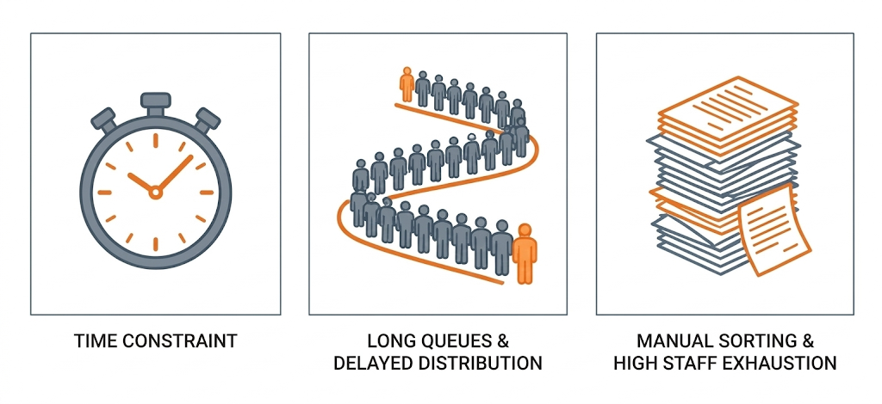
PROBLEM STATEMENT
With high student volumes, narrow administrative working window leads to long queues and delayed distribution

Slide 4
PROPOSED SOLUTIONS
An automated card issuance system, with:
Automated reliable dispensing:
Sorts and distributes cards
24/7 with real-time control
Secure Authentication:
OTP and PIN for student
verification
Computer Vision:
Automated card details verification
for sorting and distribution
Audit logging:
Record all activities happening
for debugging and tracking

Slide 5
OBJECTIVES
Main Objective:
To design and implement an Automated ID card Issuance System
Specific Objectives:
To implement robust authentication
To implement an actuator control system
To enforce security policy and audit logging

Slide 6
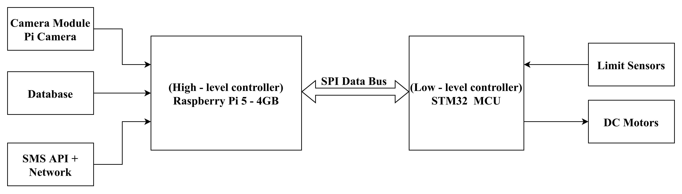
SYSTEM ARCHITECTURE
High – level controller manages authentication, UI, database and computer vision while low – level controller manages real – time controls and sensor integration

Slide 7
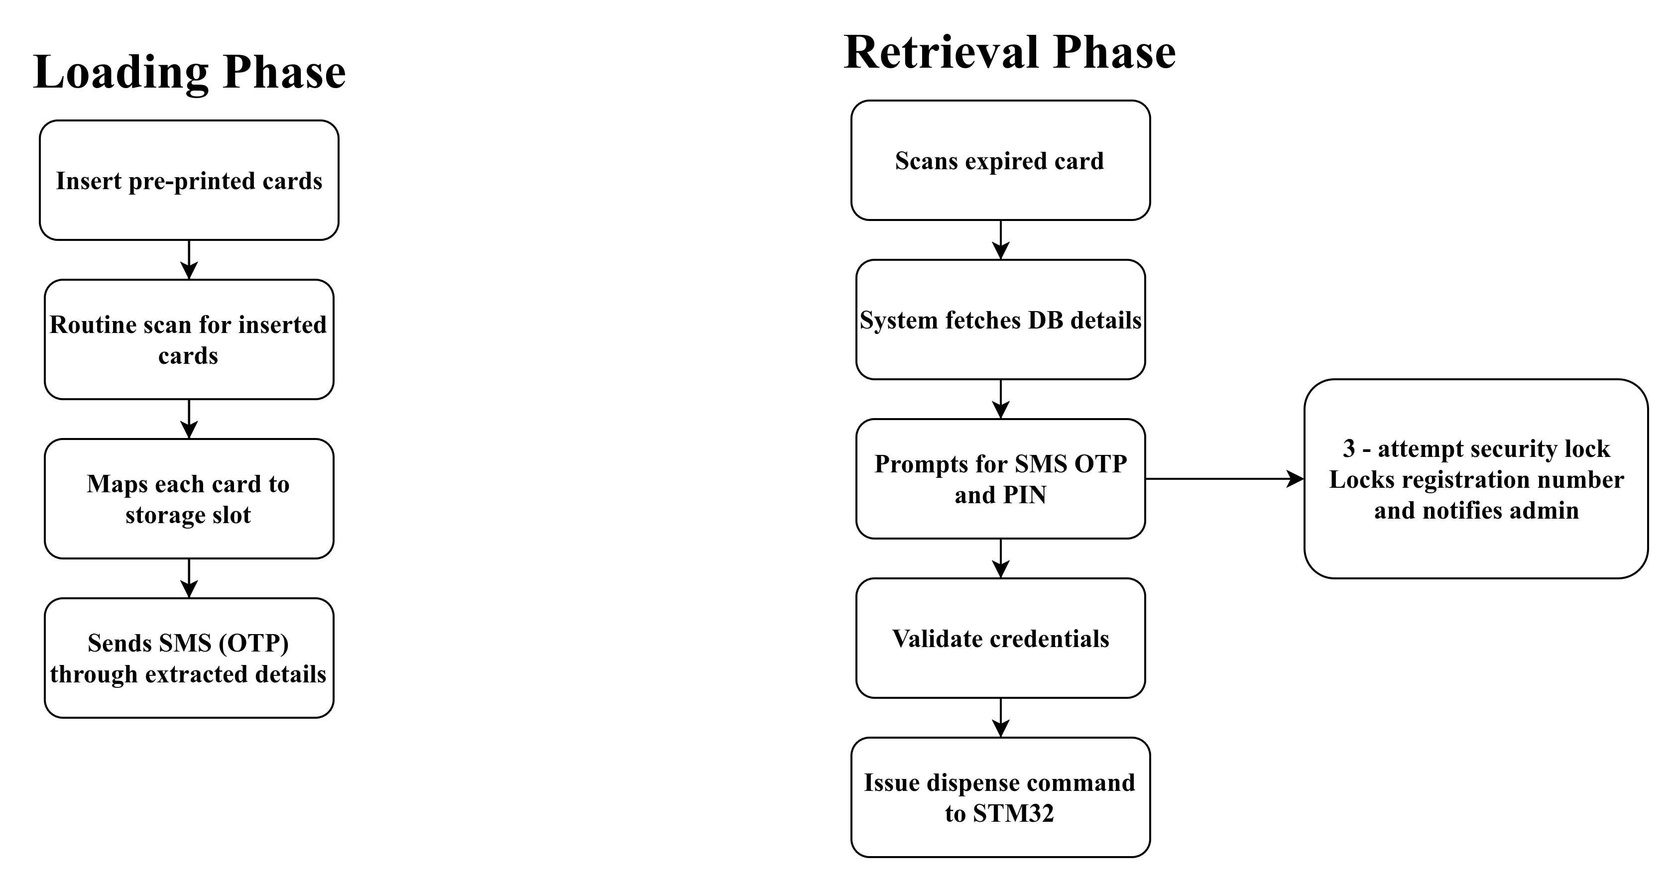
FUNCTIONAL WORKFLOW

Slide 8
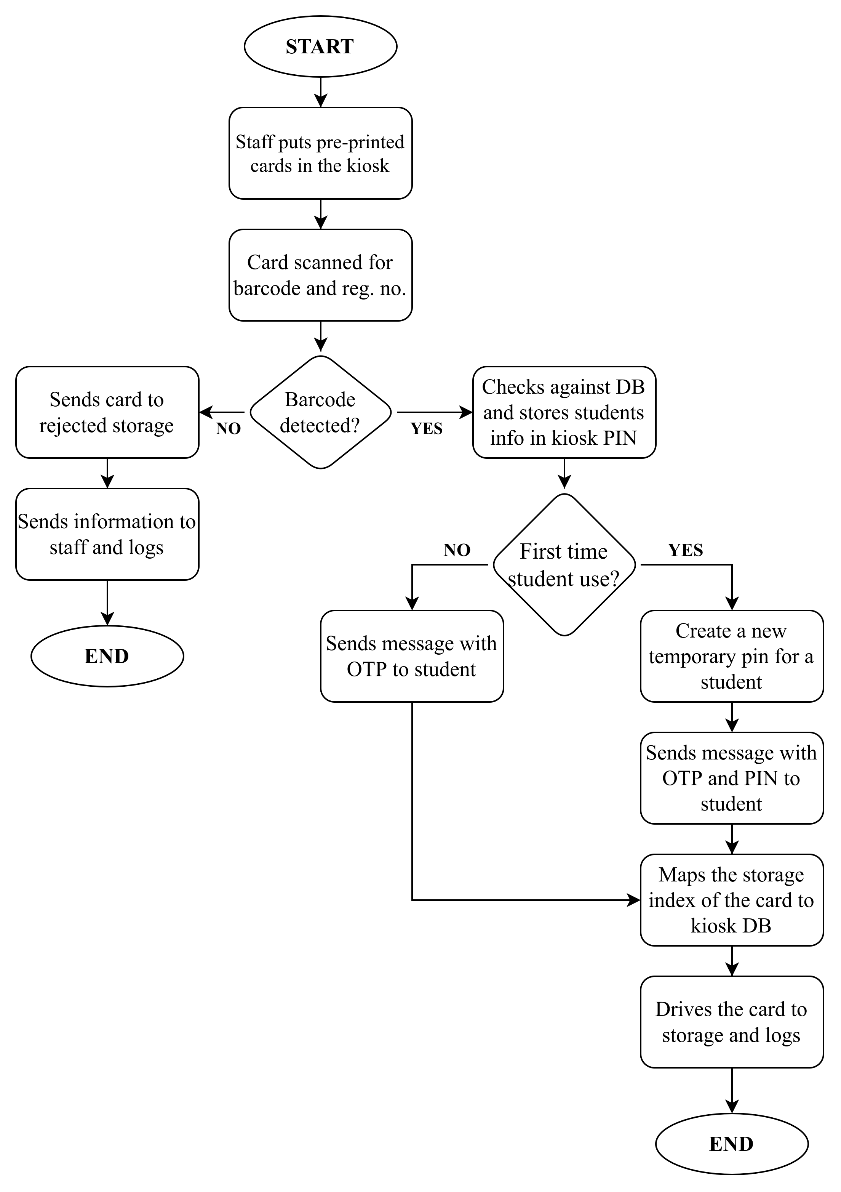
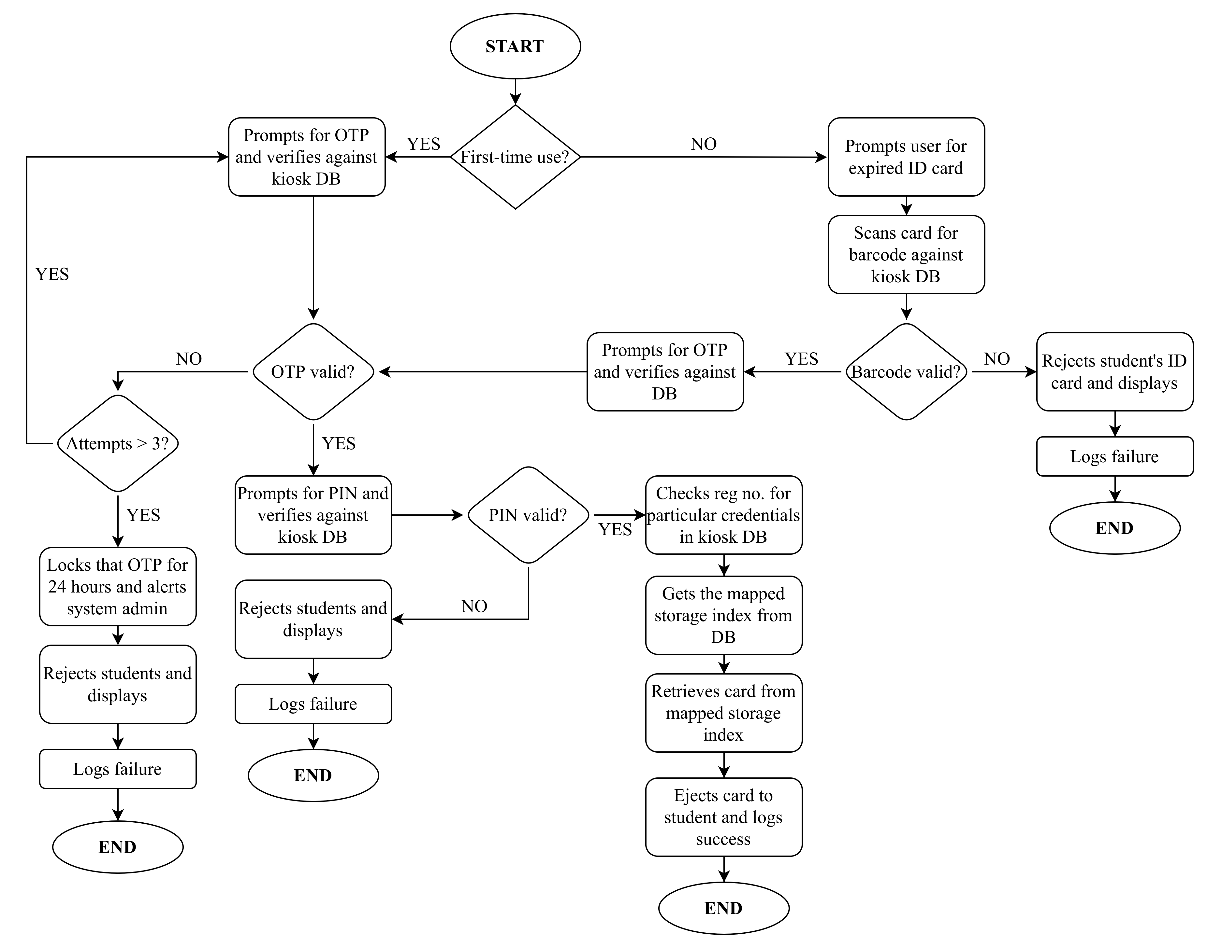
FUNCTIONAL WORKFLOW

Slide 9
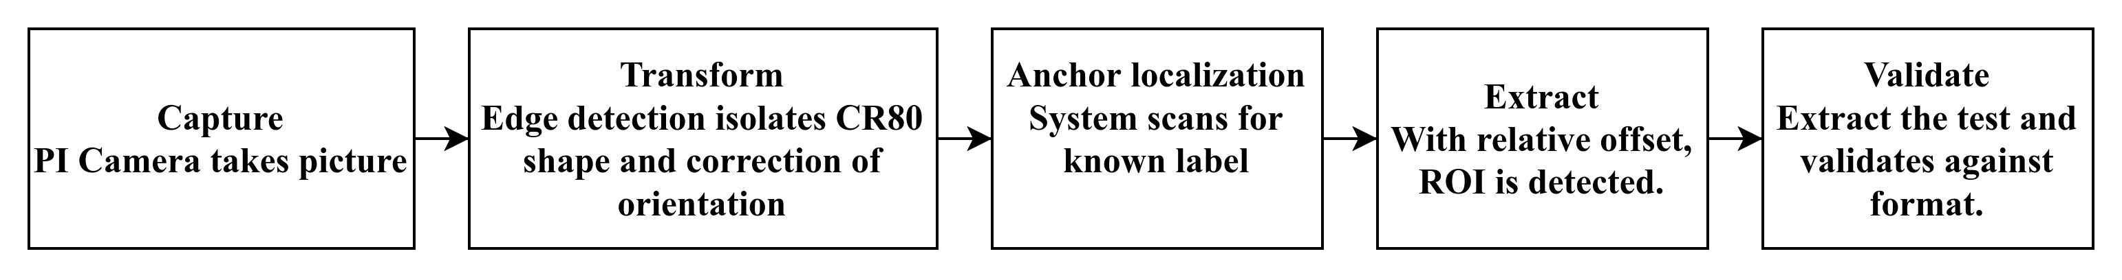
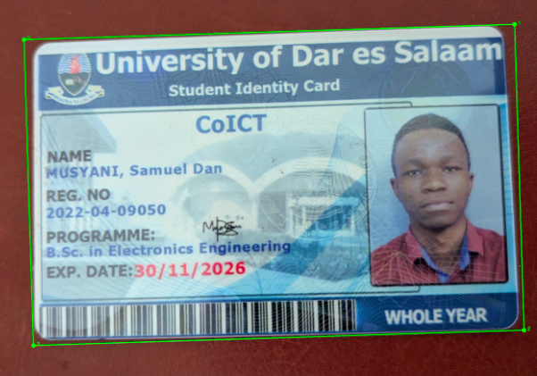
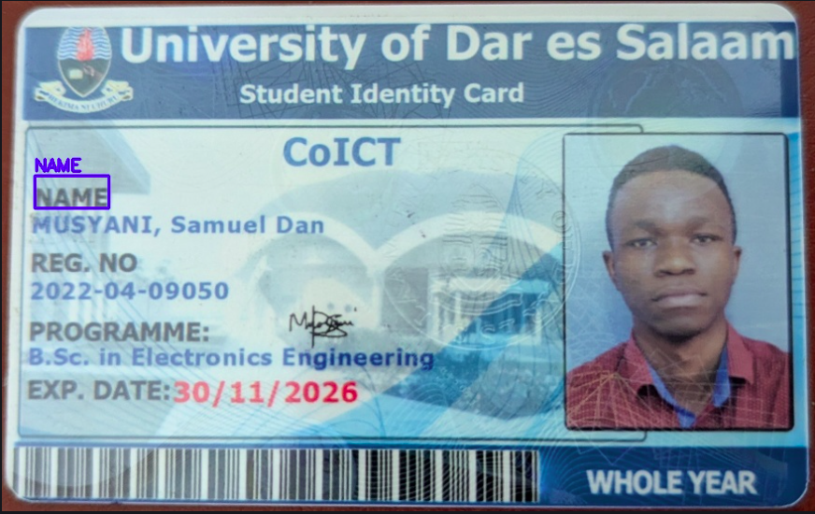
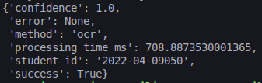
COMPUTER VISION PIPELINE

Slide 10
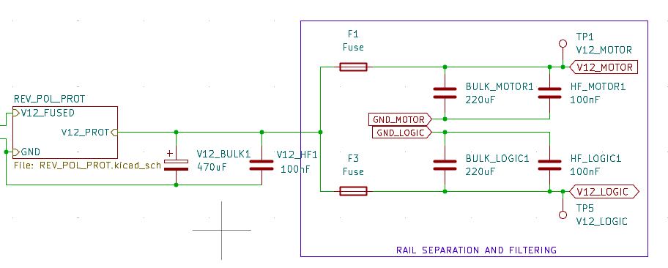
CIRCUIT DESIGN AND SIMULATION
Power separation rail design
Separation is done to prevent inrush current (motors) interfering from logic components

Slide 11
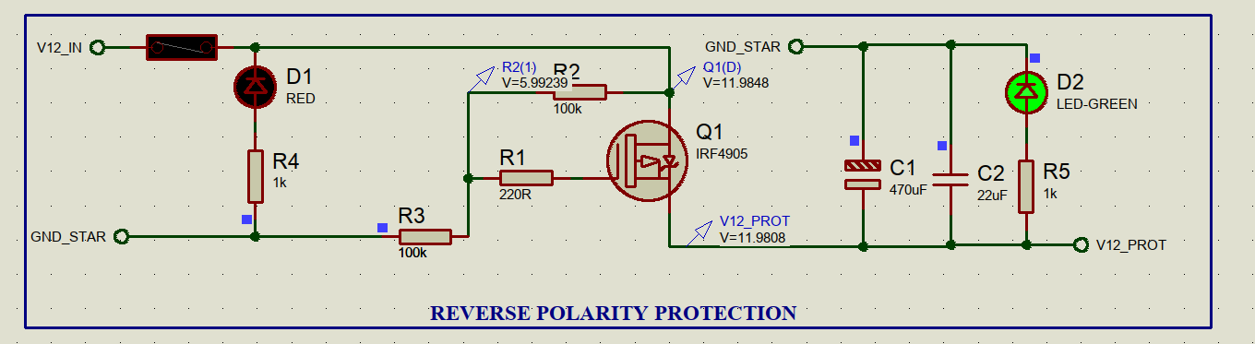
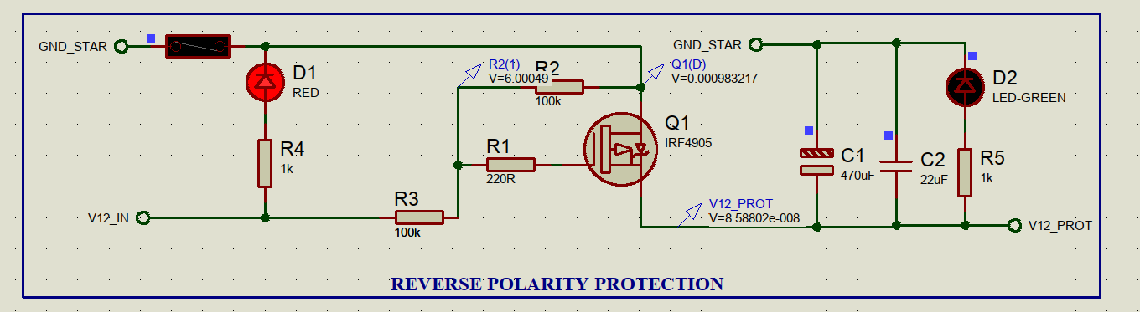
CIRCUIT DESIGN AND SIMULATION
Reverse Polarity Protection Circuit
Correct polarity connection allows connection to the output node
Wrong polarity connection does not allow connection to the output node

Slide 12
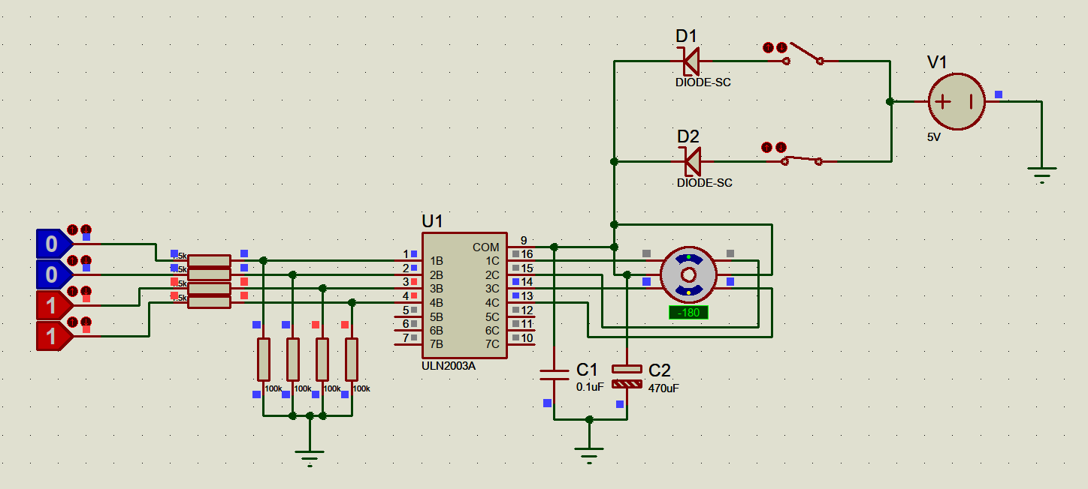
CIRCUIT DESIGN AND SIMULATION
Motor driver circuit
ULN2003A driver circuit was designed to drive stepper motors and simulation went as expected

Slide 13
CONCLUSION
Work done to date; system architecture design, computer vision pipeline, database creation, schematic design and electronic components’ simulation
Next progress; authentication system, hardware components procurement, circuit integration and enclosure design and implementation

