Slide 1


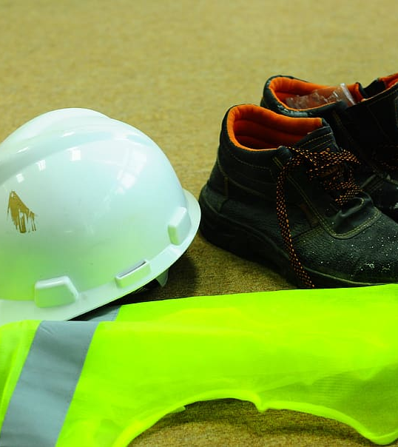
Real tıme Personal prospectıve equıpment detectıon
Artificial Intelligence & Machine Learning (623.504, 22W)
Project PRESENTATION
12237686 Mustafa Tayyİp BAYRAM

Slide 2
Agenda
Learning Task
Why it is important?
What is object detection?
Object detection applications
Preliminary Data Analysis
Literature Overview
Performance Measure
YOLO
Modelling YOLOv5
Modelling YOLOv7
Results and Conclusions

Slide 3
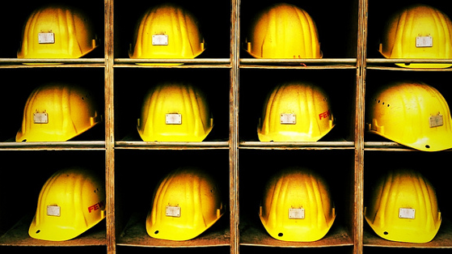
Learnıng Task
Real time personal prospective equipment detection.
Object Detection Task (Computer Vision)
Hard Hat
This Photo by Unknown Author is licensed under CC BY

Slide 4
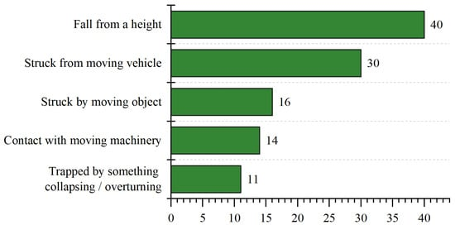
Why ıt ıs ımportant?
The most common cause of construction accidents is falling or becoming stuck in equipment, as well as collisions.
The majority of these injuries can be avoided by using proper protective equipment.

Slide 5
What ıs object detectıon
Object detection is a type of computer vision approach that detects occurrences of semantic items in digital photos and movies.
There are two types of object detection
Image Level: Detecting presence of an object in an image.
Instance Level: Additionally locates each occurrence of the object and drawing a bounding box around it.
Real time algorithms such as
Faster R-CNN, YOLO, SSD, etc.

Slide 6
Object detectıon applıcatıons
Self-driving cars
Surveillance and security
Object tracking in videos
Augmented Reality (AR)
Medical imaging
Retail and e-commerce

Slide 7
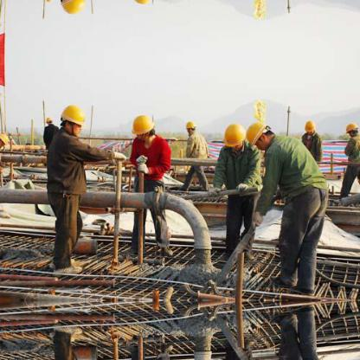
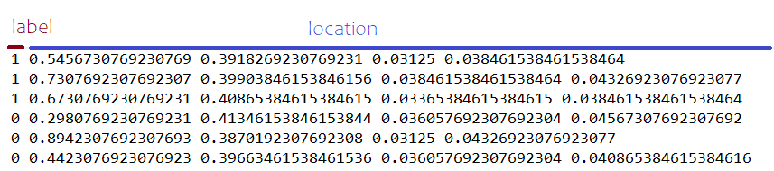
PrelImınary Data Analysıs
Obtained from {roboflow}: Hard Hat Workers Dataset
Shared by Northeastern University – China
Totally 7035 Images
Train: 3688
Validation: 1581
Test: 1766
2 Classes
0 – Head (Without Hard Hat)
1 – Hard Hat
2 – Person (Removed)

Slide 8
Lıterature revıew
Focus on developing Computer Vision algorithms in real time.
COVID-19 Real Time PPE Deteciton with YOLOv4 - mAP 79%
Deep Learning for Site Safety: Real-Time Detection of Personal Protective Equipment YOLOv3 with different methods - mAP 72.3%
Fast Personal Protective Equipment Detection for Real Construction Sites Using Deep Learning Approaches YOLOv5s - mAP 82.65
Focus on developing wearable devices for detection.

Slide 9
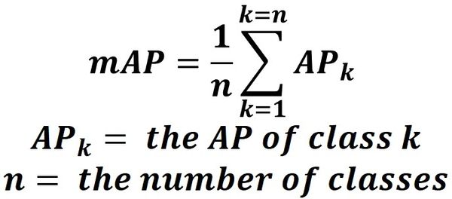
Performance Measure
Purpose: Accuracy and efficiency
Mean Average Precision (mAP): Gives overall measure of the accuracy.
Processing Speed: Measure of the time taken by algorithm to process an image.

Slide 10
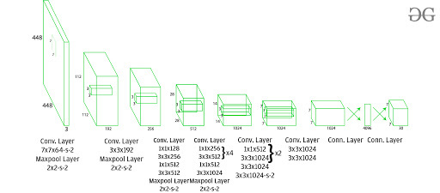
Why and what ıs YOLO (You Only Look once) archıtecture
Fast and Efficient
Uses single neural network to predict bounding boxes and class probabilities directly from full images in one evaluation.
Allows to run in real time on standard hardware such as CCT.
Scalable architecture and simple to implement.
YOLOV_x or YOLOV_s

Slide 11
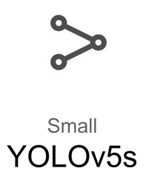
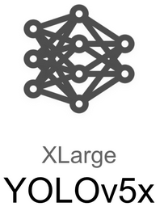
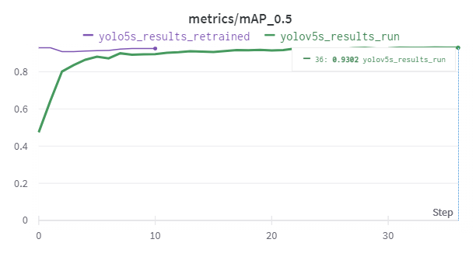
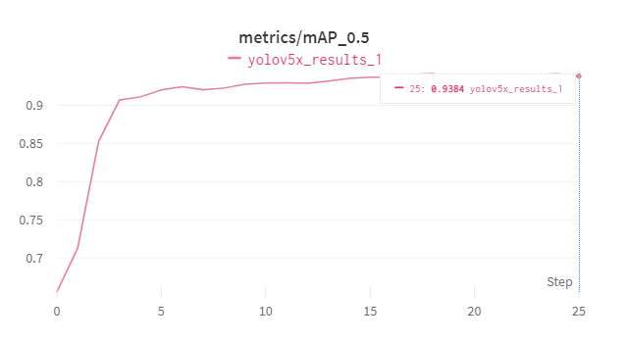
Modelıng yoloV5
YOLOV5S
Best mAP – 0.93
YOLOV5X
Best mAP – 0.93 (non-completed)

Slide 12
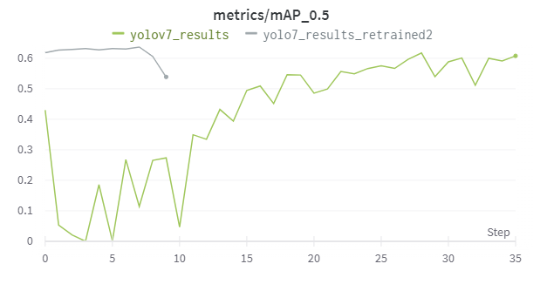
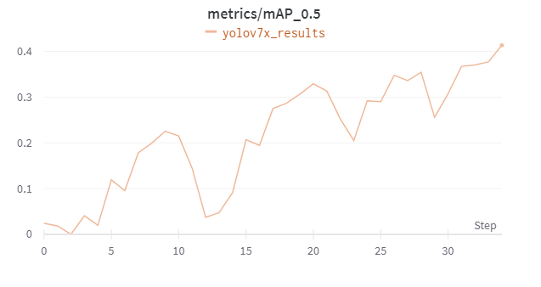
Modelıng yoloV7
YOLOV7
Best mAP – 0.61
YOLOV7X
Best mAP – 0.41 (non-completed)

Slide 13

Results
X models are so complex, and they are not fast as much as base models.
v5 models are more accurate. (Research shows that v7 is much more accurate.)
v5s model is the fastest (it depends on the system)
v5s model is the optimal with new starting (fast and accurate)

Slide 14

Thank you for listening

