Slide 1
User Interface Development - Laboratory
Group D
Mustafa Tayyip BAYRAM 257639
Furkan ÖCALAN 257638

Slide 2
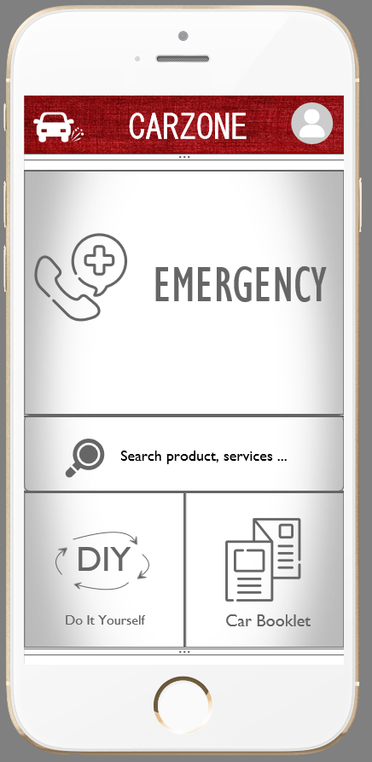
CARZONE Driver Assistance
The aim of our application is to assist drivers comprehensively.

Slide 3
There are 4 main problems we want to solve
The emergencies callings such as ambulance, police, fire department, car towing service in particular.
The closest place where they need such as mechanic, rubber shop, petrol station, car washer, car accessory, car electrician, vehicle inspection station, park area etc.
The section of “Do It Yourself”. There are simple things which can be done by users(potential-users) such as changing tires, keeping vehicle accident reports, changing snow chains, filling wiper fluid following the visual instructions to be displayed.
Car booklets for information specific to each car

Slide 4
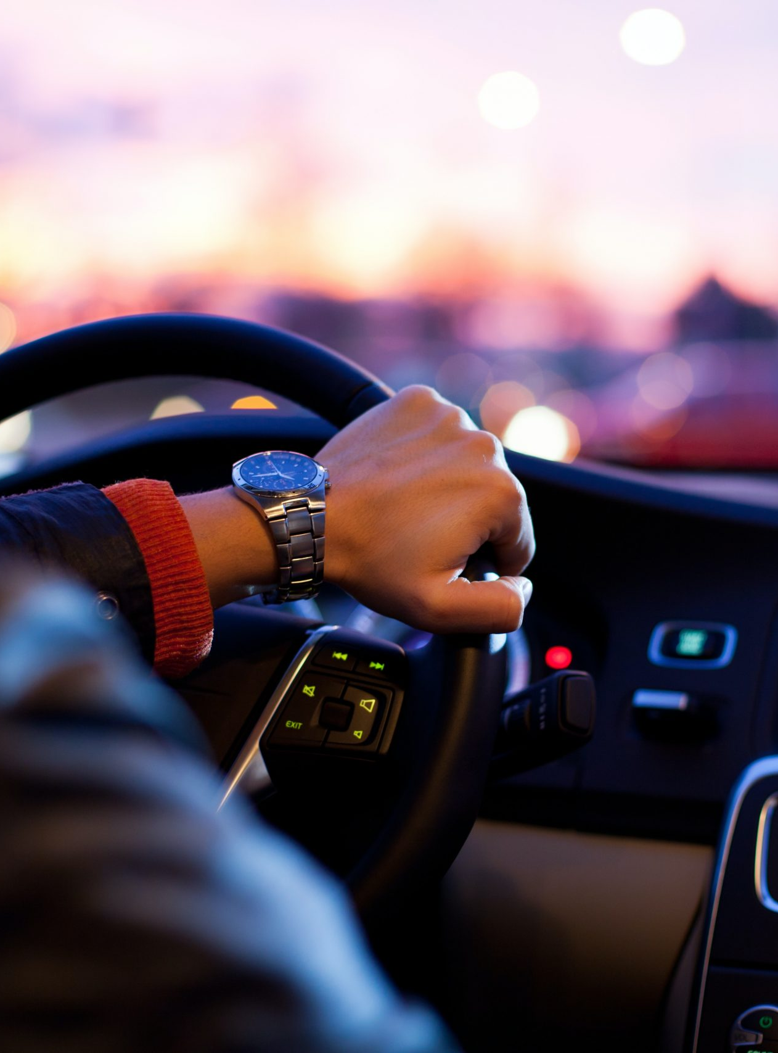
Potential Users
Our potential users are generally who want to solve their problems related to the vehicle in a practical way and financially normal class people.
Our considering is that unexperienced people are the biggest part of the potential users.
Interval of age is so important because the people who don’t have driving licence and under the age of 18 don’t need to use.

Slide 5
Our Competitors
There are some mobile applications that have some similar features and can become competitive applications.
Drivvo is sophisticated but it hasn’t simple design and not user friendly. There is no consistency about general outline.
Infocar isn’t sophisticated application. It’s just technical informations but it is consistent . It is beautifully designed.

Slide 6
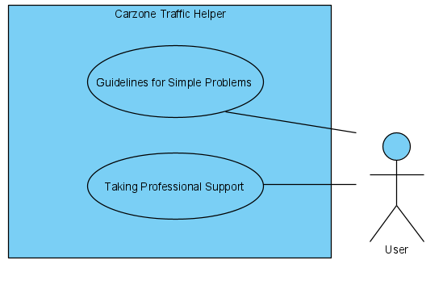
Use Case 1
Guidelines for Simple Problems (Do it yourself): In this use case, there are some detailed and illustrated information prepared by developer. User can use this information to handle simple problems which is drivers encounter.
Taking Professional Support (Emergency Calling): In case of emergency or support, the user will be directed to get the support they need.

Slide 7
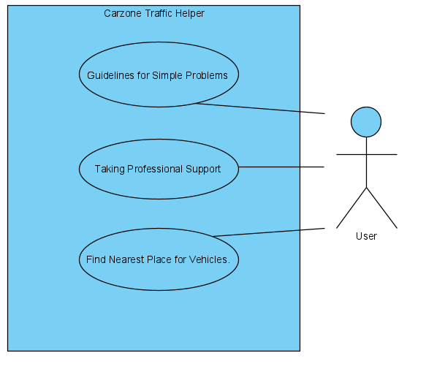
Use Case 2
Guidelines for Simple Problems (Do it yourself): In this use case, there are some detailed and illustrated information prepared by developer. User can use this information to handle simple problems which is drivers encounter.
Taking Professional Support (Emergency Calling): In case of emergency or support, the user will be directed to get the support they need.
Find Nearest Place for Vehicles: This use case contains nearest places which is related to cars, vehicles with different subcategories.

Slide 8
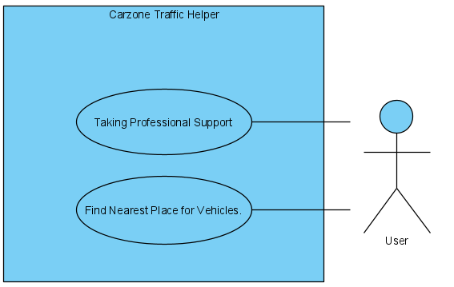
Use Case 3
Taking Professional Support (Emergency Calling): In case of emergency or support, the user will be directed to get the support they need.
Find Nearest Place for Vehicles: This use case contains nearest places which is related to cars, vehicles with different subcategories.

Slide 9
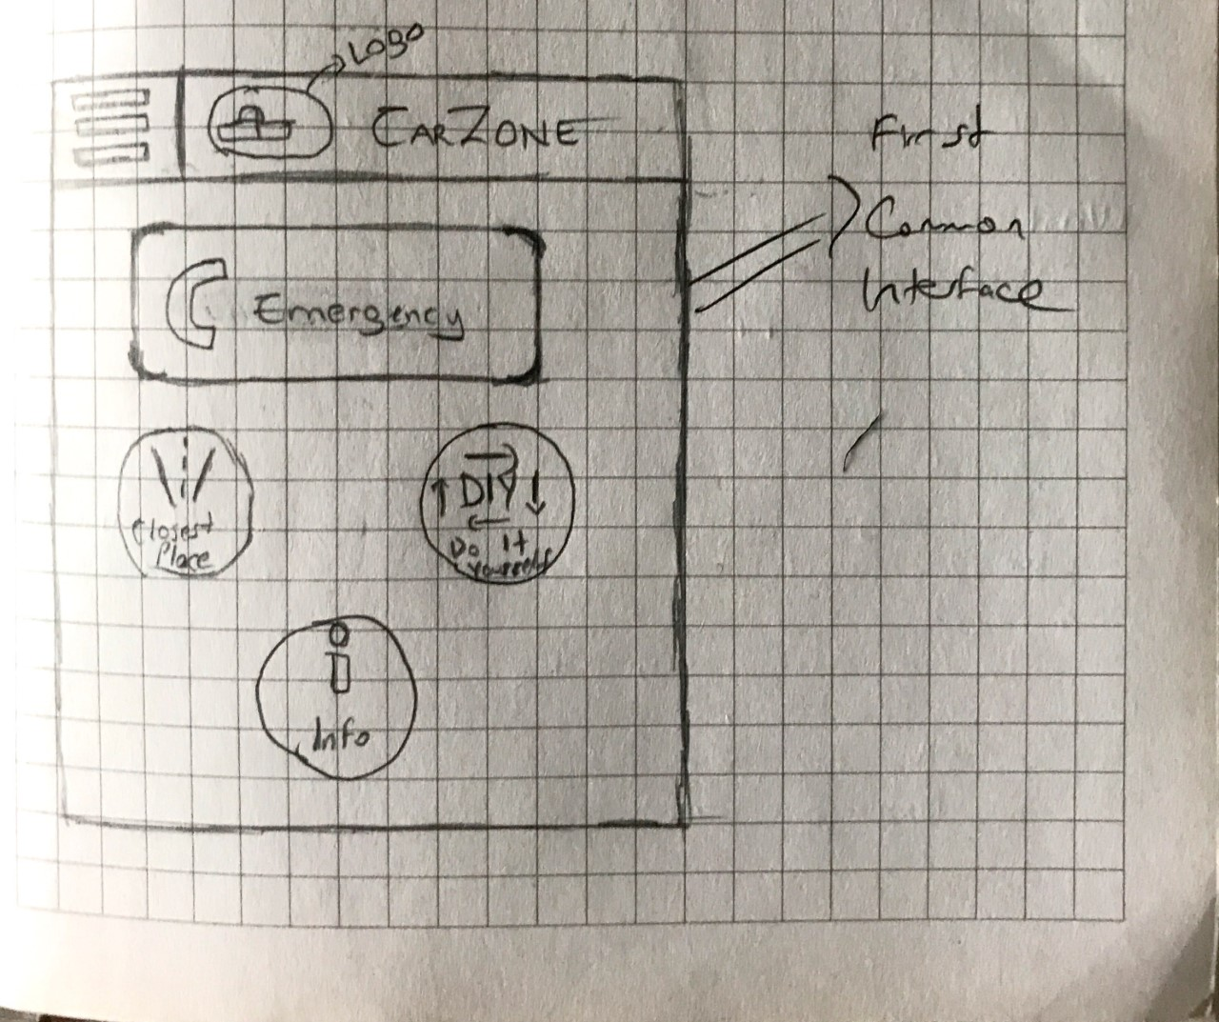
Paper Prototype 1
Our first common user interface.

Slide 10
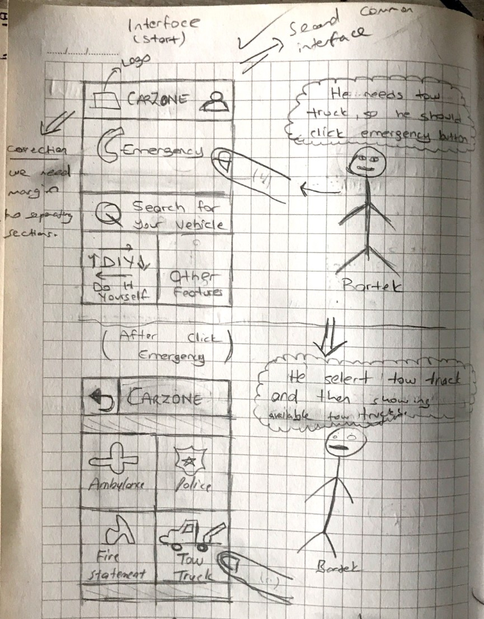
Second Common User Interface.
We chose second one because second one is more simple and more suitable to Fitts’ Law.
Corrections
Correction 1: Simples theme for easy access to application content.
Correction 2: Emergency buttons should be bigger than other operations. ( Fitts’ Law)

Slide 11
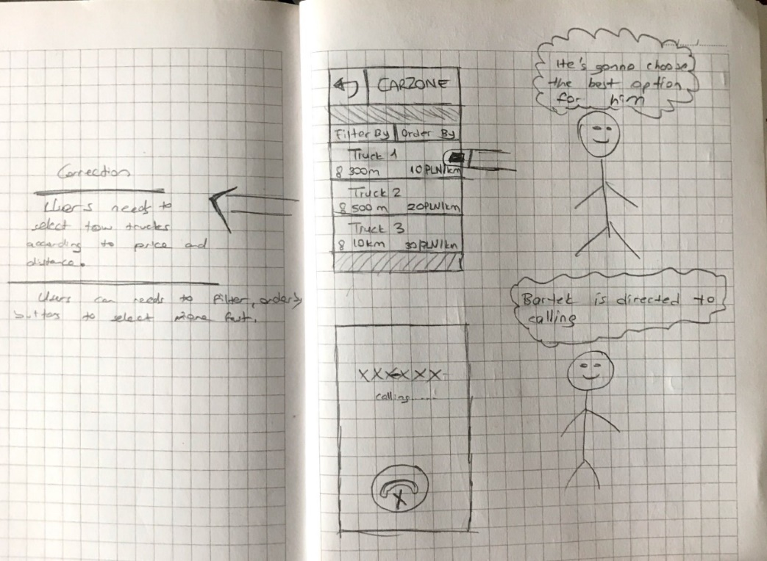
Correction 3: Users needs to select tow trucks according to price and distances. We should show them these properties.
Correction 4: Users can needs to filter, order by buttons to select faster.

Slide 12
Mockup Prototype
BEFORE THE IMPROVEMENT
AFTER THE IMPROVEMENT

Slide 13
Adding Details Button and Searching for tow trucks according to the selected vehicle.
Tow Truck Page

Slide 14
When searching something. It will search accoding to car model which is added user informations .Adding details,map, star grades about shop,contact and website directions. Also Filter By, Order By added.
Searching Product,Service…

