Slide 1

Week 7: Exploratory Data Analysis (EDA) and Basic Statistical Concepts

Slide 2
1. What is Exploratory Data Analysis (EDA)?
Core Definition
Exploratory Data Analysis (EDA) is the process of examining and summarizing datasets to understand their key characteristics before applying formal models or algorithms.
Notes:
Start by asking students: Why do you think EDA is important?

Slide 3
What is EDA continued…
Key Purposes
Understand your data — shape, size, and structure (rows, columns, data types).
Identify data quality issues — missing values, duplicates, outliers, or inconsistent entries.
Explore relationships — detect trends, correlations, and patterns between variables.
Guide next steps — EDA informs decisions on feature engineering, transformations, and modeling approaches.

Slide 4
What is EDA continued
EDA Involves
Summarization: Using descriptive statistics (mean, median, mode, variance).
Visualization: Graphical tools like histograms, box plots, scatter plots, and correlation heatmaps.
Pattern Discovery: Spotting relationships, anomalies, or clusters that might influence analysis.

Slide 5
What is EDA continued
Example
Before predicting student performance, we first explore the dataset:
Check if all subjects have the same grading scale.
Find outliers (e.g., scores above 100).
Identify missing attendance records.
Visualize score distributions across gender.

Slide 6
Why EDA is Important
Detect Data Quality Issues:
Identify missing values, errors, duplicates, or outliers early.
Understand Data Distribution:
Learn whether variables are normal, skewed, categorical, or continuous.
Discover Relationships Between Variables:
Identify correlations, patterns, or associations that inform analysis or modelling.
Guide Data Cleaning and Transformation:
Decide on normalization, scaling, encoding, or imputing based on data behaviour.
Inform Modelling Choices:
Helps select appropriate models and features for predictive or descriptive analysis.
Generate Initial Insights:
Provides preliminary answers and helps form hypotheses for deeper analysis.
Communicate Findings Effectively:
Visualizations from EDA make complex data understandable for stakeholders.
Reduce Risk of Misinterpretation:
Helps prevent making decisions based on unclean or misunderstood data.

Slide 7
Key Components of EDA
1. Descriptive Statistics
Summarize and describe key features of a dataset.
Examples: Mean, Median, Mode, Variance, Standard Deviation.
2. Measures of Central Tendency
Show where the center of the data lies.
Mean → average value
Median → middle value
Mode → most frequent value
3. Measures of Spread (Dispersion)
Show how data values vary around the center.
Range, Variance, Standard Deviation, Interquartile Range (IQR)
4. Data Visualization
Graphical exploration to identify patterns and outliers.
Examples: Histograms, Boxplots, Scatterplots, Pair plots.
5. Relationships and Correlations
Identify how variables relate to each other.

Slide 8
Descriptive Statistics: Understanding your data
Definition: Descriptive statistics summarize and describe the main features of a dataset.
Purpose:
Simplify complex datasets
Highlight patterns and trends
Prepare data for further analysis (EDA & modeling)
Notes:
Explain what each statistic tells us about the data distribution.

Slide 9
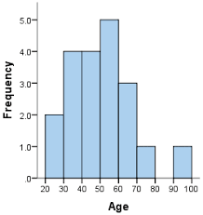
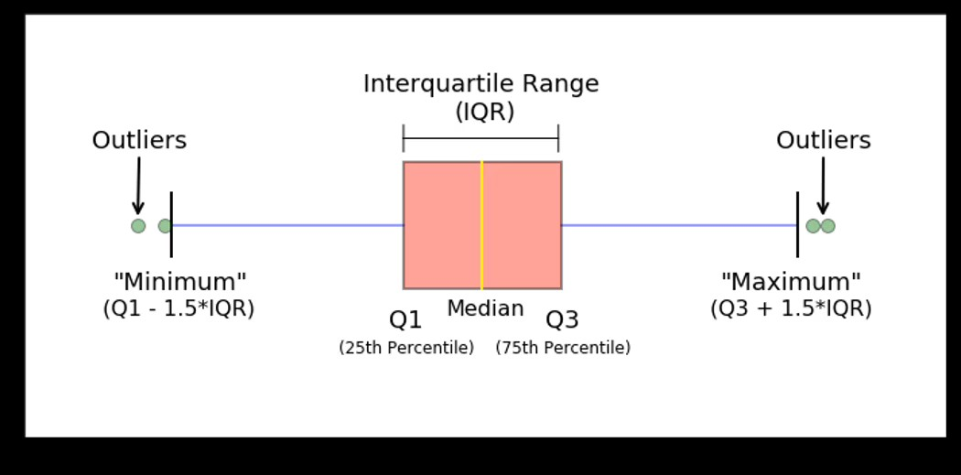
What is a Distribution?
Definition: A distribution shows how the values of a variable are spread or arranged.
Key Concepts:
Frequency: How often each value occurs
Shape: Symmetry, skewness, and peakedness
Spread: Range of values
Example: Age distribution of students in a class

Slide 10
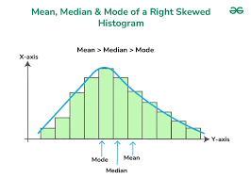
Measures of Central Tendency
Statistic | What it Tells Us | Example in Python
Mean | Average value | df['Age'].mean()
Median | Middle value (50th percentile) | df['Age'].median()
Mode | Most frequent value | df['Age'].mode()

Slide 11
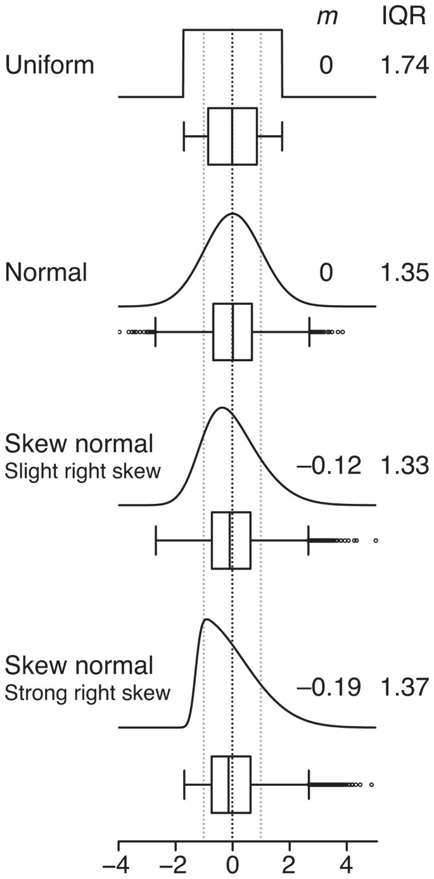
Understanding Asymmetry in a Distribution
Definition:
Skewness measures the asymmetry of a data distribution around its mean.
It tells us whether the data is balanced or lopsided.
Types of Skewness:
Positive Skew (Right Skew):
Tail stretches to the right (towards larger values).
Most data values are smaller, with a few large outliers.
Mean > Median > Mode
Negative Skew (Left Skew):
Tail stretches to the left (towards smaller values).
Most data values are larger, with a few small outliers.
Mean < Median < Mode
Zero Skew (Symmetrical):
Data is balanced around the mean.
Mean ≈ Median ≈ Mode
Example: Normal distribution

Slide 12
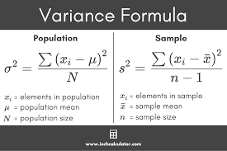
Measures of Spread
Statistic | What it Tells Us | Example in Python
Variance | Average squared deviation from the mean | df['Age'].var()
Standard Deviation | Square root of variance; in same units as data | df['Age'].std()
1. Variance
Definition: Variance measures the average squared deviation of each data point from the mean.
Purpose: Shows how much the data varies or spreads out from the mean.
Key Points:
High variance → data points are widely spread.
Low variance → data points are close to the mean.
Notes:
“Variance tells us how far the data points are from the mean on average, but it’s in squared units.”
“Standard deviation puts it back in the original units, making it easier to interpret.”
“High SD → data is more spread out; Low SD → data is tightly clustered around the mean.”

Slide 13
variance
import pandas as pd
# Example dataset
ages = [18, 20, 20, 21, 25]
# Variance
variance = pd.Series(ages).var()
# Standard deviation
std_dev = pd.Series(ages).std()
print("Variance:", variance)
print("Standard Deviation:", std_dev)

Slide 14
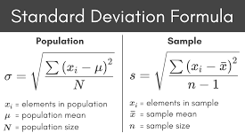
Measures of Spread
2. Standard Deviation (SD)
Definition: Standard deviation is the square root of variance, giving spread in the same units as the data.
Purpose: Makes variance easier to interpret.
Key Points:
High SD → wide spread of values
Low SD → values are clustered around the mean
Formula:

Slide 15
SD
import pandas as pd
# Example dataset
ages = [18, 20, 20, 21, 25]
# Convert to Pandas Series
age_series = pd.Series(ages)
# Calculate standard deviation
std_dev = age_series.std()
print("Standard Deviation:", std_dev)

Slide 16
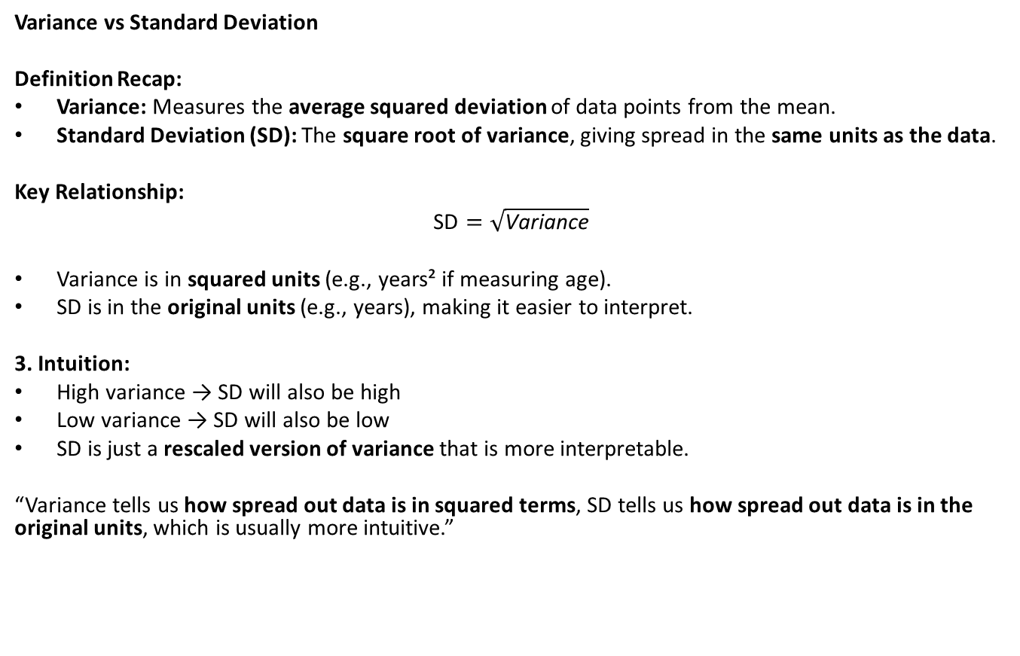
Variance vs Standard Deviation
Variance vs Standard Deviation
Definition Recap:
Variance: Measures the average squared deviation of data points from the mean.
Standard Deviation (SD): The square root of variance, giving spread in the same units as the data.
Key Relationship:
$$\text{SD}=\sqrt{\text{Variance}}$$
Variance is in squared units (e.g., years² if measuring age).
SD is in the original units (e.g., years), making it easier to interpret.
3. Intuition:
High variance → SD will also be high
Low variance → SD will also be low
SD is just a rescaled version of variance that is more interpretable.
“Variance tells us how spread out data is in squared terms, SD tells us how spread out data is in the original units, which is usually more intuitive.”

Slide 17
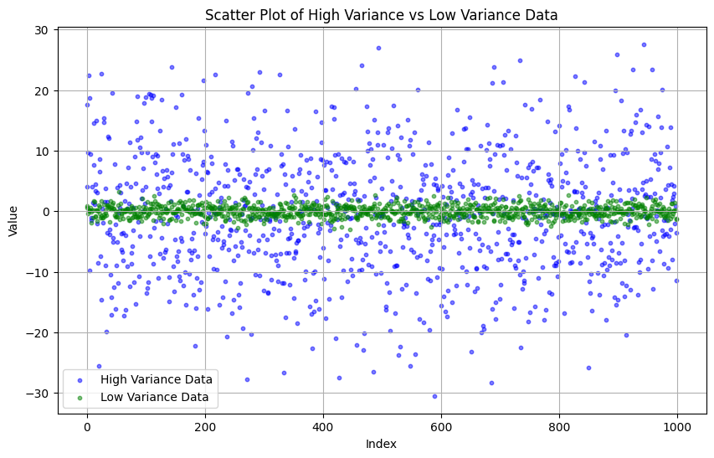
SD and Variance

Slide 18
Exploring Data in Pandas: Useful Functions
Pandas is a powerful Python library for data manipulation and analysis.
Before analysis, we need to understand the dataset’s structure, content, and quality.
These functions help us explore data quickly and efficiently.
Function | Purpose | Example / Output
df.info() | Shows dataset summary: column names, types, non-null counts | Gives a quick overview of dataset structure
df.describe() | Summarizes numeric columns: count, mean, std, min, quartiles, max | Quick summary statistics for numeric variables
df.value_counts() | Counts occurrences of unique values in a column | df['Sex'].value_counts() → {'Male': 50, 'Female': 45}
df.isnull().sum() | Counts missing values in each column | Identifies where data cleaning may be needed
df.groupby('Sex')['Age'].mean() | Aggregates data: calculates mean Age by Sex | Output: Male → 28.5, Female → 27.8
Notes:
Live demo: Show df.describe() and ask learners what insights they get.

Slide 19

Correlation Analysis
Correlation analysis helps us measure the strength and direction of relationships between numeric variables.
It is a key step in EDA to understand how variables interact before modelling.
What is Correlation?
Definition: Correlation quantifies the linear relationship between two variables.
Range: -1 to +1
+1 → perfect positive correlation (as one increases, the other increases)
-1 → perfect negative correlation (as one increases, the other decreases)
0 → no linear correlation
Use Case: Helps identify predictor variables and potential multicollinearity.
Notes:
Discuss: What variables are strongly correlated? Remind that correlation ≠ causation.

Slide 20
Pandas and Seaborn for Correlation
1. Using Pandas:
# Compute correlation matrix
corr_matrix = df.corr()
print(corr_matrix)
2. Visualizing with Seaborn Heatmap:
import seaborn as sns
import matplotlib.pyplot as plt
sns.heatmap(df.corr(), annot=True, cmap='coolwarm')
plt.show()

Slide 21
Visualizing Distributions: Histograms and Boxplots
Visualizations are a key part of EDA, helping us understand how data is distributed and identify patterns or outliers.
Two common ways to visualize numeric data: Histograms and Boxplots.

Slide 22
1. Histogram
Definition:
A histogram displays the frequency distribution of a numeric variable by grouping values into bins.
KDE (Kernel Density Estimate) shows a smooth estimate of the distribution.
Python Example:
import seaborn as sns
import matplotlib.pyplot as plt
sns.histplot(df['Age'], bins=20, kde=True)
plt.title("Histogram of Age")
plt.xlabel("Age")
plt.ylabel("Frequency")
plt.show()
Interpretation:
Shows where most data points are concentrated.
Reveals skewness and potential outliers.
Helps decide whether to transform variables (e.g., log-transform skewed data).
Notes:
Ask: What patterns can you see in age distribution between survivors and non-survivors?

Slide 23
2. Boxplot
Definition:
A boxplot (or whisker plot) shows median, quartiles, range, and outliers.
Useful for comparing distributions across groups.
Python Example:
sns.boxplot(x='Survived', y='Age', data=df)
plt.title("Boxplot of Age by Survival")
plt.show()
Interpretation:
Box → interquartile range (IQR)
Line inside box → median
Whiskers → range of typical data
Dots outside whiskers → outliers
Helps compare distributions between categories (e.g., Survived = 0 vs 1)
Notes:
Ask: What patterns can you see in age distribution between survivors and non-survivors?

Slide 24
Scatter and Pair Plots: Visualizing Relationships
Beyond distributions, we often want to explore relationships between two or more variables.
Scatter plots and pair plots are powerful tools for this purpose.
Notes:
Interactive discussion: What can scatter plots reveal that summary stats cannot?

Slide 25
1. Scatter Plot
Definition:
A scatter plot shows the relationship between two numeric variables.
Adding a hue allows us to distinguish groups (e.g., categorical outcomes).
Python Example:
import seaborn as sns
import matplotlib.pyplot as plt
sns.scatterplot(x='Age', y='Fare', hue='Survived', data=df)
plt.title("Scatter Plot of Age vs Fare by Survival")
plt.xlabel("Age")
plt.ylabel("Fare")
plt.show()
Interpretation:
Pattern: Do higher fares correlate with age?
Group differences: Are survivors clustered differently from non-survivors?
Outliers: Spot unusual points that may affect analysis.

Slide 26
2. Pair Plot (Scatterplot Matrix)
Definition:
A pair plot shows scatter plots for every combination of selected numeric variables.
Often includes histograms or KDE on the diagonal.
Color-coded by a categorical variable to compare groups.
Python Example:
sns.pairplot(df[['Age','Fare','Survived']], hue='Survived’)
plt.show()
Interpretation:
Quickly observe relationships between multiple variables.
Identify linear or non-linear trends, clusters, and potential correlations.
Diagonal plots show variable distributions for each group.

Slide 27
Grouping and Aggregation in Pandas
Often in EDA, we want to summarize numeric data by categories.
Grouping and aggregation help us compute statistics for subsets of data, such as averages, counts, or sums.
This is key for comparing patterns across groups.
1. Basic Grouping
Python Example:
# Mean Fare by Passenger Class
df.groupby('Pclass')['Fare'].mean()
Interpretation:
Groups data by Passenger Class (Pclass) and calculates the average fare for each class.
Useful for understanding differences between categories.
Example Output:
Pclass
1 87.5
2 21.0
13.0
Shows that first-class passengers paid higher fares on average.
Notes:
Highlight how groupby helps summarize data by categories.

Slide 28
2. Grouping by Multiple Columns
Python Example:
# Mean survival rate by Sex and Pclass
df.groupby(['Sex','Pclass'])['Survived'].mean()
Interpretation:
Groups data by Sex and Passenger Class, then calculates the average survival rate.
Reveals interaction effects between categories.
Example Output:
Sex Pclass
female 1 0.97
2 0.92
3 0.50
male 1 0.36
2 0.16
3 0.13
Shows females had higher survival rates, especially in higher classes.

Slide 29
Probability and Normal Distribution
Probability is the likelihood of an event occurring.
Many statistical methods assume that data follows a normal distribution (bell-shaped curve).
Understanding distributions helps in modeling, hypothesis testing, and inference.
Notes:
Explain z-scores and why normality matters in statistical analysis.

Slide 30
1. What is a Normal Distribution?
A symmetric, bell-shaped distribution where most values cluster around the mean.
Characteristics:
Mean = Median = Mode
About 68% of data lies within 1 standard deviation of the mean
About 95% of data lies within 2 standard deviations
About 99.7% of data lies within 3 standard deviations (Empirical Rule)

Slide 31
2. Python Example: Simulating Normal Data
import numpy as np
import seaborn as sns
import matplotlib.pyplot as plt
# Generate random normal data
data = np.random.normal(0, 1, 1000)
# Plot histogram with KDE
sns.histplot(data, kde=True)
plt.title("Histogram of Normally Distributed Data")
plt.xlabel("Value")
plt.ylabel("Frequency")
plt.show()
Explanation:
np.random.normal(mean, std, size) generates synthetic normally distributed data.
Histogram with KDE visualizes the bell-shaped distribution.

Slide 32
3. Interpretation
“Normal distributions are fundamental in statistics for probability calculations and inferential methods.”
“Many statistical tests (t-test, ANOVA, regression) assume normally distributed residuals.”
“Visual inspection with histograms or KDE helps verify this assumption.”
“Real data may not be perfectly normal; small deviations are often acceptable.”

Slide 33
9. Project 1: Titanic Dataset EDA
1. Load dataset: sns.load_dataset('titanic')
2. Explore survival by Sex, Age, Pclass
3. Visualize relationships using Seaborn plots
Notes:
Guide students to explore patterns and discuss real-world implications.

Slide 34
Code example
# Step 1: Import libraries
import pandas as pd
import seaborn as sns
import matplotlib.pyplot as plt
# Step 2: Load dataset
df = sns.load_dataset('titanic')
# Quick look at the dataset
print(df.head())
print(df.info())
# Step 3: Explore survival by Sex, Age, and Pclass
# Survival counts by Sex
print(df.groupby('sex')['survived'].value_counts(normalize=True))
# Survival rate by Pclass
print(df.groupby('pclass')['survived'].mean())
# Survival rate by Sex and Pclass
print(df.groupby(['sex','pclass'])['survived'].mean())
# Step 4: Visualizations
# 4a: Bar plot - Survival by Sex
sns.countplot(x='sex', hue='survived', data=df)
plt.title("Survival Counts by Sex")
plt.show()
# 4b: Boxplot - Age distribution by Survival
sns.boxplot(x='survived', y='age', data=df)
plt.title("Age Distribution by Survival")
plt.show()
# 4c: Histogram - Age distribution
sns.histplot(df['age'], bins=20, kde=True)
plt.title("Histogram of Age")
plt.show()
# 4d: Scatter plot - Age vs Fare colored by Survival
sns.scatterplot(x='age', y='fare', hue='survived', data=df)
plt.title("Age vs Fare by Survival")
plt.show()
# 4e: Pair plot - Age, Fare, Survival
sns.pairplot(df[['age','fare','survived']], hue='survived')
plt.show()

Slide 35
10. Wrap-Up
1. Purpose of EDA:
Understand your data before modeling.
Detect errors, missing values, outliers, and unusual patterns.
Inform data cleaning, feature selection, and transformations.
2. Key Tools and Techniques:
Descriptive Statistics: Mean, Median, Mode, Variance, Standard Deviation, Skewness.
Data Exploration in Pandas: df.info(), df.describe(), value_counts(), isnull().sum(), groupby().
Visualizations:
Histograms & KDE → distributions
Boxplots → spread & outliers
Scatter & Pair plots → relationships
Heatmaps → correlations
3. Practical Insights:
Patterns and relationships help generate hypotheses.
Visualizations make data intuitive and interpretable.
EDA is iterative: explore → clean → visualize → summarize → repeat.
4. Next Steps:
Use insights from EDA to prepare for modeling or reporting.
Always document findings to support decision-making.
Visual Suggestion:
A flow diagram:
Raw Data → EDA (Summary Stats + Visuals) → Cleaned Data → Modeling / Insights
Notes:
Close with reflection and invite learners to share insights.

