Slide 1

Car price..
Between 2006 and 2019

Slide 2
Welcome.
This presentation is to present the project of used Car prices in Riyadh during the period from 2006 to 2019 and to note the significant change in prices during this period.

Slide 3





Tools:
Data:
https://www.kaggle.com/kerneler/starter-saudi-arabia-car-prices-84317d90-9/data

Slide 4
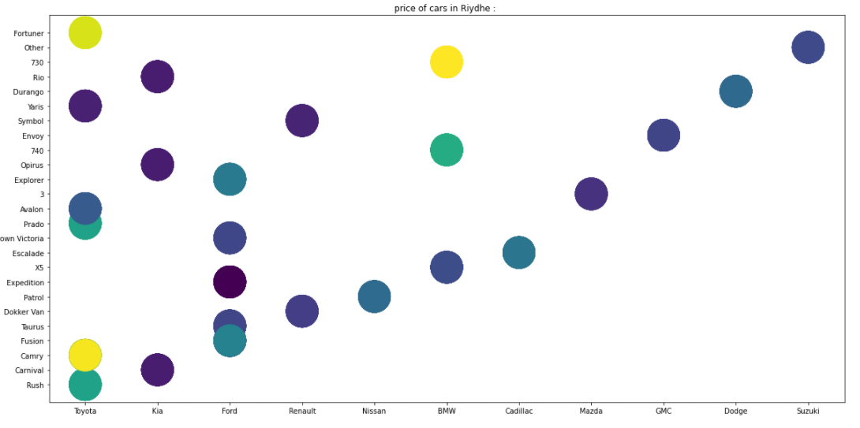
The Top used car’s in Riyadh
By{Car_Maker & model}:

Slide 5
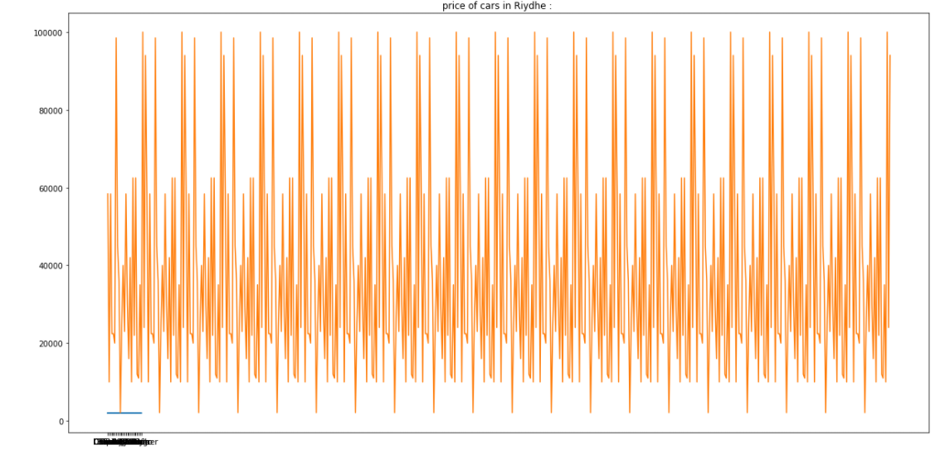
The price of used car’s in Riyadh:

Slide 6
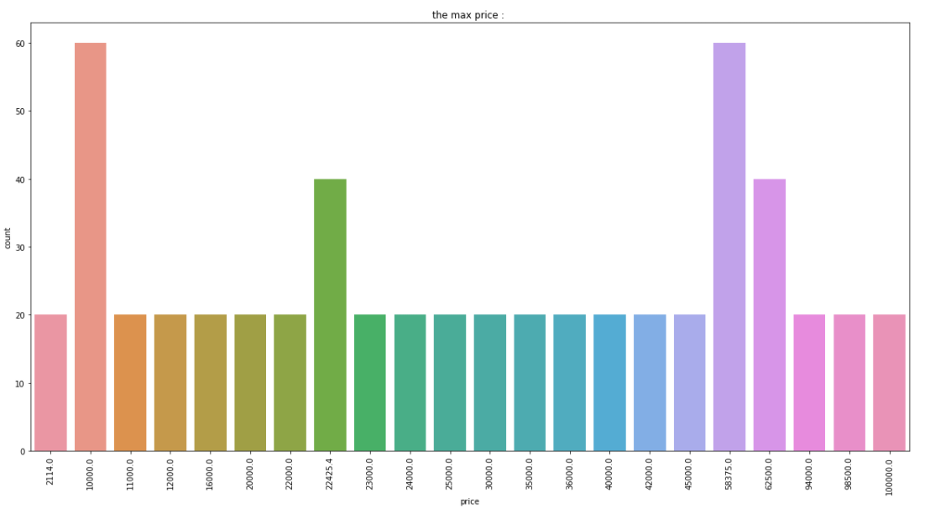
The highest price for used cars in Riyadh.

Slide 7



What is the best selling company in Riyadh
TOYOTA

Slide 8


What is the most expensive car?
BMW

Slide 9
Performance of models
 | score
LinearRegression | 1.0
DecisionTree | 1.0

Slide 10

Any Question?

Slide 11
Thank You.
Mutlaq Alqahtani
https://github.com/mutalqahtani
L2@hotmail.dk

