Slide 1

Big Data Final Exam
Title Slide
Global Secondary School Enrollment Analysis
Capstone Project
Analytics
INSY 8413: Introduction to Big Data
Sector: Education
Student: Mutamba Alice
Instructor: Eric Maniraguha
Date: August 2025
Project Introduction
Many countries face challenges achieving universal secondary school enrollment.
Goal: Identify countries and regions where enrollment lags.
Explore socio-economic factors driving these gaps (e.g., GDP, literacy, urbanization).
Use big data analytics & visualization to uncover actionable insights.
Dataset & Methodology
Dataset:https://data.uis.unesco.org
Source: UNESCO UIS Data
Structured CSV, ~2500 rows × 10 columns

Slide 2
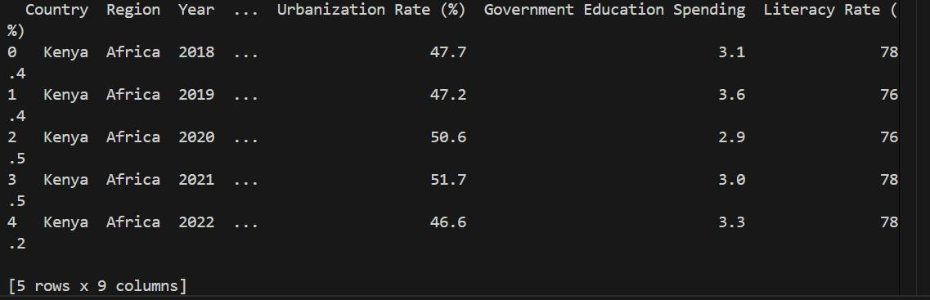
Variables: Country, Region, Year, Enrollment Rate, GDP per capita, Literacy Rate,
Urbanization, Population, etc.
Methodology:
1. Data cleaning & preprocessing
2. Exploratory Data Analysis (EDA)
3. Clustering (KMeans)
4. Visualization & dashboard in Power BI
EDA Results
- Histograms & boxplots: Show distribution & detect outliers.
- Correlation heatmap: Found positive correlation between:
- GDP per capita & Enrollment Rate
- Literacy Rate & Enrollment Rate
- Regional comparison: Some regions consistently below global average.

Slide 3
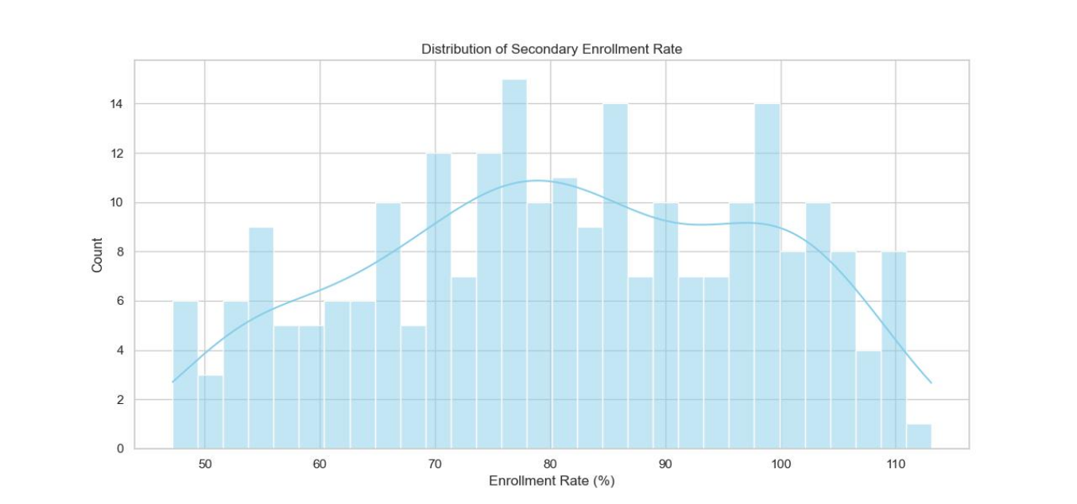
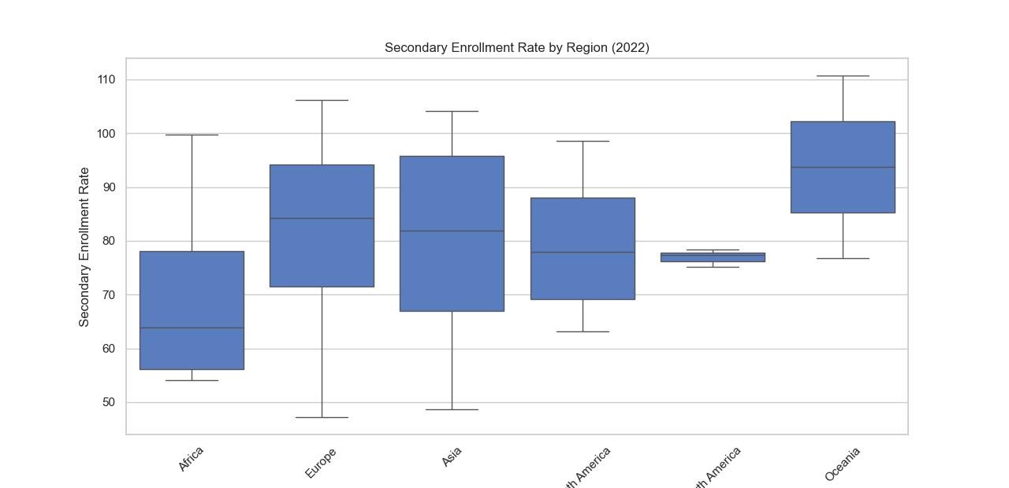
Histograms
Most countries have high enrollment rates, but some still lag behind highlighting
regional inequality
Boxplots
Regions differ in both median enrollment and variability. Some regions show wide
gaps among countries, highlighting unequal education opportunities.

Slide 4
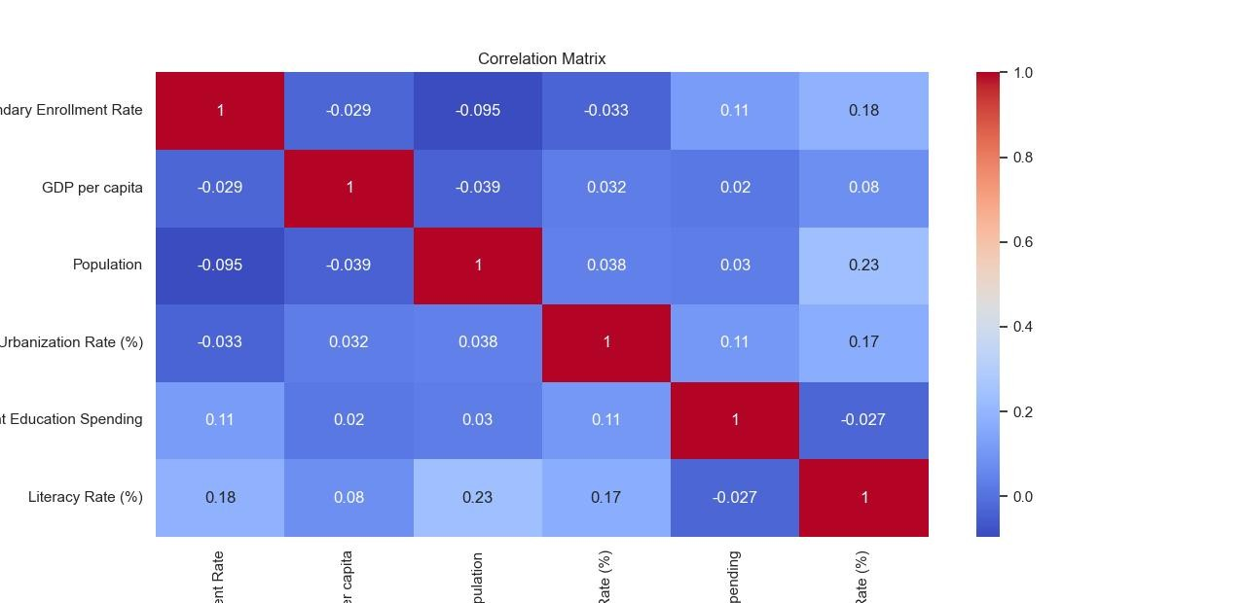
Heatmap
Higher GDP and literacy strongly relate to better enrollment rates. Urbanization also
contributes, though to a lesser extent.
Clustering & Insights
- Used KMeans to group countries with similar profiles.
- Evaluated with silhouette score.
- Identified clusters:
- High GDP & high enrollment
- Medium GDP & medium enrollment
- Low GDP & low enrollment
- Helps policymakers target similar countries together

Slide 5
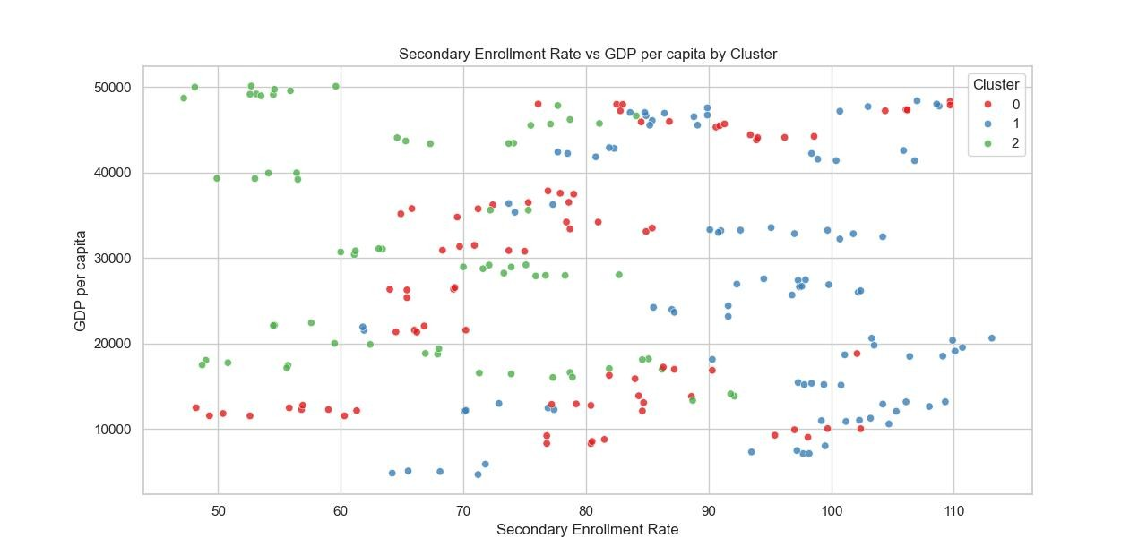
plot
Clustering scatter
Dashboard Walkthrough (Power BI)
Visuals included:
Line chart: Enrollment trend over years
Bar chart: Enrollment by region (with drill-down to countries)
Scatter plot: GDP vs Enrollment Rate (colored by cluster, sized by population)
Map: Enrollment by country
Summary card: Avg Global Enrollment Rate
Tooltips: Literacy Rate & Urbanization Rate
Slicers: Year & Region

Slide 6
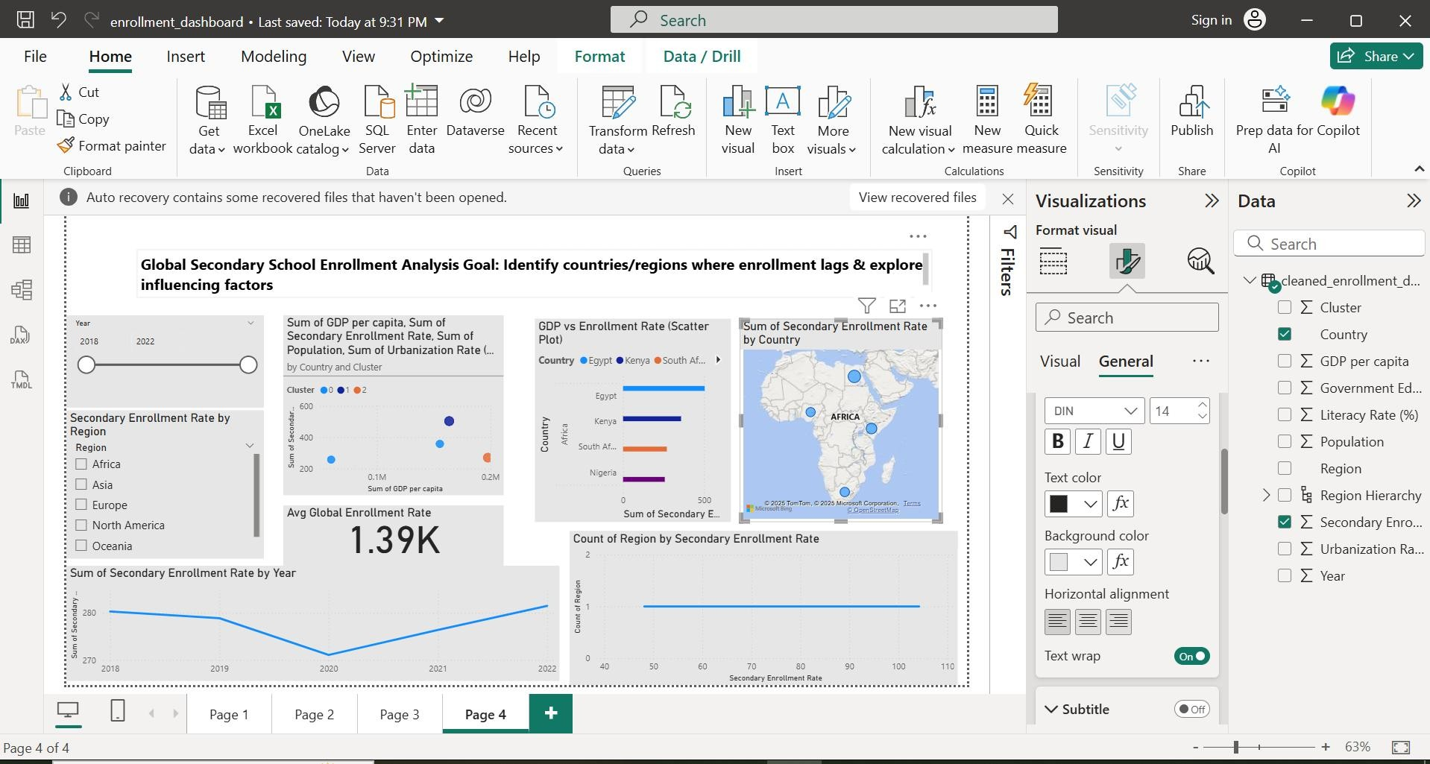
AI Visual: Decomposition tree (factors explaining low
enrollment)
Recommendations
Title:Recommendations to Improve Secondary School Enrollment
Bullet points (formatted clearly):
Target interventions in low-GDP and low-literacy regions, where enrollment lags
most.
Invest in literacy programs and improve access to education in urban and rural
areas.
Use clustering insights to design policy measures that address countries with similar
socio-economic profiles.
Continuously monitor enrollment trends and key indicators through interactive
dashboards, enabling data-driven decisions.
(Optional add)
Encourage cross-country collaboration within clusters to share best practices and
resources.
Future Work

Slide 7
Title:Future Work & Next Steps
Bullet points (keep concise, clear):
Expand analysis to include multi-year data to track trends over time.
Integrate additional variables, such as:
Government spending on education
Student–teacher ratios
Internet and digital access
Apply predictive models (e.g., time series forecasting) to anticipate future enrollment
changes.
Enhance the dashboard by:
Adding AI-powered visuals (Key Influencers, Forecast)
Including primary and tertiary enrollment data
Collaborate with policymakers and researchers to turn insights into action.
Conclusion
Title:Conclusion & Key Takeaways
Bullet points:
Used big data analytics and visualization to explore global secondary school
enrollment.
Identified regions and countries where enrollment rates lag behind global averages.
Found that GDP per capita and literacy rates strongly correlate with higher
enrollment.
Applied clustering to group countries with similar profiles, helping design targeted
interventions.
Developed an interactive Power BI dashboard to support data-driven policy
decisions.
Project highlights the value of data science in tackling global education challenges.

