Slide 1
Aircraft Safety Analysis
DSFT13 Phase1 Project
By Narcisse Mutabaruka

Slide 2
Business Understanding
Our company wants to invest in aircraft operations but lacks aviation risk knowledge.
This analysis helps decision-makers understand patterns behind fatal aircraft accidents.

Slide 3
Data Overview
Source: Aviation Safety Reporting System (ASRS)
Records from 1962 to 2023
Key fields:
Make,
Event Date,
Phase of Flight
Fatal Injuries

Slide 4
Data Cleaning and Approach
Standardized column names
Removed columns with >50% missing
Cleaned and converted date and numeric values
Focused on fatal injuries and flight phases

Slide 5
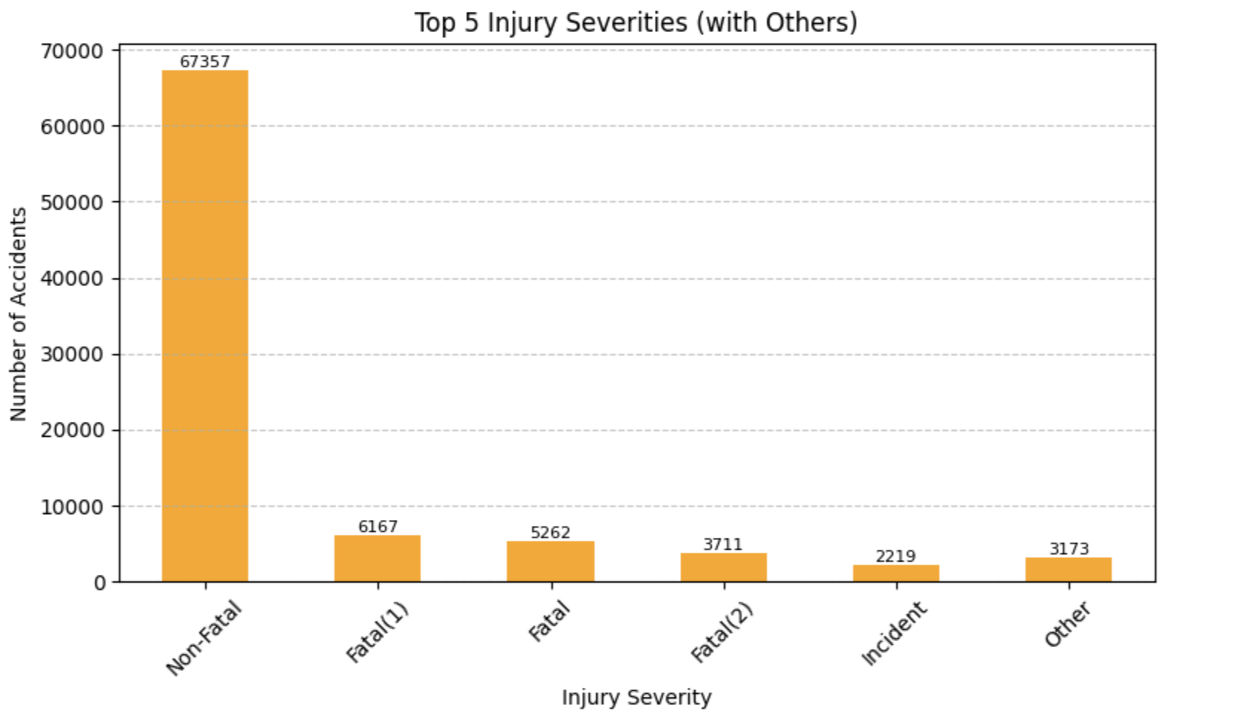
Injury Severity Distribution

Slide 6
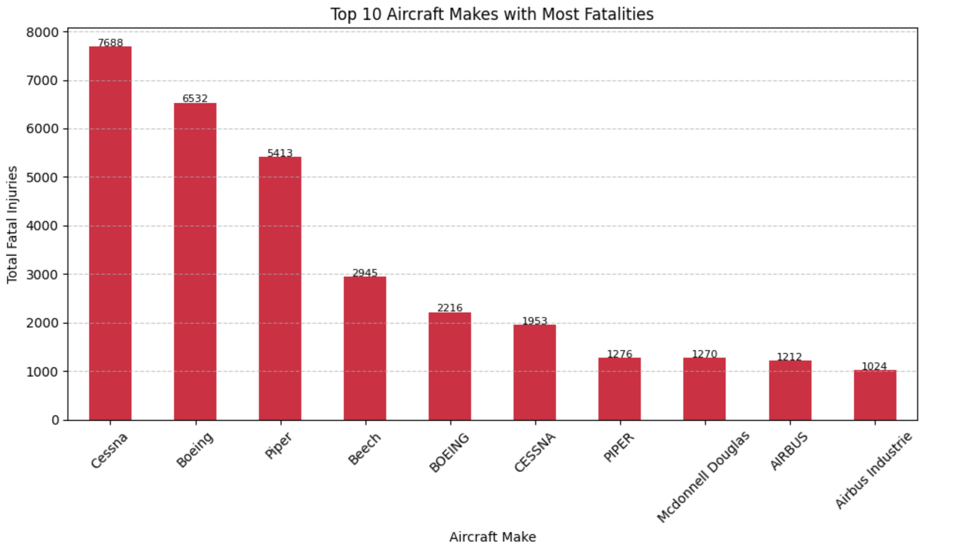
Most Fatal Aircraft Makers

Slide 7
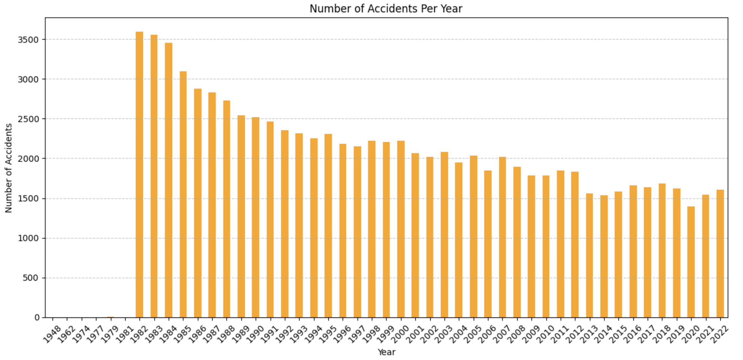
Accidents Over the Years

Slide 8
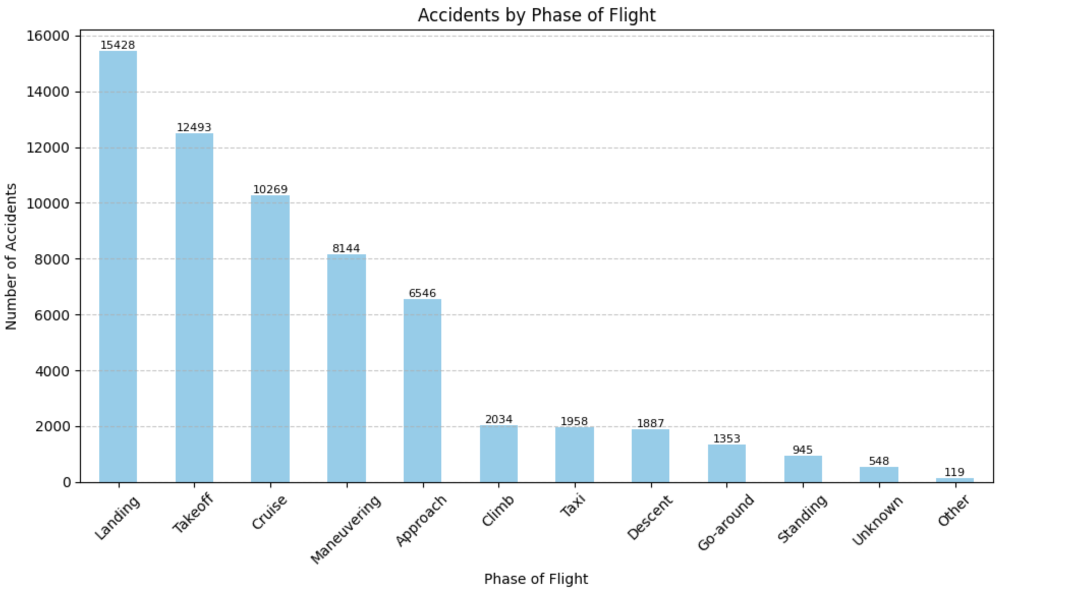
Accidents by Phase of Flight

Slide 9
Business Recommendations
Focus pilot training on landing and approach.
Be cautious with aircraft makes with high fatality records.
Improve incident reporting for better future analysis.

Slide 10
Next Steps
Share insights with decision-makers.
Compare results with insurance claims.
Build an interactive dashboard.

