Slide 1
Chapter 3
Data Modeling Using the Entity-Relationship (ER) Model

Slide 2
Chapter Outline
Overview of Database Design Process
Example Database Application (COMPANY)
ER Model Concepts
Entities and Attributes
Entity Types, Value Sets, and Key Attributes
Relationships and Relationship Types
Weak Entity Types
Roles and Attributes in Relationship Types
ER Diagrams - Notation
ER Diagram for COMPANY Schema
Alternative Notations – UML class diagrams, others

Slide 3
Overview of Database Design Process
Two main activities:
Database design
Applications design
Focus in this chapter on database design
To design the conceptual schema for a database application
Applications design focuses on the programs and interfaces that access the database
Generally considered part of software engineering

Slide 4
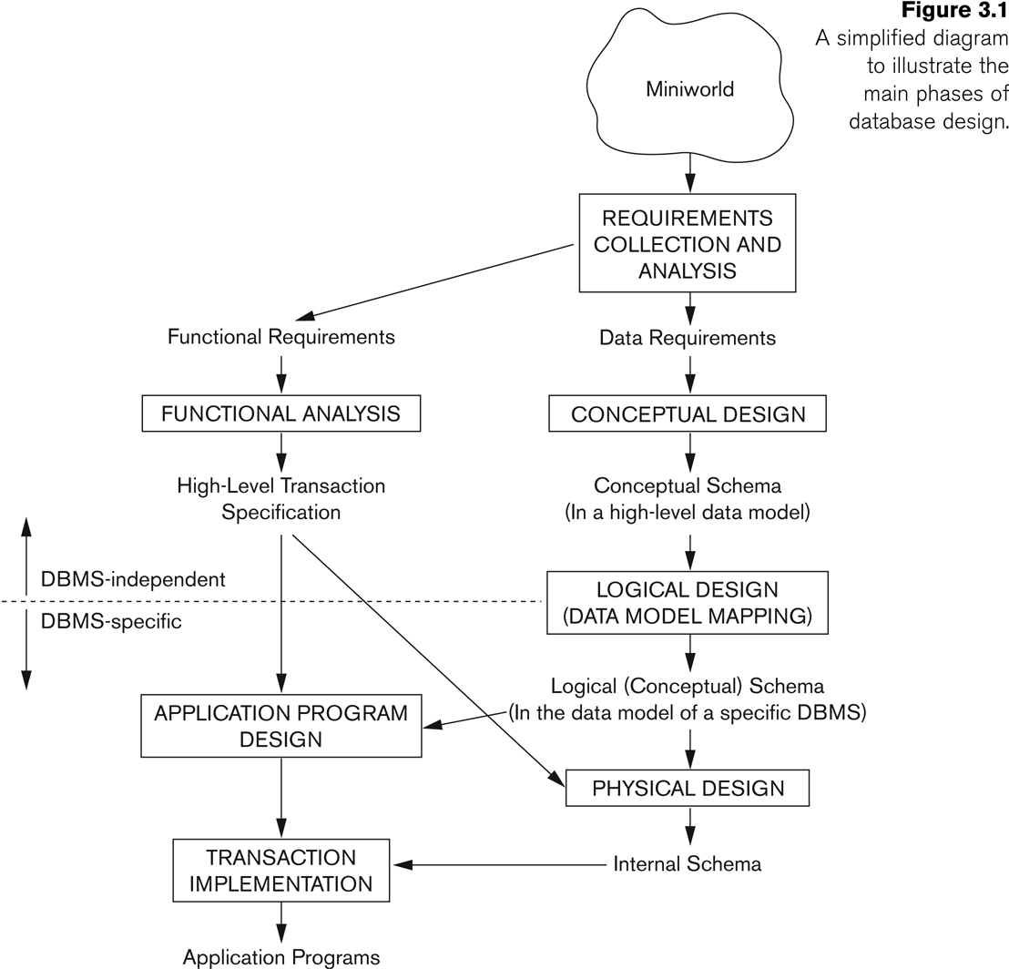
Overview of Database Design Process
Notes:
Figure 3.1 shows a simplified overview of the database design process. The first step shown is requirements collection and analysis. During this step, the database designers interview prospective database users to understand and document their data requirements. The result of this step is a concisely written set of users’ requirements. These requirements should be specified in as detailed and complete a form as possible. In parallel with specifying the data requirements, it is useful to specify the known functional requirements of the application. These consist of the user defined operations (or transactions) that will be applied to the database, including both retrievals and updates
The conceptual Design/schema is a concise description of the data requirements of the users and includes detailed descriptions of the entity types, relationships, and constraints; these are expressed using the concepts provided by the high-level data model.

Slide 5
Example COMPANY Database
We need to create a database schema design based on the following (simplified) requirements of the COMPANY Database:
The company is organized into DEPARTMENTs. Each department has a name, number and an employee who manages the department. We keep track of the start date of the department manager. A department may have several locations.
Each department controls a number of PROJECTs. Each project has a unique name, unique number and is located at a single location.
Notes:
Database design goes through the 4 phases of:
(1) requirements analysis
(2) conceptual database schema design
(3)Implementation with a commercial DBMS
(4) physical database design

Slide 6
Example COMPANY Database (Contd.)
We store each EMPLOYEE’s social security number, address, salary, sex, and birthdate.
Each employee works for one department but may work on several projects.
We keep track of the number of hours per week that an employee currently works on each project.
We also keep track of the direct supervisor of each employee.
Each employee may have a number of DEPENDENTs.
For each dependent, we keep track of their name, sex, birthdate, and relationship to the employee.

Slide 7
ER Model Concepts
Entities and Attributes
Entities are specific objects or things in the mini-world that are represented in the database.
Entities is a thing or object in the real world with an independent existence
For example the EMPLOYEE John Smith, the Research DEPARTMENT, the ProductX PROJECT
Attributes are properties used to describe an entity.
For example an EMPLOYEE entity may have the attributes Name, SSN, Address, Sex, BirthDate
A specific entity will have a value for each of its attributes.
For example a specific employee entity may have Name='John Smith', SSN='123456789', Address ='731, Fondren, Houston, TX', Sex='M', BirthDate='09-JAN-55‘
Each attribute has a value set (or data type) associated with it – e.g. integer, string, subrange, enumerated type, …
Notes:
An entity may be an object with a physical existence (for example, a particular person, car, house, or employee) or it may be an object with a conceptual existence (for instance, a company, a job, or a university course).
Several types of attributes occur in the ER model: simple versus composite, single valued versus multivalued, and stored versus derived.

Slide 8
Types of Attributes (1)
Simple
Each entity has a single atomic value for the attribute. For example, SSN or Sex. Attributes that are not divisible are called simple or atomic attributes
Composite
Composite attributes can be divided into smaller subparts, which represent more basic attributes with independent meanings.
The attribute may be composed of several components. For example:
Address(Apt#, House#, Street, City, State, ZipCode, Country), or
Name(FirstName, MiddleName, LastName).
Composition may form a hierarchy where some components are themselves composite.
Multi-valued
An entity may have multiple values for that attribute. For example, Color of a CAR or Previous_Degrees of a STUDENT.
Denoted as {Color} or {PreviousDegrees}.
Notes:
The value of a composite attribute is the concatenation of the values of its component simple attributes.
Single-Valued versus Multivalued Attributes. Most attributes have a single value for a particular entity; such attributes are called single-valued. For example, Age is a single-valued attribute of a person. In some cases an attribute can have a set of values for the same entity—for instance, a Colors attribute for a car, or a College_degrees attribute for a person. Cars with one color have a single value, whereas two-tone cars have two color values. Similarly, one person may not have any college degrees, another person may have one, and a third person may have two or more degrees; therefore, different people can have different numbers of values for the College_degrees attribute. Such attributes are called multivalued

Slide 9
Types of Attributes (2)
In general, composite and multi-valued attributes may be nested arbitrarily to any number of levels, although this is rare.
For example, PreviousDegrees of a STUDENT is a composite multi-valued attribute denoted by {PreviousDegrees (College, Year, Degree, Field)}
Multiple PreviousDegrees values can exist
Each has four subcomponent attributes:
College, Year, Degree, Field
Stored versus Derived Attributes: The Age attribute is called a derived attribute and is said to be derivable from the Birth_date attribute, which is called a stored attribute.
Notes:
Some attribute values can be derived from related entities; for example, an attribute Number_of_employees of a DEPARTMENT entity can be derived by counting the number of employees related to (working for) that department.

Slide 10
Example of a composite attribute
NULL Values. In some cases, a particular entity may not have an applicable value for an attribute.
A College_degrees attribute applies only to people with college degrees. For such situations, a special value called NULL is created.
Complex Attributes. Notice that, in general, composite and multivalued attributes can be nested arbitrarily. We can represent arbitrary nesting by grouping components of a composite attribute between parentheses ( ) and separating the components with commas, and by displaying multivalued attributes between braces { }
Notes:
A multivalued attribute may have lower and upper bounds to constrain the number of values allowed for each individual entity. For example, the Colors attribute of a car may be restricted to have between one and two values, if we assume that a car can have two colors at most.

Slide 11
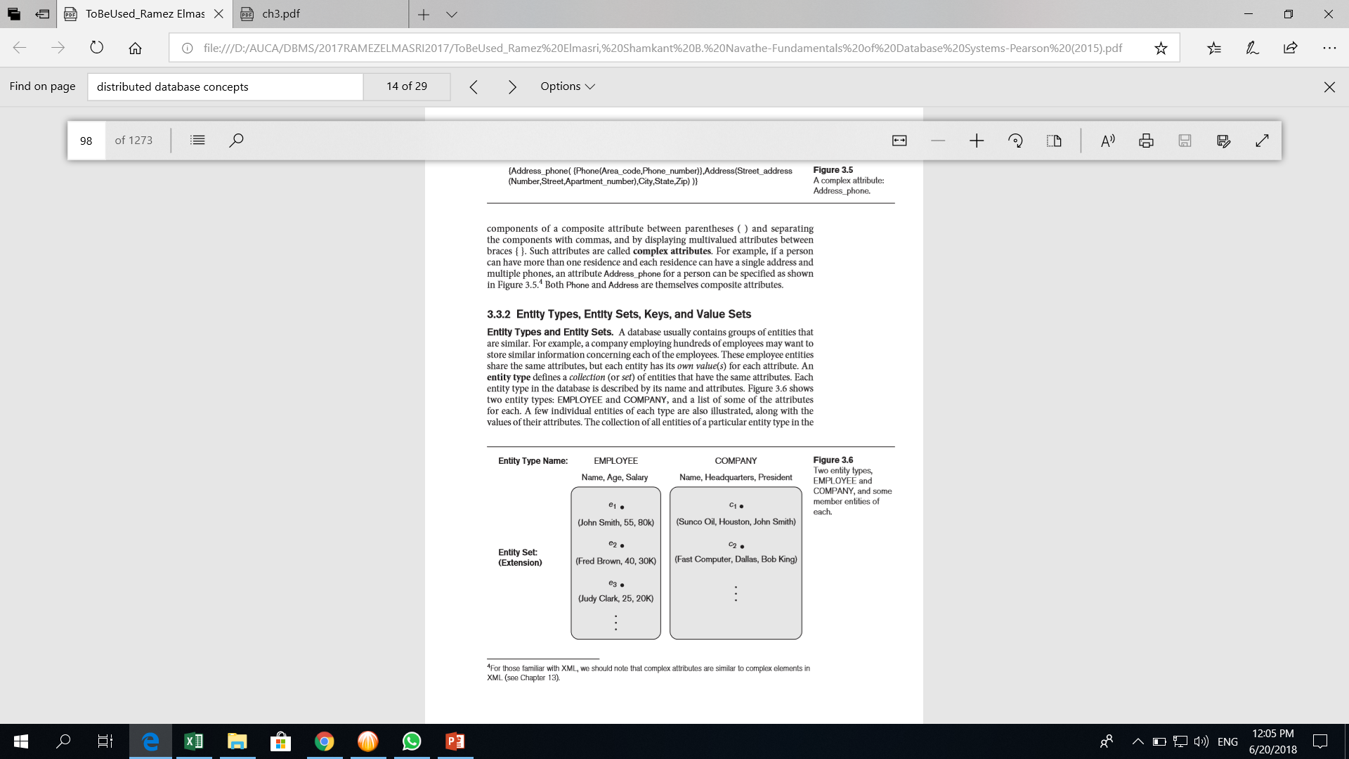
Example of a composite attribute
Notes:
A multivalued attribute may have lower and upper bounds to constrain the number of values allowed for each individual entity. For example, the Colors attribute of a car may be restricted to have between one and two values, if we assume that a car can have two colors at most.

Slide 12
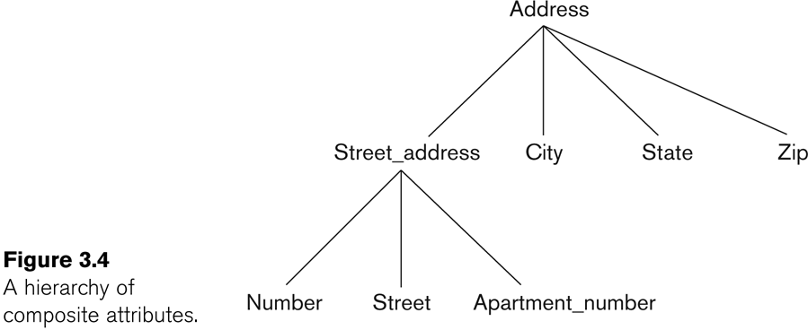
Example of a composite attribute
Notes:
A multivalued attribute may have lower and upper bounds to constrain the number of values allowed for each individual entity. For example, the Colors attribute of a car may be restricted to have between one and two values, if we assume that a car can have two colors at most.

Slide 13
Entity Types and Key Attributes (1)
Entities with the same basic attributes are grouped or typed into an entity type.
For example, the entity type EMPLOYEE and PROJECT.
An attribute of an entity type for which each entity must have a unique value is called a key attribute of the entity type.
For example, SSN of EMPLOYEE.

Slide 14
Entity Types and Key Attributes (2)
A key attribute may be composite.
An important constraint on the entities of an entity type is the key or uniqueness constraint on attributes
VehicleTagNumber is a key of the CAR entity type with components (Number, State).
An entity type may have more than one key.
The CAR entity type may have two keys:
VehicleIdentificationNumber (popularly called VIN)
VehicleTagNumber (Number, State), aka license plate number.
Each key is underlined
Notes:
An entity type usually has one or more attributes whose values are distinct for each individual entity in the entity set. Such an attribute is called a key attribute, and its values can be used to identify each entity uniquely.
Specifying that an attribute is a key of an entity type means that the preceding uniqueness property must hold for every entity set of the entity type.
Some entity types have more than one key attribute. For example, each of the Vehicle_id and Registration attributes of the entity type CAR (Figure 3.7) is a key in its own right.

Slide 15
Displaying an Entity type
In ER diagrams, an entity type is displayed in a rectangular box
Attributes are displayed in ovals
Each attribute is connected to its entity type
Components of a composite attribute are connected to the oval representing the composite attribute
Each key attribute is underlined
Multivalued attributes displayed in double ovals
See CAR example on next slide

Slide 16
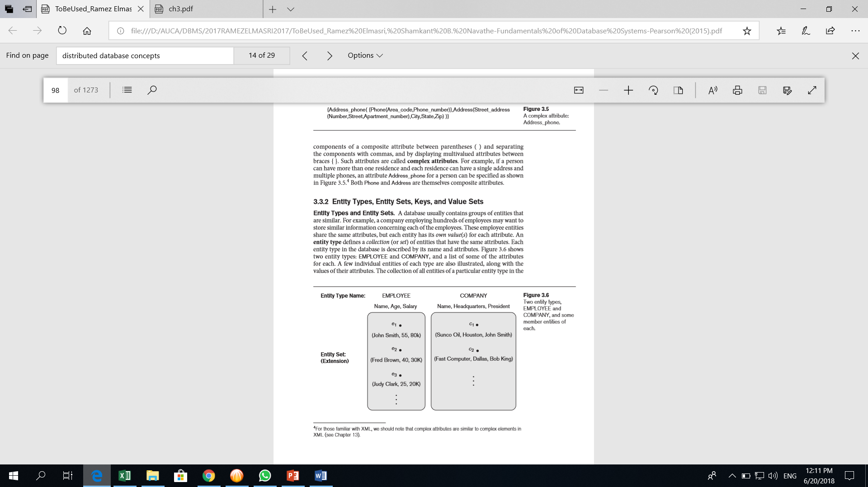
Two Entity Types Employee and COMPANY, and some member entities of each

Slide 17
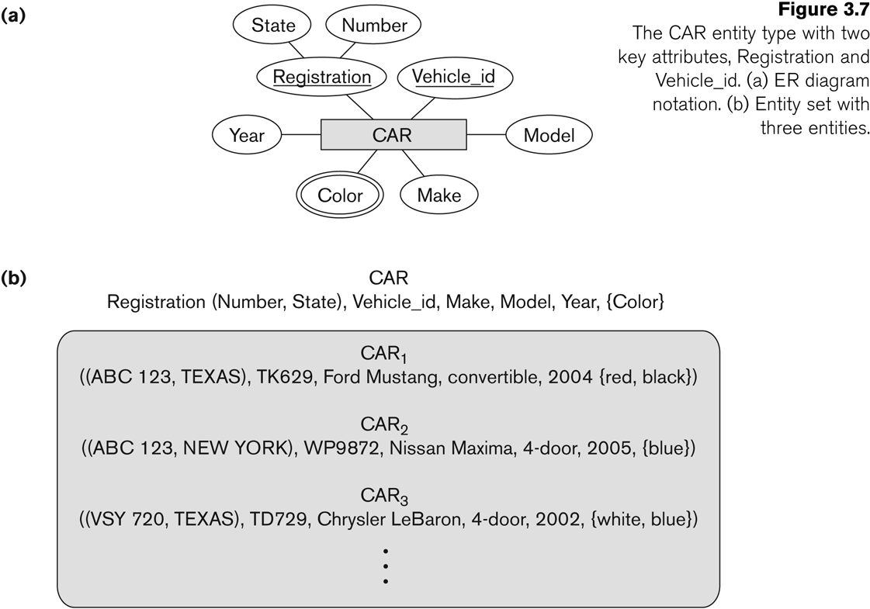
Entity Type CAR with two keys and a corresponding Entity

Slide 18
Entity Set
Each entity type will have a collection of entities stored in the database
An entity type defines a collection (or set) of entities that have the same attributes.
Called the entity set
Previous slide shows three CAR entity instances in the entity set for CAR
Same name (CAR) used to refer to both the entity type and the entity set
Entity set is the current state of the entities of that type that are stored in the database
Notes:
The collection of all entities of a particular entity type in the database at any point in time is called an entity set or entity collection.
An entity type describes the schema or intension for a set of entities that share the same structure. The collection of entities of a particular entity type is grouped into an entity set, which is also called the extension of the entity type.

Slide 19
Initial Design of Entity Types for the COMPANY Database Schema
Based on the requirements, we can identify four initial entity types in the COMPANY database:
DEPARTMENT
PROJECT
EMPLOYEE
DEPENDENT
Their initial design is shown on the following slide
The initial attributes shown are derived from the requirements description

Slide 20
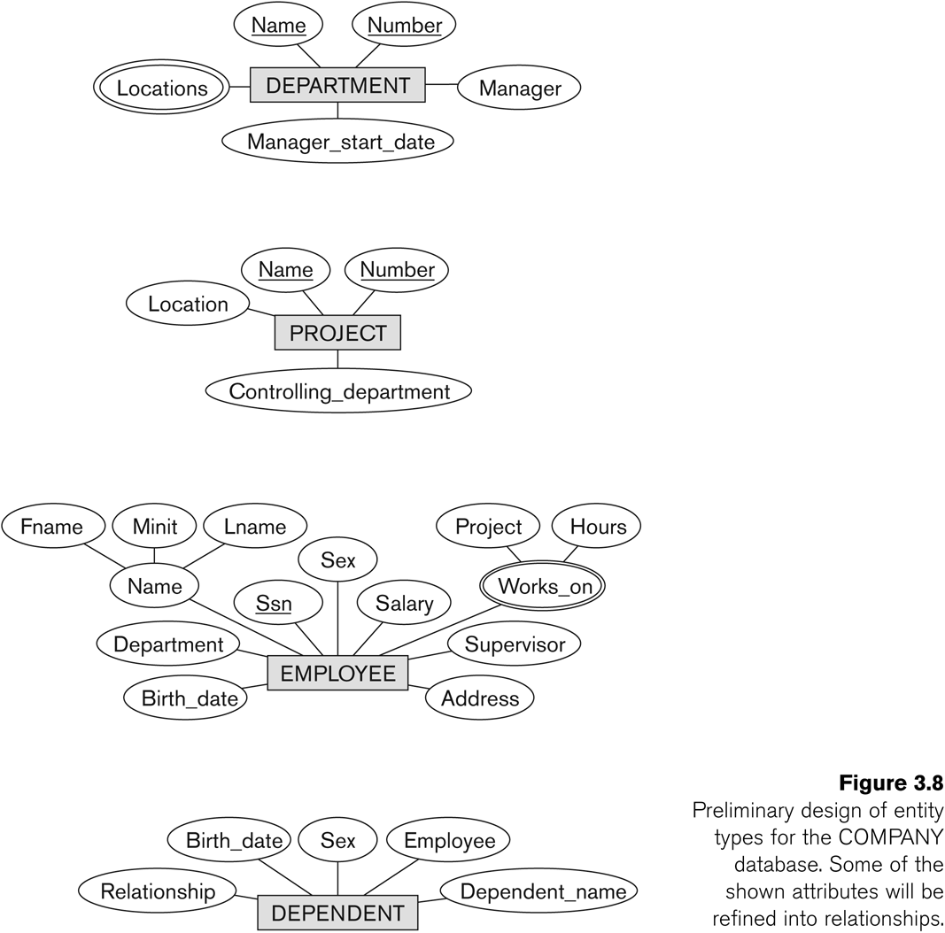
Initial Design of Entity Types: EMPLOYEE, DEPARTMENT, PROJECT, DEPENDENT

Slide 21
Refining the initial design by introducing relationships
The initial design is typically not complete
Some aspects in the requirements will be represented as relationships
ER model has three main concepts:
Entities (and their entity types and entity sets)
Attributes (simple, composite, multivalued)
Relationships (and their relationship types and relationship sets)
We introduce relationship concepts next

Slide 22
Relationships and Relationship Types
A relationship relates two or more distinct entities with a specific meaning.
For example, EMPLOYEE John Smith works on the ProductX PROJECT, or EMPLOYEE Franklin Wong manages the Research DEPARTMENT.
Relationships of the same type are grouped or typed into a relationship type.
For example, the WORKS_ON relationship type in which EMPLOYEEs and PROJECTs participate, or the MANAGES relationship type in which EMPLOYEEs and DEPARTMENTs participate.
The degree of a relationship type is the number of participating entity types.
Both MANAGES and WORKS_ON are binary relationships.

Slide 23
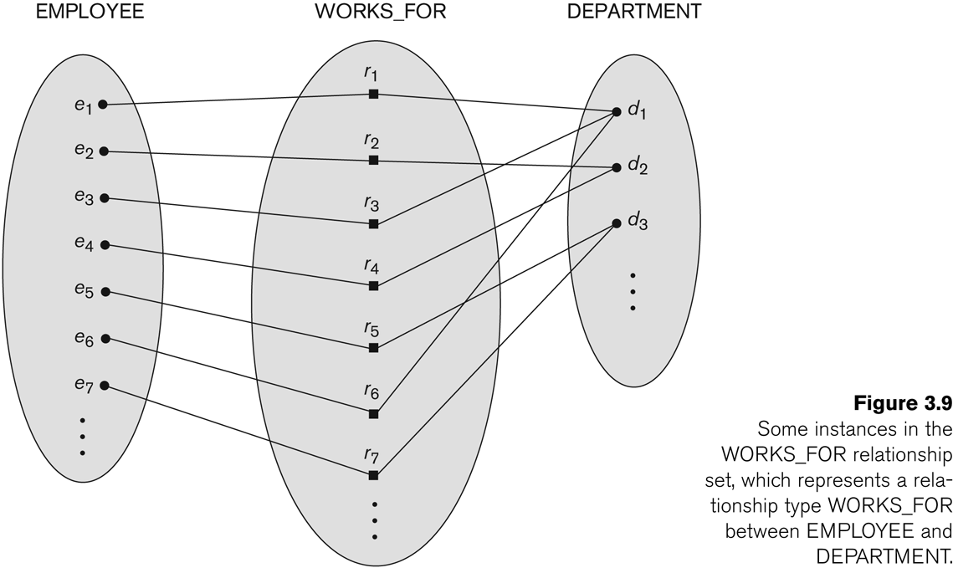
Relationship instances of the WORKS_FOR N:1 relationship between EMPLOYEE and DEPARTMENT

Slide 24
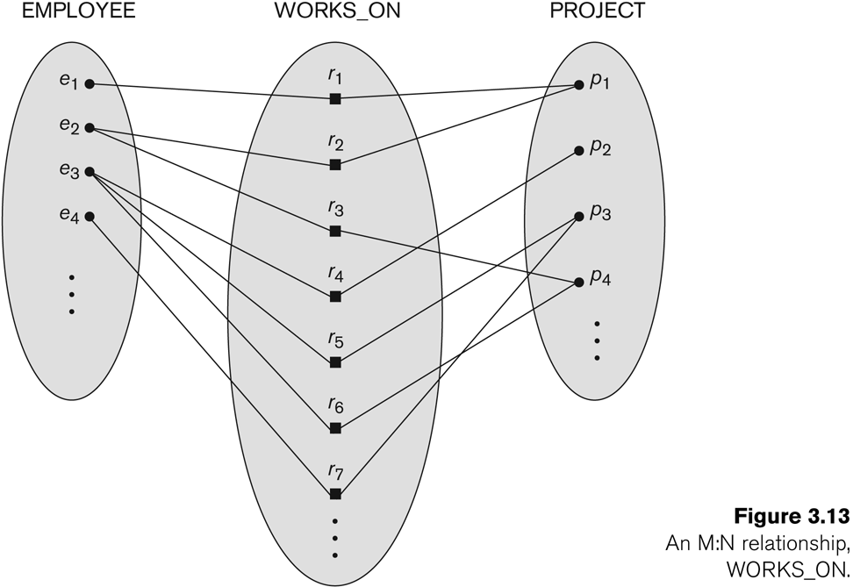
Relationship instances of the M:N WORKS_ON relationship between EMPLOYEE and PROJECT

Slide 25
Relationship type vs. relationship set
Relationship Type:
Is the schema description of a relationship
Identifies the relationship name and the participating entity types
Also identifies certain relationship constraints
Relationship Set:
The current set of relationship instances represented in the database
The current state of a relationship type

Slide 26
Relationship type vs. relationship set
Previous figures displayed the relationship sets
Each instance in the set relates individual participating entities – one from each participating entity type
In ER diagrams, we represent the relationship type as follows:
Diamond-shaped box is used to display a relationship type
Connected to the participating entity types via straight lines

Slide 27
Refining the COMPANY database schema by introducing relationships
By examining the requirements, six relationship types are identified
All are binary relationships( degree 2)
Listed below with their participating entity types:
WORKS_FOR (between EMPLOYEE, DEPARTMENT)
MANAGES (also between EMPLOYEE, DEPARTMENT)
CONTROLS (between DEPARTMENT, PROJECT)
WORKS_ON (between EMPLOYEE, PROJECT)
SUPERVISION (between EMPLOYEE (as subordinate), EMPLOYEE (as supervisor))
DEPENDENTS_OF (between EMPLOYEE, DEPENDENT)

Slide 28
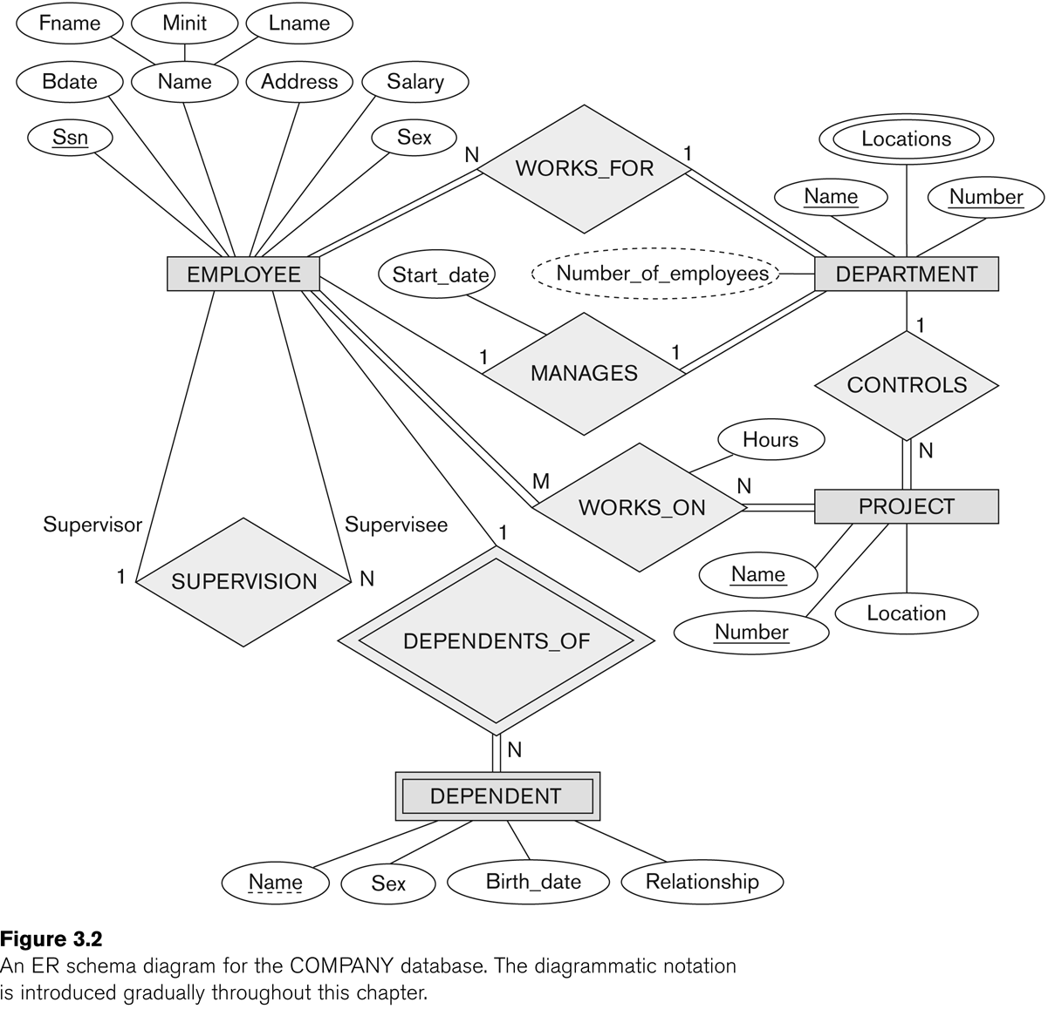
ER DIAGRAM – Relationship Types are: WORKS_FOR, MANAGES, WORKS_ON, CONTROLS, SUPERVISION, DEPENDENTS_OF

Slide 29
Discussion on Relationship Types March
In the refined design, some attributes from the initial entity types are refined into relationships:
Manager of DEPARTMENT -> MANAGES
Works_on of EMPLOYEE -> WORKS_ON
Department of EMPLOYEE -> WORKS_FOR
etc
In general, more than one relationship type can exist between the same participating entity types
MANAGES and WORKS_FOR are distinct relationship types between EMPLOYEE and DEPARTMENT
Different meanings and different relationship instances.

Slide 30
Recursive Relationship Type
An relationship type whose with the same participating entity type in distinct roles
Example: the SUPERVISION relationship
EMPLOYEE participates twice in two distinct roles:
supervisor (or boss) role
supervisee (or subordinate) role
Each relationship instance relates two distinct EMPLOYEE entities:
One employee in supervisor role
One employee in supervisee role

Slide 31
Weak Entity Types
An entity that does not have a key attribute
A weak entity must participate in an identifying relationship type with an owner or identifying entity type
Entities are identified by the combination of:
A partial key of the weak entity type
The particular entity they are related to in the identifying entity type
Example:
A DEPENDENT entity is identified by the dependent’s first name, and the specific EMPLOYEE with whom the dependent is related
Name of DEPENDENT is the partial key
DEPENDENT is a weak entity type
EMPLOYEE is its identifying entity type via the identifying relationship type DEPENDENT_OF

Slide 32
Constraints on Relationships
Constraints on Relationship Types
(Also known as ratio constraints)
Cardinality Ratio (specifies maximum participation)
One-to-one (1:1)
One-to-many (1:N) or Many-to-one (N:1)
Many-to-many (M:N)
Existence Dependency Constraint (specifies minimum participation) (also called participation constraint)
zero (optional participation, not existence-dependent)
one or more (mandatory participation, existence-dependent)

Slide 33
Many-to-one (N:1) Relationship

Slide 34
Many-to-many (M:N) Relationship

Slide 35
Displaying a recursive relationship
In a recursive relationship type.
Both participations are same entity type in different roles.
For example, SUPERVISION relationships between EMPLOYEE (in role of supervisor or boss) and (another) EMPLOYEE (in role of subordinate or worker).
In following figure, first role participation labeled with 1 and second role participation labeled with 2.
In ER diagram, need to display role names to distinguish participations.

Slide 36
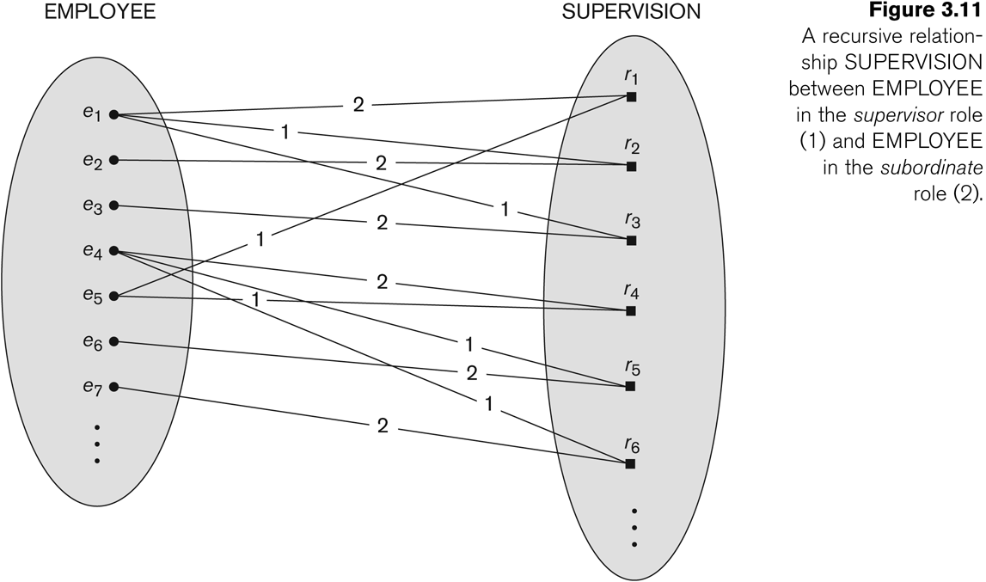
A Recursive Relationship Supervision`

Slide 37
Recursive Relationship Type is: SUPERVISION (participation role names are shown) Next

Slide 38
Attributes of Relationship types
A relationship type can have attributes:
For example, HoursPerWeek of WORKS_ON
Its value for each relationship instance describes the number of hours per week that an EMPLOYEE works on a PROJECT.
A value of HoursPerWeek depends on a particular (employee, project) combination
Most relationship attributes are used with M:N relationships
In 1:N relationships, they can be transferred to the entity type on the N-side of the relationship

Slide 39
Example Attribute of a Relationship Type: Hours of WORKS_ON

Slide 40
Notation for Constraints on Relationships
Cardinality ratio (of a binary relationship): 1:1, 1:N, N:1, or M:N
Shown by placing appropriate numbers on the relationship edges.
Participation constraint (on each participating entity type): total (called existence dependency) or partial.
Total shown by double line, partial by single line.
NOTE: These are easy to specify for Binary Relationship Types.

Slide 41
Alternative (min, max) notation for relationship structural constraints:
Specified on each participation of an entity type E in a relationship type R
Specifies that each entity e in E participates in at least min and at most max relationship instances in R
Default(no constraint): min=0, max=n (signifying no limit)
Must have min≤max, min≥0, max ≥1
Derived from the knowledge of mini-world constraints
Examples:
A department has exactly one manager and an employee can manage at most one department.
Specify (0,1) for participation of EMPLOYEE in MANAGES
Specify (1,1) for participation of DEPARTMENT in MANAGES
An employee can work for exactly one department but a department can have any number of employees.
Specify (1,1) for participation of EMPLOYEE in WORKS_FOR
Specify (0,n) for participation of DEPARTMENT in WORKS_FOR

Slide 42
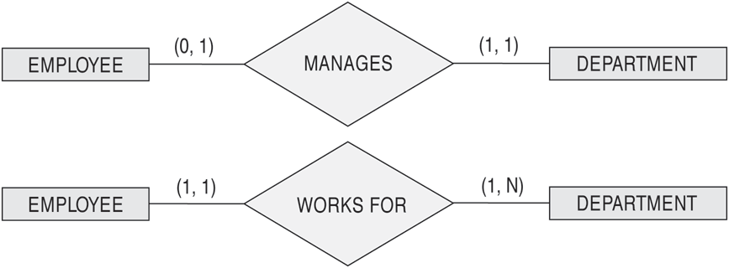
The (min,max) notation for relationship constraints
Read the min,max numbers next to the entity type and looking away from the entity type

Slide 43
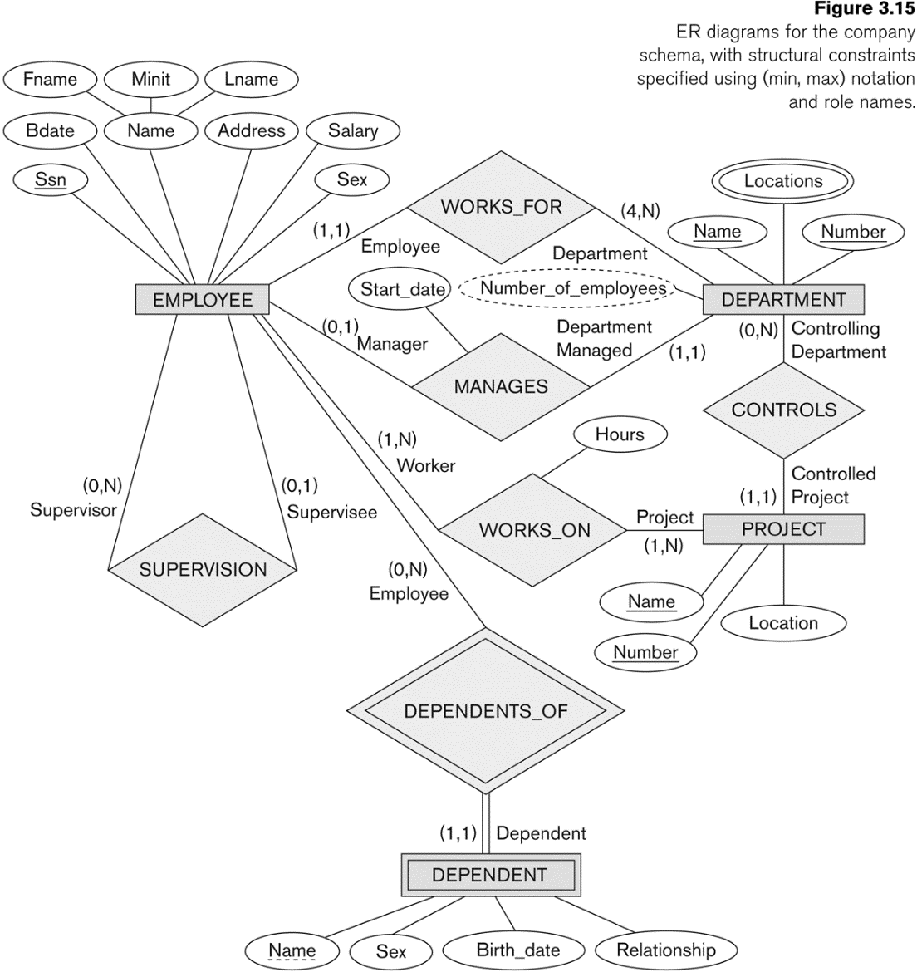
COMPANY ER Schema Diagram using (min, max) notation

Slide 44
Alternative diagrammatic notation
ER diagrams is one popular example for displaying database schemas
Many other notations exist in the literature and in various database design and modeling tools
Appendix A illustrates some of the alternative notations that have been used
UML class diagrams is representative of another way of displaying ER concepts that is used in several commercial design tools

Slide 45
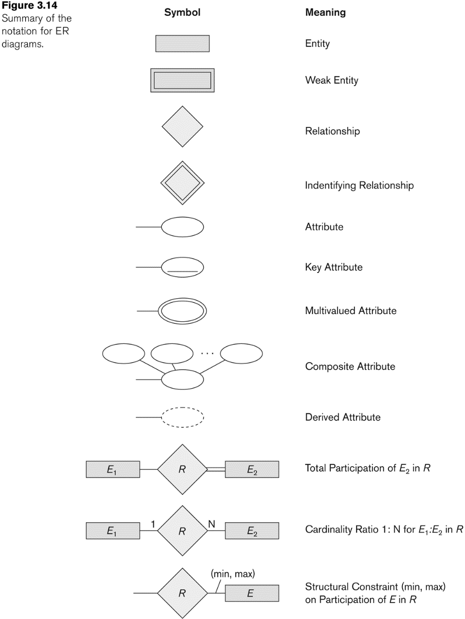
Summary of notation for ER diagrams

Slide 46
UML class diagrams
Represent classes (similar to entity types) as large rounded boxes with three sections:
Top section includes entity type (class) name
Second section includes attributes
Third section includes class operations (operations are not in basic ER model)
Relationships (called associations) represented as lines connecting the classes
Other UML terminology also differs from ER terminology
Used in database design and object-oriented software design

Slide 47
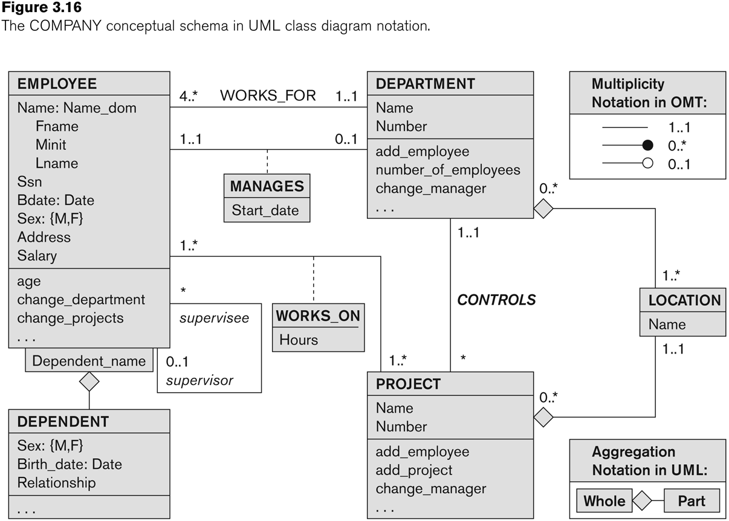
UML class diagram for COMPANY database schema

Slide 48
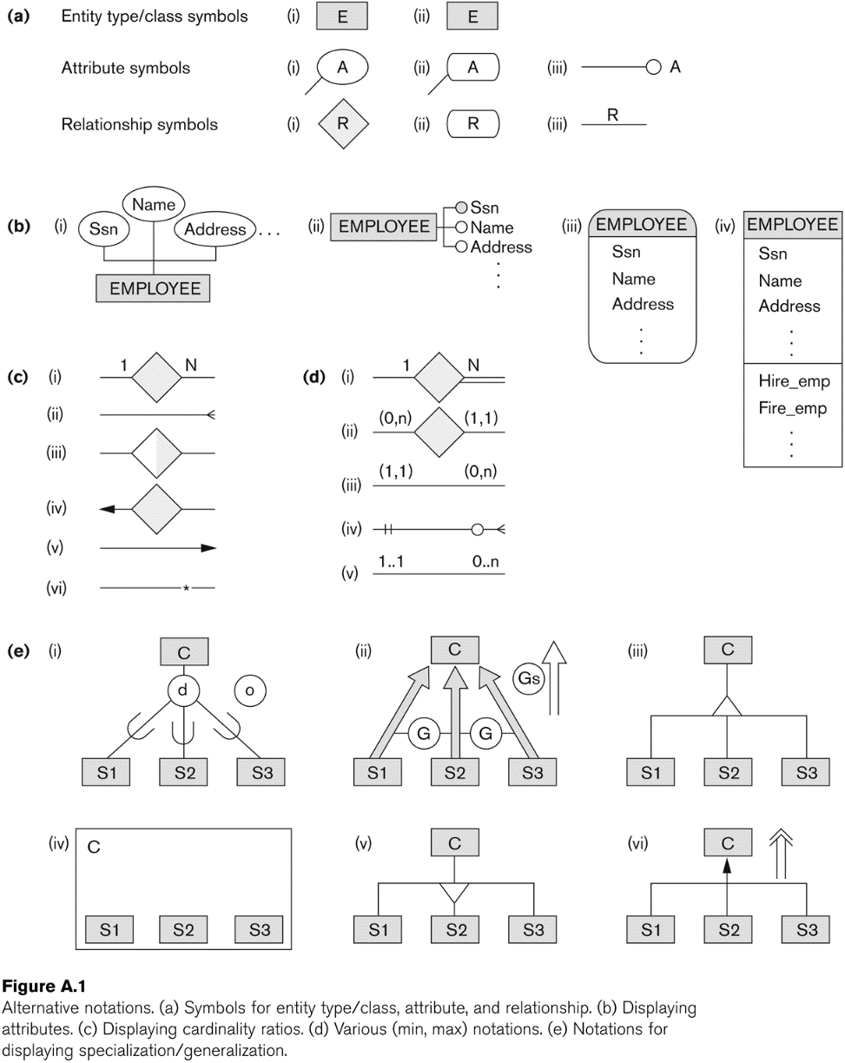
Other alternative diagrammatic notations

Slide 49
Relationships of Higher Degree
Relationship types of degree 2 are called binary
Relationship types of degree 3 are called ternary and of degree n are called n-ary
In general, an n-ary relationship is not equivalent to n binary relationships
Constraints are harder to specify for higher-degree relationships (n > 2) than for binary relationships

Slide 50
Discussion of n-ary relationships (n > 2)
In general, 3 binary relationships can represent different information than a single ternary relationship (see Figure 3.17a and b on next slide)
If needed, the binary and n-ary relationships can all be included in the schema design (see Figure 3.17a and b, where all relationships convey different meanings)
In some cases, a ternary relationship can be represented as a weak entity if the data model allows a weak entity type to have multiple identifying relationships (and hence multiple owner entity types) (see Figure 3.17c)

Slide 51
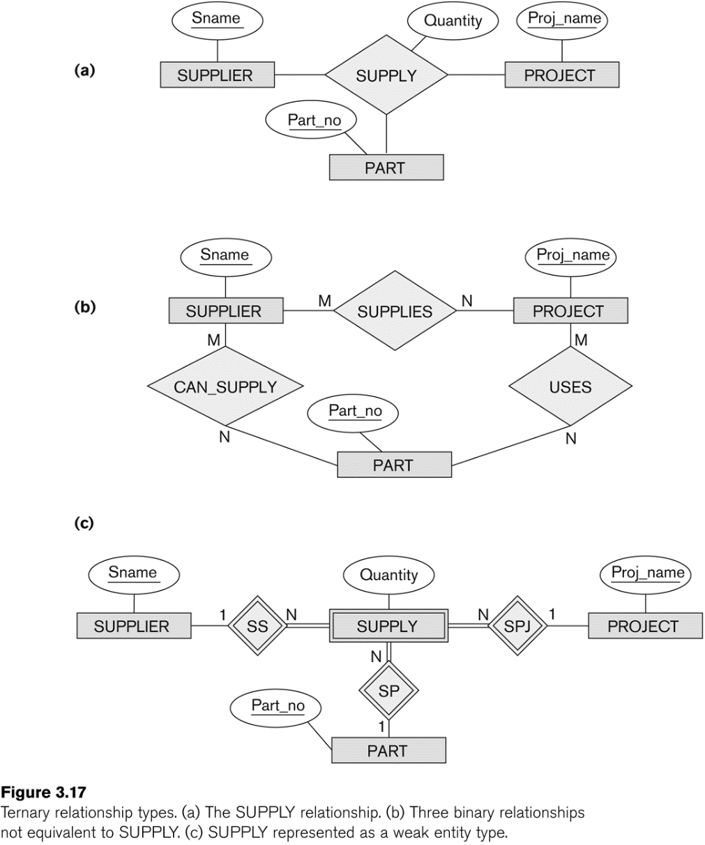
Example of a ternary relationship

Slide 52
Discussion of n-ary relationships (n > 2)
If a particular binary relationship can be derived from a higher-degree relationship at all times, then it is redundant
For example, the TAUGHT_DURING binary relationship in Figure 3.18 (see next slide) can be derived from the ternary relationship OFFERS (based on the meaning of the relationships)

Slide 53
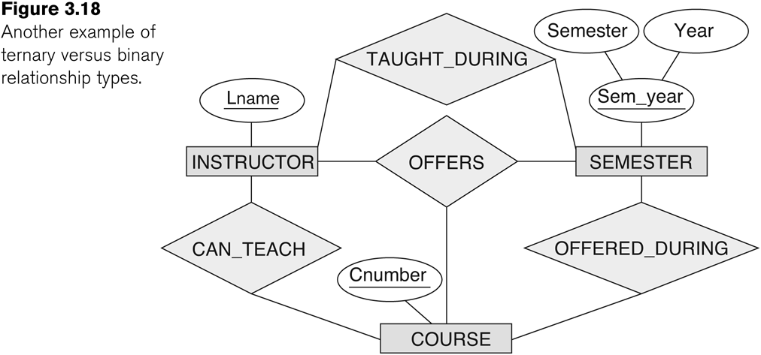
Another example of a ternary relationship

Slide 54
Displaying constraints on higher-degree relationships
The (min, max) constraints can be displayed on the edges – however, they do not fully describe the constraints
Displaying a 1, M, or N indicates additional constraints
An M or N indicates no constraint
A 1 indicates that an entity can participate in at most one relationship instance that has a particular combination of the other participating entities
In general, both (min, max) and 1, M, or N are needed to describe fully the constraints

Slide 55
Data Modeling Tools
A number of popular tools that cover conceptual modeling and mapping into relational schema design.
Examples: ERWin, S- Designer (Enterprise Application Suite), ER- Studio, etc.
POSITIVES:
Serves as documentation of application requirements, easy user interface - mostly graphics editor support
NEGATIVES:
Most tools lack a proper distinct notation for relationships with relationship attributes
Mostly represent a relational design in a diagrammatic form rather than a conceptual ER-based design

Slide 56
Some of the Currently Available Automated Database Design Tools
COMPANY | TOOL | FUNCTIONALITY
Embarcadero Technologies | ER Studio | Database Modeling in ER and IDEF1X
 | DB Artisan | Database administration, space and security management
Oracle | Developer 2000/Designer 2000 | Database modeling, application development
Popkin Software | System Architect 2001 | Data modeling, object modeling, process modeling, structured analysis/design
Platinum (Computer Associates) | Enterprise Modeling Suite: Erwin, BPWin, Paradigm Plus | Data, process, and business component modeling
Persistence Inc. | Pwertier | Mapping from O-O to relational model
Rational (IBM) | Rational Rose | UML Modeling & application generation in C++/JAVA
Resolution Ltd. | Xcase | Conceptual modeling up to code maintenance
Sybase | Enterprise Application Suite | Data modeling, business logic modeling
Visio | Visio Enterprise | Data modeling, design/reengineering Visual Basic/C++

Slide 57
Extended Entity-Relationship (EER) Model (in next chapter)
The entity relationship model in its original form did not support the specialization and generalization abstractions
Next chapter illustrates how the ER model can be extended with
Type-subtype and set-subset relationships
Specialization/Generalization Hierarchies
Notation to display them in EER diagrams

Slide 58
Chapter Summary
ER Model Concepts: Entities, attributes, relationships
Constraints in the ER model
Using ER in step-by-step conceptual schema design for the COMPANY database
ER Diagrams - Notation
Alternative Notations – UML class diagrams, others

