Slide 1
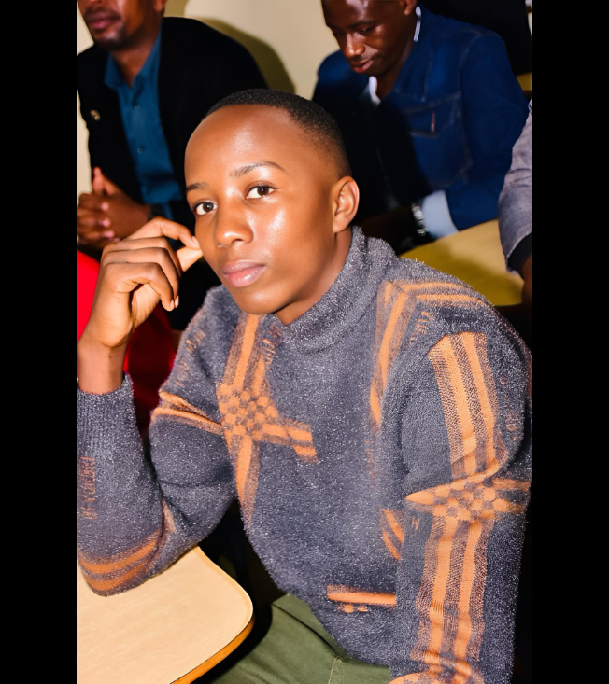
I don’t know how long I will last in this world, but what I do know is that when I was born, God had already prepared two packages for me — one that contains my entire life, and another that I would use to live it.
So whether it’s –1 from the full‑life package or +1 to the life I’ve lived so far, I’m grateful that God has allowed me to receive one more year — to take from what’s left, and to add to what’s been lived.
Happy Birthday to me! 🎉

