Slide 1
Chapter 2
Database System concepts and architecture

Slide 2
Outline
Data Models and Their Categories
History of Data Models
Schemas, Instances, and States
Three-Schema Architecture
Data Independence
DBMS Languages and Interfaces
Database System Utilities and Tools
Centralized and Client-Server Architectures
Classification of DBMSs
Notes:
n the other hand, an instance is a state when data is loaded into the database or when any change is acquired by the corresponding database. Schema is the detailed description of the structure of database whereas the information stored at a specific moment in a database is known as an instance

Slide 3
Data Models
Data Model:
A set of concepts to describe the structure of a database, the operations for manipulating these structures, and certain constraints that the database should obey.
Data Model Structure and Constraints:
Constructs are used to define the database structure
Constructs typically include elements (and their data types) as well as groups of elements (e.g. entity, record, table), and relationships among such groups
Constraints specify some restrictions on valid data; these constraints must be enforced at all times

Slide 4
Data Models (continued)
Data Model Operations:
These operations are used for specifying database retrievals and updates by referring to the constructs of the data model.
Operations on the data model may include basic model operations (e.g. generic insert, delete, update) and user-defined operations (e.g. compute_student_gpa, update_inventory)

Slide 5
Categories of Data Models
Conceptual (high-level, semantic) data models:
Provide concepts that are close to the way many users perceive data.
(Also called entity-based or object-based data models.)
Physical (low-level, internal) data models:
Provide concepts that describe details of how data is stored in the computer. These are usually specified in an ad-hoc manner through DBMS design and administration manuals
Implementation (representational) data models:
Provide concepts that fall between the above two, used by many commercial DBMS implementations (e.g. relational data models used in many commercial systems).
Notes:
Conceptual: This Data Model defines WHAT the system contains. This model is typically created by Business stakeholders and Data Architects. The purpose is to organize, scope and define business concepts and rules.
Logical: Defines HOW the system should be implemented regardless of the DBMS. This model is typically created by Data Architects and Business Analysts. The purpose is to developed technical map of rules and data structures.
Physical: This Data Model describes HOW the system will be implemented using a specific DBMS system. This model is typically created by DBA and developers. The purpose is actual implementation of the database.

Slide 6
Schemas versus Instances
Database Schema:
The description of a database.
Includes descriptions of the database structure, data types, and the constraints on the database.
Schema Diagram:
An illustrative display of (most aspects of) a database schema.
Schema Construct:
A component of the schema or an object within the schema, e.g., STUDENT, COURSE.

Slide 7
Schemas versus Instances
Database State:
The actual data stored in a database at a particular moment in time. This includes the collection of all the data in the database.
Also called database instance (or occurrence or snapshot).
The term instance is also applied to individual database components, e.g. record instance, table instance, entity instance

Slide 8
Database Schema vs. Database State
Database State:
Refers to the content of a database at a moment in time.
Initial Database State:
Refers to the database state when it is initially loaded into the system.
Valid State:
A state that satisfies the structure and constraints of the database.

Slide 9
Database Schema vs. Database State (continued)
Distinction
The database schema changes very infrequently.
The database state changes every time the database is updated.
Schema is also called intension.
State is also called extension.

Slide 10
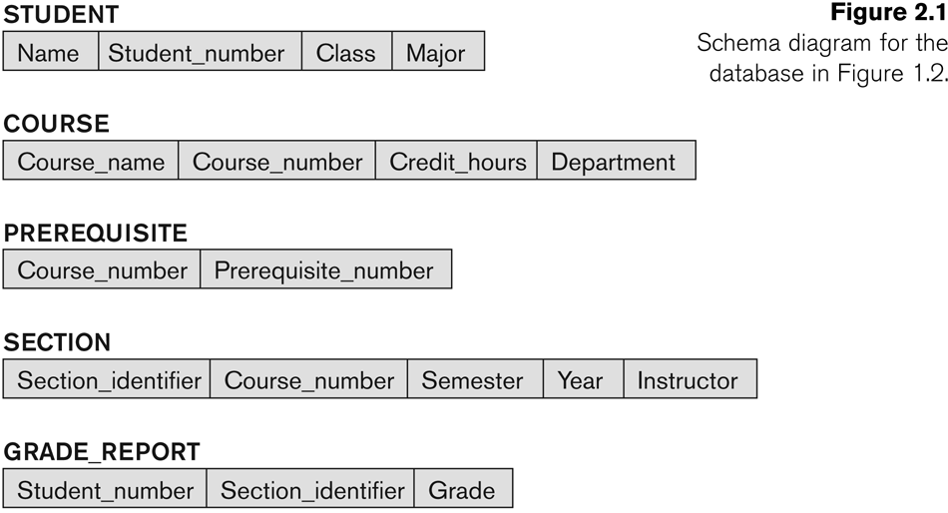
Example of a Database Schema

Slide 11
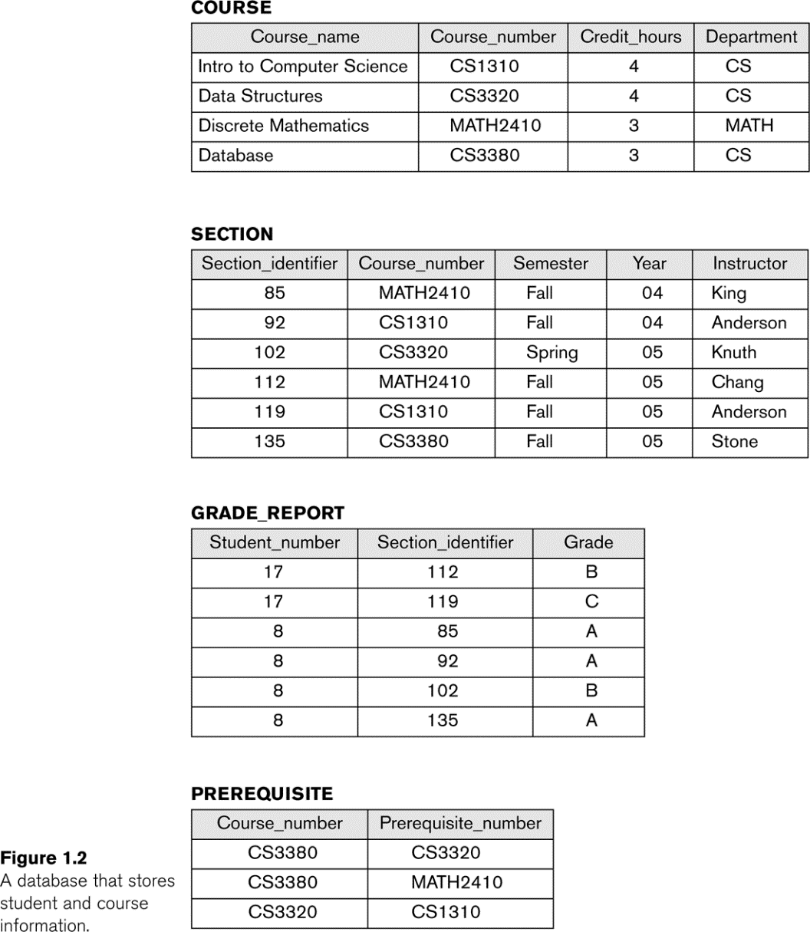
Example of a database state

Slide 12
Three-Schema Architecture
Proposed to support DBMS characteristics of:
Program-data independence.
Support of multiple views of the data.
Not explicitly used in commercial DBMS products, but has been useful in explaining database system organization

Slide 13
Three-Schema Architecture
Defines DBMS schemas at three levels:
Internal schema at the internal level to describe physical storage structures and access paths (e.g indexes).
Typically uses a physical data model.
Conceptual schema at the conceptual level to describe the structure and constraints for the whole database for a community of users.
Uses a conceptual or an implementation data model.
External schemas at the external level to describe the various user views.
Usually uses the same data model as the conceptual schema.

Slide 14
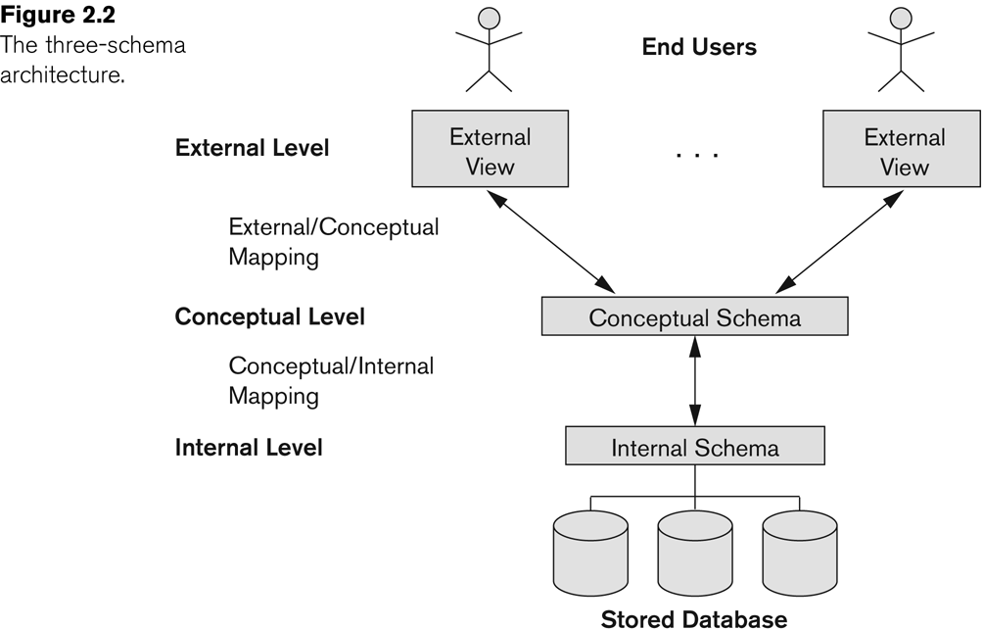
The three-schema architecture

Slide 15
Three-Schema Architecture
Mappings among schema levels are needed to transform requests and data.
Programs refer to an external schema, and are mapped by the DBMS to the internal schema for execution.
Data extracted from the internal DBMS level is reformatted to match the user’s external view (e.g. formatting the results of an SQL query for display in a Web page)

Slide 16
Data Independence
Logical Data Independence:
The capacity to change the conceptual schema without having to change the external schemas and their associated application programs.
Physical Data Independence:
The capacity to change the internal schema without having to change the conceptual schema.
For example, the internal schema may be changed when certain file structures are reorganized or new indexes are created to improve database performance

Slide 17
Data Independence (continued)
When a schema at a lower level is changed, only the mappings between this schema and higher-level schemas need to be changed in a DBMS that fully supports data independence.
The higher-level schemas themselves are unchanged.
Hence, the application programs need not be changed since they refer to the external schemas.

Slide 18
DBMS Languages
Data Definition Language (DDL)
Data Manipulation Language (DML)
High-Level or Non-procedural Languages: These include the relational language SQL
May be used in a standalone way or may be embedded in a programming language
Low Level or Procedural Languages:
These must be embedded in a programming language

Slide 19
DBMS Languages
Data Definition Language (DDL):
Used by the DBA and database designers to specify the conceptual schema of a database.
In many DBMSs, the DDL is also used to define internal and external schemas (views).
In some DBMSs, separate storage definition language (SDL) and view definition language (VDL) are used to define internal and external schemas.
SDL is typically realized via DBMS commands provided to the DBA and database designers

Slide 20
DBMS Languages
Data Manipulation Language (DML):
Used to specify database retrievals and updates
DML commands (data sublanguage) can be embedded in a general-purpose programming language (host language), such as COBOL, C, C++, or Java.
A library of functions can also be provided to access the DBMS from a programming language
Alternatively, stand-alone DML commands can be applied directly (called a query language).

Slide 21
Types of DML
High Level or Non-procedural Language:
For example, the SQL relational language
Are “set”-oriented and specify what data to retrieve rather than how to retrieve it.
Also called declarative languages.
Low Level or Procedural Language:
Retrieve data one record-at-a-time;
Constructs such as looping are needed to retrieve multiple records, along with positioning pointers.

Slide 22
DBMS Interfaces
Stand-alone query language interfaces
Example: Entering SQL queries at the DBMS interactive SQL interface (e.g. SQL*Plus in ORACLE)
Programmer interfaces for embedding DML in programming languages
User-friendly interfaces
Menu-based, forms-based, graphics-based, etc.

Slide 23
DBMS Programming Language Interfaces
Programmer interfaces for embedding DML in a programming languages:
Embedded Approach: e.g embedded SQL (for C, C++, etc.), SQLJ (for Java)
Procedure Call Approach: e.g. JDBC for Java, ODBC for other programming languages
Database Programming Language Approach: e.g. ORACLE has PL/SQL, a programming language based on SQL; language incorporates SQL and its data types as integral components

Slide 24
User-Friendly DBMS Interfaces
Menu-based, popular for browsing on the web
Forms-based, designed for naïve users
Graphics-based
(Point and Click, Drag and Drop, etc.)
Natural language: requests in written English
Combinations of the above:
For example, both menus and forms used extensively in Web database interfaces

Slide 25
Other DBMS Interfaces
Speech as Input and Output
Web Browser as an interface
Parametric interfaces, e.g., bank tellers using function keys.
Interfaces for the DBA:
Creating user accounts, granting authorizations
Setting system parameters
Changing schemas or access paths

Slide 26
Database System Utilities
To perform certain functions such as:
Loading data stored in files into a database. Includes data conversion tools.
Backing up the database periodically on tape.
Reorganizing database file structures.
Report generation utilities.
Performance monitoring utilities.
Other functions, such as sorting, user monitoring, data compression, etc.

Slide 27
Other Tools
Data dictionary / repository:
Used to store schema descriptions and other information such as design decisions, application program descriptions, user information, usage standards, etc.
Active data dictionary is accessed by DBMS software and users/DBA.
Passive data dictionary is accessed by users/DBA only.

Slide 28
Other Tools
Application Development Environments and CASE (computer-aided software engineering) tools:
Examples:
PowerBuilder (Sybase)
JBuilder (Borland)
JDeveloper 10G (Oracle)

Slide 29
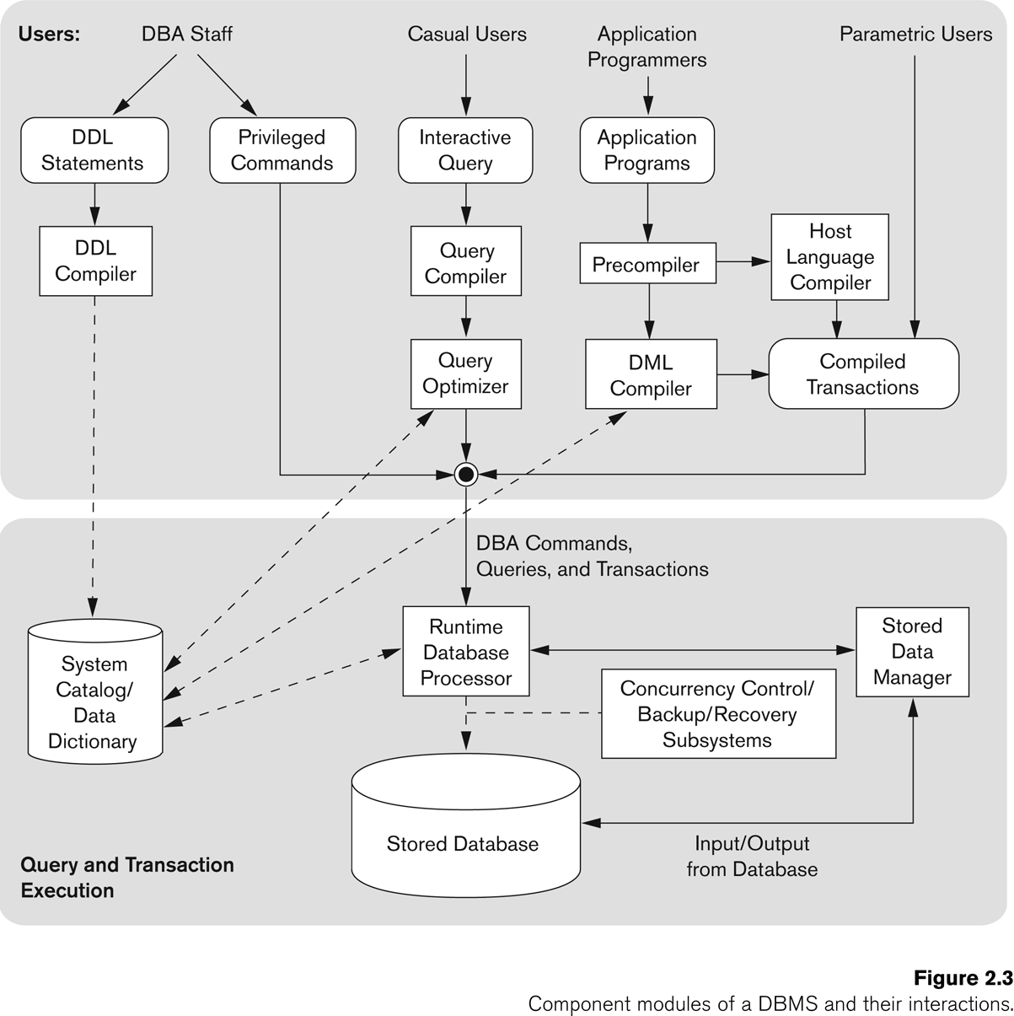
Typical DBMS Component Modules

Slide 30
Centralized and Client-Server DBMS Architectures
Centralized DBMS:
Combines everything into single system including- DBMS software, hardware, application programs, and user interface processing software.
User can still connect through a remote terminal – however, all processing is done at centralized site.

Slide 31
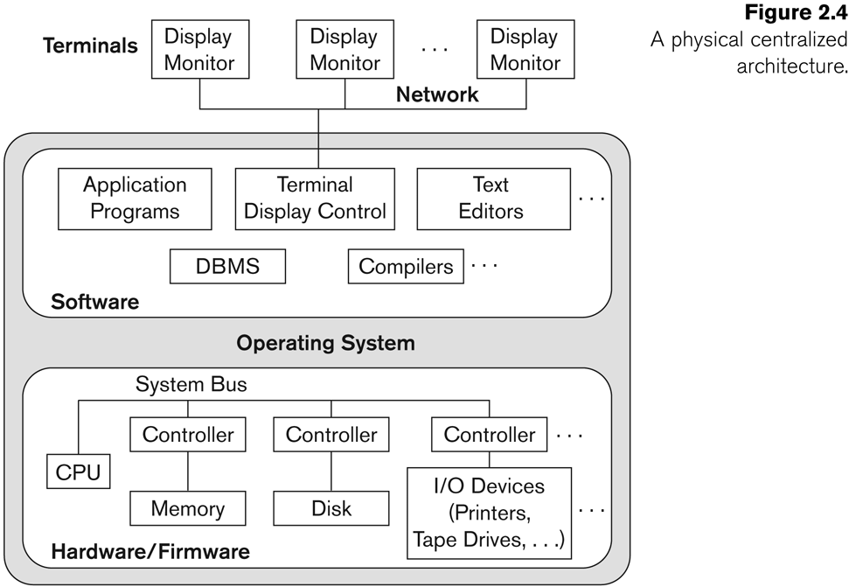
A Physical Centralized Architecture

Slide 32
Basic 2-tier Client-Server Architectures
Specialized Servers with Specialized functions
Print server
File server
DBMS server
Web server
Email server
Clients can access the specialized servers as needed

Slide 33
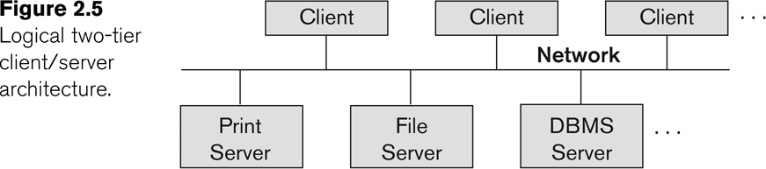
Logical two-tier client server architecture

Slide 34
Clients
Provide appropriate interfaces through a client software module to access and utilize the various server resources.
Clients may be diskless machines or PCs or Workstations with disks with only the client software installed.
Connected to the servers via some form of a network.
(LAN: local area network, wireless network, etc.)

Slide 35
DBMS Server
Provides database query and transaction services to the clients
Relational DBMS servers are often called SQL servers, query servers, or transaction servers
Applications running on clients utilize an Application Program Interface (API) to access server databases via standard interface such as:
ODBC: Open Database Connectivity standard
JDBC: for Java programming access
Client and server must install appropriate client module and server module software for ODBC or JDBC

Slide 36
Two Tier Client-Server Architecture
A client program may connect to several DBMSs, sometimes called the data sources.
In general, data sources can be files or other non-DBMS software that manages data.
Other variations of clients are possible: e.g., in some object DBMSs, more functionality is transferred to clients including data dictionary functions, optimization and recovery across multiple servers, etc.

Slide 37
Three Tier Client-Server Architecture
Common for Web applications
Intermediate Layer called Application Server or Web Server:
Stores the web connectivity software and the business logic part of the application used to access the corresponding data from the database server
Acts like a conduit for sending partially processed data between the database server and the client.
Three-tier Architecture Can Enhance Security:
Database server only accessible via middle tier
Clients cannot directly access database server

Slide 38
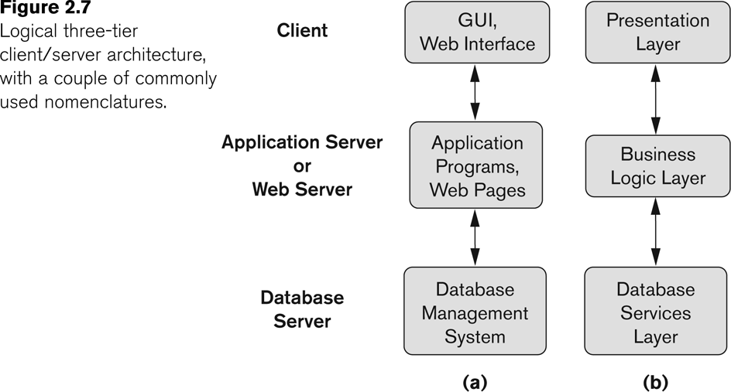
Three-tier client-server architecture

Slide 39
Classification of DBMSs
Based on the data model used
Traditional: Relational, Network, Hierarchical.
Emerging: Object-oriented, Object-relational.
Other classifications
Single-user (typically used with personal computers) vs. multi-user (most DBMSs).
Centralized (uses a single computer with one database) vs. distributed (uses multiple computers, multiple databases)
Notes:
We can define a distributed database (DDB) as a collection of multiple logically interrelated databases distributed over a computer network, and a distributed database management system (DDBMS) as a software system that manages a distributed database while making the distribution transparent to the user.
What Constitutes a DDB For a database to be called distributed,
the following minimum conditions should be satisfied:
■ Connection of database nodes over a computer network. There are multiple computers, called sites or nodes. These sites must be connected by an underlying network to transmit data and commands among sites.
■ Logical interrelation of the connected databases. It is essential that the information in the various database nodes be logically related.
■ Possible absence of homogeneity among connected nodes. It is not necessary that all nodes be identical in terms of data, hardware, and software.

Slide 40
Variations of Distributed DBMSs (DDBMSs)
Homogeneous DDBMS
Heterogeneous DDBMS
Federated or Multidatabase Systems
Distributed Database Systems have now come to be known as client-server based database systems because:
They do not support a totally distributed environment, but rather a set of database servers supporting a set of clients.

Slide 41
Cost considerations for DBMSs
Cost Range: from free open-source systems to configurations costing millions of dollars
Examples of free relational DBMSs: MySQL, PostgreSQL, others
Commercial DBMS offer additional specialized modules, e.g. time-series module, spatial data module, document module, XML module
These offer additional specialized functionality when purchased separately
Sometimes called cartridges (e.g., in Oracle) or blades
Different licensing options: site license, maximum number of concurrent users (seat license), single user, etc.

Slide 42
History of Data Models
The chronological order of the development of DBMS is as follows
1. Flat Files models (1970s-1990s)
2. Hierarchical models (1970s-1990s)
3. Network models (1970s- 1990s)
4. Relational models (1980s-present)
5. Object-Oriented models (1990s- present)
6. Object-Relational models (1990s-present)
7. Web enabled models(1990s-present)
8. NoSQL models

Slide 43
History of Data Models
1. Flat Files (1970s-1990s) : Flat files database is a database that stores information in a single file or table. In text file, every line contains one record where fields either have fixed length or they are separated by commas, whitespaces, tabs or any records and they cannot contain multiple tables as well.
2. Network database (1970s -1990s) :
The inventor of network model is Charles Bachmann. Unlike hierarchical database model, network database allows multiple parent and child relationships i. e., it maintains many-to many relationship.
Network database is basically a graph structure.
The network database model was created to achieve three main objectives:
To represent complex data relationship more effectively.
To improve the performance of the database.
To improve a database standard.

Slide 44
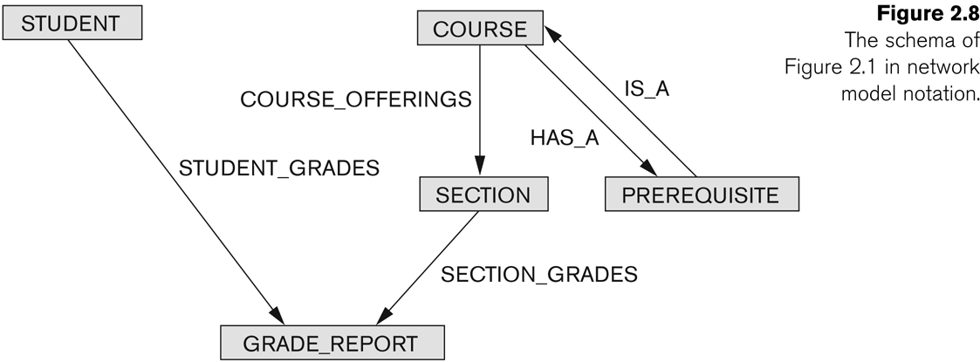
Example of Network Model Schema

Slide 45
Network Model
Advantages:
Network Model is able to model complex relationships and represents semantics of add/delete on the relationships.
Can handle most situations for modeling using record types and relationship types.
Language is navigational; uses constructs like FIND, FIND member, FIND owner, FIND NEXT within set, GET, etc.
Programmers can do optimal navigation through the database.

Slide 46
Network Model
Disadvantages:
Navigational and procedural nature of processing
Database contains a complex array of pointers that thread through a set of records.
Little scope for automated “query optimization”

Slide 47
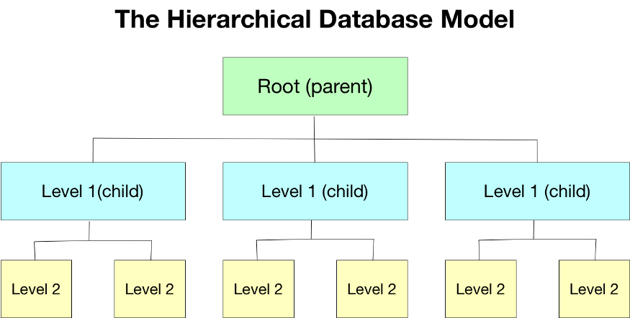
History of Data Models
3. Hierarchical (1970s-1990s) :
As the name indicates, hierarchical database contains data in a hierarchically-arranged data.
More Perceptively it can parent can have many children but one child can only have one parent i. e.,; one-to-many relationship.
Its hierarchical structure contains levels or segments which are equivalent to the file system’s record type.
All attributes of a specific record are listed under the entity type.

Slide 48
Hierarchical Model
Advantages:
Simple to construct and operate
Corresponds to a number of natural hierarchically organized domains, e.g., organization (“org”) chart
Language is simple:
Uses constructs like GET, GET UNIQUE, GET NEXT, GET NEXT WITHIN PARENT, etc.
Disadvantages:
Navigational and procedural nature of processing
Database is visualized as a linear arrangement of records
Little scope for "query optimization"

Slide 49
History of Data Models
4. Relational database (1980s-present) :
Relationship database model was proposed by E. F. Codd.
After the hierarchical and network model the birth of this model was huge step ahead. It allows the entities to be related through a common attribute. In the table there are alternative keys. This property makes this model extremely flexible

Slide 50
History of Data Models
5. Object- relationship models (1990s-present) :
Defined in simple teams, an object relationship database management system displays a modified object- oriented user- display over the already implemented relationship database management system.
When various software interact with this modified- database management system, they will customarily operate in a manner such that data is assumed to be saved as objects.
The basic working of this database management system is that is translated the useful data into organized tables distributed in rows and columns, and from then onwards, it manages data the same way done in the relational database system.
Similarly, when the data is to be accessed by the user, it is again translated from processed to complex form.

Slide 51
History of Data Models
6. Web enabled (1990s-present)
The graph wave began with The Semantic Web stack from the Worldwide Web Consortium in 1999, with property graphs appearing around 2008

Slide 52
History of Data Models
6. NoSQL Models
The NoSQL wave includes big data and much more; it began in 2008.

Slide 53
History of Data Models
6. Object-Relational Models:
Most Recent Trend. Started with Informix Universal Server.
Relational systems incorporate concepts from object databases leading to object-relational.
Exemplified in the latest versions of Oracle-10i, DB2, and SQL Server and other DBMSs.
Standards included in SQL-99 and expected to be enhanced in future SQL standards.
Chapter 22 describes this model.

Slide 54
Summary
Data Models and Their Categories
History of Data Models
Schemas, Instances, and States
Three-Schema Architecture
Data Independence
DBMS Languages and Interfaces
Database System Utilities and Tools
Centralized and Client-Server Architectures
Classification of DBMSs

Slide 55
Practice: Table creation, insert, update data
CREATING TABLES
ENTERING VALUES IN TABLES
CREATE TABLE departments
(deptno NUMBER(5) CONSTRAINT depts_deptno_PK PRIMARY KEY,
name VARCHAR2(25) CONSTRAINT depts_name_NN NOT NULL,
loc VARCHAR2(30) CONSTRAINT depts_loc_NN NOT NULL);
CREATE TABLE employees
(empno NUMBER(9) CONSTRAINT emps_empno_PK PRIMARY KEY,
fname VARCHAR2(15) CONSTRAINT emps_fname_NN NOT NULL,
lname VARCHAR2(20) CONSTRAINT emps_lname_NN NOT NULL,
hiredate DATE CONSTRAINT emps_hiredt_NN NOT NULL,
salary NUMBER(9,2),
commission NUMBER(9,2),
mgr NUMBER(9) CONSTRAINT emps_mgr_FK
REFERENCES employees(empno),
deptno NUMBER(5) CONSTRAINT emps_deptno_FK
REFERENCES departments(deptno));
INSERT INTO departments
(deptno,name,loc)
VALUES
(123,'Accounts','US');
SELECT fname, lname, deptno
FROM employees
WHERE deptno = 123;
UPDATE departments
SET name = 'marketing'
WHERE deptno=123

