Slide 2
Resources

Slide 3
Handouts
Download the Unit 04 Handout: Probability before class and bring it with you.
I will continue to post additional handouts as we progress through the course. Please watch for Canvas Announcements when a new handout becomes available.
It is very important that you bring the appropriate handout to class regularly, either as a printed copy or on your writing device.

Slide 4
Practice Problems
Practice Problems (PP) are essential for strengthening your understanding, building confidence, and exploring the concepts covered in class.
The Unit 04 Practice Problems are available under the Practice Problems tab on the course website. The solutions are provided in Canvas.
Complete the relevant Practice Problems as we progress through the unit.
Make sure you have completed and reviewed the Practice Problems before attempting the corresponding HW assignment.

Slide 5
Discrete Random Variable

Slide 6
Class Notes
Live class lecture notes
I usually post the class notes on Canvas by the end of the day. If you don’t see it, shoot me an email next day!

Slide 7
Proof: Expected Value of Linear Transformation
Let $a$ and $b$ be constants.
We want to show that
$$E\left(aX+b\right)=aE\left(X\right)+b.$$
Start from the definition of expected value:
$$E\left(aX+b\right)=∑\left(ax+b\right)p\left(x\right).$$
Distribute inside the summation:
$$E\left(aX+b\right)=∑axp\left(x\right)+∑bp\left(x\right).$$
Since $a$ and $b$ are constants, they can be taken outside the summations:
$$E\left(aX+b\right)=a∑xp\left(x\right)+b∑p\left(x\right).$$
Recall that
$$∑xp\left(x\right)=E\left(X\right)$$
and
$$∑p\left(x\right)=1.$$
Therefore,
$$E\left(aX+b\right)=aE\left(X\right)+b\left(1\right).$$
Hence,
$$\boxed{E\left(aX+b\right)=aE\left(X\right)+b}$$

Slide 8
Variance of a Discrete Random Variable
Recall that the variance of a discrete random variable $X$ is
$$V\left(X\right)=∑{\left(x−μ\right)}^{2}P\left(X=x\right).$$
Since
$$P\left(X=x\right)=p\left(x\right),$$
we can write
$$V\left(X\right)=∑{\left(x−μ\right)}^{2}p\left(x\right).$$
Expand the squared term:
$$V\left(X\right)=∑\left(x^{2}−2μx+μ^{2}\right)p\left(x\right).$$
Distribute $f\left(x\right)$:
$$V\left(X\right)=∑x^{2}p\left(x\right)−2μ∑xp\left(x\right)+μ^{2}∑p\left(x\right).$$
Recall that
$$∑xp\left(x\right)=E\left(X\right)=μ$$
and
$$∑p\left(x\right)=1.$$
Therefore,
$$V\left(X\right)=∑x^{2}p\left(x\right)−2μ\left(μ\right)+μ^{2}\left(1\right).$$
Hence,
$$V\left(X\right)=∑x^{2}p\left(x\right)−μ^{2}.$$
Since
$$E\left(X^{2}\right)=∑x^{2}p\left(x\right),$$
we obtain the useful variance formula
$$\boxed{V\left(X\right)=E\left(X^{2}\right)−{\left[E\left(X\right)\right]}^{2}}$$

Slide 9
Proof: Variance of a Linear Transformation
We want to show that
$$V\left(aX+b\right)=a^{2}V\left(X\right).$$
By the definition of variance,
$$V\left(aX+b\right)=∑{\left[\left(ax+b\right)−E\left(aX+b\right)\right]}^{2}p\left(x\right).$$
Using
$$E\left(aX+b\right)=aE\left(X\right)+b,$$
we get
$$V\left(aX+b\right)=∑{\left[ax+b−aE\left(X\right)−b\right]}^{2}p\left(x\right).$$
Simplifying,
$$V\left(aX+b\right)=∑{\left[ax−aE\left(X\right)\right]}^{2}p\left(x\right).$$
Factor out $a$:
$$V\left(aX+b\right)=∑{\left[a\left(x−E\left(X\right)\right)\right]}^{2}p\left(x\right).$$
Therefore,
$$V\left(aX+b\right)=∑a^{2}{\left[x−E\left(X\right)\right]}^{2}p\left(x\right).$$
Since $a^{2}$ is a constant,
$$V\left(aX+b\right)=a^{2}∑{\left[x−E\left(X\right)\right]}^{2}p\left(x\right).$$
But
$$∑{\left[x−E\left(X\right)\right]}^{2}p\left(x\right)=V\left(X\right).$$
Hence,
$$\boxed{V\left(aX+b\right)=a^{2}V\left(X\right)}$$
The other two properties are special cases:
$$V\left(aX\right)=a^{2}V\left(X\right)$$
when $b=0$, and
$$V\left(X+b\right)=V\left(X\right)$$
when $a=1$.

Slide 10
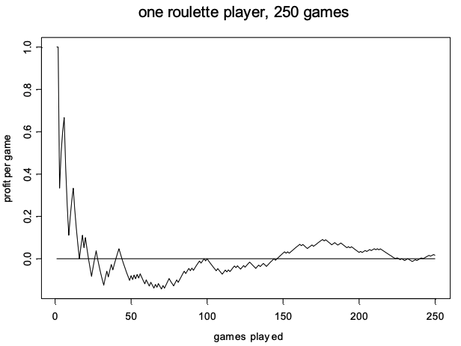
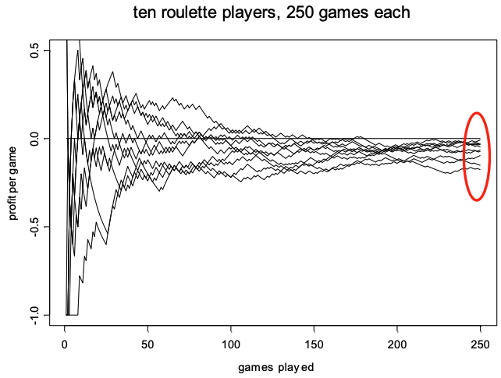
Simulating Roulette!
One Player - 250 Games.
Ten Players - 250 Games.

Slide 11
Bernoulli Distribution
Idea
A Bernoulli experiment has exactly two possible outcomes.
One outcome is called success, and the other is called failure.
  For example, we can define “rolling a six” as a success.
  We can define “an item is defective” as a success.
Let $p$ be the probability that the experiment results in a success.
Define the discrete random variable
$$X=\left\{\begin{matrix}1, & \text{if the experiment is a success}, \\ 0, & \text{if the experiment is a failure}.\end{matrix}\right.$$
Then
$$P\left(X=1\right)=p$$
and
$$P\left(X=0\right)=1−p.$$
Therefore, the probability mass function (PMF) of $X$ is
$$p\left(x\right)=\left\{\begin{matrix}p, & x=1, \\ 1−p, & x=0.\end{matrix}\right.$$
Formula
A discrete random variable $X$ has the Bernoulli distribution with parameter $p$ (A parameter is a fixed number that describes or controls a probability distribution) if
$$P\left(X=1\right)=p$$
and
$$P\left(X=0\right)=1−p.$$
The probability mass function (PMF) of $X$ is
$$p\left(x\right)=\left\{\begin{matrix}p, & x=1, \\ 1−p, & x=0.\end{matrix}\right.$$
Equivalently,
$$p\left(x\right)=p^{x}{\left(1−p\right)}^{1−x}, x=0,1.$$
The parameter $p$ can be any number between $0$ and $1$.
The mean and variance are
$$E\left(X\right)=p$$
and
$$V\left(X\right)=p\left(1−p\right).$$
Bernoulli Trials
A sequence of independent Bernoulli experiments with the same probability of success $p$ is called a sequence of Bernoulli trials.
Examples:
  Tossing a coin 10 times.
  Rolling a die 8 times and recording each time whether we get a six.
  Inspecting 50 manufactured items for defects.
With Bernoulli trials, we are usually interested in the total number of successes.
For example:
  Out of 10 tosses, how many heads did we get?
  How many sixes did we get in 8 rolls of a die?
  Out of 50 manufactured items, how many are defective?
Bernoulli Trials: Example
Suppose $n=5$ items are manufactured independently of each other.
Define:
  $B=$ success (defect)
  $A=$ failure (no defect)
Suppose the probability of a defect is
$$p=0.05.$$
Let
$$X_{i}=\left\{\begin{matrix}1, & \text{if the }i\text{th item is defective}, \\ 0, & \text{otherwise}.\end{matrix}\right.$$
Let
$$Y=\text{total number of defects}.$$
Therefore,
$$Y=X_{1}+X_{2}+X_{3}+X_{4}+X_{5}.$$
The possible values of $Y$ are
$$Y=\{0,1,2,3,4,5\}.$$
Bernoulli Trials: Possible Outcomes
The table below shows all possible outcomes of the five Bernoulli trials and the corresponding value of $Y$.
Bernoulli Trials: Probability of an Outcome
The Bernoulli random variables $X_{i}$ are independent.
Therefore, using basic probability rules we get,
$$\begin{matrix}P\left(AABAB\right) & =P\left(X_{1}=0\text{ and }X_{2}=0\text{ and }X_{3}=1\text{ and }X_{4}=0\text{ and }X_{5}=1\right) \\ & =P\left(X_{1}=0\right)P\left(X_{2}=0\right)P\left(X_{3}=1\right)P\left(X_{4}=0\right)P\left(X_{5}=1\right) \\ & =\left(0.95\right)\left(0.95\right)\left(0.05\right)\left(0.95\right)\left(0.05\right) \\ & ={0.05}^{2}{\left(0.95\right)}^{3}.\end{matrix}$$
Similarly,
$$P\left(BAAAB\right)={0.05}^{2}{\left(0.95\right)}^{3}.$$
Thus, the probability of each particular outcome containing exactly 2 defects is
$${0.05}^{2}{\left(0.95\right)}^{3}.$$
Bernoulli Trials: Number of Outcomes
We want to find
$$P\left(Y=2\right).$$
Each particular outcome containing exactly 2 defects has probability
$${0.05}^{2}{\left(0.95\right)}^{3}.$$
Therefore,
$$P\left(Y=2\right)=\left(\text{number of outcomes with 2 defects}\right)×{0.05}^{2}{\left(0.95\right)}^{3}.$$
How many different outcomes of 5 items contain exactly 2 defects?
$$\left({5 \atop 2}\right)=\frac{5!}{2!3!}=10.$$
Therefore,
$$P\left(Y=2\right)=\left({5 \atop 2}\right){\left(0.05\right)}^{2}{\left(0.95\right)}^{3}.$$
Bernoulli Trials Leading to ?
We can group all possible outcomes of the Bernoulli trials according to the value of $Y$.
The probability mass function of $Y$ is
$$P\left(Y=0\right)=1{\left(0.05\right)}^{0}{\left(0.95\right)}^{5},$$
$$P\left(Y=1\right)=5{\left(0.05\right)}^{1}{\left(0.95\right)}^{4},$$
$$P\left(Y=2\right)=10{\left(0.05\right)}^{2}{\left(0.95\right)}^{3},$$
$$P\left(Y=3\right)=10{\left(0.05\right)}^{3}{\left(0.95\right)}^{2},$$
$$P\left(Y=4\right)=5{\left(0.05\right)}^{4}{\left(0.95\right)}^{1},$$
and
$$P\left(Y=5\right)=1{\left(0.05\right)}^{5}{\left(0.95\right)}^{0}.$$
Therefore, the PMF of $Y$ can be written as
$$P\left(Y=x\right)=\left({5 \atop x}\right){\left(0.05\right)}^{x}{\left(0.95\right)}^{5−x}, x=0,1,…,5.$$
The distribution of $Y$ is called the Binomial distribution.

Slide 12
Hypergeometric Distribution
A set of $N$ objects contains:
  $K$ objects classified as successes
  $N−K$ objects classified as failures
A sample of size $n$ is selected randomly without replacement from the $N$ objects, where $K≤N$ and $n≤N$.
Let the random variable $X$ denote the number of successes in the sample.
Then $X$ is a hypergeometric random variable with probability mass function
$$P\left(X=x\right)=\frac{\left({K \atop x}\right)\left({N−K \atop n−x}\right)}{\left({N \atop n}\right)},$$
where
$$x=max\left(0,n+K−N\right),…,min\left(K,n\right).$$

Slide 13
Hypergeometric Mean and Variance
If $X$ is a hypergeometric random variable with parameters $N$, $K$, and $n$, then
$$μ=E\left(X\right)=np,$$
and
$$σ^{2}=V\left(X\right)=np\left(1−p\right)\left(\frac{N−n}{N−1}\right),$$
where
$$p=\frac{K}{N}.$$
The quantity
$$\frac{N−n}{N−1}$$
is called the finite population correction factor.
Therefore,
$$σ=\sqrt{np\left(1−p\right)\left(\frac{N−n}{N−1}\right)}.$$
As the sampling fraction $n/N$ becomes small, the hypergeometric variance approaches the corresponding binomial variance.

