Slide 2
Resources

Slide 3
Course Website
The Course Website will serve as the main hub for this course.
Class Activities: Lecture notes, handouts, examples, and other class resources will be posted under the Activities tab.
I will continue adding materials to each unit as we progress through the course.
Once a unit is completed, we will move on to the next unit.

Slide 4
The Course Website will also provide easy access to:
Practice Problems (PP)
Homework Assignments (HW)
Live Course Schedule
R Resources
Course Syllabus

Slide 5
Canvas will primarily be used for:
Taking quizzes
Submitting HW assignments
Viewing Practice Problem solutions
Accessing/downloading the course textbook and other restricted course materials
Course announcements and discussions
Notes:
I assume you have gone through the syllabus, participated in the Special Quiz, if not do this by next class
We will visit the syllabus and course rules later when needed

Slide 6
Class Notes vs Slides
Slides are generated automatically from the Activities posted on the course website.
During class, we will focus primarily on live note-taking rather than simply reading from slides.
Please watch for my email after each class for the corresponding electronic class notes.
Notes:
You can download the PP version directly from the course website

Slide 7
Live note-taking will generally have two parts:
Notes on a blank page: We will write down important definitions, concepts, theories, formulas, and other key ideas discussed during class.
Notes on the handouts: The handouts contain examples and exercises that apply the concepts and theories we have just discussed. We will work through these together during class.

Slide 8
Handouts
Download the Unit 02A Handout: Visualization before class and bring it with you.
Download additional Handout on Boxplot (no need to print and bring it in the class though!)
I will continue to post additional handouts as we progress through the course. Please watch for Canvas Announcements when a new handout becomes available.
It is very important that you bring the appropriate handout to class regularly, either as a printed copy or on your writing device.

Slide 9
Practice Problems
Practice Problems (PP) are essential for strengthening your understanding, building confidence, and exploring the concepts covered in class.
The Unit 02 Practice Problems are available under the Practice Problems tab on the course website.
Complete the relevant Practice Problems as we progress through the unit.
Make sure you have completed and reviewed the Unit 02 Practice Problems before attempting the corresponding HW assignment.

Slide 10
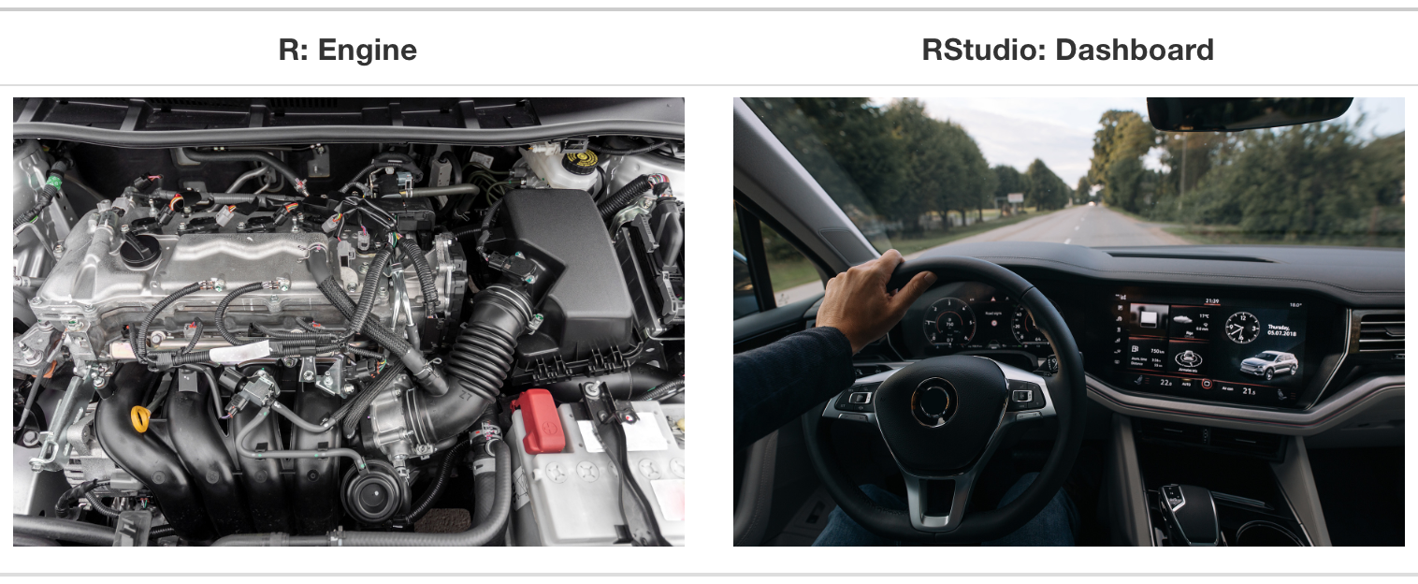
R & RStudio
“Doing” statistical modeling and working with data in general requires statistical software. Calculators and spreadsheet functionality alone do not cut it.
We will use R and RStudio throughout the course.
Figure 1.1 from A ModernDive into R and the Tidyverse.

Slide 11
Download and install R and RStudio on your device by the end of this week.
Check the R Resources tab on the course website for detailed installation instructions.
If you encounter problems during the installation process, you may use AI tools to help troubleshoot the issue.
If you are still unable to complete the installation, please bring your device to class or office hours so we can troubleshoot it together.

Slide 12
Communcation
Syllabus

Slide 13
Why Engineers Need Statistics

Slide 14

Why should engineers study statistics?

Slide 15
What is statistics?
Statistics is the science of collecting, analyzing, and interpreting data.
Engineers collect data from experiments, manufacturing processes, and systems.
Engineers analyze data to understand patterns and relationships.
Engineers interpret data to make decisions and improve processes.

Slide 16
Example: Manufacturing bolts
A factory is manufacturing bolts that should be exactly 2 inches long.
Measuring the length of all bolts (a census) may be:
too time consuming,
too expensive,
or impossible.
Instead, we can collect a sample of bolts.

Slide 17
Population and sample
A random sample of 5 bolts yields the following measurements, in inches:
[ {2.003, 1.999, 2.006, 1.996, 2.001} ]
Population: The set of all people or things being studied, i.e., all possible observations.
Sample: The subset of the population from which information is actually collected.

Slide 18
Variability
Consider again the measurements:
[ {2.003, 1.999, 2.006, 1.996, 2.001} ]
The data have variability.
Identify the source(s) of the variation.
Reduce the variation.

Slide 19
Additional information: Machines
The bolts are being produced by two different machines:
Machine A
Machine B
This gives us one possible source of variation in bolt length.

Slide 20
Additional information: Production speed
Each machine has three speed settings:
Slow: 500 bolts/minute
Medium: 1000 bolts/minute
Fast: 2000 bolts/minute
Now we have two possible sources of variation:
Machine
Production speed

Slide 21
How should we collect the data?
There are several options.
Retrospective Study
Use data that have been collected in the past.
Observational Study
Observe the process in the present and collect data.
Designed Experiment
Exhibit maximum control over when, where, and how the data are collected.

Slide 22
Example: Sample Variance and Standard Deviation
$x_{i}$ | $x_{i}−\overset{‾}{x}$ | ${\left(x_{i}−\overset{‾}{x}\right)}^{2}$ | $x_{i}^{2}$
3 | $−6$ | 36 | 9
7 | $−2$ | 4 | 49
10 | 1 | 1 | 100
11 | 2 | 4 | 121
14 | 5 | 25 | 196
Total: 45 | 0 | 70 | 475
Suppose we have collected the following random sample of $n=5$ observations:
$$\{3,7,10,11,14\}$$
Find the sample variance and sample standard deviation.
Step 1: Calculate the sample mean
$$\begin{matrix}\overset{‾}{x} & =\frac{\sum_{i=1}^{n}{x_{i}}}{n} \\ & =\frac{3+7+10+11+14}{5} \\ & =\frac{45}{5} \\ & =9.\end{matrix}$$
Step 2: Complete the table

Slide 23
Step 3: Calculate the sample variance
Using the deviations from the sample mean:
$$s^{2}=\frac{\sum_{i=1}^{n}{{\left(x_{i}−\overset{‾}{x}\right)}^{2}}}{n−1}.$$
Therefore,
$$\begin{matrix}s^{2} & =\frac{70}{5−1} \\ & =\frac{70}{4} \\ & =17.5.\end{matrix}$$
Step 4: Verify using the convenient formula
The convenient formula for the sample variance is
$$s^{2}=\frac{\sum_{i=1}^{n}{x_{i}^{2}}−\frac{{\left(\sum_{i=1}^{n}{x_{i}}\right)}^{2}}{n}}{n−1}.$$
Substituting the values from the table:
$$\begin{matrix}s^{2} & =\frac{475−\frac{{45}^{2}}{5}}{5−1} \\ & =\frac{475−405}{4} \\ & =\frac{70}{4} \\ & =17.5.\end{matrix}$$
Both methods give the same sample variance:
$$\boxed{s^{2}=17.5}$$
Step 5: Calculate the sample standard deviation
$$\begin{matrix}s & =\sqrt{s^{2}} \\ & =\sqrt{17.5} \\ & ≈4.18.\end{matrix}$$
Therefore,
$$\boxed{s≈4.18}$$

Slide 24
Quiz 01
We have now covered all the topics included in Quiz 01, which covers Units 01 and 02.
Before attempting the quiz, carefully review the course material covered since the first day of class, including:
Class notes
Whiteboard notes
Handouts
Relevant textbook sections, especially if you missed a class
Quiz 01 is designed to assess your general understanding of the course material covered so far.
Due: Thursday, September 3, at 11:59 p.m. on Canvas.

