Slide 1

Given a scatterplot, guess where the regression line should go and the value of r.

Slide 2
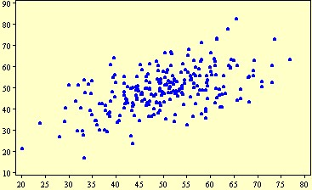
r = .54

Slide 3
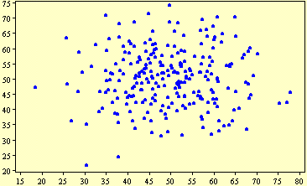
r = .02

Slide 4
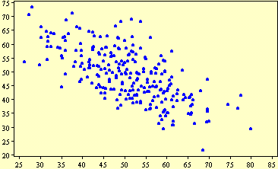
r = −.68

Slide 5
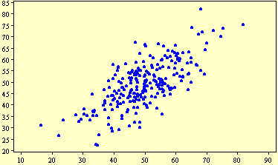
r = .71

Slide 6
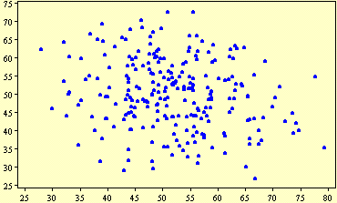
r = −.18

