Slide 1
EEE 4407 · RANDOM SIGNALS AND PROCESSES
Real-Time ECG
Arrhythmia Detector
Modeling the human heartbeat as a stochastic process — and catching the moment it stops behaving like one.
Islamic University of Technology (IUT) · MATLAB · MIT-BIH Arrhythmia Database

Slide 2
THE PROBLEM
A healthy heartbeat isn't a metronome — but it isn't noise either
Every heartbeat is timed slightly differently: breathing, posture, and the autonomic nervous system all add natural variability. Somewhere between “perfectly regular” and “random” sits the real signature of a healthy heart. The question this project answers is deceptively simple:
360 Hz
MIT-BIH sampling rate
2,274
R-peaks detected (Patient 100)
“Given a stream of heartbeats, how do we rigorously and automatically decide — with a stated level of confidence — that one of them is abnormal?”
95%
Confidence-interval decision boundary
That “rigorously” is the whole project. It's the difference between eyeballing a plot and applying the statistical machinery of EEE 4407 to a real, physiological data stream.
2-state
Markov chain: Normal ↔ Arrhythmia
Real-Time ECG Arrhythmia Detector
2

Slide 3
CORE IDEA
Three statistical moves, one detector
01
02
03
Model
Learn
Decide
Treat the R-R interval sequence as a Wide Sense Stationary (WSS) random process, and verify it empirically.
Estimate its mean, variance, and probability density — then build a 95% confidence interval around “normal.”
Test every new beat with H₀ vs. H₁, and track state transitions with a Markov chain instead of judging beats alone.
Real-Time ECG Arrhythmia Detector
3

Slide 4
SYSTEM ARCHITECTURE
Five checkpointed phases, one MATLAB pipeline
1
2
3
4
5
Data
Acquisition
→
Preprocessing
& Detection
→
Stochastic
Modeling
→
Hypothesis
Testing
→
Real-Time
GUI
Load MIT-BIH record, visualize raw signal & noise
Bandpass filter (5–15 Hz) + R-peak detection
PDF fit, point estimates, WSS verification
H₀/H₁ decision + Markov transition matrix
Live streaming visualization & alerting
Each phase loads the previous phase's saved .mat checkpoint, does one clearly scoped job, and saves its own output for the next stage — so the pipeline can be re-run from any point without recomputing everything upstream.
Real-Time ECG Arrhythmia Detector
4

Slide 5
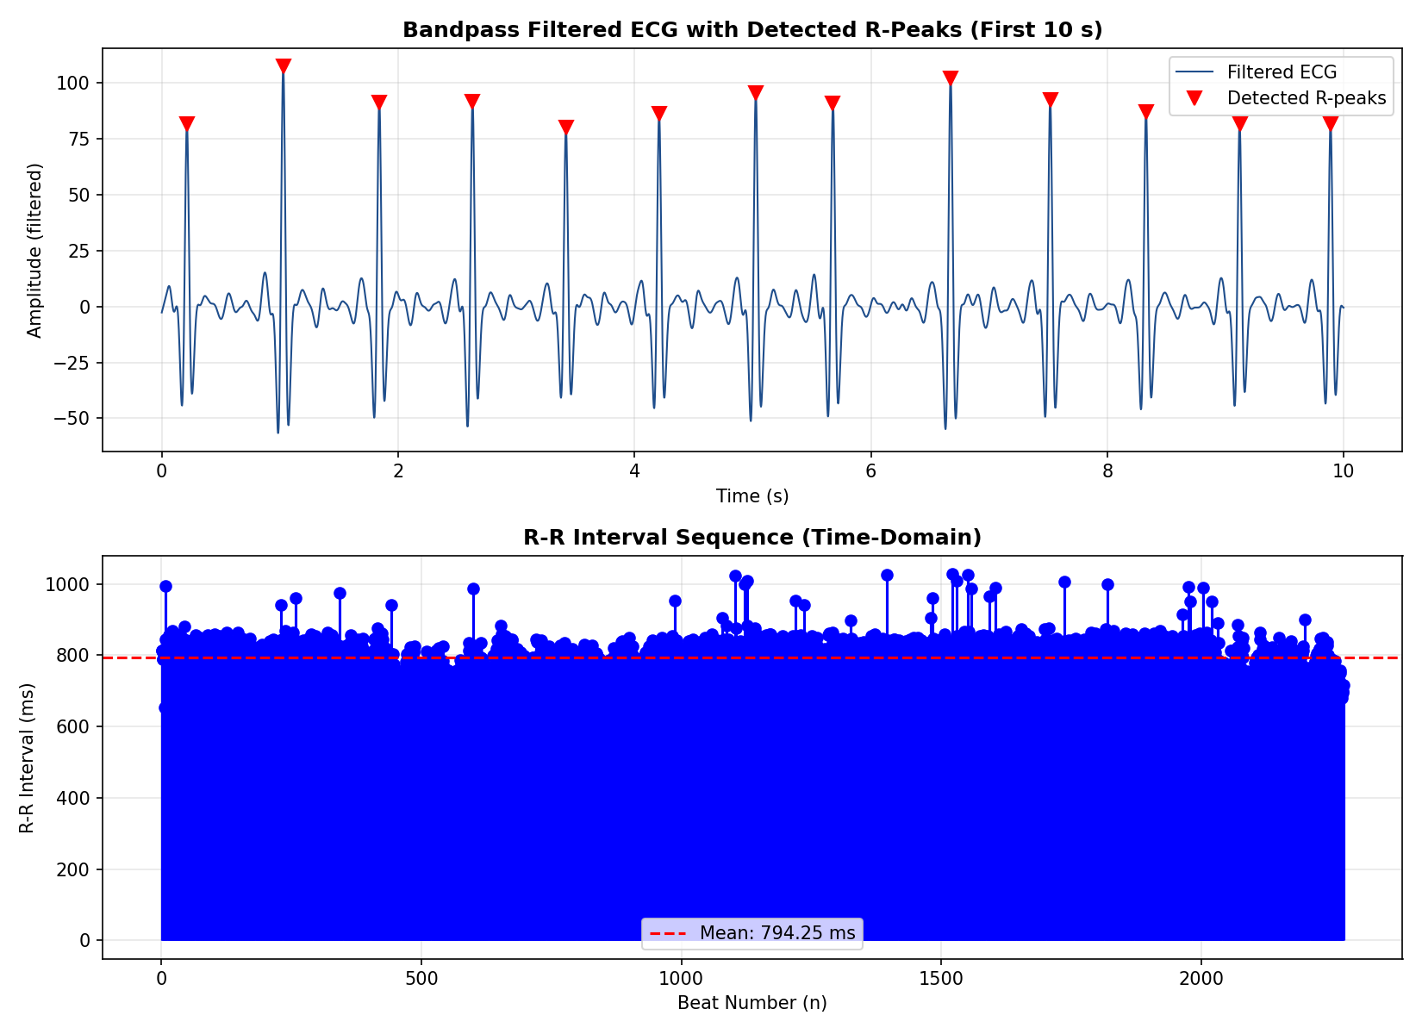
PHASES 1–2
From raw waveform to a clean R-R interval sequence
Data Acquisition
MIT-BIH Patient 100, dual-lead (MLII, V5), 360 Hz — loaded via readtable and inspected for noise structure.
Bandpass Filtering
2nd-order Butterworth, 5–15 Hz, applied with filtfilt for zero-phase response — preserves exact R-peak timing.
Adaptive R-Peak Detection
findpeaks with a 108-sample minimum spacing (~200 bpm ceiling) and prominence set to 15% of the signal's own amplitude range.
Real-Time ECG Arrhythmia Detector
5

Slide 6
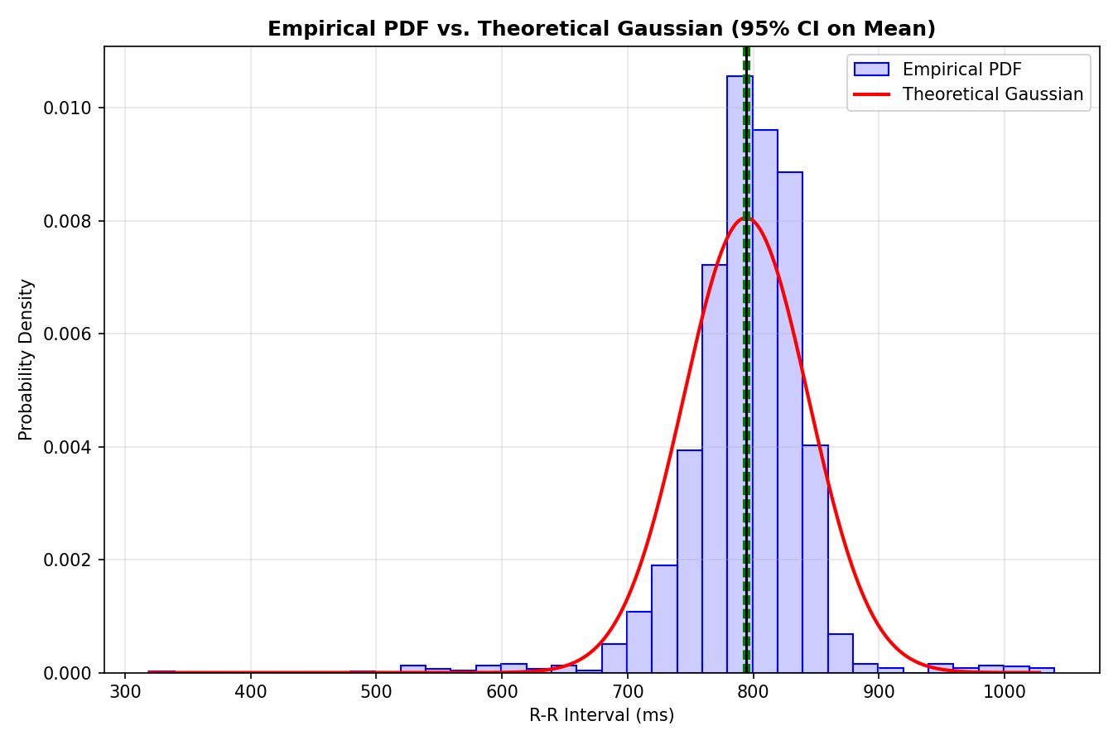
PHASE 3
Learning what “normal” looks like, statistically
Point Estimation
Sample mean μ̂ ≈ 794 ms and standard deviation σ̂ ≈ 49.5 ms computed directly from the R-R sequence.
PDF Estimation
Empirical histogram fit against a theoretical Gaussian via normfit — the model every future beat gets compared against.
WSS Verification (two independent tests)
Windowed mean stability across 10 segments, and a normalized autocorrelation check against the white-noise confidence band.
95% Confidence Interval
Becomes the acceptance region carried forward into Phase 4's decision rule.
Real-Time ECG Arrhythmia Detector
6

Slide 7
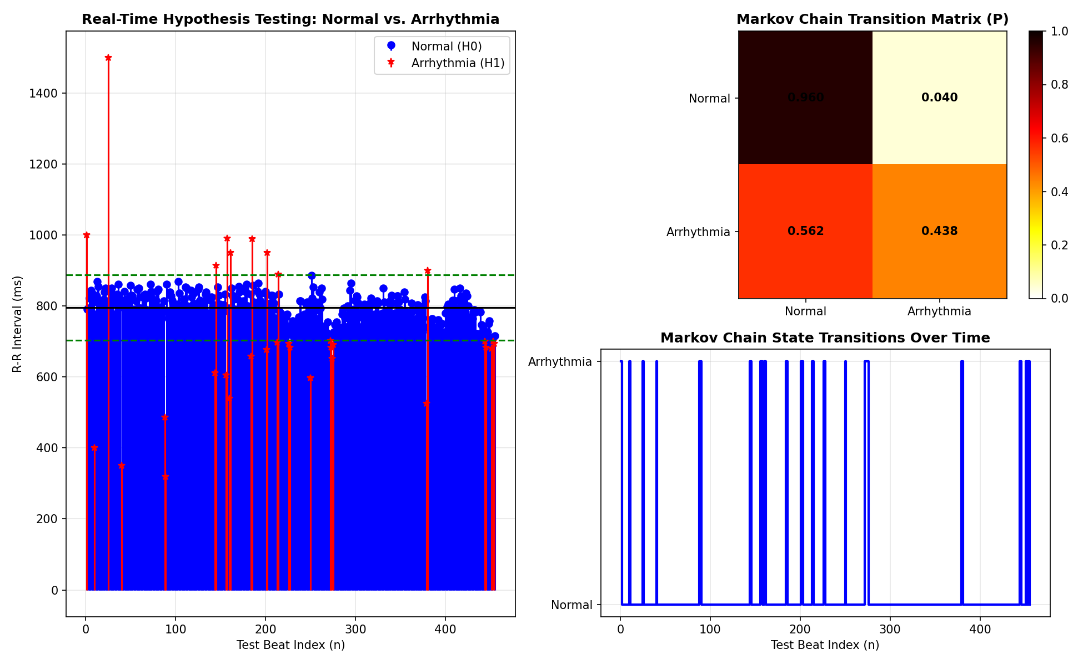
PHASE 4
Deciding, and remembering the decision
H₀ vs. H₁
Reject H₀ (normal) when a beat falls outside μ_train ± 1.96·σ_train.
Validation
3 synthetic arrhythmias injected into the held-out test split — all 3 correctly flagged.
Markov Chain
Empirical 2×2 transition matrix distinguishes a one-off blip from a sustained abnormal state.
Real-Time ECG Arrhythmia Detector
7

Slide 8
PHASE 5
A live, interactive demo — not just a static plot
Real-Time ECG Arrhythmia Detector | EEE 4407
Live R-R Interval Stream
SYSTEM STATUS DASHBOARD
NORMAL SINUS RHYTHM
Current R-R Interval: 812 ms
Training Mean: 795.9 ms
95% CI: [703, 888] ms
State: Normal (H₀ Accepted)
▶ Start Real-Time Simulation
Reset Simulation
Illustrative recreation of the MATLAB App Designer interface (phase5_realtime_gui.m) — streams beats live at ~20/sec with real-time state updates.
Real-Time ECG Arrhythmia Detector
Real-Time ECG Arrhythmia Detector
8

Slide 9
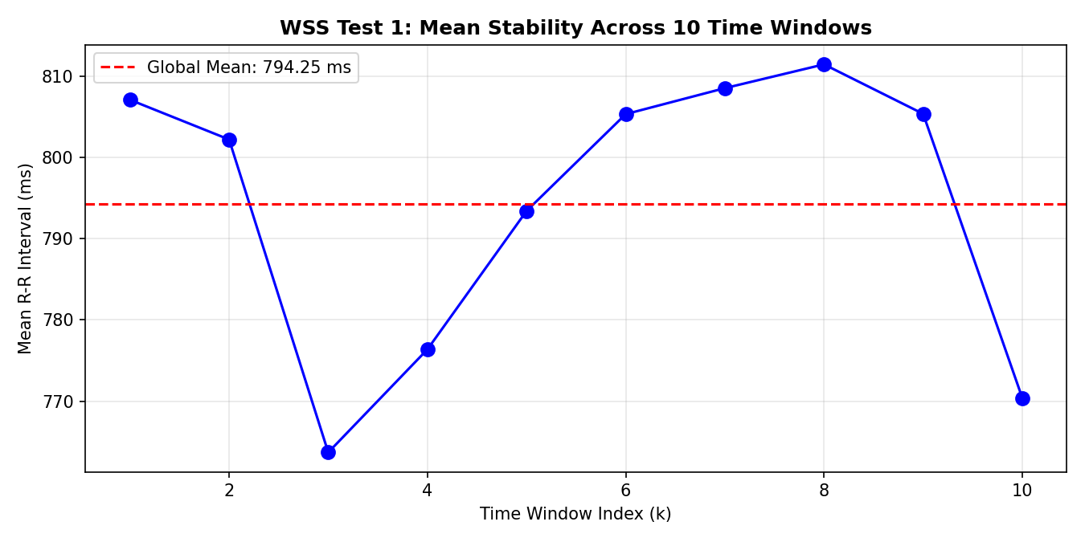
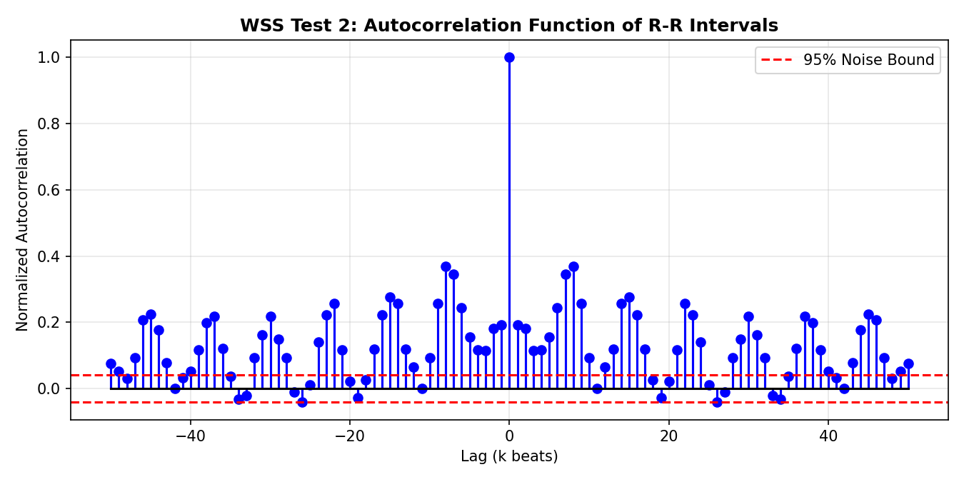
RESULTS
Validated on MIT-BIH Patient 100
2,274
794 ms
[703, 888] ms
3 / 3
R-peaks detected across a 30-minute strip
Mean R-R interval (σ ≈ 49.5 ms)
95% confidence acceptance band (training split)
Injected synthetic arrhythmias correctly flagged
WSS Test 1: windowed mean stability
WSS Test 2: autocorrelation within noise bounds
Real-Time ECG Arrhythmia Detector
9

Slide 10
SYLLABUS MAPPING
Every stage is a named EEE 4407 concept, applied
Course Concept | Purpose | Where It's Used
Random Process | Model ECG as a signal changing over time | R-R interval sequence (Phase 2–3)
Wide Sense Stationarity | Define stable, healthy behavior | Windowed mean + autocorrelation tests (Phase 3)
PDF Estimation | Describe the distribution of R-R intervals | histogram + normfit (Phase 3)
Expected Value | Define the normal heartbeat interval | mean(rr) baseline (Phase 3–4)
Variance | Measure heartbeat variability | var(rr), std(rr) (Phase 3–4)
Confidence Intervals | Set the acceptable range for normal beats | 95% CI as decision boundary (Phase 3–4)
Hypothesis Testing | Accept/reject a beat as normal | H₀ vs. H₁ threshold rule (Phase 4)
Markov Chains | Model rhythm evolution over time | 2×2 transition matrix P (Phase 4)
Real-Time ECG Arrhythmia Detector
10

Slide 11
TEAM
Three leads, one pipeline
Signal Processing Lead
Stochastic Process & Math Lead
Statistical Testing & Integration Lead
Data ingestion, noise filtering, and QRS / R-peak detection accuracy.
PDF estimation, expected value & confidence intervals, Markov transition matrices.
Hypothesis testing algorithms, detection evaluation, and the real-time MATLAB GUI.
Course project — EEE 4407: Random Signals and Processes, Islamic University of Technology (IUT)
Real-Time ECG Arrhythmia Detector
11

Slide 12
WHAT'S NEXT
This is a living project
Validate against ground truth
Multi-state Markov chain
Score the detector against MIT-BIH's official beat annotations (precision / recall / F1).
Move beyond binary Normal/Arrhythmia to PVC, Bradycardia, Tachycardia, Fibrillation-like states.
Adaptive thresholds
ML comparison baseline
Replace the fixed training-split CI with a rolling or online estimator.
Benchmark the statistical approach against an SVM / 1D-CNN classifier.
Live hardware input
Standalone deployable app
Stream from an AD8232 + Arduino/ESP32 front-end for a truly real-time system.
Package Phase 5 as a compiled MATLAB App for one-click demos.
Real-Time ECG Arrhythmia Detector
12

Slide 13
Statistics you can hear a heartbeat in.
Thank you
Real-Time ECG Arrhythmia Detector · EEE 4407: Random Signals and Processes · IUT

