Slide 1



A Mutation Carol
Past, Present and Future
Jeff Offutt
Software Engineering
George Mason University
Fairfax, VA USA
www.cs.gmu.edu/~offutt/
offutt@gmu.edu
Mutation Workshop 2009
Denver, CO, USA
4-April-2009

Slide 2
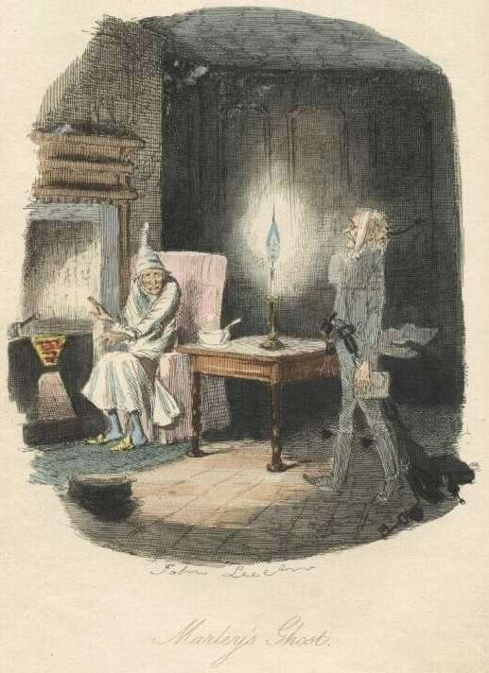
Mutation Past – 1970s
Originally proposed by Dick Lipton in 1971 as a class project to Dave Parnas
Ghost of Mutation Past
Mutation 2009
© Offutt

Slide 3
Mutation Past – 1970s
DeMillo (Georgia Tech), Lipton (Princeton) and Sayward (Yale) started mutation research
Mutation operators for Fortran and Cobol
Unit testing
Several published papers
Working systems
  PIMS (Fortran), CPMS (Cobol), EXPER (Cobol)
Two PhD theses laid out original theoretical concepts
  Alan Acree (1980-Georgia Tech)
  Tim Budd (1980-Yale)
Mutation 2009
© Offutt

Slide 4
Mutation Past – 1980s
This work developed the fundamental concepts and theory behind program-based mutation analysis
Coupling effect (DeMillo, Lipton, Sayward 1978)
Competent programmer hypothesis (DeMillo, Lipton, Sayward 1978)
Program neighborhoods (Budd’s dissertation, 1980)
Acceptors and generators (Budd’s dissertation, 1980)
Mutation 2009
© Offutt

Slide 5
Mutation Past – 1980s
Working systems established that tools could be built to support mutation
Limited
Not distributed
Only effectively used by developers
Mutation 2009
© Offutt

Slide 6
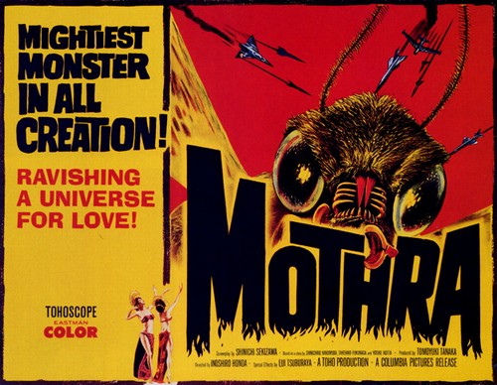
Mutation Past – 1980s
The Mothra project was established in the 1980s to demonstrate practical feasibility
Goal was to solve the many engineering problems associated with using mutation in practice
Mothra was the first widely used working mutation system
  Installed at hundreds of universities
  and research labs
  Source was provided (>100 KLOC)
  in C—an early precursor to modern
  open source software
Mutation 2009
© Offutt

Slide 7
Mutation Past – 1980s
Dozens of papers during the project, more after
PhD theses : Offutt 1988, Agarwal 1990, Krauser 1991, Wong 1993
Follow-on PhD theses : Kim 1989, Choi 1991, Untch 1995
Follow-on MS theses : Craft 1989, Seaman 1989, Lee 1991, Pressley 1992, Zapf 1993, Pan 1994
Mutation 2009
© Offutt

Slide 8
Mutation Past – 1980s
Engineering problems addressed by Mothra
Most effective mutation operators
Creation and storage of mutants
Definition and storage of test cases
Process and user interface
Test data generation
Parallelization of mutation execution
Comparison with other test technique
Mutation 2009
© Offutt

Slide 9
Mutation Past – 1980s
Architecturally, Mothra was designed as a collection of separate programs, integrating around a common set of data stores with standardized APIs …
Mutation 2009
© Offutt

Slide 10

Mutation Past – 1980s
The Mothra Tool Set
several UIs
mutant maker
interpreter
parser
MOTHRA INTERMEDIATE LANGUAGE
MUTANTS
killer
P
test case manager
TEST CASES
EXPECTED OUTPUT
User
decoder
ATDG
User
Mutation 2009
© Offutt

Slide 11
Mutation Past – 1990s
Two problems identified during the Mothra project
  Mutation was too slow
  Mutation was too hard to use
Do fewer (fewer mutants)
  Selective mutation, mutant sampling
Do smarter
  Weak mutation, distributed execution, different process
Do faster
  Schema-based analysis, separate compilation
Eliminating manual labor
  Automatic test data generation, equivalent mutant detection
Mutation 2009
© Offutt

Slide 12
Mutation Past – 1990s
Most of this work focused on program unit testing
Mutation operators
  Modified individual statements
  One at a time
Traditional programming languages
  Fortran
  Ada
  C
  Lisp
Mutation 2009
© Offutt

Slide 13
Mutation Past – 1990s
First “out of the box” ideas for mutation
Interface mutation
  mutating function calls, moving beyond the unit level
Specification mutation
  mutating formal specifications, moving beyond the program
Mutation 2009
© Offutt

Slide 14
Mutation Past – 1990s
In 2000, I thought mutation research was finished
Time for industry adoption
But I missed the significance of these two ideas …
Mutation 2009
© Offutt

Slide 15
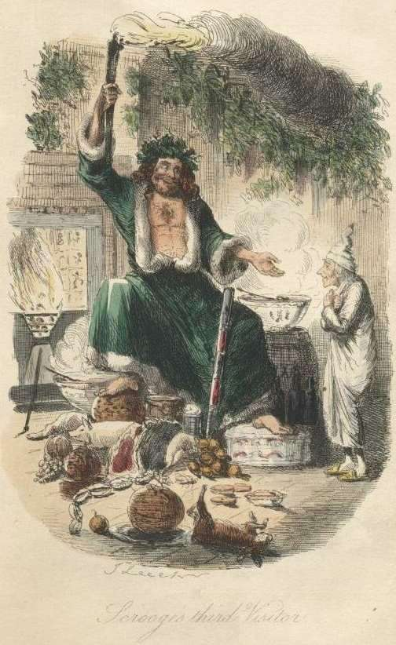
Mutation Present – 2000s
Lots of new tools
muJava
Proteum
Csaw
Certitude
Mu Dynamics
Jumble
PlexTest
Heckle
…
Ghost of
Mutation Present
Mutation 2009
© Offutt

Slide 16
Mutation Present – 2000s
Mutation has been applied at a variety of program levels, issues and languages
Interface mutation
Classes
Object-oriented
Real-time
Concurrency
…
Java
Ruby
…
Mutation 2009
© Offutt

Slide 17
Mutation Present – 2000s
Several formal specification languages
SMV
Z
Object-Z
Algebraic specs
…
Mutation 2009
© Offutt

Slide 18
Mutation Present – 2000s
Eventually to other software artifacts and models
XML
Statecharts
Activity diagrams
Input languages
SQL
HTML
Spreadsheet formulas
…
Mutation 2009
© Offutt

Slide 19
Mutation Present – 2000s
Not to mention problems other than testing
Security
Reliability
Complexity measurement
…
Mutation 2009
© Offutt

Slide 20
Mutation Present – 2000s
Aggregating Realization
We are performing mutation analysis whenever we
use well defined rules
defined on syntactic descriptions
to make systematic changes
to the syntax or to objects developed from the syntax
Diversity View
Mutation is one version of syntax directed testing, which finds tests that cover a space defined by a grammar
Mutation 2009
© Offutt

Slide 21
Mutation Present – 2000s
Mutation has entered the mainstream !
Successful commercialization
  Certitude by Certess tests integrated circuit designs in VHDL or Verilog
  PlexTest by ITRegister tests C++
Use by non-researchers
And in Wikipedia
  http://en.wikipedia.org/wiki/Mutation_testing
Mutation 2009
© Offutt

Slide 22
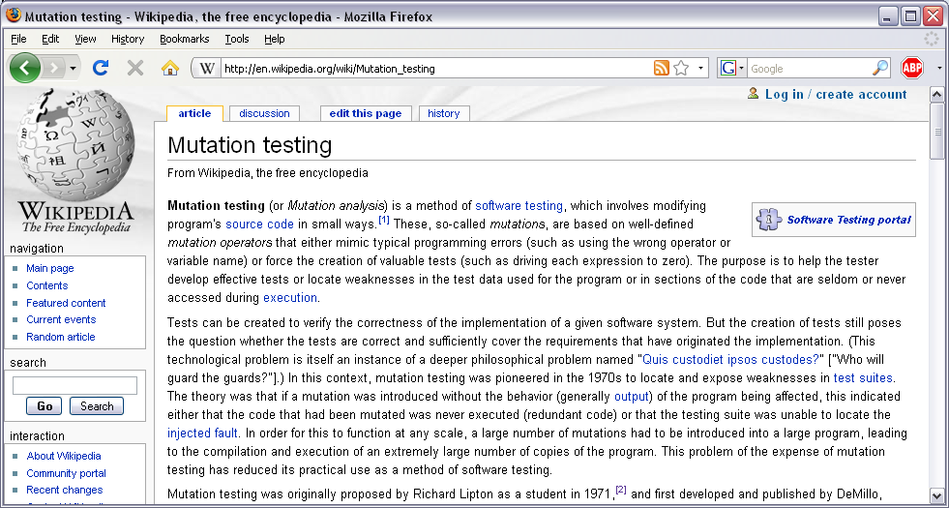
Mutation Present – 2000s
Mutation 2009
© Offutt

Slide 23
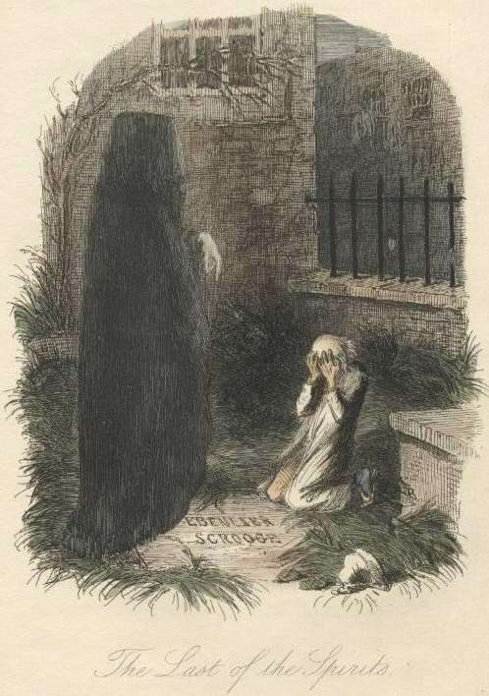
Mutation Future – 2010++
Ghost of
Mutation Future
Mutation 2009
© Offutt

Slide 24
Mutation Present – 2010s
Prediction is difficult –
especially about the future
— Niels Bohr
But damn fun !!
— Jeff Offutt
Mutation 2009
© Offutt

Slide 25
Mutation Future – 2010s
(1) Mutation must be integrated with development
Developers do not want to understand mutation
  They just want good tests
Developers do not want to understand testing
  They just want to find problems with their software
Tool must ignore theoretical problems of completeness and infeasibility
  Developers do not care about equivalent mutants
  Developers do not care about the mutation score
Developers just want to know when software fails
Mutation 2009
© Offutt

Slide 26
Mutation Future – 2010s
mutation
P
compiler
semantic
failures
syntax errors
editor
Users do not have to get involved with this process
Why do they
have to here?
Mutation 2009
© Offutt

Slide 27
Mutation Future – 2010s
(2) What kinds of faults can we detect with mutation?
What kinds of faults is mutation good at finding ?
  … particularly bad at finding ?
What kinds of faults do we really care about ?
  … do we not care about ?
Java example : If you override equals(), you must override hashcode() ?
  Can a mutant catch that fault ?
Many OO mutants cannot be killed unless the tester subclasses or otherwise uses the mutated class
Mutation 2009
© Offutt

Slide 28
Mutation Future – 2010s
(3) Mutate for improvement, not correctness
model of software
mutated model 1
mutated model 2
tradeoffs
mutate
assess
Quantitative measures
Maintainability
Performance
Size of the resulting program
…
mutated model N
Mutation 2009
© Offutt

Slide 29
Mutation Future – 2010s
(4) Deeper theory of mutation operators
What can we model and what can’t we model ?
How do we define mutation operators ?
  What theory for how to define mutation operators ?
Some data indicate that our mutation operators are inefficient—what is a minimalist approach ?
Mutation 2009
© Offutt

Slide 30
Mutation Future – 2010s
(5) What else can we mutate ?
What else can we model with grammars ?
What additional problems can be solved with mutation ?
How else can we use mutants ?
Mutation 2009
© Offutt

Slide 31
A Contrarian View
If we have mutation, do we need other test criteria ?
Jeff Offutt
offutt@gmu.edu
http://cs.gmu.edu/~offutt/
Mutation 2009
© Offutt

