Slide 1


An Evaluation of Mutation and Data-flow Testing
A Meta Analysis
Sahitya Kakarla AdVanced Empirical Software Testing and Analysis (AVESTA) Department of Computer Science Texas Tech University, USA sahitya.kakarla@ttu.edu | Selina Momotaz AdVanced Empirical Software Testing and Analysis (AVESTA) Department of Computer Science Texas Tech University, USA selina.momotaz@ttu.edu | Akbar Siami Namin AdVanced Empirical Software Testing and Analysis (AVESTA) Department of Computer Science Texas Tech University, USA akbar.namin@ttu.edu
The 6th International Workshop on Mutation Analysis (Mutation 2011)
Berlin, Germany, March 2011

Slide 2
Outline
Motivation
  What we do/don’t know about mutation and Data-flow?
Research synthesis methods
Research synthesis in software engineering
Mutation vs. Data-flow testing
  A meta-analytical assessment
Discussion
Conclusion
Future work

Slide 3
Motivation
What We Already Know?
We already know[1, 2, 3]:
  Mutation testing detects more faults than data-flow testing
  Mutation adequate test suites are larger than data-flow adequate test suites
[1] A.P. Mathur, W.E. Wong, “An empirical comparison of data flow and mutation-based adequacy criteria,” Software Testing, Verification, and Reliability, 1994
[2] A.J.Offutt, J. Pan, K. Tewary, and T. Zhang, “An experimental evaluation of dataflow and mutation testing,” Software Practice and Experience, 1996
[3] P.G. Frankl, S. N. Weiss, and C. Hu, “All-uses vs. mutation testing: An experimental comparison of effectiveness,” Journal of Systems and Software

Slide 4
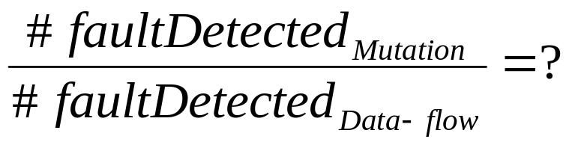
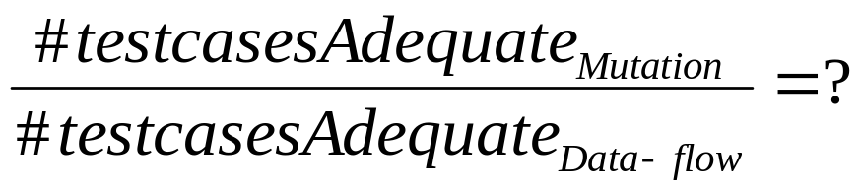
Motivation
What We Don’t Know?
However, we don’t know!!!
  The magnitude order of fault detection ratio between mutation and data-flow testing
  The magnitude order of test suite size between mutation and data-flow adequacy testing

Slide 5

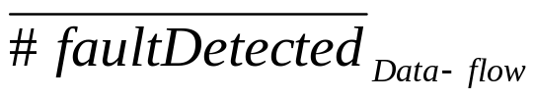
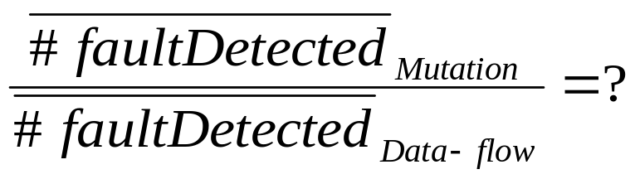
Motivation
What Can We Do?
How about:
  Taking the average of the number of faults detected by mutation technique
  Taking the average of the number of faults detected by data-flow technique
  Compute any of these:
    Computing the mean differences
    Computing the odds

Slide 6

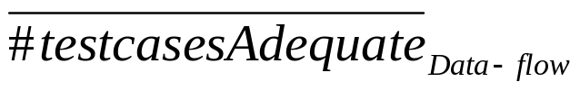
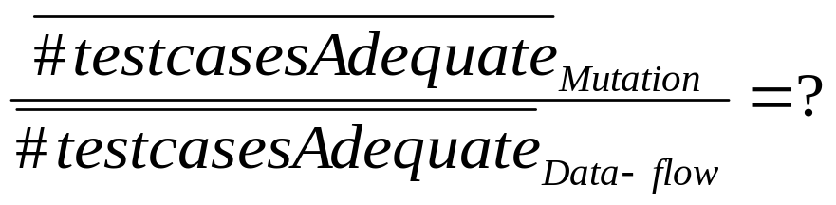
Motivation
What We Can Do?
Similarly, for adequate test suites and their sizes:
  Taking the average of the number of faults detected by mutation technique
  Taking the average of the number of faults detected by data-flow technique
  Compute any of these:
    Computing the mean differences
    Computing the odds

Slide 7
Motivation
In Fact…
The mean differences and odds are two measures for quantifying differences between techniques as reported in experimental studies.
More precisely!
  The mean differences and odds are two techniques of quantitative research synthesis
In addition to quantitative approaches
  There are qualitative techniques for synthesizing research through experimental studies
    meta-ethnography, qualitative meta-analysis, interpretive synthesis, narrative synthesis, and qualitative systematic review

Slide 8
Motivation
The Objectives of This Research Paper
A quantitative approach using meta-analysis to assess the differences between mutation and data-flow testing based on the results already reported in the literature [1, 2, 3] and with respect to:
  Effectiveness
    The number of faults detected by each technique
  Efficiency
    The number of test cases required to build an adequate (mutant | data-flow) test suite
[1] A.P. Mathur, W.E. Wong, “An empirical comparison of data flow and mutation-based adequacy criteria,” Software Testing, Verification, and Reliability, 1994
[2] A.J.Offutt, J. Pan, K. Tewary, and T. Zhang, “An experimental evaluation of dataflow and mutation testing,” Software Practice and Experience, 1996
[3] P.G. Frankl, S. N. Weiss, and C. Hu, “All-uses vs. mutation testing: An experimental comparison of effectiveness,” Journal of Systems and Software

Slide 9
Research Synthesis Methods
Two major methods
  Narrative reviews
    Vote counting
  Statistical research syntheses
    Meta-analysis
Other methods
  Qualitative syntheses of qualitative and quantitative research
  etc.

Slide 10
Research Synthesis Methods
Narrative Reviews
Often inconclusive when compared to statistical approaches for systematic reviews
Use “vote counting” method to determine if an effect exists
  Findings are divided into three categories
    Those with statistically significant results in one direction
    Those with statistically significant results in the opposite direction
    Those with statistically insignificant results
Very common in medical sciences

Slide 11
Research Synthesis Methods
Narrative Reviews (Con’t)
Major problems
  Gives equal weights to studies with different sample sizes and effect sizes at varying significant levels
    Misleading conclusions
  No notion of determination of the size of the effect
  Often fail to identify the variables, or study characteristics

Slide 12
Research Synthesis Methods
Statistical Research Syntheses
A quantitative integration and analysis of the findings from all the empirical studies relevant to an issue
Quantifies the effect of a treatment
Identifies potential moderator variables of the effect
  Factors the may influence the relationship
Findings from different studies are expressed in terms of a common metric called “effect size”
  Standardization towards a meaningful comparison

Slide 13
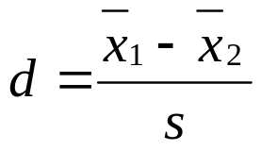
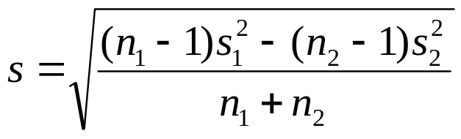
Research Synthesis Methods
Statistical Research Syntheses – Effect Size
Effect size
  The difference between the means of the experimental and control conditions divided by the standard deviation (Glass, 1976)
[Cohen’s d]
[Pooled Standard Deviation]

Slide 14
Research Synthesis Methods
Statistical Research Syntheses (Con’t)
Advantages over narrative reviews
  Shows the direction of the effect
  Quantifies the effect
  Identifies the moderator variables
  Allows computation of weights for studies

Slide 15
Research Synthesis Methods
Meta-Analysis
The statistical analysis of a large collection of analysis results for the purpose of integrating the findings (Glass, 1976)
Generally centered on the relation between one explanatory and one response variable
  The effect of X on Y

Slide 16
Research Synthesis Methods
Steps to Perform a Meta-Analysis
Define the theoretical relation of interest
Collect the population of studies that provide data on the relation
Code the studies and compute effect sizes
  Standardize the measurements reported in the articles
  Decide on coding protocol to specify the information to be extracted from each study
Examine the distribution of effect sizes and analyze the impact of moderating variables
Interpret and report the results

Slide 17
Research Synthesis Methods
Criticisms of Meta-Analysis
These problems are in common with narrative reviews
  Add and compare apples and oranges
  Ignore qualitative differences between studies
  A Garbage-in, garbage-out procedure
  Consider only significant findings which are published

Slide 18
Research Synthesis in Software Eng.
The Major Problems
There is no clear understanding on what a representative sample of programs looks like!
  The results of experimental studies are often incomparable
    Different settings
    Different metrics
    Inadequate information
Lack of interest in replication of experimental studies
Lower acceptance rate for replicated studies
  Unless the results obtained are significantly different
    Publication Bias

Slide 19
Research Synthesis in Software Eng.
Only a Few Studies
Miller, 1998
  Applied meta-analysis for assessing functional and structural testing
Succi, 2000
  A study on weighted estimator of a common correlation technique for meta-analysis in software engineering
Manso, 2008
  Applied meta-analysis for empirical validation of UML class diagrams

Slide 20
Mutation vs. Data-flow Testing
A Meta-Analytical Assessment
Three papers were selected and coded
  A.P. Mathur, W.E. Wong, “An empirical comparison of data flow and mutation-based adequacy criteria,” Software Testing, Verification, and Reliability, 1994
  A.J.Offutt, J. Pan, K. Tewary, and T. Zhang, “An experimental evaluation of dataflow and mutation testing,” Software Practice and Experience, 1996
  P.G. Frankl, S. N. Weiss, and C. Hu, “All-uses vs. mutation testing: An experimental comparison of effectiveness,” Journal of Systems and Software

Slide 21
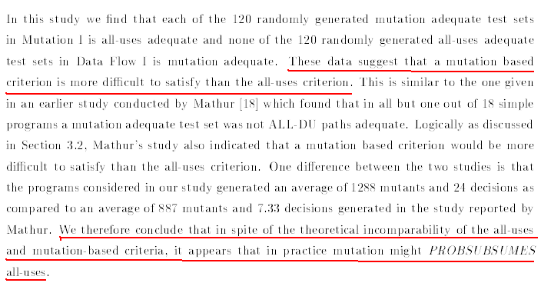
Mutation vs. Data-flow Testing
A Meta-Analytical Assessment
A.P. Mathur, W.E. Wong, “An empirical comparison of data flow and mutation-based adequacy criteria,” Software Testing, Verification, and Reliability, 1994

Slide 22
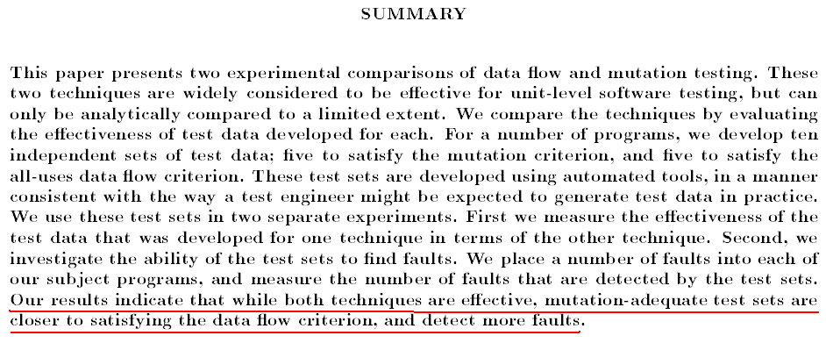
Mutation vs. Data-flow Testing
A Meta-Analytical Assessment
A.J.Offutt, J. Pan, K. Tewary, and T. Zhang, “An experimental evaluation of dataflow and mutation testing,” Software Practice and Experience, 1996

Slide 23
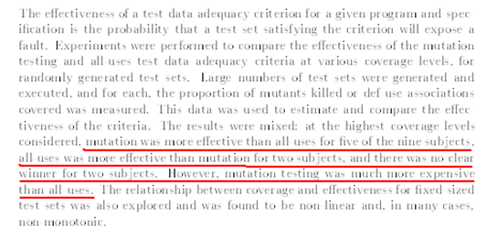
Mutation vs. Data-flow Testing
A Meta-Analytical Assessment
P.G. Frankl, S. N. Weiss, and C. Hu, “All-uses vs. mutation testing: An experimental comparison of effectiveness,” Journal of Systems and Software

Slide 24
Mutation vs. Data-flow Testing
The Moderator Variables
Variable | Description
LOC | Lines of code
No. Faults | Number of faults used
NM | Number of mutants generated
NEX | Number of executable def-use pairs
NTC | Number of test cases required for achieving adequacy
PRO | Proportion of test cases detecting faults OR Proportion of faults detected

Slide 25



Mutation vs. Data-flow Testing
The Result of Coding
Study Reference | Language | LOC | No. Faults
Mathur & Wong, 1994 | Fortran/C | ~ 40 | NA
Offutt et al., 1996 | Fortran/C | ~ 18 | 60
Frankl et al., 1997 | Fortran/Pascal | ~ 39 | NA
Study Reference | No. Mutants | No. test cases | Proportion
Mathur & Wong, 1994 | ~ 954 | ~ 22 | NA
Offutt et al., 1996 | ~ 667 | ~ 18 | ~ 92%
Frankl et al., 1997 | ~ 1812 | ~ 63.6 | ~ 69%
Study Reference | No. Executable def-use | No. test cases | Proportion
Mathur & Wong, 1994 | ~ 72 | ~ 6.6 | NA
Offutt et al., 1996 | ~ 40 | ~ 4 | ~ 76%
Frankl et al., 1997 | ~ 73 | ~ 50.3 | ~ 58%

Slide 26
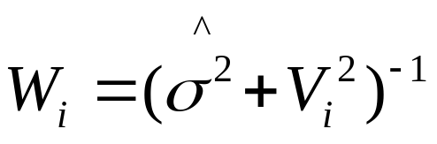
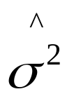
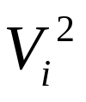
Mutation vs. Data-flow Testing
The Meta-Analysis Technique Used
The inverse variance method was used
  Average effect size across all studies is used as “weighted mean”
    Larger studies with less variation weigh more
    i : the i-th study
    : the estimated between-study variance
    : the estimated within-study variance for the i-th study

Slide 27

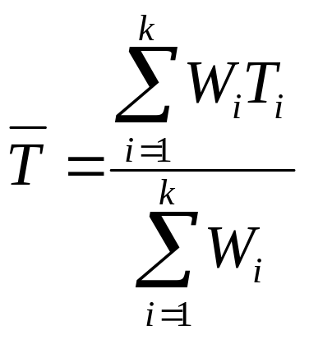
Mutation vs. Data-flow Testing
The Meta-Analysis Technique Used
The inverse variance method
  As defined in Mantel-Haenszel technique
  Use a weighted average of the individual study effects as effect size

Slide 28
Mutation vs. Data-flow Testing
Treatment & Control Groups
Efficiency (to avoid negative odds ratio)
  Control group: data-flow data group
  Treatment group: mutation data group
Effectiveness (to avoid negative odds ratio)
  Control group : mutation data group
  Treatment group : data-flow data group

Slide 29


Mutation vs. Data-flow Testing
The Odds Ratios Computed
Study Reference | Estimated Variance | Study Weight | Odds Ratio OR | 95% CI | Effect Size log(OR)
Mathur & Wong, 1994 | 0.220 | 2.281 | 3.99 | (1.59, 10.02) | 1.383
Offutt et al., 1996 | 0.328 | 1.831 | 5.27 | (1.71, 16.19) | 1.662
Frankl et al., 1997 | 0.083 | 3.321 | 1.73 | (0.98, 3.04) | 0.548
Fixed | -- | -- | 2.6 | (1.69, 4) | 0.955
Random | 0.217 | -- | 2.94 | (1.43, 6.03) | 1.078
Cohen’s scaling: up to 0.2, 0.5, and 0.8: Small, Medium, Large
Study Reference | Estimated Variance | Study Weight | Odds Ratio OR | 95% CI | Effect Size log(OR)
Offutt et al., 1996 | 0.190 | 2.622 | 3.63 | (1.54, 8.55) | 1.289
Frankl et al., 1997 | 0.087 | 3.590 | 1.61 | (0.90, 2.88) | 0.476
Fixed | -- | -- | 2.12 | (1.32, 3.41 ) | 0.751
Random | 0.190 | -- | 2.27 | (1.03, 4.99) | 0.819

Slide 30


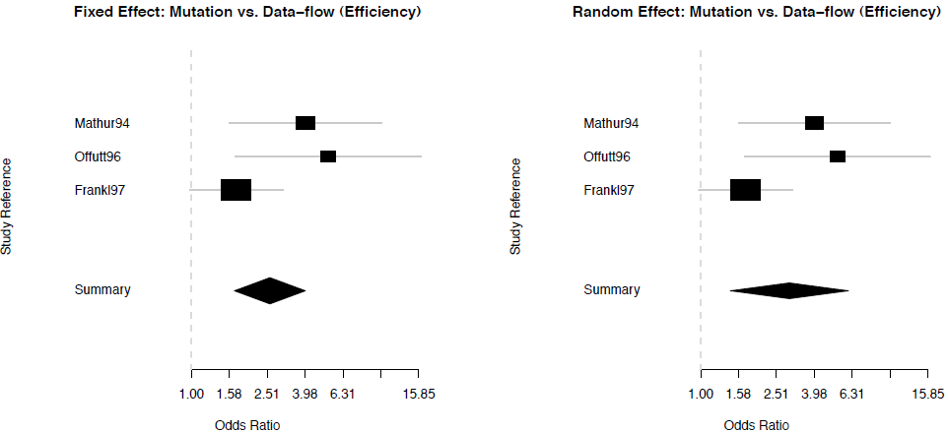



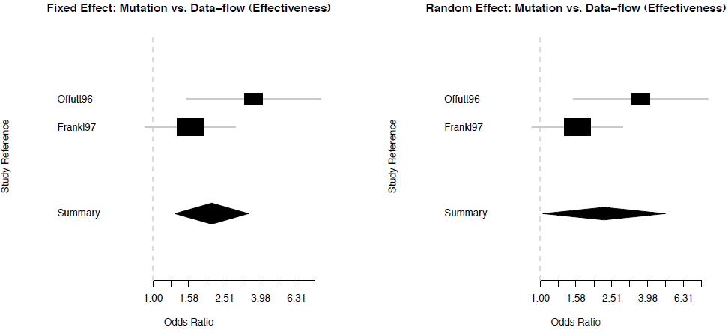

Mutation vs. Data-flow Testing
The Forest Plots

Slide 31
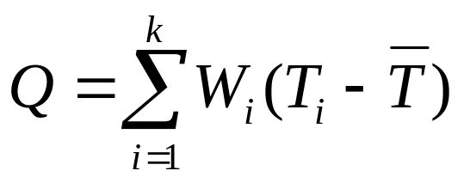
Mutation vs. Data-flow Testing
Homogeneity & Publication Bias
We need to test whether the variation in the effects computed is due to randomness only
  Testing the homogeneity of the studies
    Cochrane chi-square test or Q-test
    High Q rejects the hypothesis that the studies are homogeneous (null hypothesis)
    Q = 4.37 with p-value = 0.112
    No evidence to reject the null hypothesis
  Funnel plots – A symmetric plot indicates that the homogeneity of studies is maintained

Slide 32
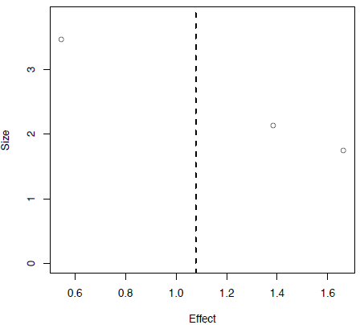

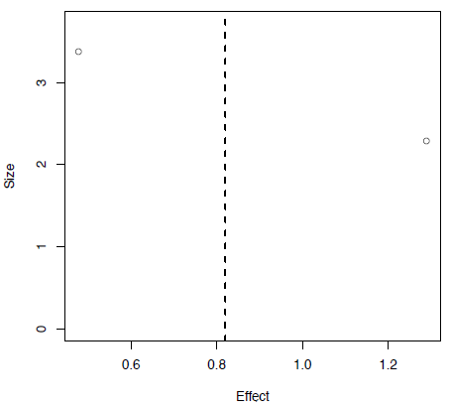

Mutation vs. Data-flow Testing
Publication Bias - Funnel Plots

Slide 33
Mutation vs. Data-flow Testing
A Meta-Regression on Efficiency
Examining how the factors (moderator variables) affect the observed effect sizes in the studies chosen
Apply weighted linear regressions
  Weights are the study weights computed for each study references
The moderator variables in our studies
  Number of mutants (No.Mut)
  Number of executable data-flow coverage elements (e.g. def-use) (No.Exe)

Slide 34
Mutation vs. Data-flow Testing
A Meta-Regression on Efficiency
A meta-regression on efficiency
  The number of predictors (three)
    The intercept
    The number of mutants (No.Mut)
    The number of executable coverage elements (No.Exe)
  The number of observations
    Three papers
  # predictors = # observations
    Not possible to fit a linear regression with an intercept
    Possible to fit a linear regression without an intercept

Slide 35
Mutation vs. Data-flow Testing
A Meta-Regression on Efficiency
The p-values are considerably larger than 0.05
No evidence to believe that the No.Mut and No.Exc have significant influence on the effect size
Coefficients | Estimated Values | Standard Error | t- value | p-value
No. Mutants | -0.002 | 0.001 | -2.803 | 0.218
No. Executable def-use pairs | 0.081 | 0.023 | 3.415 | 0.181
Summary | Statistics
Residual Standard Error | 0.652
Multiple R-Squared | 0.959
Adjusted R-Squared | 0.877
F-Statistics | 11.73
p-value | 0.202

Slide 36
Mutation vs. Data-flow Testing
A Meta-Regression on Effectiveness
A meta-regression on effectiveness
  The number of predictors (three)
    The intercept
    The number of mutants (No.Mut)
    The number of executable coverage elements (No.Exe)
  The number of observations
    Two papers
  # predictors > # observations
    Not possible to fit a linear regression (with or without intercept)

Slide 37
Conclusion
A meta-analytical assessment of mutation and data-flow testing
  Mutation is at least two times more effective than data-flow testing
    Odds ratio = 2.27
  Mutation is almost three times less efficient than data-flow testing
    Odd ratio = 2.94
No evidence to believe that the number of mutants or the number of executable coverage elements have any influence on the size effect

Slide 38
Future Work
We missed two related papers!!
  Offut and Tewary, “Empirical comparison of data-flow and mutation testing”, 1992
  N. Li, U. Praphamontripong, and J. Offutt, “An experimental comparison of four unit test criteria: Mutation, edge-pair, all-uses, and prime path coverage,” Mutation 2009, DC, USA
A group of my students are conducting (replicating) an experiment for Java similar to the above paper.
Further replications are required
Applications of other meta-analysis measurements, e.g. Cohen d, Hedge g, etc. may be of interest

Slide 39
Thank You
The 6th International Workshop on Mutation Analysis (Mutation 2011)
Berlin, Germany, March 2011

