Slide 1

original
mutated
Mutation
Mutation
mutation
operator
Analysis
Analysis
Third Workshop on Mutation Analysis and Testing
2007

Slide 2
Mutation Analysis Workshops
2000 – first workshop, San Jose, CA
  With ISSRE
2006 – second workshop, Raleigh, NC
  With ISSRE
2007 – third workshop, Windsor, UK
  With TAIC PART
The pace of mutation is accelerating …

Slide 3
Mutation 2007
Workshop and retreat
Foster and develop new ideas
  New applications of mutation
  Improved mutation analysis techniques
  Empirical studies using mutation
Great location !
Published by the IEEE
Keynote by Rich DeMillo

Slide 4
Planned Program Highlights
Paper sessions
  Full length (10 page)
  Short (5 pages)
Late-breaking results
Panels
Group topic sessions
Awards for best presentation

Slide 5
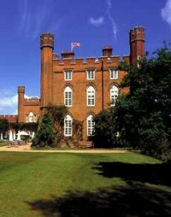
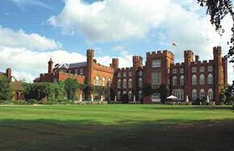
At Cumberland Lodge, Windsor, UK
Cumberland lodge is a former royal residence given to the British nation in 1946 by the late Queen Mother
Ideal setting for a productive and enjoyable workshop
  world-class conference facilities
  ideal location
  resonates with centuries of historical significance, dating back to the mid 17th century

Slide 6

All Mutators Welcome!
Mutation 2007
  11 and 12 September, 2007
In conjunction with TAIC PART 2007
  13—15 September, 2007
  http://www2007.taicpart.org/
General Chair: Mark Harman
Program Chairs: John Clark & Jeff Offutt
Submissions due: 13 April, 2007
http://ise.gmu.edu/mutation2007/

