Slide 1



Alarcos Research Group
University of Castilla-La Mancha
Pedro Reales Mateo
University of
Castilla-La Mancha
Macario Polo Usaola
University of
Castilla-La Mancha
Jeff Offutt
George Mason
University

Slide 2
Outline
Introduction.
Mutation at the Multi-Class and System Levels.
Implications of Mutation at Multi-Class and System Levels.
Flexible Weak Mutation.
A Tool for Mutation at System Level: Bacterio.
Conclusions and Future Work.
Introduction | Mutation at the System Level | Implications | Flexible Weak Mutation | The Tool | Conclusions

Slide 3
Introduction
Mutation has been applied at different levels:
  Unit level – Individual functions or methods.
  Integration level - Communications between two functions.
  Class level- Multiple functions in a single class.
This research is applying mutation at the multi-class and system level:
  Design test inputs that target two kinds of faults:
    Faults in how classes interoperate in OO technologies.
    Faults that are not presented in lower levels of abstraction.
Introduction | Mutation at the System Level | Implications | Flexible Weak Mutation | The Tool | Conclusions
Notes:
Mutation has been applied in several contexts.
Complete systems or subsystems into a program.

Slide 4
Introduction
Mutation at multi-class and system levels has new technical problems:
  New mutation operators.
  Manage mutants as entire system.
  Detect equivalent mutant at this level.
  Execute complete functionalities can have high cost.
    Weak mutation can control costs
  Redefine what “program output” is.
Introduction | Mutation at the System Level | Implications | Flexible Weak Mutation | The Tool | Conclusions

Slide 5
Introduction
What is a “program output”?
  Program output at unit level.
    Return values of the functions and printed variables: Mothra, Proteum.
  Program output at class level.
    State of a class: muJava.
  Program output at multi-class and system levels.
    Files, data bases – geographic information systems.
    Sent messages to other systems or users – video games.
    Object in memory or elements in user interfaces - word processors.
Introduction | Mutation at the System Level | Implications | Flexible Weak Mutation | The Tool | Conclusions

Slide 6
Introduction
Mutation execution techniques:
  Strong mutation.
  Weak mutation, which uses values of internal variables.
    Stops the execution just after the mutated statement.
    No propagation.
    Less effectiveness.
  Firm mutation.
    In between weak and strong mutation.
Mutation tools:
  Mothra, Proteum, muJava, Jumble and Certitude.
Introduction | Mutation at the System Level | Implications | Flexible Weak Mutation | The Tool | Conclusions

Slide 7





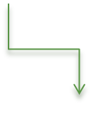




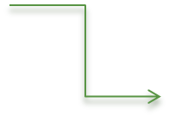


Mutation at the Multi-Class and System Levels
1. Traditional mutation analysis (Mothra)
3. Integration mutation
analysis (Proteum)
B
C
A
M1()
M2()
M3()
D
2. Class mutation analysis (muJava)
4. System mutation
analysis (Bacterio)
Introduction | Mutation at the System Level | Implications | Flexible Weak Mutation | The Tool | Conclusions

Slide 8
Mutation at the Multi-Class and System Levels
Check interaction between all the elements of the system.
Check features that are difficult to check in lower abstraction levels.
  Concrete sequence of relation between units.
Establish the base to check non-functional features through mutation.
  Performance.
  Security.
  …
  This new abstraction level complements the test tasks.
Introduction | Mutation at the System Level | Implications | Flexible Weak Mutation | The Tool | Conclusions

Slide 9
Implications of Mutation at the System level
What to compare: what is a state or what is an output?
How manage a entire system.
New mutation operators.
When to compare.
Introduction | Mutation at the System Level | Implications | Flexible Weak Mutation | The Tool | Conclusions

Slide 10
1-What to compare
We must find anomalous states.
In weak mutation, a state is represented by internal values.
  At system level, these values can be distributed.
    Multiple objects, global variables, static variables and local variables in methods.
In strong mutation, a state is represented by outputs.
  At system level, the outputs of the system are complex.
    Files or databases.
    Sent messages to other systems or uses.
    Objects that keep in memory after the test.
Introduction | Mutation at the System Level | Implications | Flexible Weak Mutation | The Tool | Conclusions
Notes:
This is a crucial task.
An anomalous state is a mutated state different from the original state.

Slide 11
1-What to compare
The notion of masking is different.
  In unit, integration and class levels, masking can happen in two ways:
    A variable with a incorrect value get another correct value before infect another part of the system.
    A variable with a incorrect value can go out of scope.
  In system level there is another way more:
    An object with an incorrect value is destroyed.
Deciding what to compare is a crucial decision.
  Flexible Weak Mutation
Introduction | Mutation at the System Level | Implications | Flexible Weak Mutation | The Tool | Conclusions
Notes:
Masking can happend in two ways.

Slide 12
2-Managing a entire system
A mutant is a complete system.
To replace mutants, there are two possibilities:
  Replace the whole system.
    Many copies of the system – high space requirements.
    Simple.
  Replace the mutated part of the system.
    Low space requirement.
    Complex.
To accelerate execution traditional techniques can be adapted.
  Mutant schemata, compiler-integration and bytecode transformations.
Introduction | Mutation at the System Level | Implications | Flexible Weak Mutation | The Tool | Conclusions
Notes:
A complete system is composed by classes, files, configurations…
Tools has to manage complete systems and replaces it in each execution.
Complex: the mutation system has to control the execution environment enough to swap partas of the system.
We can use traditional techniques to acelerate execution, but has to be adapted at system level.

Slide 13
3-Mutation operators
New mutation operators are needed to target errors at system level.
  Errors related with configuration.
    CPDV: Configuration Parameter Default Value.
  Errors related sequences of interactions.
    COI: Calls Order Interchange.
  Errors related with graphical user interfaces.
    GCD: Graphical component deletion.
Currently we are identifying more typical errors at the system level and developing more mutation operators.
Introduction | Mutation at the System Level | Implications | Flexible Weak Mutation | The Tool | Conclusions
Notes:
In the paper there are a little descripton of the mutation operators that we have designed
We have to identify more tipical errors and design operators to target them.

Slide 14
4- When to compare
At system level, weak mutation can be very important to reduce costs.
  Complete functionalities can involve remote connections, user interactions, file access...
Problem of weak mutation at system level.
  A mutated part of the system can lead to an anomalous state in another par of the system.
Deciding when to compare is a crucial decision.
  Flexible Weak Mutation
Introduction | Mutation at the System Level | Implications | Flexible Weak Mutation | The Tool | Conclusions
Notes:
As i said before, what to compare and when to compare are crucial decisions.

Slide 15
Flexible Weak Mutation
Flexible Weak Mutation (FWM) is a new mutation execution technique.
FWM solves two important issues related with mutation at the multi-class and system levels.
  When to compare.
    At the beginning and at the end of each executed method.
  What to compare.
    The state of the unit of the method where the comparison is done.
Introduction | Mutation at the System Level | Implications | Flexible Weak Mutation | The Tool | Conclusions
Notes:
To solve the problem of weak mutation and control execution cost we have design a new muation execution technique.
The point where the execution is stopped is decide dynamically and sometimes the execution is not stopped.
A trace of the original execution is stored.
The trace of each mutant is compare with the original.
If an anomalous state is found, the execution is stopped.
If an anomalous state is not found, the execution is not stopped.

Slide 16
Flexible Weak Mutation
FWM compares before to finish the execution like weak mutation, but the execution is not stopped.
  The “entire” state is never compare, only the state of the unit.
  The execution is stopped only when an anomalous state is found.
  A trace of the original execution is stored.
There are 2 important differences:
  The execution is only stopped when an anomalous state is found. So, when to stop the execution is decided dynamically.
  Partial states are compared different times during the execution.
Introduction | Mutation at the System Level | Implications | Flexible Weak Mutation | The Tool | Conclusions
Notes:
To solve the problem of weak mutation and control execution cost we have design a new muation execution technique.
The point where the execution is stopped is decide dynamically and sometimes the execution is not stopped.
A trace of the original execution is stored.
The trace of each mutant is compare with the original.
If an anomalous state is found, the execution is stopped.
If an anomalous state is not found, the execution is not stopped.

Slide 17
Test Case
a:ClassA
b:ClassB
aM1(x,y)
bM1()
<<Create>>
c:ClassC
cM1(x)
aM2()
bM2(z)
aM3(y)
cM2(y)
<<Destruct>>
Introduction | Mutation at the System Level | Implications | Flexible Weak Mutation | The Tool | Conclusions

Slide 18
Flexible Weak Mutation
aM1()
aM1()
bM1()
bM1()
cM1()
cM1()
aM2()
aM2()
aM3()
aM3()
bM2()
bM2()
cM2()
cM2()
Original
A
B
B
C
C
A
B
B
A
A
C
C
A
A
Original trace execution
Introduction | Mutation at the System Level | Implications | Flexible Weak Mutation | The Tool | Conclusions

Slide 19
Flexible Weak Mutation
aM1()
aM1()
bM1()
bM1()
cM1()
cM1()
aM2()
aM2()
aM3()
aM3()
bM2()
bM2()
cM2()
cM2()
Mutant1
Different state found
(execution stopped)
A
B
B
C
C
A
B
B
A
A
C
C
A
A
Mutation
Introduction | Mutation at the System Level | Implications | Flexible Weak Mutation | The Tool | Conclusions

Slide 20
Flexible Weak Mutation
aM1()
aM1()
bM1()
bM1()
cM1()
cM1()
aM2()
aM2()
aM3()
aM3()
bM2()
bM2()
cM2()
cM2()
Mutant2
Different state found
(execution stopped)
A
B
B
C
C
A
B
B
A
A
C
C
A
A
Mutation
Introduction | Mutation at the System Level | Implications | Flexible Weak Mutation | The Tool | Conclusions

Slide 21
Flexible Weak Mutation
aM1()
aM1()
bM1()
bM1()
cM1()
cM1()
aM2()
aM2()
aM3()
aM3()
bM2()
bM2()
cM2()
cM2()
Mutant3
A
B
B
C
C
A
B
B
A
A
C
C
A
A
Mutation
Different state not found (execution not stopped)
Introduction | Mutation at the System Level | Implications | Flexible Weak Mutation | The Tool | Conclusions

Slide 22
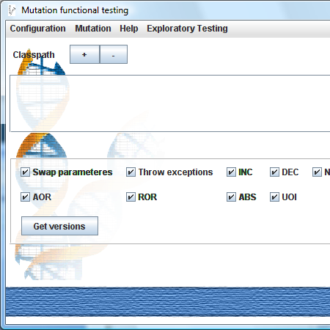
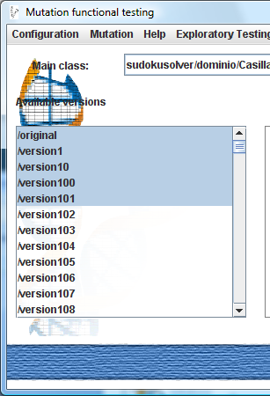
A tool for system level mutation:
Bacterio
System level mutation is being implemented in a tool named Bacterio.
  For Java programs.
  Use Flexible Weak Mutation.
  Instrument java bytecode to create mutants and implements Flexible Weak Mutation.
  Currently uses traditional and interface mutation operators.
Introduction | Mutation at the System Level | Implications | Flexible Weak Mutation | The Tool | Conclusions

Slide 23
Conclusions and Future Work
Conclusions.
  A new level of abstraction to test complete systems through mutation.
  The basis to tests emergent properties such as security, usability, etc.
  Flexible Weak Mutation and a tool: Bacterio.
Future work
  Design and implements more mutation operators at system level.
  Check the efficiency and effectiveness of these ideas through experiments.
Introduction | Mutation at the System Level | Implications | Flexible Weak Mutation | The Tool | Conclusions

Slide 24

Questions?
Pedro Reales Mateo
University of Castilla–La Mancha
pedro.reales@uclm.es
Thanks!

