Slide 1

GameQuery
GameQuery is an easy to use jQuery plug-in to help make javascript game development easier by adding some simple game-related classes.

Slide 2
What is jQuery?
JQuery is a fast, small, and feature-rich JavaScript library. It makes things like HTML document traversal and manipulation, event handling, animation, and Ajax much simpler with an easy-to-use API that works across a multitude of browsers. With a combination of versatility and extensibility, jQuery has changed the way that millions of people write JavaScript.

Slide 3
Who is behind gameQuery?
GameQuery has been created and is still being written by me, Selim Arsever. I’m a computer engineer living and working in Zürich, Switzerland. Being an open source framework its the produce from the feedback of many friendly user and you too can contribute! For a list of the contributor you can have a look at the project’s history on GitHub.

Slide 4
Who is GitHub?
GameQuery has been created and is still being written by me, Selim Arsever. I’m a computer engineer living and working in Zürich, Switzerland. Being an open source framework its the produce from the feedback of many friendly user and you too can contribute! For a list of the contributor you can have a look at the project’s history on GitHub.
GitHub Founded:
2008

Slide 5

Mascot GitHub:

Slide 6
How much for GameQuery:
It's free;
License:
This game engin is release under the very permissive MIT license (reproduce here under). If you use or modify it I would be very happy to know it even though it’s not required by the license. The content of this site, the documentation and the tutorials are under a Creative Commons Attribution-Share Alike 2.5 license.
Lastest releases version
gameQuery 0.7.1;

Slide 7

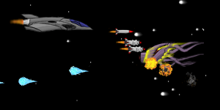
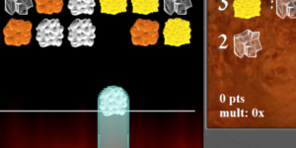
Games:
Collision Demo
First tutorial Demo
Mechalchemist

Slide 8
site
http://gamequeryjs.com/
Users:
244
Draw by:
Malkai Dos S. P. Oliveira

