Slide 1
CPU Scheduling
CS 3305A
Lecture 8
Oct 4th 2023
Copyright Notice:
1. Lecture slides are being provided with permission from the copyright for in-class (CS3305A) use only. The slides must not be reproduced or provided to anyone outside of the class.
2. All download copies of the slides and/or lecture recordings are for personal use only.
3. Students must destroy these copies within 30 days after receipt of final course evaluations

Slide 2
CPU-I/O Cycle
Maximum CPU utilization is obtained with context switching –> CPU Scheduling
Process execution consists (1) CPU execution (CPU burst time) and (2) I/O wait (I/O burst time).

Slide 3
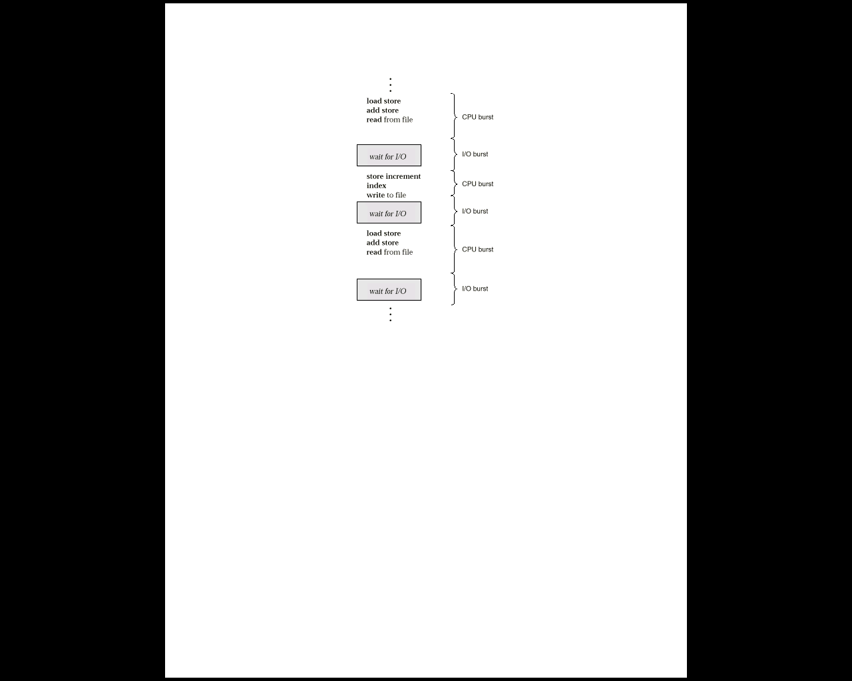
Alternating CPU And I/O Bursts
CPU and I/O burst time:
Alternates, between CPU and I/O activity.
CPU times are generally much shorter than I/O times

Slide 4
CPU Scheduler
Selects a process from the Ready queue
Two mode of operations:
Non-preemptive
Process runs until it is completed
Preemptive
A process runs for a certain amount of time (could be a predetermined fixed time)

Slide 5
Scheduling Evaluation Metrics
Many quantitative criteria for evaluating a scheduling algorithm:
CPU utilization: Percentage of time the CPU is occupied (i.e., not idle)
Throughput: # completed processes per time unit
Waiting time: Time spent on the ready queue
Turnaround time: Time from the submission to the ready queue to the completion time
Fairness: No Process suffers starvation

Slide 6
Scheduler Options
First Come, First Served (FCFS)
Last In First Out (LIFO)
Shortest Job First
Round Robin (RR)
Multilevel Queuing
Multilevel Queuing with Feedback
Lottery Scheduling

Slide 7
First-Come, First-Served (FCFS) Scheduling
The process that requests the CPU first is allocated the CPU first
The code for FCFS scheduling is simple to write and understand
We will illustrate the use of FCFS with three processes
Preemptive or non-preemptive?

Slide 8
First-Come, First-Served (FCFS) Scheduling
Process Arrival time CPU Burst Time
P1 0 24
P2 1 3
P3 2 3
Processes serving request in the order: P1 , P2 , P3 The scheduling chart:
Waiting time for P₁ = 0; P₂= 24-1=23; P₃ = 27-2= 25
Average waiting time: (0 + 23 + 25)/3 = 16
Turnaround time: P₁ ₌ 24-0=24, P₂= 27-1=26; P₃ = 30-2=28
Average Turnaround time: (24 + 26 + 28)/3 = 26
P₁
P₂
P₃
0
24
27
30

Slide 9
First-Come, First-Served (FCFS) Scheduling
Process Arrival time CPU Burst Time
P1 2 24
P2 0 3
P3 1 3
Processes serving request in the order: P2 , P3 , P1 The scheduling chart:
Waiting time: P₂ = 0; P₃ = 3-1 = 2; P₁ = 6-2= 4
Average waiting time: (0 + 2 + 4)/3 = 2
Turnaround time: P₂ ₌ 3-0=3, P₃= 6-1=5; P₁ = 30-2=28
Average Turnaround time: (3 + 5 + 28)/3 = 12
Much better than previous case! why: ??
P₂
P₃
P₁
0
3
6
30

Slide 10
Scheduling Algorithms LIFO
Last-In First-out (LIFO)
New processes are placed at head of ready queue
Improves response time for newly created processes
Problem:
May lead to starvation – early processes may never get CPU

