Slide 1
Google Fiber
Customer Support
Repeat Call Analysis
Uncovering why customers call back — and what we can do about it
Data Period: Jan – Mar 2022 | Buruhani Mutebi –Data Analyst

Slide 2
Executive Summary
65K
20K
31%
14.99
Total Contacts
Total Repeat Calls
Repeat Rate
Avg Repeat Calls
Jan – Mar 2022
callbacks recorded
of contacts called back
per caller segment
Key Insight
Out of every 100 customer contacts, approximately 31 result in at least one repeat call — indicating that nearly one-third of customer issues are not resolved on first contact. This points to a significant opportunity to improve first-call resolution (FCR) through agent training, better knowledge bases, and issue-type-specific escalation paths.

Slide 3
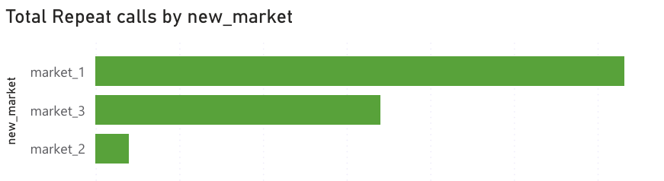
Repeat Calls by Market
Market Breakdown
market_1
12,647 calls (62.5%)
market_3
6,806 calls (33.6%)
market_2
787 calls (3.9%)
market_1 accounts for 62.5% of all repeat calls — the highest-priority market for FCR improvement.

Slide 4
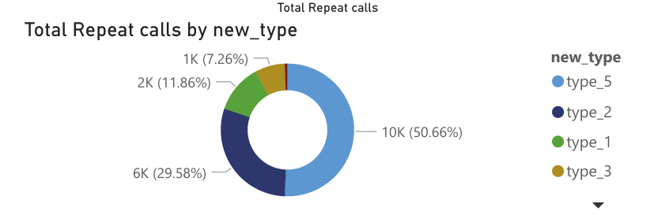
Repeat Calls by Issue Type
Issue Type Detail
type_5
10,253 | 50.7%
Highest volume — dominant issue category
type_2
5,987 | 29.6%
Second largest — likely a systemic issue
type_1
2,400 | 11.9%
Moderate volume
type_3
1,469 | 7.3%
Low volume but worth monitoring
type_4
131 | 0.6%
Minimal — least critical

Slide 5
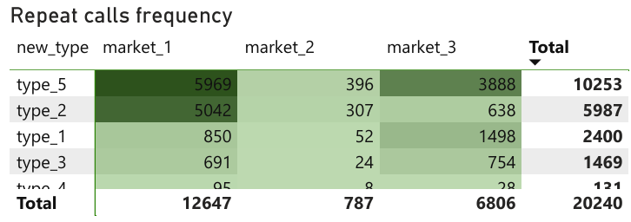
Repeat Call Frequency: Market × Issue Type
Type | Mkt 1 | Mkt 2 | Mkt 3 | Total
type_5 | 5,969 | 396 | 3,888 | 10,253
type_2 | 5,042 | 307 | 638 | 5,987
type_1 | 850 | 52 | 1,498 | 2,400
type_3 | 691 | 24 | 754 | 1,469
type_4 | 95 | 8 | 28 | 131
Total | 12,647 | 787 | 6,806 | 20,240
type_5 × market_1 is the single largest problem combination with 5,969 calls — a clear priority for targeted resolution improvements.

Slide 6
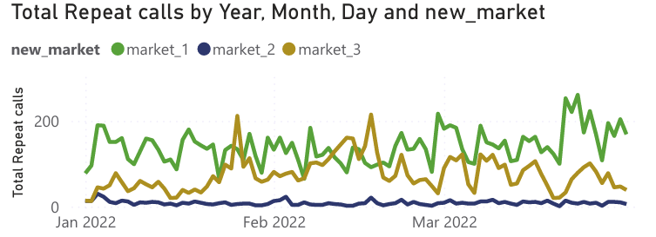
Repeat Call Trends — Jan to Mar 2022
Upward Trend
All three markets show a gradual increase in repeat calls from January to March 2022.
market_1 Dominates
market_1 consistently drives the highest volume, hovering around 4,100–4,350 calls/month.
market_2 Stable
market_2 remains very low across all months, suggesting stronger first-call resolution.

Slide 7
Recommendations & Next Steps
01
Focus on type_5 & type_2
03
Study market_2 Best Practices
These two categories account for 80% of repeat calls. Conduct root-cause analysis and build targeted knowledge-base articles and agent scripts for these issue types.
market_2's low repeat rate (3.9%) suggests effective resolution practices. Identify and replicate those practices in market_1 and market_3.
02
Prioritise market_1
04
Track Week-over-Week Trends
With 62.5% of all repeat calls, market_1 needs dedicated FCR improvement initiatives — coaching sessions, escalation reviews, and quality audits.
Build real-time dashboards segmented by week and quarter to detect spikes early and measure the impact of improvement initiatives.
Thank you! By Buruhani Mutebi-Data Analyst

