Slide 1
Predicting error in Optical Networks Using Machine Learning
Using Data-Driven Approaches to Enhance Routing Efficiency
Ojas Tewari
    Roll No. 21355077
    Date 23/03/2023

Slide 2
Contents
Introduction
Project Objective
Mininet-Optical
Topology Used
Machine Learning Algorithms
Predicting error Values with Machine Learning
Other Applications of Machine Learning in Optical Networking
Conclusion and Future Work
References
Demonstration
Q & A

Slide 3
Introduction
Simulation is a powerful tool for exploring the possibilities of the future, and for testing the viability of new ideas before they are put into practice.
Through the use of Mininet-Optical, this project has been able to generate valuable data that has been used to train machine learning algorithms for improved performance in optical networking.
In this presentation, we will delve into the process of data generation and discuss the results that this work has yielded, as well as the potential implications for the future of optical networking.

Slide 4
Project Objective
The main objective of this project is to optimize the performance of optical networks by predicting the quality of the signal before it is transmitted through the network. By doing so, we hope to improve the overall efficiency of the network and reduce the number of errors and signal degradation.
To achieve this objective, we will be using machine learning algorithms to predict the OSNR (Optical Signal-to-Noise Ratio) and GOSNR (Generalized Optical Signal-to-Noise Ratio) values of the signal using Mininet-Optical.

Slide 5
What is Mininet-Optical?
Mininet-Optical is an open-source network simulator that provides an emulation platform for optical networks. It is an extension of Mininet, a popular open-source network emulator used for testing and development of software-defined networks.
The optical network elements in Mininet-Optical are managed by SDN controllers, which allow for flexible and programmable control over network behaviour. This provides researchers and developers with the ability to evaluate and validate new network designs, protocols, and algorithms before deploying them in real-world scenarios.
The impact of Mininet-Optical lies in its ability to facilitate research and development of new network technologies by providing a cost-effective and efficient platform for simulating complex optical networks. It allows researchers and developers to quickly iterate and test new ideas, accelerating the pace of innovation in the field of networking.

Slide 6
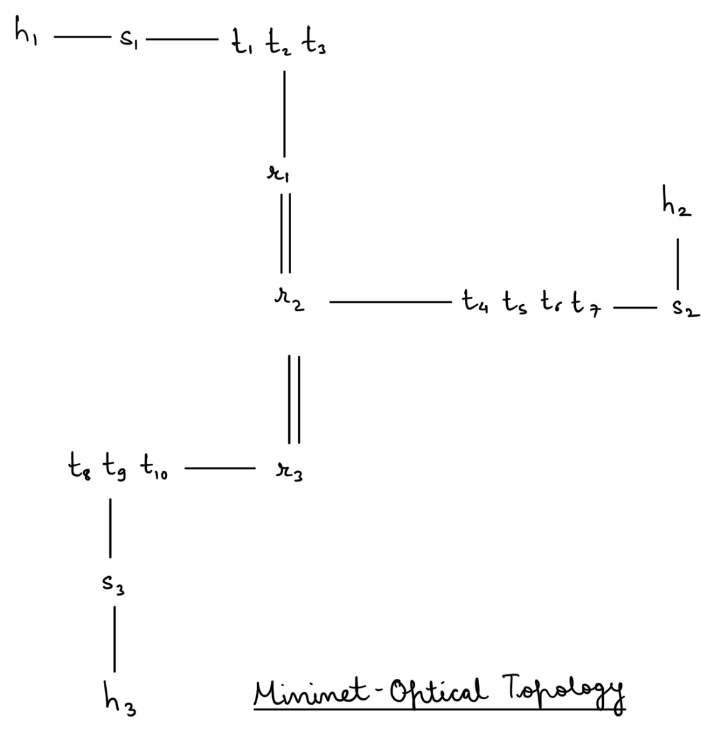
Fig 1: Simple Mininet Optical topology of 10 transceivers.

Slide 7
Topology Used
The topology consists of three hosts (h1, h2, h3) connected by three switches (s1, s2, s3) and three ROADMs (reconfigurable optical add-drop multiplexers), represented by r1, r2 and r3. The hosts are labelled as follows: h1, h2 and h3. Each host is connected to one switch, and the switches are connected to the ROADMs via transceivers. Additionally, the ROADMs are connected to each other bidirectionally.
t1, t2, ..., tn are transceivers that connect to the three switches and to the three ROADMs (r1, r2, and r3), which are also connected to each other. The links between the switches and routers are optical links that simulate the behaviour of real optical networks.

Slide 8
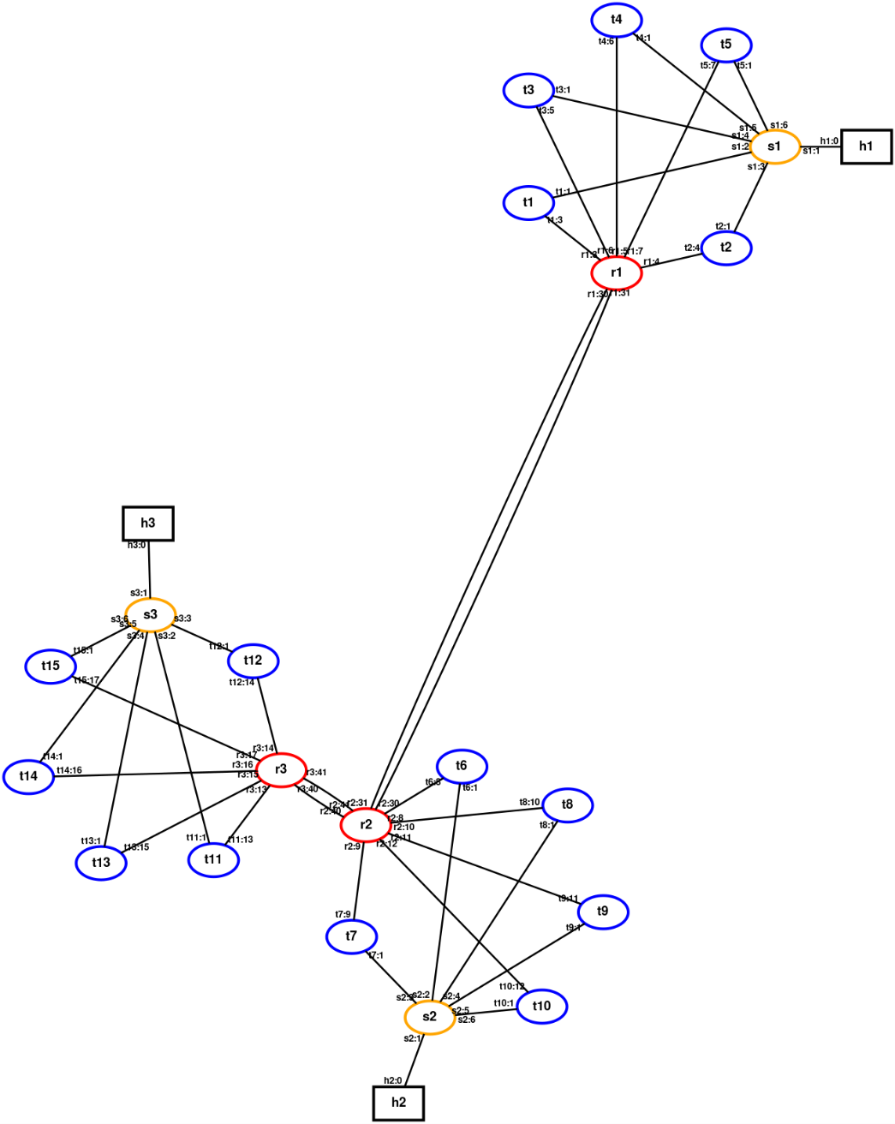
Topology
Fig 2: Mininet Optical topology as generated by the software of 15 transceivers.

Slide 9
Understanding OSNR and GOSNR
In optical networks, the OSNR and GOSNR values are used to measure the quality of the signal.
The OSNR is the ratio of the optical signal power to the noise power, expressed in decibels (dB). It is used to determine the quality of the signal before it is transmitted through the network.
The GOSNR is a generalization of the OSNR that takes into account the non-linear effects of the signal transmission. It is a more accurate measure of the signal quality, especially in networks with high data rates and long transmission distances.
The OSNR and GOSNR values are essential for predicting the quality of the signal and optimizing the performance of optical networks.

Slide 10
Code Implementation Details
Network Configuration: Code to connect hosts, switches, transceivers, and roadms in the topology.
Bash File Generation: Python code to generate a bash file for connecting the roadms and adding data receiving capabilities to transceivers.
Bash File Execution: Executing the bash file in a secondary terminal as per Mininet-Optical requirements.
Machine Learning Code: Code implementation for training and testing the machine learning algorithms using the generated data.

Slide 11
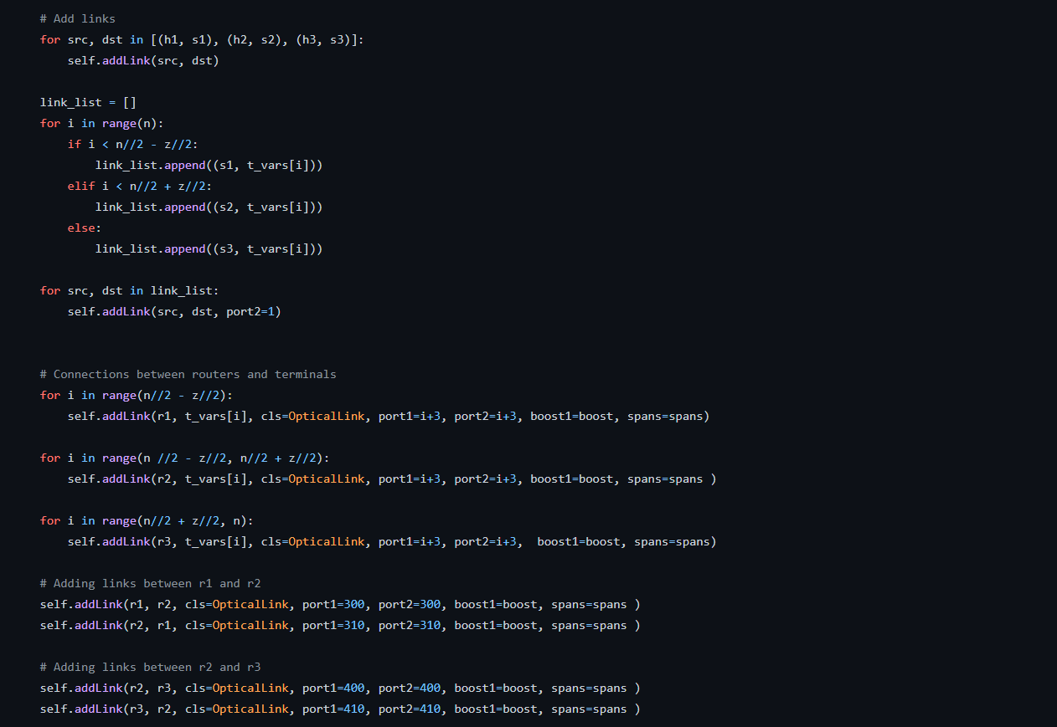
Fig 3: Network Configuration Code

Slide 12
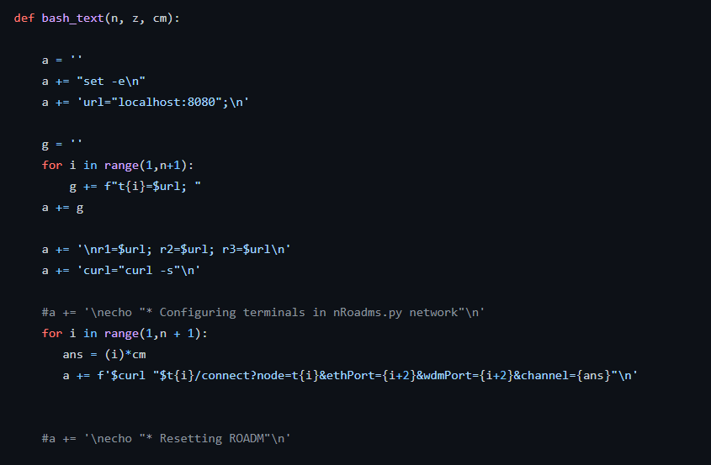
Fig 4: Bash File Generating Code

Slide 13
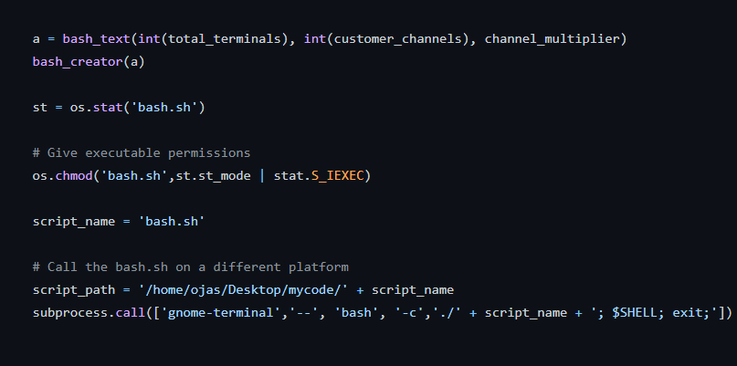
Fig 5: Bash File Execution Code

Slide 14
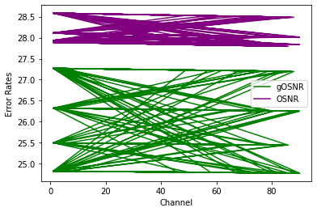
Fig 6: Data Set Visually
The chart was created using around 3700 data points

Slide 15
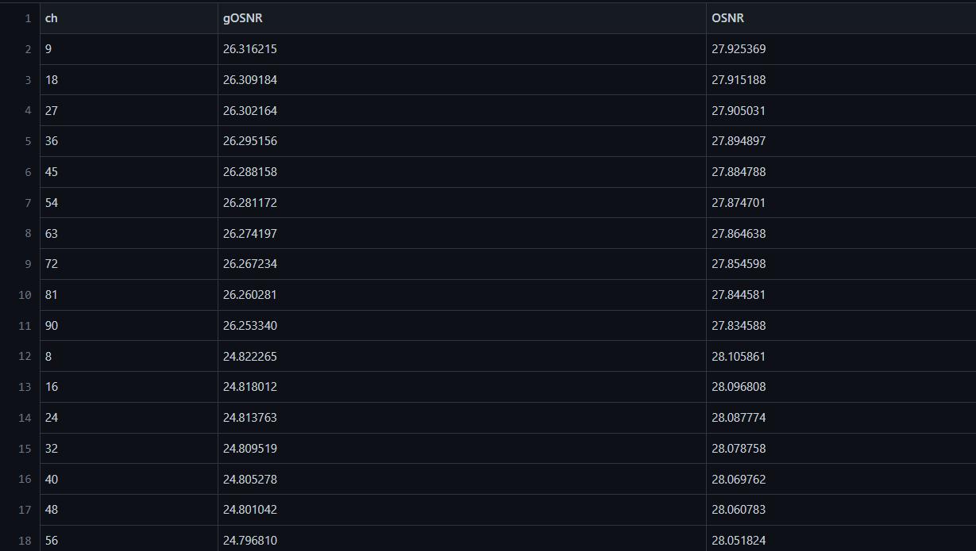
Fig 7: data.csv

Slide 16
Variability of the Data Set
In this project, the quality of our machine learning models depended heavily on the quality of data used for training. One important aspect of data quality is its variation. Inconsistent or highly varying data can lead to overfitting, where a model fits too closely to the training data and performs poorly on new data. On the other hand, too little variation in the data can result in underfitting, where a model is too simple and fails to capture important patterns in the data.
To address this issue, we added 4 different types of spans chosen at random to our WDM links. Each span had a different combination of amplifiers and fibre lengths. The spans were created using the Mininet-Optical API and added to the topology. The result was a data set with enough variation to train our machine learning models effectively.

Slide 17
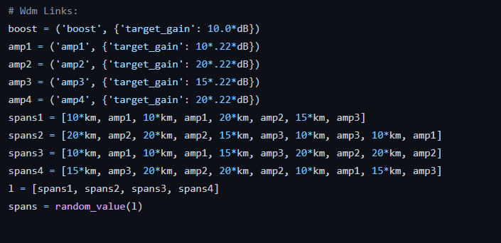
Fig 8: Variable Spans resulting in Variable Errors

Slide 18
What is Machine Learning?
Machine learning is a subfield of artificial intelligence.
It involves training computers to learn from data without being explicitly programmed.
Machine learning algorithms can identify patterns in data.
Based on identified patterns, machine learning algorithms can make predictions.
Some common applications of machine learning include image recognition, speech recognition, and natural language processing.

Slide 19
Machine Learning Algorithms
Linear Regression and Neural Nets were used
Both algorithms were used to predict gOSNR and OSNR error rates
Mean squared error was used to evaluate the performance of the models
In Linear Regression predictions are based on the linear relationship between the input feature (channel number) and the output variable (error rate)

Slide 20
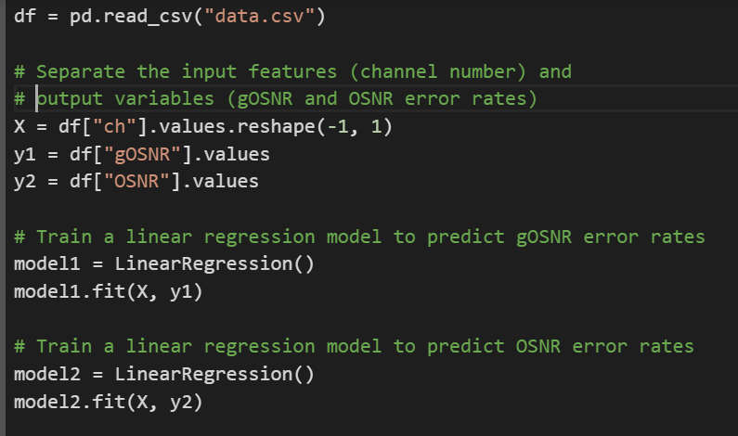
Fig 9: Linear Regression Code

Slide 21
Use of Deep Neural Networks
MLP Regressor (Multi-Layer Perceptron Regressor) was used to predict gOSNR and OSNR.
Neural network models are more complex and can learn non-linear relationships between input features and output variables.
Standard Scaler was used to standardize the input feature (channel number) before training the model.
Mean squared error was used to evaluate the performance of the models.

Slide 22
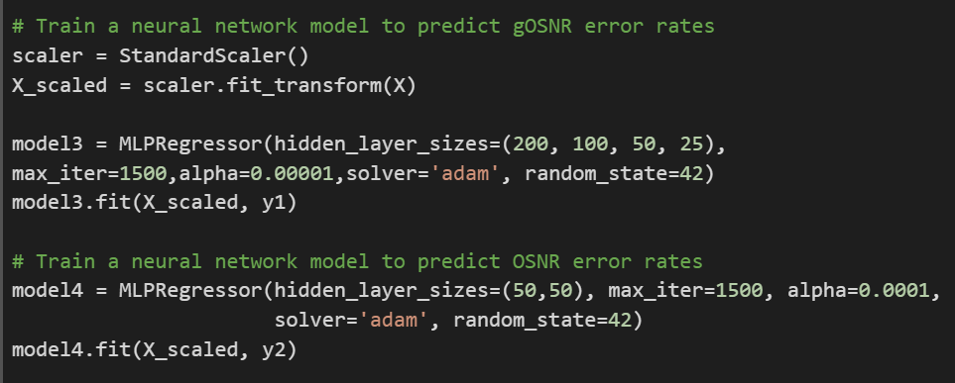
Fig 10: Neural Nets Code

Slide 23
Mean Squared Error
MSE is a commonly used metric to measure the accuracy of a regression model. It calculates the average squared differences between the predicted and actual values of the target variable.
MSE is the average of the squared differences between the predicted and actual values of the target variable. A lower MSE value indicates better performance of the regression model, as it means that the predicted values are closer to the actual values.
The reason for using MSE is that the values were pretty similar, and squaring the error rate generally provides an accurate measurement.

Slide 24
gOSNR Results
  Linear Regression MSE for gOSNR error rate: 0.90
  Neural Network MSE for gOSNR error rate: 0.97
  The project results reveal that both Linear Regression and Neural Network models were able to predict the gOSNR values with some level of accuracy, but the Linear Regression model outperformed the Neural Network model in terms of MSE, with a value of 0.90 compared to 0.97 for the Neural Network.

Slide 25
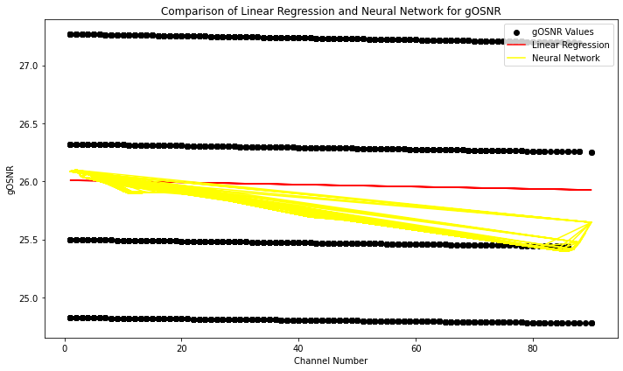
Fig 11: gOSNR Prediction

Slide 26
OSNR Results
Linear Regression MSE for OSNR error rate: 0.079
Neural Network MSE for OSNR error rate: 0.091
The project results indicate that both linear regression and neural network algorithms can be used to predict OSNR error rates in optical networks with reasonable accuracy. The linear regression model achieved a slightly better mean squared error (MSE) of 0.079, while the neural network model had an MSE of 0.091.

Slide 27
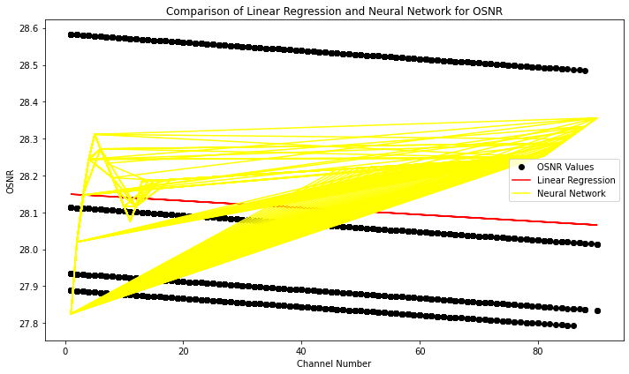
Fig 12: OSNR Prediction

Slide 28
Challenges
Integrating Mininet-Optical with the ROADM was complex and required experimentation and troubleshooting
Learning Bash scripts was challenging, but our team overcame it with dedicated effort and practice.
Generating 90 Bash files with distinct datasets using Python demanded meticulous planning and attention to detail.
Debugging intricate code, optimizing performance, and ensuring machine learning model accuracy presented additional challenges that required focused effort from our team.

Slide 29
Conclusion
Project showcases machine learning for optimizing routing in optical networks
Partial success achieved through simulation with Mininet-Optical and training ML algorithms
Accurate prediction achieved for OSNR and inaccurate predictions for gOSNR
Resulting, in good use of the software, in places where the external environment is almost similar
Research has potential to enhance efficiency and reliability of optical networks, crucial in today's digital era.

Slide 30
Future Work
While this project has demonstrated the potential of machine learning for optimizing routing in optical networks, there are still several avenues for future research. One possible direction would be to investigate the effectiveness of more complex machine learning algorithms, such as polynomial regression models, which may better capture the nuances and complexities of optical networks.
Furthermore, expanding the dataset by collecting additional data for each span would increase the amount of data by a factor of four, allowing for more comprehensive analysis and potentially more accurate predictions. Additionally, exploring the application of the same machine learning configuration on different network topologies could help identify a more universal and optimal learning algorithm for routing in optical networks.
Overall, further research and development in the field of machine learning for optimizing routing in optical networks can have significant practical applications, and we look forward to exploring these opportunities in the future.

Slide 31
References
Lantz, B., D´ıaz-Montiel, A. A., Yu, J., Rios, C., Ruffini, M., & Kilper, D. (n.d.). Demonstration of Software-Defined Packet-Optical Network Emulation with Mininet-Optical and ONOS.
D´ıaz-Montiel, A. A., & Ruffini, M. (n.d.). A Performance Analysis of Supervised Learning Classifiers for QoT Estimation in ROADM-based Networks. CONNECT Centre, Trinity College Dublin, Ireland. Email: fadiazmon, ruffinimg@tcd.ie.
mininet-optical. (n.d.). Retrieved from https://mininet-optical.org/
scikit-learn. (n.d.). Retrieved from https://scikit-learn.org/stable/

Slide 32
Demonstration

Slide 33
Questions and Answers

Slide 34
Thank You

