Slide 1
U.S. Hospital Performance Analysis (2011–2022)
Financial, Operational, and Geographic Insights Using CMS Cost Report Data
Presented By:
Manjunath Muthineni
Rajesh Thota
Neha
Abhishekh Choudhary
Krishna Chaitanya Venuturumilli

Slide 2
Agenda
Introduction & Problem Statement
Research Questions
Dataset & Methodology
Dashboard Overview
Key Insights (Financial, Operational, Geographic)
Challenges & Recommendations
Future Work
Q & A

Slide 3
Problem Statement and Research Questions
Problem Statement
U.S. hospitals face rising costs while trying to operate efficiently and meet different regional healthcare needs. Understanding hospital performance helps support better decision-making and planning.
Research Questions
How has the financial performance of U.S. hospitals changed over time?
How well are hospitals using their resources?
Are there differences in hospital performance across U.S. states?

Slide 4
Dataset Information
Data Source: CMS Hospital Provider Cost Reports
Organization: Centers for Medicare & Medicaid Services (CMS)
Time Period: 2011–2022
Coverage: U.S. hospitals (financial & operational data)
Data Preparation: Annual cost report files were combined to create a single analysis dataset

Slide 5
Methodology
Data collected from CMS Hospital Provider Cost Reports (2011–2022)
Combined annual files into one dataset for analysis
Selected required columns for analysis
Cleaned and standardized key financial and operational variables
Used EDA to check data quality and validate trends
Created KPIs for financial, operational, and geographic performance
Designed dashboards in Power BI to visualize insights

Slide 6
Dashboard Overview
Our analysis is presented using Power BI dashboards that summarize hospital performance from multiple perspectives:
Overall Dashboard: High-level national performance summary
Financial Dashboard: Revenue, expenses, and profit metrics
Operational Dashboard: Utilization and efficiency indicators
Geographic Dashboard: State-level performance comparisons

Slide 7
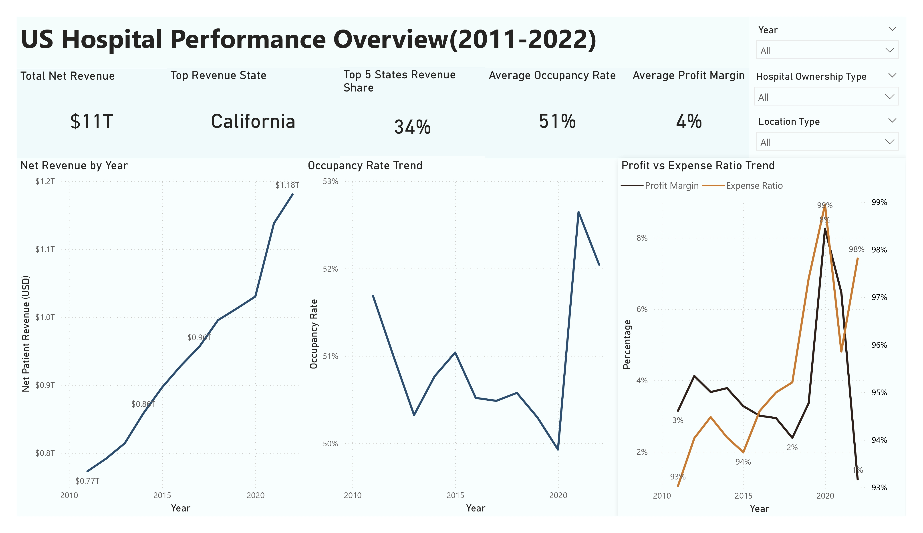

Slide 8
Insights
Total hospital revenue steadily increased from 2011 to 2022.
Profit margins remain low due to consistently high expense ratios.
Occupancy rates declined around 2020 and partially recovered afterward.
California contributes the highest share of total hospital revenue.
Significant differences exist in hospital performance across regions and facility types.

Slide 9
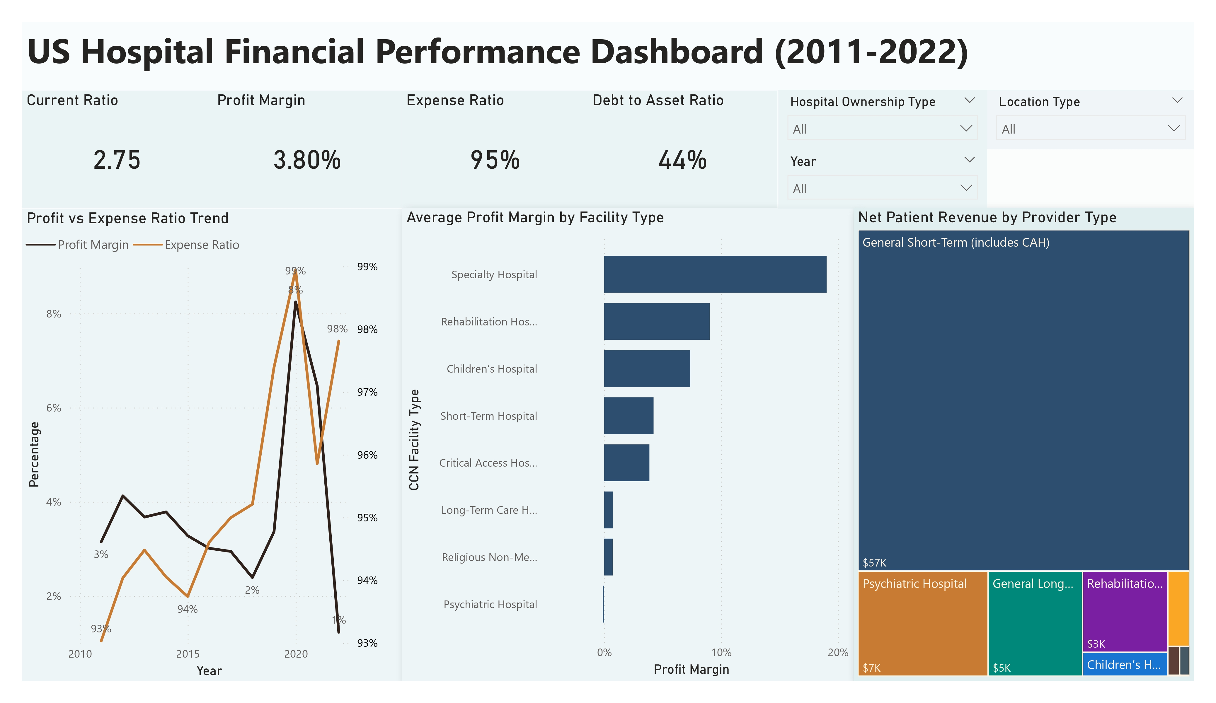

Slide 10
Financial Insights
Hospitals have a strong current ratio (2.75), indicating good short-term liquidity.
Profit margins remain low (3.8%) mainly due to very high expense ratios (95%).
A sharp profit spike appears around 2020, followed by a decline.
Specialty hospitals show higher profit margins compared to other facility types.
General short-term hospitals generate the highest net patient revenue.

Slide 11
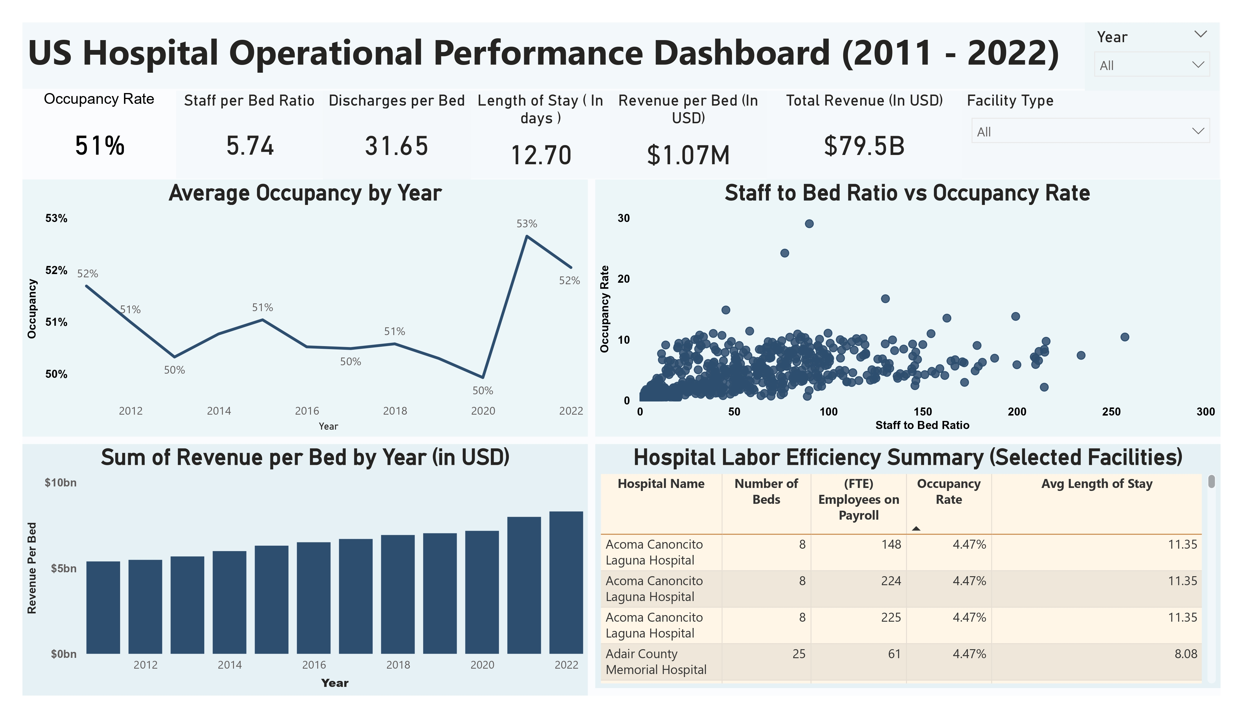

Slide 12
Operational Insights
Average hospital occupancy remained around 51%, with a noticeable dip in 2020 and recovery afterward.
Staffing levels vary widely, showing differences in how hospitals allocate labor resources.
Hospitals with higher staff-to-bed ratios do not always achieve higher occupancy.
Revenue per bed has steadily increased over time, indicating improved revenue generation.
Length of stay remains consistent, suggesting stable patient care patterns.

Slide 13
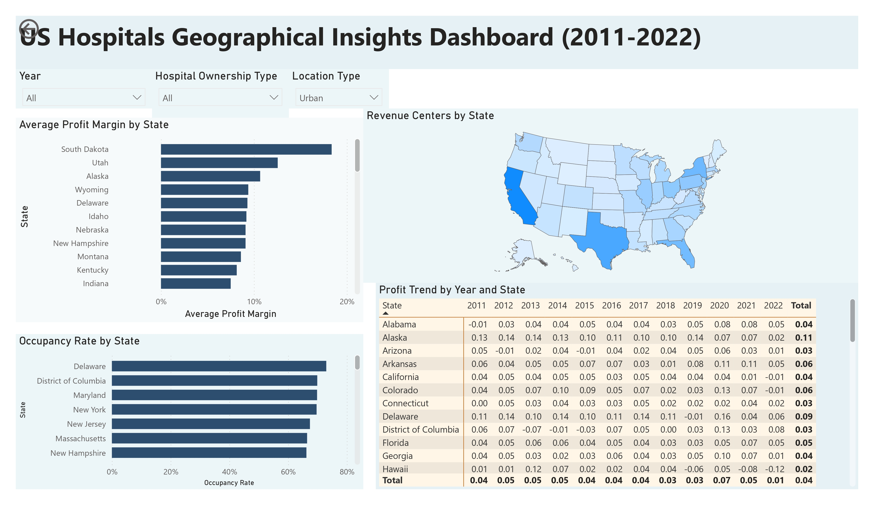

Slide 14
Geographical Insights
Hospital performance varies significantly across different U.S. states.
States like California and Texas generate the highest hospital revenue.
Profit margins are higher in some smaller states compared to large population states.
Occupancy rates differ by region, showing uneven demand for hospital services.
Urban hospitals tend to report stronger revenue concentrations than rural areas.

Slide 15
Advanced Insights
Financial Insights
Profit margins are thin: most hospitals operate near break-even.
Specialty and proprietary hospitals report the highest average margins.
High expenses—not low revenue—are the main cause of poor profitability.
Debt-to-asset ratios are lower for religious and nonprofit hospitals.
Operational Insights
Bed occupancy is highest in psychiatric and rehab hospitals.
Some hospitals are overstaffed relative to their actual occupancy.
Revenue per bed has steadily increased over the last decade.
Payroll costs don't always translate to better performance.

Slide 16
Advanced Insights
Geographic Insights
Smaller states like Delaware and Utah outperform large states in profit margins.
Rural hospitals often generate higher revenue per bed than urban ones.
Critical Access Hospitals are almost entirely rural and low-utilization.
Religious nonprofit hospitals have strong liquidity and minimal debt.
Temporal Insights
Revenue and expenses both doubled from 2011 to 2022—but margins stayed flat.
2020 saw sharp drops in occupancy and revenue due to COVID-19.
Post-pandemic, hospitals showed partial recovery with tighter operations.
Hospital performance tiers (high, mid, low) remained consistent over time.

Slide 17
Key Challenges
Persistent High Expense Ratios: Operating costs typically exceed 90% of revenue, leaving minimal net profit even among high-revenue hospitals.
Mismatch Between Staffing and Utilization: Many hospitals retain large full-time staff levels despite low occupancy, leading to inefficiency and resource strain.
Structural Disparities Across Regions: Smaller states often report better margins than larger states, showing that size doesn’t always equal efficiency.
Debt and Liquidity Risks: Public and nonprofit hospitals carry higher liabilities and limited cash buffers, making them more vulnerable to disruptions.
Limited Operational Gains Over Time: Revenue and investment have increased, but profit margins remain flat—indicating a lack of operational optimization.

Slide 18
Recommendations
Address Staffing Inefficiencies: Audit facilities with high payroll but low occupancy to optimize staff-to-bed ratios and reduce unnecessary labor costs.
Scale Specialty Care Models: Replicate the efficient, high-margin practices of specialty and rehabilitation hospitals in underperforming general hospitals.
Enhance Critical Access Efficiency: Provide rural hospitals with digital tools and shared services to improve operations without inflating overhead.
Reduce Debt Vulnerability: Encourage public and nonprofit hospitals to restructure liabilities and monitor debt-to-asset ratios for financial resilience.
Plan Post-COVID Capacity Realignment: Use 2020–2022 admission trends to recalibrate staffing and bed capacity to match evolving patient volume.

Slide 19
Future Work
Forecast
Forecast Hospital Trends: Use machine learning to predict revenue, staffing, and performance by ownership type and region.
Build
Custom Dashboards for Facilities: Build drilldown dashboards for individual hospitals to support daily decision-making.
Monitor
Post-COVID Recovery Tracking: Monitor 2023+ trends in admissions, revenue, and occupancy to assess system recovery.
Enhance
Advanced Hospital Clustering: Enhance clustering with operational metrics (e.g., staff-to-bed ratio, discharge efficiency) for benchmarking.
Develop
Policy Impact Simulations: Develop tools to estimate how policy shifts (e.g., Medicaid changes) affect financial outcomes.

Slide 20


