Slide 1
Containerization

Slide 2
Development in Microservices Architecture

Slide 3

Microservice Architecture
eCommerceBookingApp
Orders
Payments
Developers

Slide 4
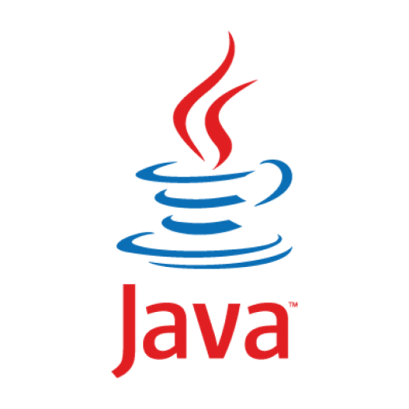



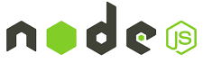

Microservice Architectures
eCommerceBookingApp
Orders
Payments
Developers

Slide 5
Microservice Architectures
eCommerceBookingApp
Orders
Payments
Developers

Slide 6
Deployments over Virtual Machines

Slide 7

Deploy Microservices to Virtual Machines
eCommerceBookingApp
DEV
Orders
QA
Payments
PROD
Developers
DevOps Engineers

Slide 8
Deployments over Virtual Machines
App1
BIN/LIBS
BIN/LIBS
BIN/LIBS
BIN/LIBS
BIN/LIBS
BIN/LIBS
GUEST OS
GUEST OS
GUEST OS
GUEST OS
GUEST OS
GUEST OS
VIRTUAL HARDWARE
VIRTUAL HARDWARE
VIRTUAL HARDWARE
VIRTUAL HARDWARE
VIRTUAL HARDWARE
VIRTUAL HARDWARE
HYPERVISIOR(Hyper-V, Xen)
HYPERVISIOR(Hyper-V, Xen)
Host Operating System
Host Operating System
Infrastrcture-CPU,Memory,HDD
Infrastrcture-CPU,Memory,HDD

Slide 9
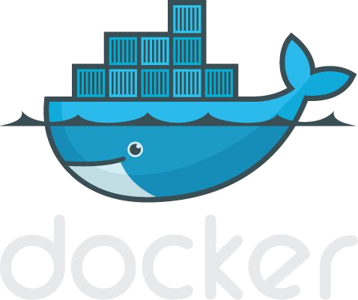
Welcome to Container Engine - Dockers

Slide 10
Container Engine (Docker)
Container
Container
Container
nginx
java
mongoDB
BIN/LIBS
tomcat
BIN/LIBS
Debian
Ubuntu
RedHat
Container Engine (Docker)

Slide 11
Container Engine (Docker)
Container
Container
Container
nginx
java
mongoDB
BIN/LIBS
tomcat
BIN/LIBS
Debian
Ubuntu
RedHat
Container Engine (Docker)
Host Operating System
Infrastructure- CPU, Memory, HDD

Slide 12
Container Engine (Docker)
Container
Container
Container
nginx
java
mongoDB
BIN/LIBS
tomcat
BIN/LIBS
Debian
Ubuntu
RedHat
Container Engine (Docker)
Host Operating System
Infrastructure- CPU, Memory, HDD

Slide 13
Virtual Machines vs Containers
App1
Container
Container
Container
BIN/LIBS
BIN/LIBS
BIN/LIBS
nginx
java
mongoDB
GUEST OS
GUEST OS
GUEST OS
BIN/LIBS
tomcat
BIN/LIBS
VIRTUAL HARDWARE
VIRTUAL HARDWARE
VIRTUAL HARDWARE
Debian
Ubuntu
RedHat
HYPERVISIOR(Hyper-V, Xen)
Container Engine (Docker)
Host Operating System
Host Operating System
Infrastrcture-CPU,Memory,HDD
Infrastructure- CPU, Memory, HDD

Slide 14




Docker components
Docker Image
The basis of a Docker container. Represents a full application
Docker Container
The standard unit in which the application service resides and executes
Docker Engine
Creates, ships and runs Docker containers deployable on a physical or virtual, host locally, in a datacenter or cloud service provider
Registry Service (Docker Hub(Public) or Docker Trusted Registry(Private))
Cloud or server based storage and distribution service for your images

Slide 15
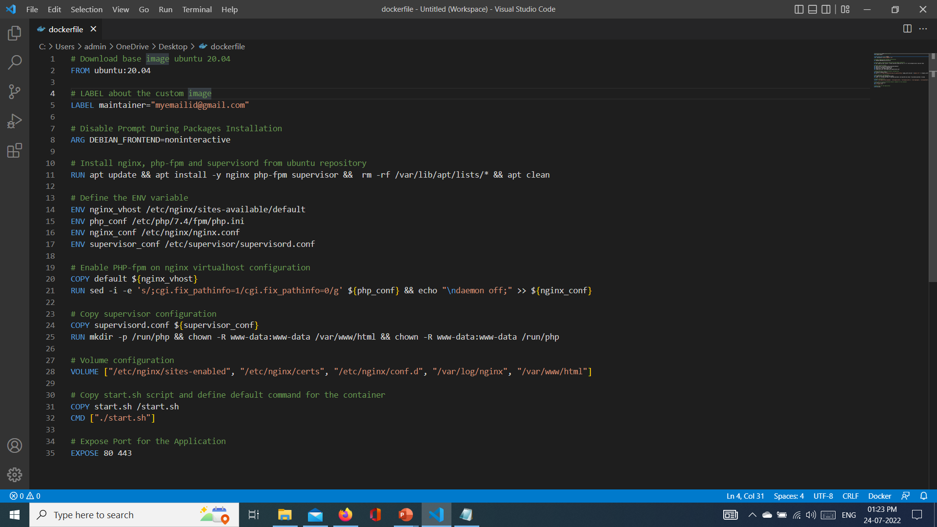
Dockerfile
A Dockerfile is a text document
It contains all the commands a user could call on the command line to assemble an image
Docker can build images automatically by reading the instructions from a Dockerfile
$ docker build -f /path/to/a/Dockerfile

Slide 16
docker commands

Slide 17
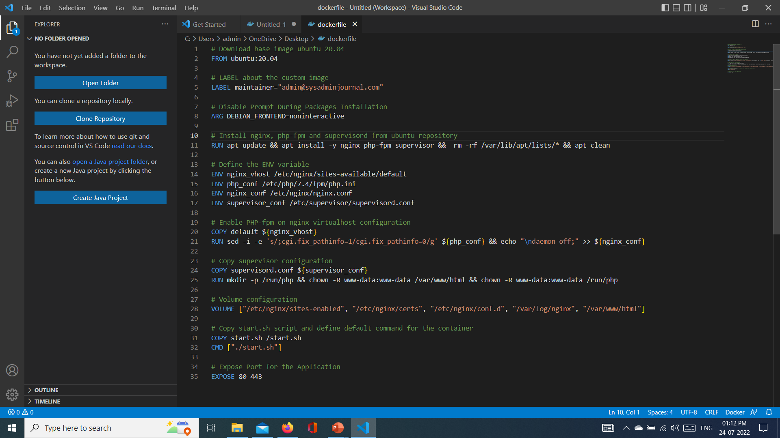
Docker command - FROM
Set the base-image for the new image that you want to create
The FROM instruction will initialize the new build-stage and must be located at the top of the Dockerfile
Needs to be the first instruction of every Dockerfile
  Usage: FROM <image>
ex: FROM ubuntu

Slide 18
Docker command - LABEL
With this instruction, you can add additional information about your Docker image, such as the version, description, maintainer, etc.
The LABEL instruction is a key-value pair that
allows you to add multiple labels and
multi-line values
  Usage: LABEL <image>
  Ex:
    LABEL version="1.0"
    LABEL description="This text illustrates / that label-values can span multiple lines."

Slide 19

Docker command - ENV
The ENV instruction is used to define an environment variable that can be used during the build stage and can be replaced inline in many as well
Usage:
ENV <key>=<value> ...
Ex:
ENV MY_NAME="John Doe"
ARG DEBIAN_FRONTEND=noninteractive
RUN apt-get update && apt-get install -y

Slide 20

Docker command - ADD
The ADD instruction copies new files or directories from <src> and adds them to the filesystem of the container at the path <dest>.
Usage:
    ADD <src>... <dest>
    ADD ["<src>",... "<dest>"]
    Ex:
    ADD hom* /mydir/
    ADD test.txt relativeDir/

Slide 21
Docker command - COPY
The COPY instruction copies new files or directories from <src> and adds them to the filesystem of the container at the path <dest>.
Usage:
    COPY <src>... <dest>
    COPY ["<src>",... "<dest>"]
    Ex:
    COPY hom* /mydir/
    COPY test.txt relativeDir/

Slide 22
ADD vs COPY
docker ADD
docker COPY
ADD <src>... <dest>..
  ADD http://foo.com/bar.go /tmp/main.go
  ADD http://foo.com/bar.go /tmp/
  ADD /foo.tar.gz /tmp/
In this case, a file named /tmp/bar.go will be added to the container's filesystem.
If the <src> argument is a local file in a recognized compression format (tar, gzip, bzip2, etc) then it is unpacked at the specified <dest> in the container's filesystem.
COPY <src>... <dest>..
COPY doesn't support URLs as a <src> argument so it can't be used to download files from remote locations.
Anything that you want to COPY into the container must be present in the local build context.

Slide 23
Docker command - RUN
Executes any commands on the current image and commit the results
Usage:
  RUN <command>
  RUN ["executable", "param1", "param2"]
  Ex:
    RUN apt-get update –y
    RUN ["/bin/bash", "-c", "echo hello"]

Slide 24
Docker command - CMD
The CMD instruction is used to define the default command to execute when running the container.
And the Dockerfile must only contain one CMD instruction, and if there is multiple CMD, the last CMD instruction will be run.
Usage:
  CMD ["executable","param1","param2"]
  CMD ["param1","param2"]
  CMD command param1 param2
  Ex:
    FROM ubuntu
    CMD echo "This is a test." | wc -

Slide 25
Docker command - ENTRYPOINT
The ENTRYPOINT instruction is used to define the first and default command that will be executed when the container is running.
Define the command to start your application with the ENTRYPOINT instruction.
Usage:
  ENTRYPOINT <command> param1 parma2
  ENTRYPOINT ["executable", "param1", "param2"] (exec form)
  Ex:
    ENTRYPOINT echo “This is my Entry Point in my Container”
    ENTRYPOINT echo [“wc”, “-l”]

Slide 26
Docker command – WORKDIR
The WORKDIR instruction is used to define the default working directory of your Docker image.
The RUN, CMD, ENTRYPOINT, and ADD instructions follow the WORKDIR instruction.
You can add multiple WORKDIR instruction on your Dockerfile, and if there is doesn't exist, it will be created automatically.
Usage:
  WORKDIR /path/to/workdir
  Ex:
    ENV DIRPATH=/path
    WORKDIR $DIRPATH/$DIRNAME
    RUN pwd

Slide 27
Docker command – EXPOSE
This instruction is used to expose the container port on the specific network ports at runtime.
The default protocol exposed is TCP, but you can specify whether the TCP or UDP.
Usage:
  EXPOSE <port> [<port>/<protocol>...]
  Ex:
  EXPOSE 80/tcp

Slide 28
docker volumes

Slide 29
docker volumes
Docker volumes are file systems mounted on Docker containers to preserve data generated by the running containers
The volumes are stored on the host, independent of the container life cycle
This allows users to back up data and share file systems between containers easily
Users can decide between the -v and the --mount flags, which are added to the docker run command
Docker automatically creates a directory for the volume on the host under the /var/lib/docker/volume/path
You can now mount this volume on a container, ensuring data persistence and data sharing among multiple containers.

Slide 30
Docker command - VOLUMES
The VOLUME instruction ad used to enable access/linked directory between the container and the host machine.
The VOLUME instruction creates a mount point with the specified name and marks it as holding externally mounted volumes from native host or other containers.
The value can be a JSON array, VOLUME ["/var/log/"], or a plain string with multiple arguments, such as VOLUME /var/log or VOLUME /var/log /var/db.
Usage:
  VOLUME [“/data”]
  Ex:
  FROM ubuntu
  RUN mkdir /myvol
  RUN echo "hello world" > /myvol/greeting
  VOLUME /myvol

Slide 31
Create ,List , Inspect and mount Volumes in dockers
To Create a Docker Volume use the command [ docker volume create [volume_name] ]
  $ docker volume create my_volume
List Docker Volumes [docker volume list]
  $ docker volume list
Inspecting Docker Volumes
  $ docker volume inspect my_volume
Mounting a Data Volume
  To mount a data volume to a container add the --mount flag to the docker run command
  It adds the volume to the specified container, where it stores the data produced inside the virtual environment.
  Syntax: docker run --mount source=[volume_name],destination=[path_in_container] [docker_image]
  $ docker run -it --name=example1 --mount source=my_volume, destination=/my_app_data ubuntu

Slide 32
Mounting a Host Directory as a Data volume
You can also mount an existing directory from the host machine to a container.
This type of volume is called Host Volumes.
You can mount host volumes by using the -v flag and specifying the name of the host directory.
Everything within the host directory is then available in the container.
What’s more, all the data generated inside the container and placed in the data volume is safely stored on the host directory.
The basic syntax for mounting a host directory is:
  $ docker run -v "$(pwd)":[volume_name] [docker_image]
The "$(pwd)" attribute instructs Docker to mount the directory the user is currently in.

Slide 33
Copying Files Between Containers From a Shared Volume
To Create a Docker Volume use the command [ docker volume create [volume_name] ]
  $ docker volume create my_volume
List Docker Volumes [docker volume list]
  $ docker volume list
Inspecting Docker Volumes
  $ docker volume inspect my_volume
Mounting a Data Volume for container example1
  $ docker run -it --name=example1 --mount source=my_volume, destination=/my_app_data ubuntu
Mounting a Data Volume for container example1
  $ docker run -it --name=example2 --mount source=my_volume, destination=/my_app_data ubuntu

Slide 34
Mounting a Host Directory as a Data volume
You can also mount an existing directory from the host machine to a container.
This type of volume is called Host Volumes.
You can mount host volumes by using the -v flag and specifying the name of the host directory.
Everything within the host directory is then available in the container.
What’s more, all the data generated inside the container and placed in the data volume is safely stored on the host directory.

Slide 35
Copying Files Between Containers From a Shared Volume
The basic syntax for mounting a host directory is:
  $ docker run -v "$(pwd)":my_data_volume ubuntu
Create a sample directory on the host under the name tmp and move into it:
  $ mkdir tmp
  $ cd tmp
Once inside the directory, create a test file to see whether it will be available from the container:
  $ touch file.txt
Use the docker run command to launch an Ubuntu container with the host directory attached to it:$
  $ docker run -it -v "$(pwd)":/my_data_volume ubuntu
This launches the container in interactive mode and mounts a volume under the name data1.
List the content of the container and verify there is a data1 directory:
  $ ls
  Mount host directory to container.
Open the mounted directory and list the content. The output should display the file you created on the host:
  $ cd data1
  $ ls
How to Delete Docker Volumes
  $ docker volume rm my_data_volume

Slide 36
docker networking

Slide 37
docker networking
Docker takes care of the networking aspects so that the containers can communicate with other containers and also with the Docker Host
If you do an ifconfig on the Docker Host, you will see the Docker Ethernet adapter
This adapter is created when Docker is installed on the Docker Host
This is a bridge between the Docker Host and the Linux Host
Listing All Docker Networks
$ docker network ls
This command can be used to list all the networks associated with Docker on the host
Inspecting a Docker network
$ docker network inspect networkname
$ docker network inspect bridge

Slide 38
docker networking
Creating Your Own New Network
  $ sudo docker network create –-driver bridge new_nw
  $ sudo docker run –it –network=new_nw ubuntu:latest /bin/bash
  $ sudo docker network inspect new_nw

Slide 39



Docker Bridge Networking and Port Mapping
Docker host 1
Host port
Container port
Cntnr1
10.0.0.8
:80
$ docker container run -p 8080:80 ...
Bridge
172.14.3.55
:8080
L2/L3 physical network

Slide 40
Docker Bridge Networking and Port Mapping
80
8080
27017
Container
Container
Container
nginx
java
mongoDB
BIN/LIBS
tomcat
BIN/LIBS
Debian
Ubuntu
RedHat
90
9090
27017
Container Engine (Docker)
Host port
Container port
$ docker container run -p 9090:8080 ...

Slide 41
docker compose

Slide 42
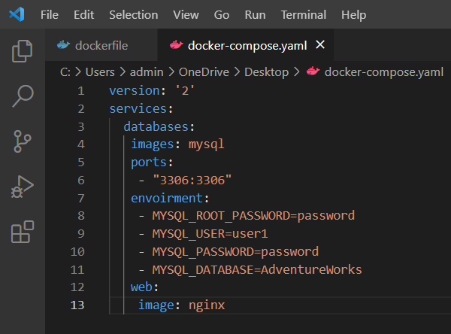
docker compose
Docker Compose is used to run multiple containers as a single service
For example, suppose you had an application which required NGNIX and MySQL, you could create one file which would start both the containers as a service without the need to start each one separately.
We will look at how to get a simple service with MySQL and NGNIX up and running using Docker Compose
Installation and running of docker compose
$ apt-get install docker-compose -y
$ chmod +x /home/demo/docker-compose
$ docker-compose version
$ sudo ./docker-compose up

Slide 43
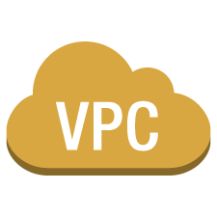
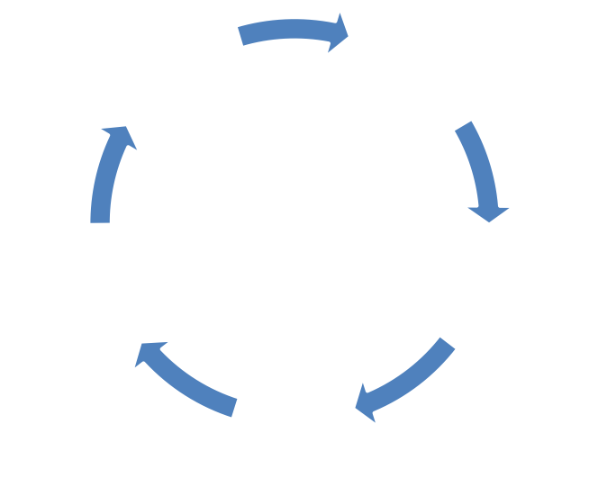




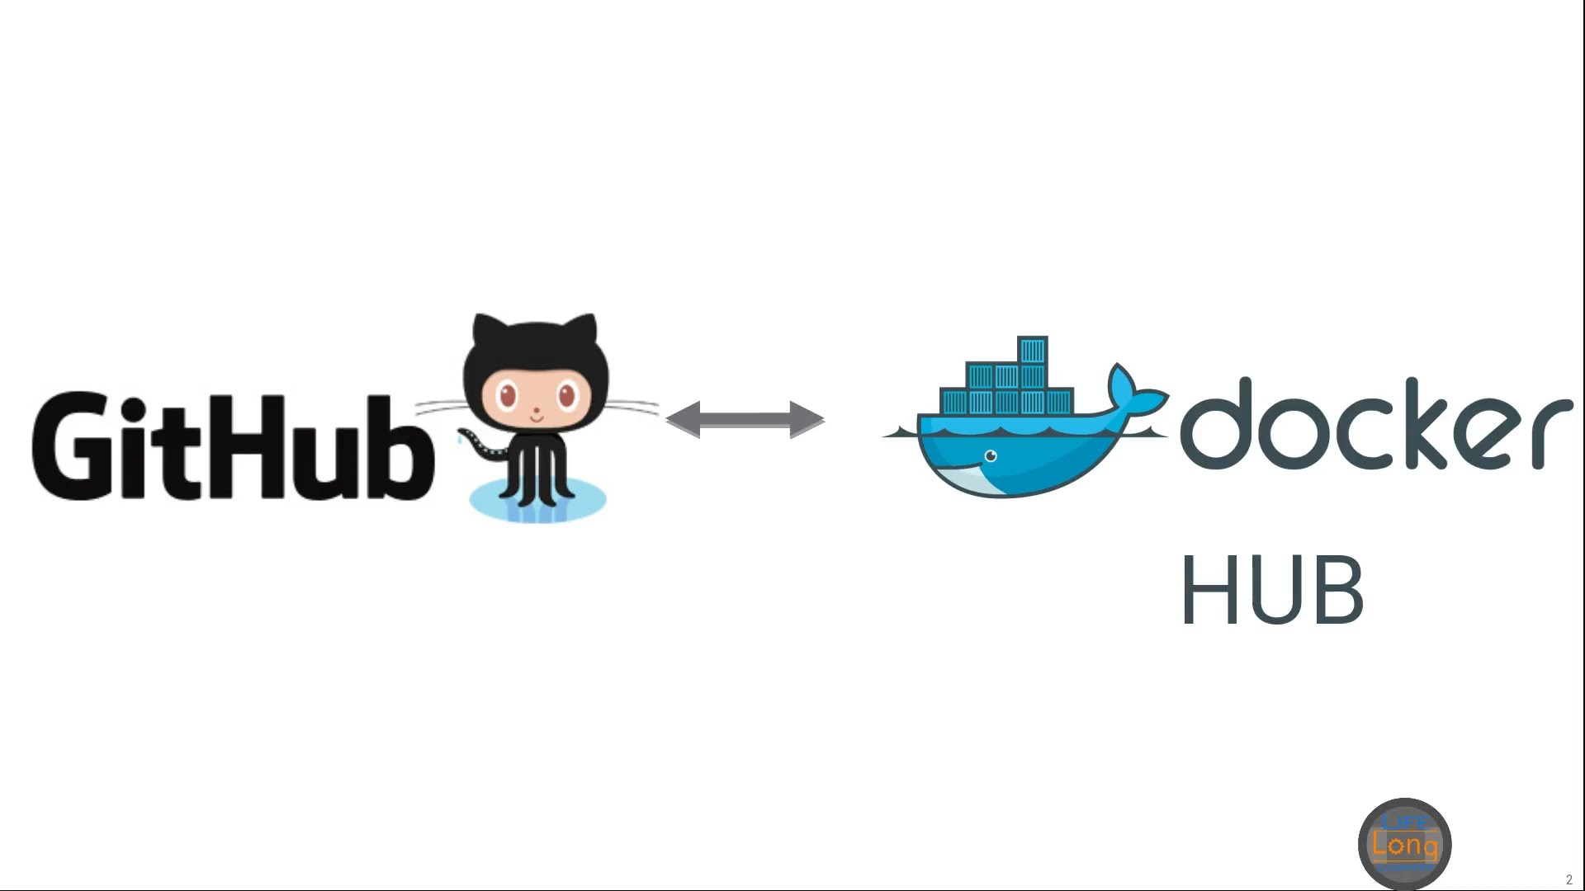

Commit and Sync to master
docker pull
Docker
Daemon
docker run
Local GitHub Repo
VPC subnet
User Commits
Virtual private cloud

Slide 44
Thank You

