Slide 1
Employee Data Analytics using Excel
R.MUTHTAMIL
STUDENT NAME:
REGISTER NO:312204244
DEPARTMENT:B.com accounting and finance
COLLEGE:Annai violent arts and science

Slide 2
PROJECT TITLE
CREATING AN EMPLOYEE PERFORMANCE SCORECARD IN EXCEL

Slide 3


AGENDA
Problem Statement
Project Overview
End Users
Our Solution and Proposition
Dataset Description
Modelling Approach
Results and Discussion
Conclusion
3/21/2024 Annual Review

Slide 4

PROBLEM STATEMENT
The procedure for creating a scorecard for employee performance in Excel begins with a goal. The OKR methodology provides the information and the meaning of a balance scorecard. You can use Schneiderman's updated categories as your foundation, which you can then populate with the relevant metrics.

Slide 5

PROJECT OVERVIEW
Develop a comprehensive employee performance scorecard in Excel to track and evaluate employee performance based on specific key performance indicators (KPIs) and competenciesThe Excel-based system allows for flexible adaptations, ensuring it can be tailored to fit the unique requirements of any organization.
.

Slide 6

WHO ARE THE END USERS?
The end users of an employee performance scorecard in Excel are typically managers, team leads, or other supervisors who are reviewing the performance of their employees.
streamlined, efficient, and user-friendly tool at your fingertips, revolutionizing the way you assess employee performance. Welcome to the world of Excel-based Employee Performance Rating Cards and Dashboards, a game-changer in the realm of performance management.

Slide 7

OUR SOLUTION AND ITS VALUE PROPOSITION
A scorecard is a high-level snapshot of organizational performance. Scorecards display a collection of key performance indicators (KPIs) and the performance targets for those KPIs

Slide 8
Dataset Description
You can use PerformancePoint Dashboard Designer to create scorecards for your dashboards. A scorecard can be thought of as a kind of report that is designed to show at a glance whether performance is on or off target for one or more key performance indicators

Slide 9

THE "WOW" IN OUR SOLUTION
You can fill in the targets with additional KPIs that reflect each sub-objectives. Remember that scorecards may differ depending on the organization or institution.
3/21/2024 Annual Review
9

Slide 10
MODELLING
template can provide a structured framework for evaluating and monitoring employee performance. You can customize the template to reflect your organization's unique priorities, roles, and objectives.
10

Slide 11
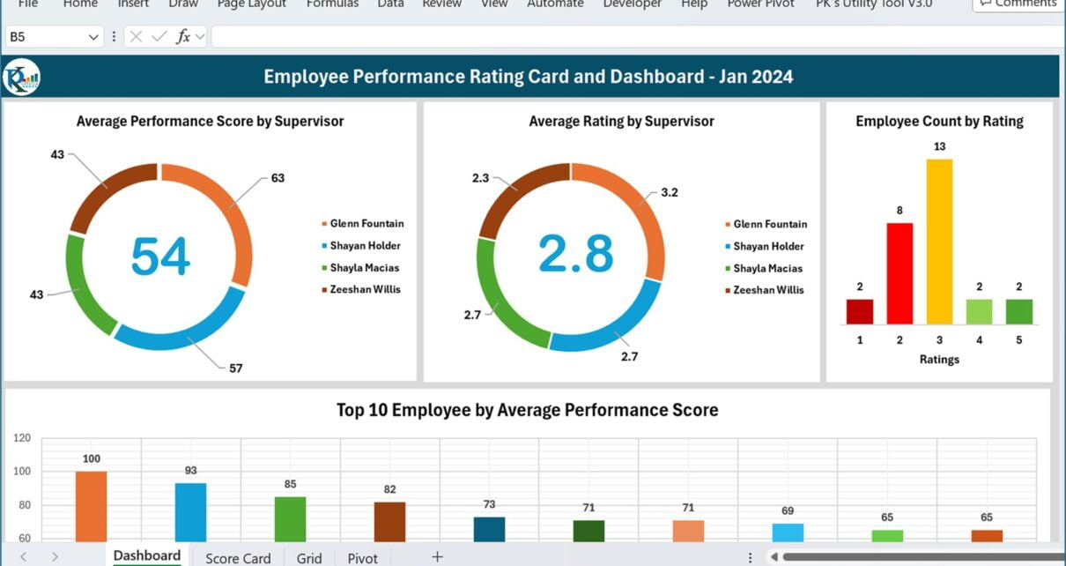
RESULTS
11

Slide 12
conclusion
A performance appraisal system is crucial in enhancing productivity by rewarding good performance, ensuring organizational objectives are met, and promoting change. It fosters communication, trust, and development, thus improving employees' participation.An Excel-based Employee Performance Rating Card and Dashboard is very useful and adaptable tool. It can significantly enhance your performance management process.

