Slide 1
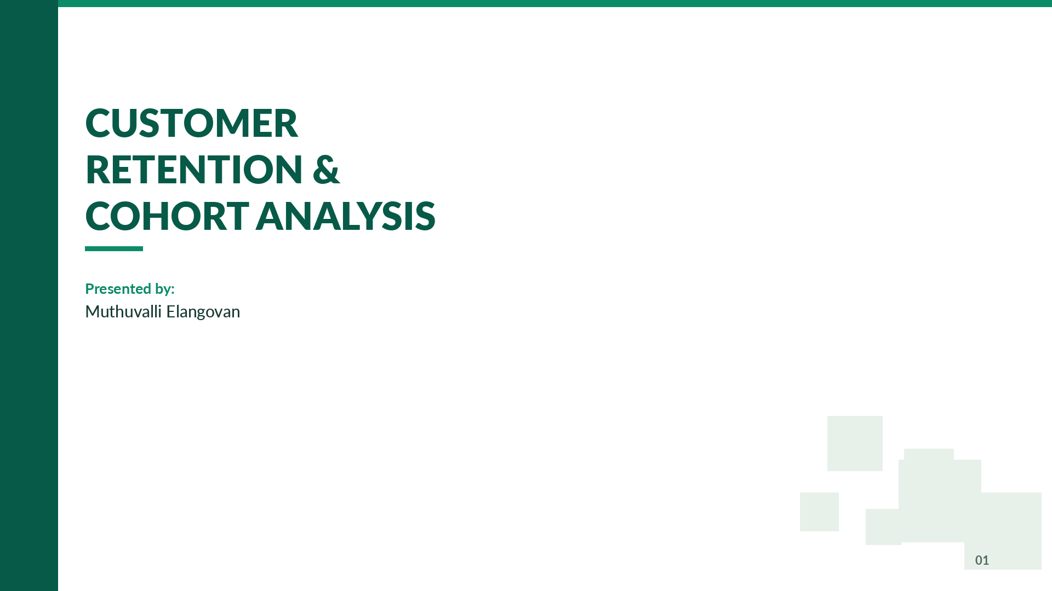
Customer Retention & Cohort Analaysis
Presented by:
Muthuvalli Elangovan

Slide 2
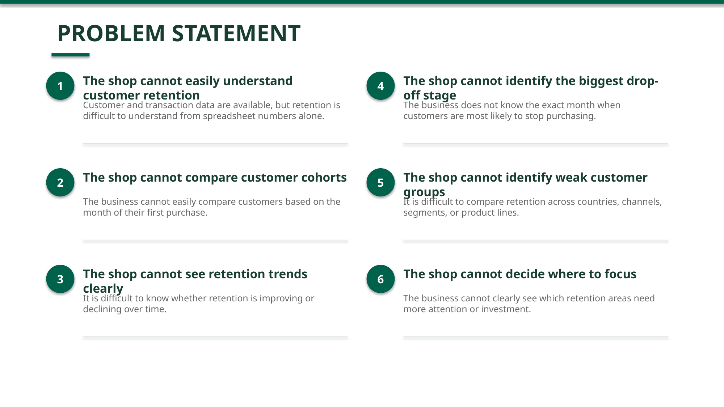
Problem Statement
No visual view of customer retention
Customer retention is shown only as numbers in a spreadsheet, making it difficult to quickly understand customer behavior over time.
Cannot compare customer groups
The business cannot easily compare whether customers who joined in different months are staying or leaving.
No visibility of retention trends
The business cannot see if customer retention is improving or declining over time after new campaigns or product changes.
Cannot identify when customers leave
The business does not know at which month or stage customers are most likely to stop using the product or service.

Slide 3
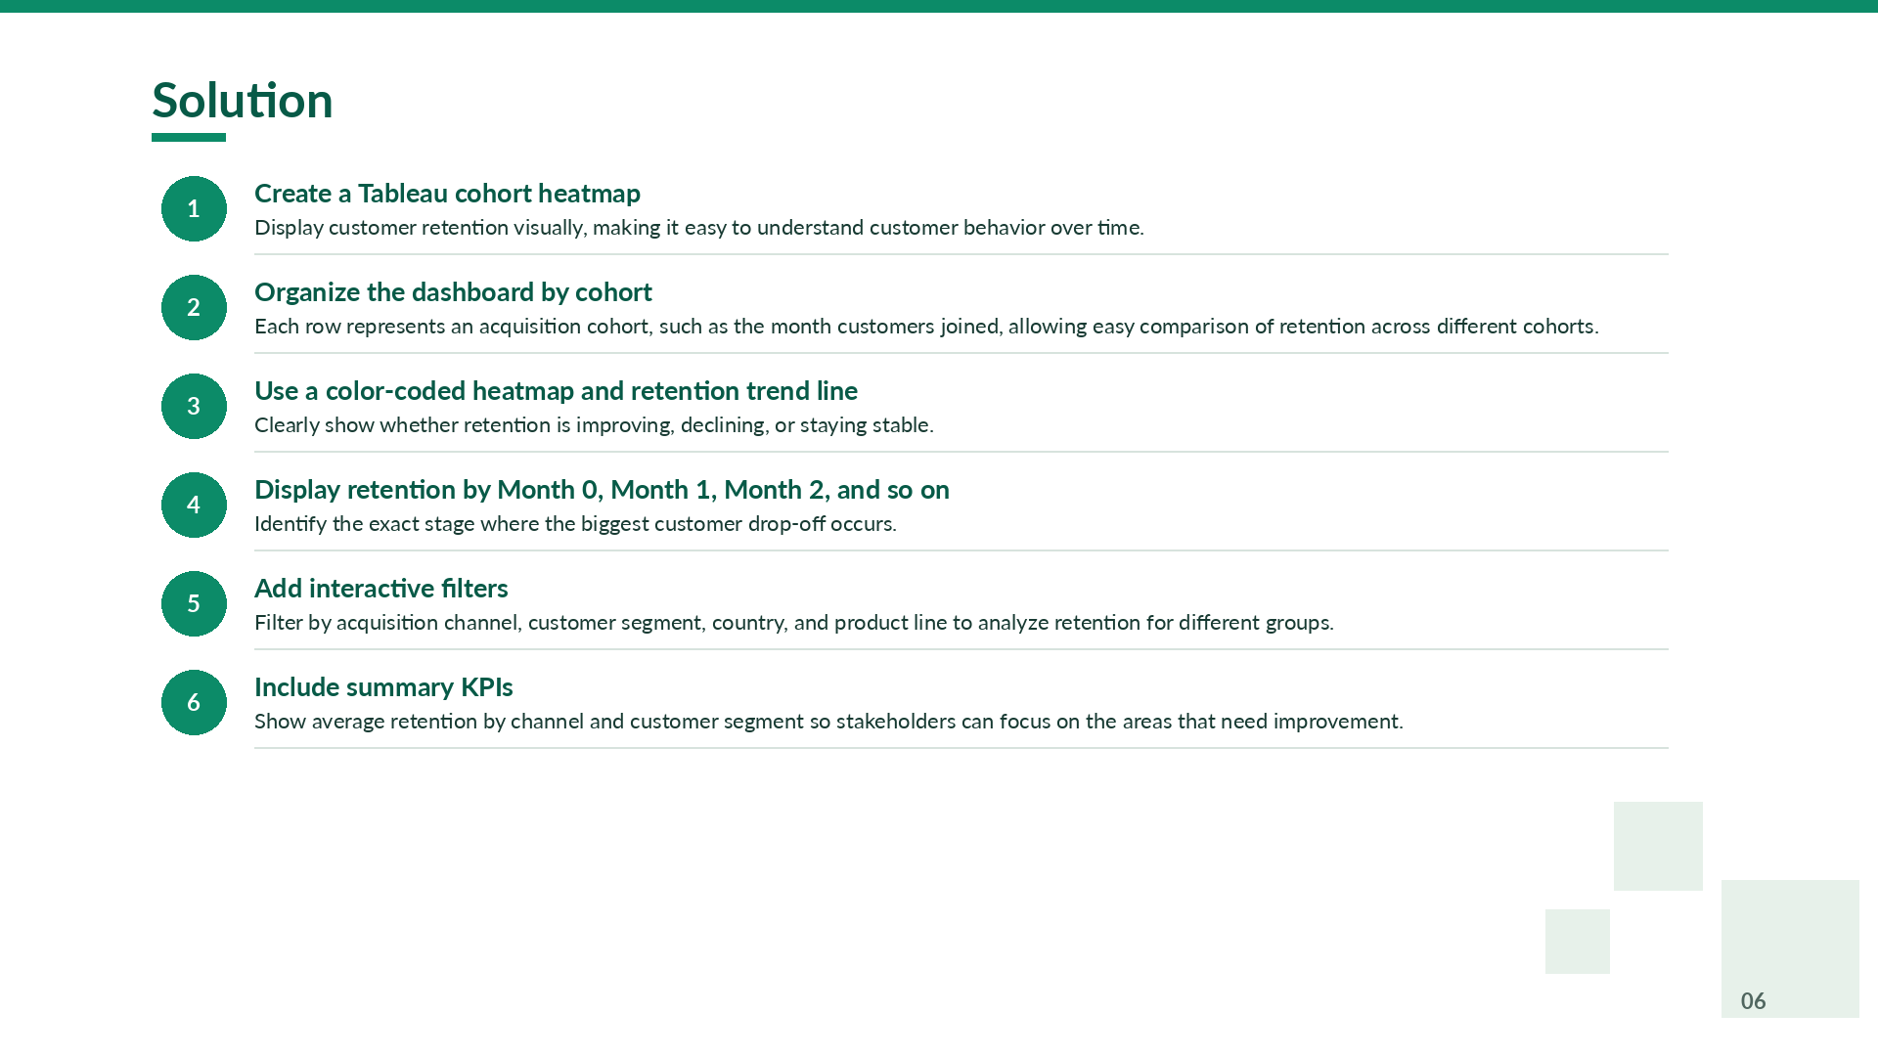
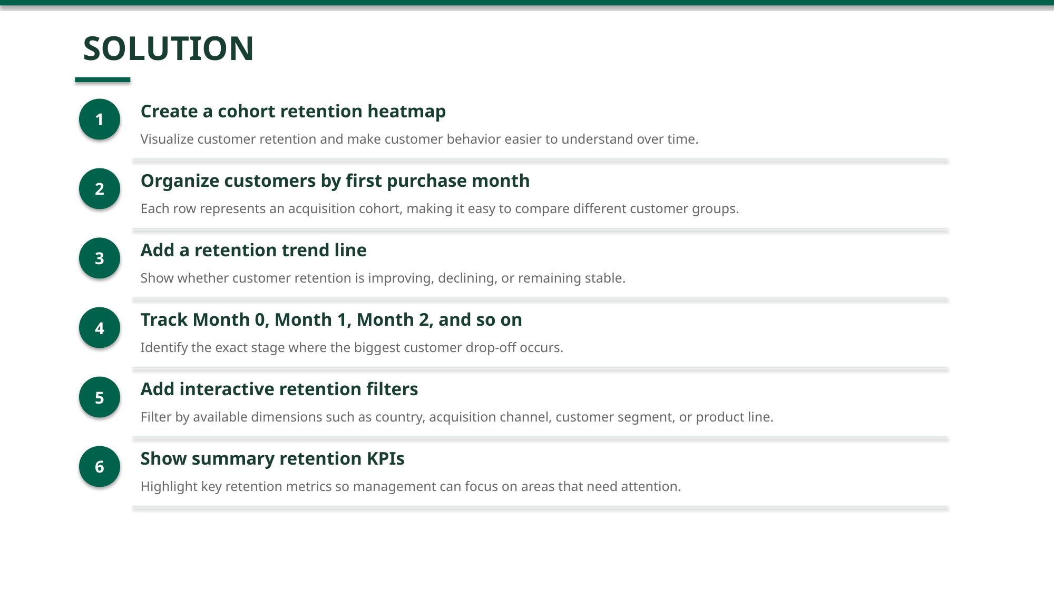
Solution
Create a Tableau cohort heatmap to display customer retention visually, making it easy to understand customer behavior over time.
Organize the dashboard so that each row represents one acquisition cohort (such as a month), allowing easy comparison of retention across different cohorts.
Use a color-coded heatmap and a retention trend line chart to clearly show whether customer retention is improving or declining over time.
Display retention by Month 0, Month 1, Month 2, and so on, to identify the exact stage where the highest customer drop-off occurs.
Add interactive filters for acquisition channel, customer segment, and product line to analyze retention for different customer groups.
Include summary KPIs such as average retention by channel and customer segment, helping stakeholders identify the most effective retention strategies and focus on areas that need improvement.

Slide 4
Dataset Details
Dataset Name : Online Retail Dataset
Source : [Kaggle – Online Retail II (UCI)](https://www.kaggle.com/datasets/mashlyn/online-retail-ii-uci)
File : online_retail.csv
Rows : 779,425 transaction records
Columns : 10 attributes

Slide 5
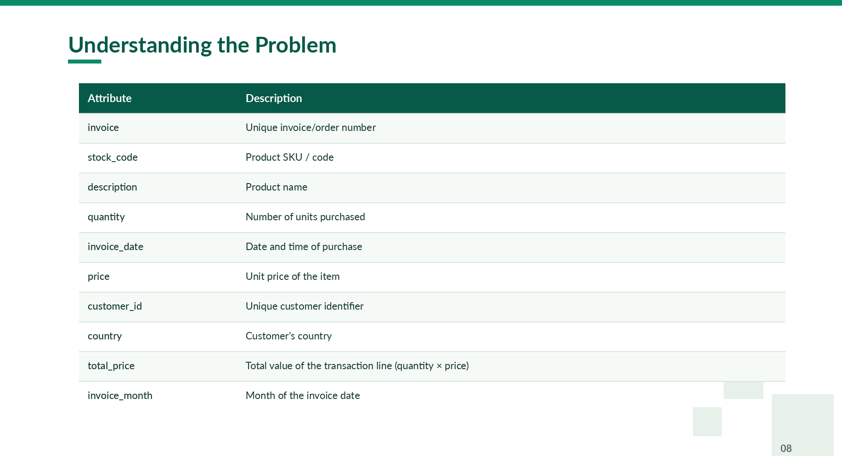
Understanding the Problem
Attribute | Description
invoice | Unique invoice/order number
stock_code | Product SKU/code
description | Product name
quantity | Number of units purchased
invoice_date | Date and time of purchase
price | Unit price of the item
customer_id | Unique customer identifier
country | Customer's country
total_price | Total value of the transaction line (quantity × price)
invoice_month | Month of the invoice date

Slide 6
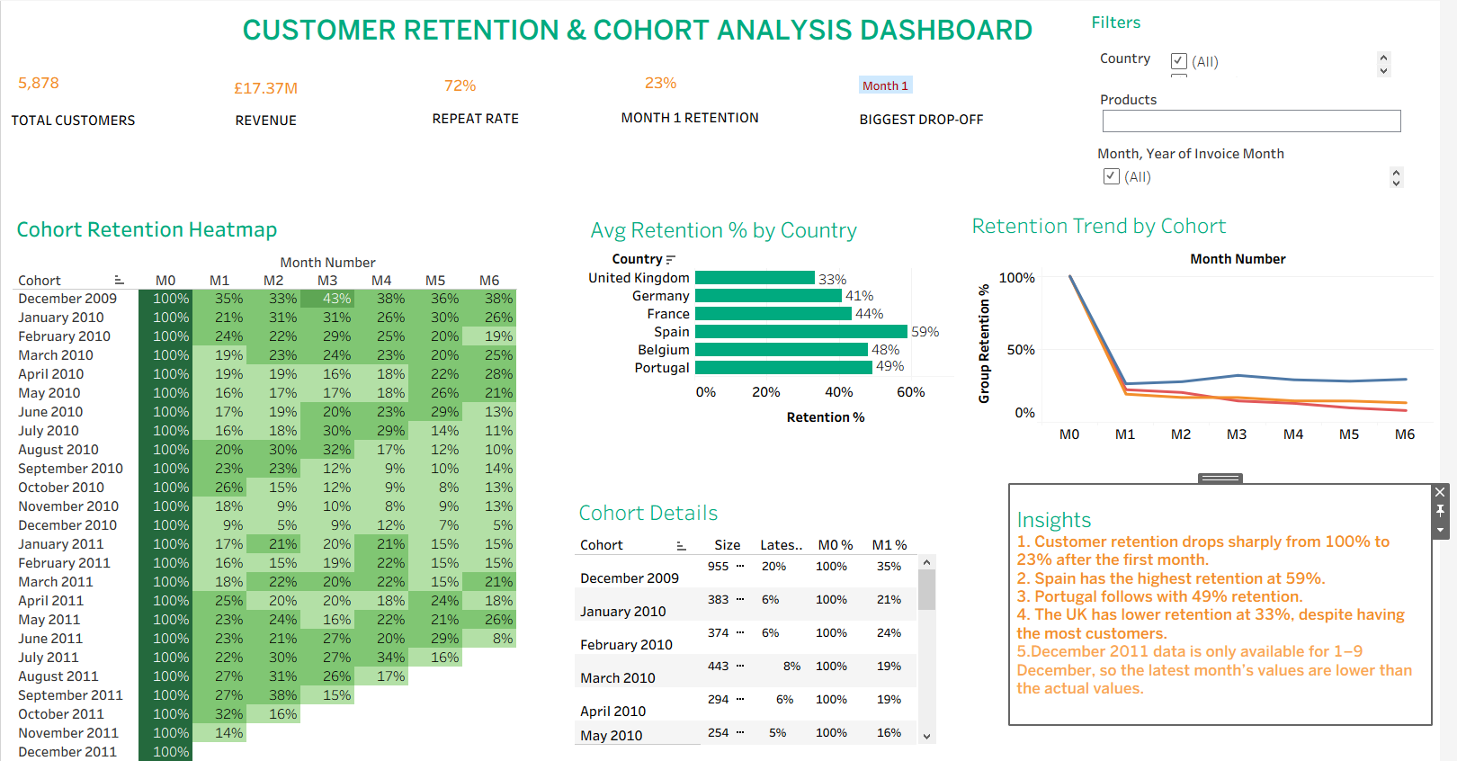
Dashboard Screenshot

Slide 7

THANK YOU

