Slide 1
REFINE-Evidence Weighted Research Gap Validation
An integrated framework for identifying candidate research gaps and evaluating them against scientific evidence.
Students Name
Muthuveal V - 3122235002075
Pavithran M - 3122235002086
Guide
Dr. Sudha P​
Associate Professor​

Slide 2
Problem Statement
The exponential growth of scientific publications makes it increasingly difficult for researchers to identify and validate research gaps systematically.
Key challenges
Fragmented literature: Relevant research is distributed across multiple publications and databases.
Limited retrieval: Conventional search methods may miss semantically related studies.
Disconnected evidence: Relationships between research concepts, methodologies, findings, and limitations are difficult to synthesize.
Unverified gaps: Potential research gaps require evidence-based validation against existing literature.

Slide 3
Existing System
Paper | Approach | Key Focus | Limitation
ResearchRAG (2026) | RAG + KG + Agents + GNN-based Gap Scoring | Knowledge graph-aided literature analysis and research gap scoring | Sensitive to literature coverage; some gaps may be generic or spurious
HySemRAG (2025) | Hybrid Semantic RAG + KG + Multi-Agent Framework | Large-scale literature synthesis and methodological gap analysis | Depends on open-access/full-text availability; gap validation remains limited
GapSpotter (2025) | Agents + Semantic Clustering | Automatic research gap detection from literature | Gap validation remains challenging; requires further analysis
GapFinder (2025) | AI-based Gap Detection | Identifies potential research gaps from publication trends | Requires human interpretation to confirm gaps
SciRAG (2026) | Adaptive + Citation-aware RAG | Literature synthesis with citation-aware generation | Focuses on synthesis rather than explicit gap identification
CG-RAG (2025) | Citation Graph + RAG | Uses citation graphs for research question answering | Focuses on research QA; no explicit gap identification
PaperQA (2023 | RAG + Scientific QA | Answers questions from research papers | No explicit gap identification

Slide 4
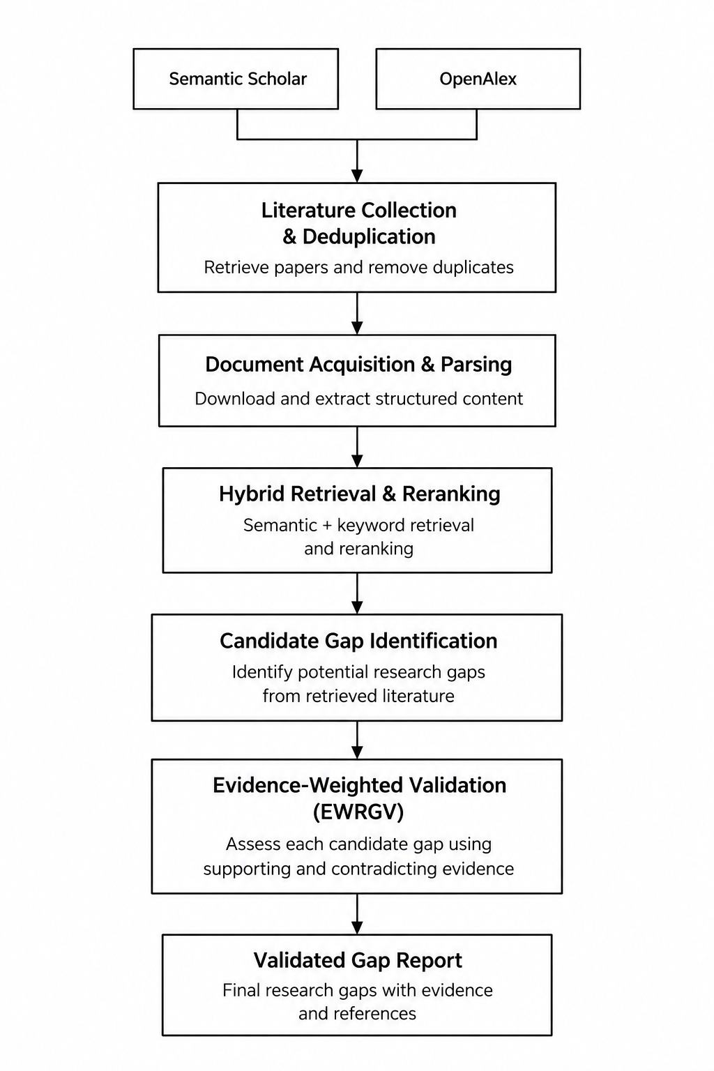
Proposed Solution
Refine is an RAG-based research gap identification and validation system that combines multi-source literature collection, hybrid retrieval, candidate gap identification, and Evidence-Weighted Research Gap Validation (EWRGV).
Key Objectives
Automated Literature Collection: Retrieve relevant research papers from sources such as OpenAlex and Semantic Scholar.
Hybrid Literature Retrieval: Combine semantic and keyword-based retrieval to find relevant evidence.
Candidate Gap Identification: Identify potential research gaps from retrieved literature using structured analysis.
Evidence-Weighted Validation: Assess candidate gaps against relevant evidence to strengthen their justification.
Evidence Traceability: Connect validation outcomes to the retrieved literature supporting or challenging each candidate gap.

Slide 5
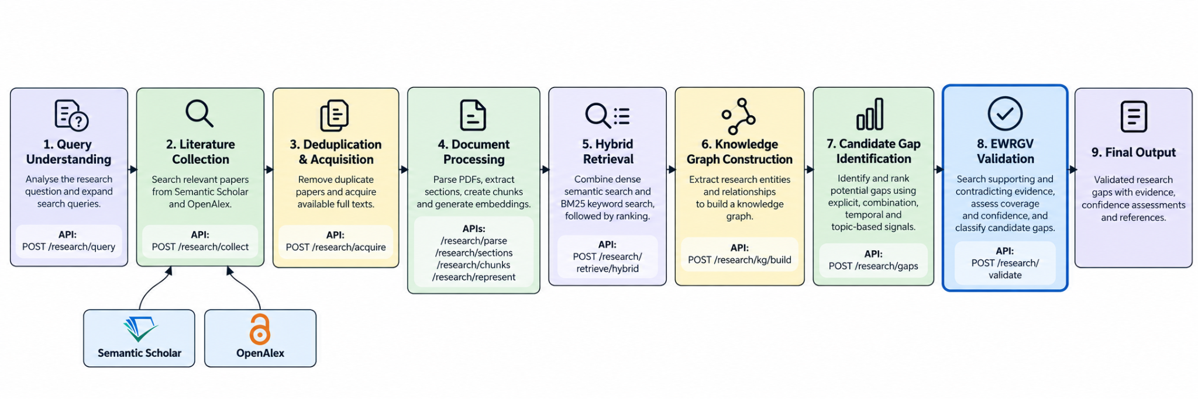
System Architecture

Slide 6
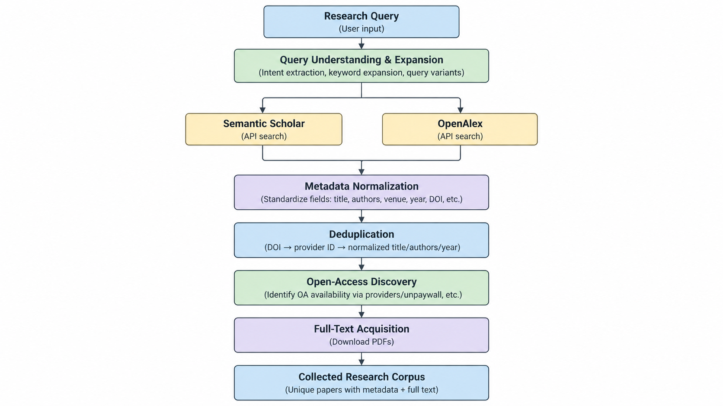
Acquisition
1. Literature Collection
Expands the research query into relevant search queries.
Collects papers from Semantic Scholar and OpenAlex.
Deduplicates records and acquires available full-text papers.

Slide 7
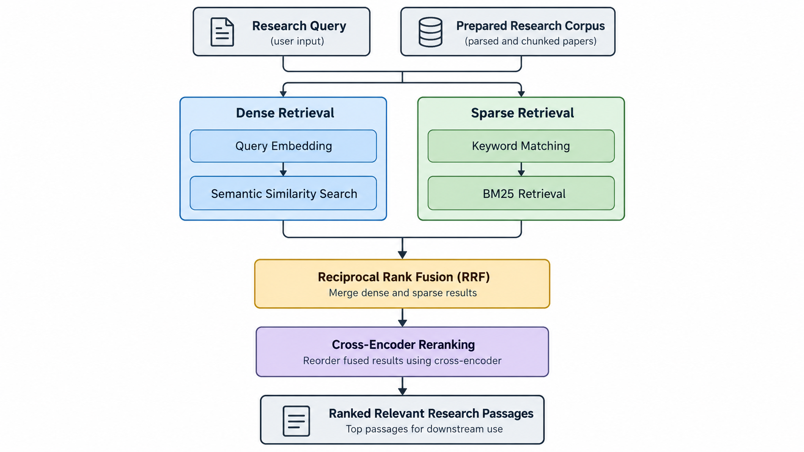
Retrieval
2. Hybrid Retrieval
Combines dense semantic retrieval with BM25 keyword retrieval.
Uses Reciprocal Rank Fusion (RRF) to combine rankings.
Applies Cross-Encoder reranking to prioritize relevant passages.

Slide 8
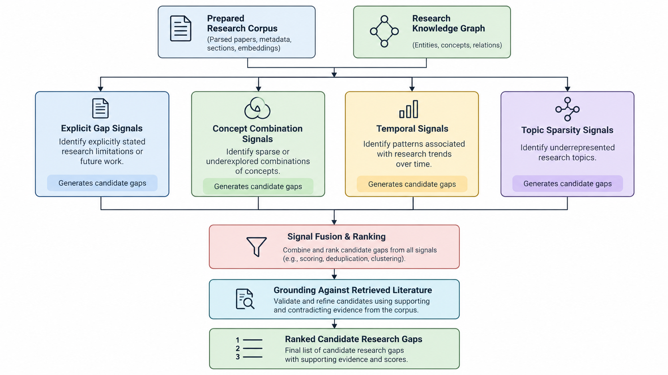
Gap Identification
3. Candidate Gap
Constructs a research knowledge graph from the prepared literature.
Identifies candidate gaps using explicit, concept-combination, temporal, and topic-sparsity signals.
Fuses and ranks candidates, grounding them in retrieved literature.

Slide 9
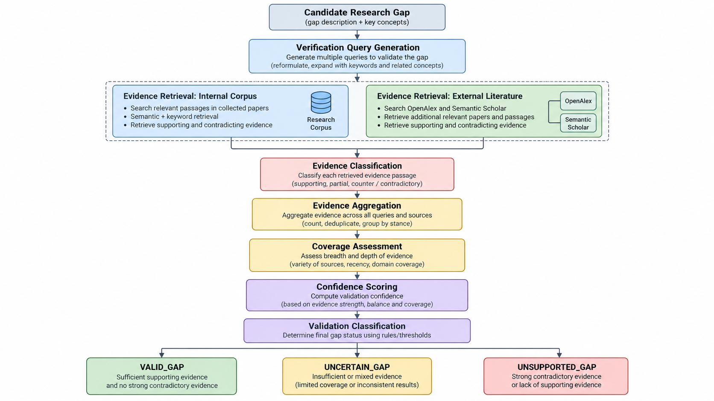
Validation
4. EWRGV
Searches for supporting and contradicting evidence in the internal corpus and external literature.
Aggregates evidence and assesses coverage and confidence.
Classifies candidates as VALID_GAP, UNCERTAIN_GAP, or UNSUPPORTED_GAP.

Slide 10
DataSet Description
Data Sources
  OpenAlex – Scholarly metadata and open-access information.
  Semantic Scholar – Research paper metadata and literature discovery.
Dataset Contents
  Research paper metadata: title, authors, publication year, DOI and source identifiers.
  Full-text PDFs and extracted paper sections, where available.
  Text chunks and embeddings for semantic retrieval.
  Knowledge graph entities, relationships and co-occurrences.
Data Preprocessing
  Duplicate paper identification and removal.
  Open-access discovery and full-text acquisition.
  PDF parsing, section extraction and text chunking.
  Embedding generation and knowledge graph construction.

Slide 11
Novelty
Section-Based Multi-Paper Analysis​
Retrieves and analyzes evidence from limitations and future scopes sections from multiple scientific papers. ​
Evidence-Based Gap Validation​
Evaluates whether the identified gap is genuinely unresolved using retrieved evidence. ​
Supporting & Counter-Evidence Analysis​
Considers evidence that supports the gap as well as evidence that may contradict it. ​
Evidence-Chain Explanation​
Links each identified gap with the papers and evidence used for its assessment.​

Slide 12
Evaluation Metrics
Evaluation Metric | EWRGV | Existing System — ResearchRAG
Precision@10 | 66.6% | 83.1%
Recall@10 | 15.1% | 70.9%
MRR | 83.37% | 77.4%
nDCG@10 | 58.1% | 74.8%

Slide 13
Future Work
1. Comprehensive Evaluation
Evaluate retrieval and gap validation using labeled benchmarks.
Compare with existing systems such as HySemRAG and ResearchRAG.
2. Improved Literature Coverage
Expand scholarly sources and full-text availability.
Improve extraction of Limitations and Future Work sections.
3. Enhanced Gap Reasoning
Strengthen multi-paper evidence analysis.
Improve supporting and counter-evidence assessment.
4. Pipeline Reliability
Automate stage orchestration and improve error recovery.
Strengthen persistent job tracking and end-to-end execution.
5. Scalability and Confidence Calibration
Optimize processing time and resource usage.
Calibrate confidence scores using expert-verified outcomes.

Slide 14
Thank You

