Slide 1
ADAPTIVE ECMP

Slide 2
Project Overview-Adaptive ECMP
This project enhances traditional Equal-Cost Multi-Path (ECMP) routing by introducing an adaptive mechanism that dynamically distributes traffic based on real-time network conditions such as congestion, latency, and bandwidth usage.
Goals:
Develop an Adaptive ECMP (A-ECMP) algorithm using live network metrics.
Achieve smarter traffic routing to avoid congested paths.
Improve network performance in dynamic traffic environments.
Expected Outcomes:
Better congestion control and load balancing
Higher bandwidth utilization
Reduced packet loss and latency
Scalable and responsive routing in real-time scenarios

Slide 3
Why This Project Is Important
Traditional ECMP is static – cannot react to real-time traffic changes, leading to congestion and poor path utilization.
Modern networks are dynamic – data centers, cloud services, and IoT demand smarter, adaptive routing.
Improves performance – reduces packet loss, latency, and enhances bandwidth utilization.
Enhances reliability – ensures better load balancing and network stability under varying traffic loads.
Future-ready – supports scalability and responsiveness for next-gen technologies like 5G, AI, and real-time applications.

Slide 4
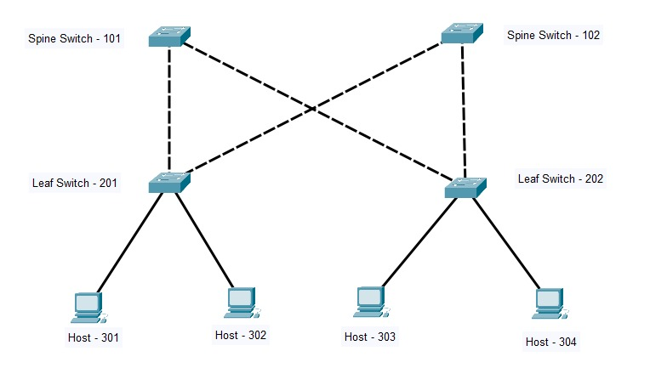
What is Spine–Leaf?
A two‑tier data‑center fabric where every leaf (access) switch uplinks to every spine (core) switch, providing:
East‑west optimisation (server‑to‑server traffic)
Predictable latency & bandwidth
Horizontal scalability

Slide 5
Is Traditional ECMP Still Enough in Modern Networks?
Uses static hashing: Next-hop = Hash(5-tuple) mod N
Hash collisions overload paths: Multiple large flows may be sent to the same link
Poor path utilization: Some links become congested while others remain idle
Repeats bad patterns: Static hashing can consistently choose suboptimal paths in high-throughput traffic
Performance suffers: Leads to buffer build-up, high RTT, and degraded application responsiveness
Lacks adaptability: Can't handle microbursts or dynamically shifting loads in real time

Slide 6
Adaptive ECMP: A Dynamic, Traffic-Aware Alternative
Traditional ECMP (Static Hashing)
Uses formula: Path = Hash(5-tuple) mod N
Always sends packets of the same flow through the same path
Causes congestion if the hashed path is overloaded
Leads to increased buffer delay and higher RTT
Advantages of Adaptive ECMP
Avoids congestion by steering clear of overloaded links
Reduces RTT by preventing buffer bloat
Maximizes bandwidth utilization by balancing traffic across all paths
Enhances reliability and performance in real-time

Slide 7
Why Adaptive ECMP?
Continuously monitors traffic on all equal-cost paths and adapts routing accordingly.
Dynamically steers traffic away from overloaded or high-latency routes.
Ensures better utilization of available bandwidth and reduces packet drops.
Delivers lower latency and higher reliability for critical services.
Questions to Ponder
Is your current routing approach truly adaptive?
Can your infrastructure afford persistent latency spikes?
How much more efficient could your network be with real-time decisions?

Slide 8
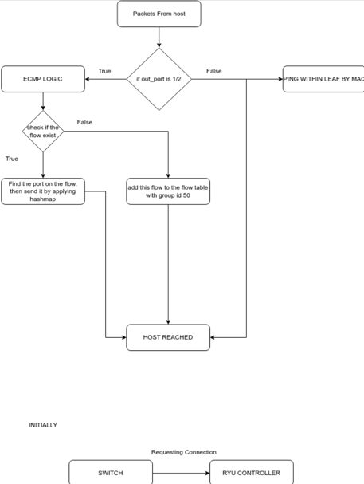
Work flow
This demonstrate how the packets flows from the host.
If the out port is 1 / 2, then the packets are flowing out to the other leaf
If not the packet are flowing within the leaf
If it is between inter leaf communication the ECMP logic is applied to the packets.
This logic then saved in the switch for every packet to follow this logic

