Slide 1
AMRITA VISHWA VIDYAPEETHAM
SCHOOL OF ARTIFICIAL INTELLIGENCE, COIMBATORE
Hardware-Aware Variational Quantum Circuits
for Portfolio Credit Risk
A complete Qiskit reproduction of the GCI credit-risk circuit on a noise-emulated device, with automated closed-loop calibration and error mitigation in place of the base paper's manual angle sweep
TEAM MEMBERS
TEAM NUMBER
CB.AI.U4AID24058
T Muthu Raam
16
CB.AI.U4AID24063
Prapul Chandra
CB.AI.U4AID24009
Lalith Sagar
23AID302 — Quantum Computing & Algorithms
CB.AI.U4AID24023
Ruthwik
Base paper: Ahmad et al., IEEE TQE 2026
Faculty in charge: Snigdhatanu Acharya • Amrita School of Artificial Intelligence, Coimbatore
Notes:
Opening: this project takes the hardware-aware quantum credit-risk circuit of Ahmad et al. (IEEE TQE 2026), rebuilds it stage by stage in Qiskit, runs it on a noise-emulated device, and replaces the paper's manual angle tuning with an automated calibration loop plus error mitigation.

Slide 2
Contents
From the credit-risk problem to a self-recalibrating quantum pipeline — base paper versus proposed work
01
Introduction & Motivation
06
Part 2 — This Project’s Proposed Work
11
Results & Analysis
02
Problem Statement
07
Proposed Methodology / Framework
12
Novelties & Contributions
03
Scope of Work
08
System Model & Formulation
13
Equation-Level Audit
04
Objectives
09
Implementation — Nine Stages
14
Comparison with the Base Paper
05
Part 1 — Base Paper: Approach & Flaws
10
Verification Status
15
Limitations & Conclusion
Team 16 • 23AID302 Quantum Computing & Algorithms • Final Review
2

Slide 3
Introduction & Motivation
Why banks need credit-risk numbers, why quantum computing promises them faster — and why noisy hardware gets in the way
The application
What this project examines
Banks hold capital against losses from borrowers who default; regulators require the 95 % Value at Risk (VaR).
Defaults are correlated — in a recession many borrowers fail together, so the default probability depends on the state of the economy.
The Gaussian Conditional-Independence (GCI / Vasicek) model captures this and underlies the Basel capital formula.
Classically it is evaluated with Monte Carlo, whose error falls only as 1/√N.
Part 1 — the base paper: a hardware-aware variational circuit that loads the GCI model, re-tuned by hand on a real superconducting chip.
Part 2 — the proposed work: the same circuit made reliable on a noisy device by an automated calibration loop and error mitigation.
Everything runs on a laptop in Qiskit — no physical quantum processor is required.
Why quantum — and why the trained circuit alone is not enough
Quantum Amplitude Estimation estimates the same risk quantities with error ∝ 1/N — a quadratic speed-up over Monte Carlo.
Its first ingredient is a circuit that loads the uncertainty model: the joint distribution of “state of the economy” and “borrower defaults”.
Today’s NISQ chips over- and under-rotate their pulses, misread qubits, add gate noise, and connect only neighbouring qubits.
A circuit trained on a perfect simulator therefore produces the wrong distribution on real hardware.
The base paper fixes this by hand, sweeping angles degree by degree — a procedure that does not scale and must be redone whenever the chip drifts.
Team 16 • 23AID302 Quantum Computing & Algorithms • Final Review
3
Notes:
Start with the business problem (VaR), then the quantum promise (QAE, quadratic speed-up), then the obstacle: NISQ noise makes a perfectly trained circuit output the wrong distribution. That obstacle is what the project solves.

Slide 4
Problem Statement
One sentence that fixes the model, the hardware, the method and the reference point
Design, implement and quantitatively validate a hardware-aware variational quantum circuit that loads the one-factor GCI credit-risk model on a noisy, limited-connectivity device — keeping its output distribution faithful to the noiseless model through automated in-situ calibration and error mitigation instead of a manual angle sweep — so that the loss distribution and the 95 % VaR derived from it match the classical baseline, benchmarked against the base paper’s own manual procedure.
Why Monte Carlo is slow
Why trained angles fail on hardware
Why manual retuning does not scale
Error falls as 1/√N: halving it needs four times as many samples.
Large portfolios with many correlated risk factors make it the bottleneck of capital calculations.
QAE promises 1/N — but only once the model is loaded correctly on the chip.
Pulse amplitude and phase errors over- or under-rotate every Ry gate.
Readout misreads 0 ↔ 1; two-qubit gates add depolarizing noise.
The base paper’s own trained angle had to move by more than 100° on its real chip.
The grid sweep tunes one or two angles at a time on a fixed degree grid.
Its cost grows exponentially with the number of angles, and θ₀ is never tuned.
Every drift of the chip means repeating the sweep by hand.
Team 16 • 23AID302 Quantum Computing & Algorithms • Final Review
4
Notes:
Read the statement, then the three columns explain each part of it: why Monte Carlo is slow, why trained angles fail on hardware, and why the paper's manual fix does not scale.

Slide 5
Scope of Work
What the study covers, what it deliberately excludes, and what was added beyond the reproduction
In scope
Out of scope
One asset and one latent risk factor; 2-qubit and 3-qubit latent-factor registers (3 and 4 qubits in total).
Full reproduction of the paper’s pipeline: Eqs. 1–17, training, SABRE transpilation, post-processing, VaR and Hellinger fidelity.
A noise-emulated device in Qiskit Aer with depolarizing, readout and coherent-drift errors.
Loss distribution, expected loss and 95 % VaR against classical discrete-grid and Monte Carlo baselines.
Execution on a physical quantum processor (no hardware access).
Pulse-level control electronics (Qblox / Quantify) used by the authors.
Full Quantum Amplitude Estimation — the paper also studies only the loading circuit.
Multi-asset, multi-factor portfolios, which the paper projects but does not run.
Added to scope beyond the reproduction
Automated closed-loop calibration — Bayesian optimisation → Bayesian optimisation → SPSA — replacing the manual grid sweep.
A mitigation-aware calibration objective J(x): the Hellinger distance measured on readout-corrected data.
Readout-error mitigation and zero-noise extrapolation, benchmarked over 20 repetitions × 20 000 shots.
A conditional-default check P(default | z) and an ACCEPT / RE-CALIBRATE loop, tested with a simulated drift event.
Team 16 • 23AID302 Quantum Computing & Algorithms • Final Review
5
Notes:
Be explicit that the study is simulation-based by design, and that full QAE is out of scope — the paper itself studies only the loading circuit.

Slide 6
Objectives
Seven measurable objectives, each with a concrete acceptance criterion
# | Objective | What it means in practice | Acceptance criterion
1 | Model the credit risk | Vasicek PD(z), discretised Gaussian latent factor, classical VaR (Eqs. 1, 10) | Discrete-grid and Monte Carlo agree: VaR $1000, P(L ≤ 0) ≈ 0.75
2 | Encode it in a circuit | sin²(αz + β) linearisation and register-indexed controlled rotations (Eqs. 2–5) | Encoding error below 0.01 over z ∈ [−3, 3]
3 | Train the loader | Ry + CNOT ansatz trained with parameter-shift gradients and Adam (Eqs. 6–13) | Shift-rule gradient = finite differences; 2-qubit loss < 10⁻⁶
4 | Fit the hardware | SABRE layout and routing to native rz, sx, x, cz on a linear coupling map | All gates native; every two-qubit gate on a coupled pair
5 | Emulate a noisy chip | Depolarizing + readout + hidden per-qubit drift; methods see only counts | Trained angles visibly fail on the device (F_H < 0.93)
6 | Calibrate automatically | 6B: BO → BO → SPSA on the Hellinger objective, against the paper’s 6A grid sweep | Higher F_H than 6A with fewer circuit executions
7 | Validate and close the loop | REM, ZNE, 20 × 20 000 shots, loss CDF, VaR, fidelity gate, drift test | F_H ≥ 0.97 → ACCEPT; automatic recovery after drift
Objectives 1–4 reproduce the base paper. Objectives 5–6 replace its manual hardware step with an automated one. Objective 7 validates the risk numbers and adds the closed loop the paper does not have.
Team 16 • 23AID302 Quantum Computing & Algorithms • Final Review
6
Notes:
Objectives 1-4 are the replication; 5-6 replace the paper's manual hardware step; 7 validates the risk numbers and adds the closed loop.

Slide 7
Part 1 — The Base Paper’s Approach
What Ahmad et al. did, and the four flaws this project identified in it
What they did
Flaws identified in their approach
Mapped the one-asset, one-factor GCI model onto 3 qubits: a 2-qubit Gaussian loader plus one asset qubit (Eqs. 1–5).
Trained the loader angles with parameter-shift gradients and Adam on a noiseless simulator (Eqs. 6–11).
Transpiled with Qiskit’s preset pass manager and SABRE, then hand-replaced a sub-circuit for their chip.
Ran on the Contralto-D superconducting processor (17 transmons) and re-tuned rotation angles by hand on a degree grid.
Reported Hellinger fidelity 98.9 ± 0.3 % against the simulated circuit, P(L ≤ 0) ≈ 0.75 and VaR = $1000.
1
Calibration is manual brute force
One or two angles at a time on a fixed degree grid; cost grows exponentially with the number of angles, and θ₀ is never tuned.
2
No error mitigation
Readout and depolarizing errors are identified but left uncorrected — stated as future work.
3
Calibration is one-off
Real chips drift; nothing detects when the tuned angles stop working, so the sweep must be redone by hand.
4
Not reproducible off-hardware
Results depend on one physical chip; the noise is never modelled, so the method cannot be re-run or stress-tested.
Each of the four flaws maps directly onto one of this project’s contributions — the next slide pairs them one to one, with the measured effect of each fix.
Team 16 • 23AID302 Quantum Computing & Algorithms • Final Review
7
Notes:
Summarise the paper fairly first (left), then the four flaws (right). Each flaw maps to one fix on the next slide.

Slide 8
Part 1 — The Flaws This Project Solved
Four flaws from the base paper’s side, four corrections, each with its measured effect
1
The manual sweep — replaced by an optimisation
Paper: 6A grid sweep — θ₁ swept 90° … 450° in 21° → 1° steps, one or two angles at a time, θ₀ fixed
Project: min_x J(x) = H( p_device(x), p_ref ) solved by BO → BO → SPSA over all n + 2 angles x = [θ₀ … θₙ₋₁, β̃, α̃]
Measured effect: Hellinger fidelity 0.939 → 0.982 (2-qubit register) and 0.957 → 0.994 (3-qubit register), with 204 instead of 347 / 477 circuit executions.
Error mitigation — added
2
Readout-error mitigation (assignment matrix + NNLS) and zero-noise extrapolation; calibration runs on readout-corrected data so the two never double-count. Deployed: 0.982 / 0.995; with ZNE 0.998 / 0.996.
Drift — detected and repaired
3
A fidelity gate (F_H ≥ 0.97) re-runs the automated calibration whenever the check fails. After a simulated drift event: 0.53 → 0.97 and 0.68 → 0.99, with no human involved.
Reproducibility — achieved
4
A noise-emulated device with the paper’s three error sources runs the whole hardware experiment on a laptop in about 75 seconds, with fixed seeds and identical results from notebooks and scripts.
Team 16 • 23AID302 Quantum Computing & Algorithms • Final Review
8
Notes:
Flaw 1 is the core: the manual sweep becomes an optimisation problem. Read the two lines in the dark box: the paper's procedure versus the project's objective.

Slide 9
Part 2 — This Project’s Proposed Work
The same circuit, made reliable on a noisy device — and judged against the paper’s own manual procedure
What it does
Rebuilds the base paper’s hardware-aware GCI circuit stage by stage, runs it on a noise-emulated device with the same three error sources, and replaces the paper’s manual angle sweep with an automated, mitigation-aware calibration loop — then validates the resulting risk numbers and closes the loop so the system repairs itself when the device drifts.
From the base paper’s side
On the noisy device
Beyond the base paper
Every printed equation (Eqs. 1–17) is implemented and checked.
The paper’s own grid sweep is reproduced with its exact ranges and steps, as the 6A baseline.
Its hardware angle shift is reproduced: θ₁ moves from 195° to ≈ 234° (paper: 224°–237°).
Calibration becomes an optimisation: minimise J(x) from measured counts only.
Bayesian optimisation places the angles globally in few runs; SPSA refines all of them together.
Readout mitigation and ZNE remove the errors that retuning cannot.
Statistics: 20 repetitions × 20 000 shots, mean and spread for every variant.
Model-level check: P(default | z) recovered from the counts against the Vasicek curve.
A closed ACCEPT / RE-CALIBRATE loop, tested with a drift event.
In one line: the same equations and the same circuit as the paper — a different, automated way of making it work on a noisy chip, and a check that it keeps working.
Team 16 • 23AID302 Quantum Computing & Algorithms • Final Review
9
Notes:
The proposed work keeps everything the paper got right (left column), changes how the noisy device is handled (middle), and adds validation the paper does not have (right).

Slide 10
Proposed Methodology / Framework
Replication pipeline on top, automated calibration loop in the middle, risk validation and the closed loop below
PD(z), p*
α̃, β̃
θ*
circuit
Classical GCI model
(Eqs. 1, 10)
→
Quantum encoding
(Eqs. 2–4)
→
Loader training
(Eqs. 5–13)
→
SABRE
transpilation
→
Noise-emulated
device
measured histogram → readout mitigation → J(x) = Hellinger distance to the noiseless reference → new commanded angles x
Automated calibration loop (6B) — replaces the paper’s manual grid sweep (6A)
Step 1 — BO
Step 2 — BO
Step 3 — SPSA
Step 4 — Verify
Calibrated
angles x*
Execution
20 × 20 000 shots
loader angles · 40 runs
asset angles · 30 runs
all angles · 60 iterations
keep the better candidate
Readout mitigation
(+ optional ZNE)
→
Post-processing
bits → loss CDF
→
VaR & four
Hellinger fidelities
→
F_H ≥ 0.97 ?
→
ACCEPT / RE-CALIBRATE
→ back to Step 1
How the noisy device is built
How a result is accepted
Qiskit AerSimulator; depolarizing 0.2 % on sx, x and 1.5 % on cz.
Per-qubit readout errors of 2–7 %, larger for 1 → 0 than 0 → 1.
Hidden drift θ_real = (1 + ε)θ + δ per physical qubit — never read by any method.
Deployed pipeline: 6B angles + readout mitigation; ZNE is an optional variant.
Bitstrings become a loss CDF; VaR and four Hellinger fidelities are computed.
F_H ≥ 0.97 → ACCEPT; otherwise 6B re-runs from the current angles.
Team 16 • 23AID302 Quantum Computing & Algorithms • Final Review
10
Notes:
Walk the top row left to right (the replication), then the calibration loop (the novelty), then the bottom row (execution, risk numbers, fidelity gate). The RE-CALIBRATE branch sends the current angles back to Step 1.

Slide 11
System Model & Formulation
The exact equations implemented — credit model, variational loader, noisy device, calibration and risk
Credit-risk model and encoding (paper Eqs. 1–4, 10)
PD(z) = Φ( (Φ⁻¹(p₀) − √ρ·z) / √(1 − ρ) ) p₀ = 0.25, ρ = 0.027, z ~ N(0, 1) z(b) = −3 + 6b / (2ⁿ − 1), p*_b ∝ exp(−z(b)² / 2)
PD(z) ≈ sin²(αz + β) → Ry(2(αz + β)) → Ry(2(α̃·b + β̃)), α̃ = α·Δz, β̃ = β − α·z_max b = Σ 2ᵏ q_k ⇒ one Ry(2β̃) + one CRy(2α̃·2ᵏ) per z-qubit
Variational loader and training (paper Eqs. 5, 6, 8–13)
N_qubits = N_assets + Σ n_k = n + 1 |ψ(θ)⟩ = Σ_b √p_b(θ) |b⟩ p_b(θ) = |⟨b|ψ(θ)⟩|² Ry(θ) on every qubit + CNOT(0 → i)
L(θ) = Σ_b (p_b(θ) − p*_b)² ∂p_b/∂θᵢ = [ p_b(θᵢ + π/2) − p_b(θᵢ − π/2) ] / 2 Adam: θ ← θ − η · m̂ / (√v̂ + ε)
Noise-emulated device and calibration objective (this project)
Depolarizing ρ → (1 − p)ρ + p·I/d readout A_is = P(read i | prepared s) drift θ_real = (1 + ε_q)·θ + δ_q (hidden from every method)
J(x) = H( p_dev(x), p_ref ) = √( 1 − Σᵢ √(pᵢ qᵢ) ) F_H = (1 − H²)² commanded angles x = [θ₀ … θₙ₋₁, β̃, α̃]
Calibration, mitigation and risk (this project + paper Sec. IV-C)
SPSA ĝ = [ J(x + cΔ) − J(x − cΔ) ] / (2c) · Δ BO EI = (J* − μ)·Φ(z) + σ·φ(z) REM min_{p ≥ 0} ‖A·p − m‖ ZNE p(λ) = a + bλ, λ = 1, 3, 5 → p(0) = a
Loss = d · LGD, F(L) = Σ_{L′ ≤ L} P(L′), VaR₀.₉₅ = min{ L : F(L) ≥ 0.95 } P(default | z_b) = p(1, b) / P(z_b) F_H ≥ 0.97 → ACCEPT
Team 16 • 23AID302 Quantum Computing & Algorithms • Final Review
11
Notes:
Cards A and B are the paper's equations (replication). Cards C and D are this project's additions: the device model, the calibration objective, the optimisers, mitigation and the acceptance rule.

Slide 12
Implementation — Nine Stages
Every stage is a narrated notebook backed by tested modules, and each reads the previous stage’s saved output
Stage 1
Classical GCI model
Stage 2
Quantum encoding
Stage 3
Circuit design
Vasicek PD(z), z-grid, discrete-grid and Monte Carlo VaR
sin² fit of PD(z), register-adapted α̃ and β̃
Ry + CNOT star loader, controlled-Ry asset qubit
Stage 4
Classical training
Stage 5
Transpilation
Stage 6
Hardware retuning
Parameter-shift gradients, Adam, topology comparison
SABRE to rz, sx, x, cz on a linear coupling map
Noisy device; 6A grid sweep vs 6B automated calibration
Stage 7
Execution
Stage 8
Post-processing
Stage 9
VaR & fidelity check
20 × 20 000 shots, readout mitigation, ZNE
Bitstrings → loss PDF → CDF, P(default | z)
Four fidelities, ACCEPT / RE-CALIBRATE, drift test
Software stack and deliverables
Platform
Python 3 + Qiskit 2.x
Simulator
Qiskit Aer 0.17 with noise model
Numerics
NumPy, SciPy (NNLS)
Optimisers
Adam, SPSA, GP-EI BO — written from scratch
Code
16 modules in src/, 10 stage notebooks
Runners
run_pipeline.py, main.ipynb, 9 scripts
Hardware needed
Laptop CPU — ≈ 75 s end to end
Not required
QPU access, GPU, IBM account
Team 16 • 23AID302 Quantum Computing & Algorithms • Final Review
12
Notes:
Stages 1-5 replicate the paper. Stage 6 is the core novelty. Stages 7-9 execute, post-process and close the loop. One command — python run_pipeline.py — runs all of them.

Slide 13
Implementation — Replication Pipeline
The finance model, encoding, circuit, training and transpilation every later stage is built on
STAGES 1–5
What was implemented
How it was verified
Vasicek PD(z) with p₀ = 0.25, ρ = 0.027 — the paper’s hardware use case.
4-bin and 8-bin Gaussian targets on z ∈ [−3, 3] (Eq. 10).
Encoding fit α = −3.47°, β = 30.03°; register-adapted β̃ = 40.42°, α̃ = −6.93° (2q) / −2.97° (3q).
Star loader (paper Figs. 1–3) trained with parameter shift + Adam: 150 iterations, η = 0.15.
SABRE transpilation: depth 6 → 33 (2q) and 8 → 56 (3q); CZ gates 5 → 8 and 8 → 14.
Discrete grid vs 2 × 10⁶-draw Monte Carlo: P(L ≤ 0) = 0.750 both, E[L] ≈ $250, VaR $1000.
sin² encoding vs Vasicek PD(z): max error 0.0065, mean 0.0025.
Parameter-shift gradient vs finite differences: max error 3.7 × 10⁻¹¹.
2-qubit loader reproduces its target: loss 2 × 10⁻⁸ at θ* = 90°, 195.4°.
Transpiled circuit reproduces the ideal distribution on a noiseless simulator (F_H = 0.99999).
An honest finding carried forward
The paper’s three-parameter star ansatz cannot represent the 8-bin Gaussian exactly: even noiselessly it reaches Hellinger fidelity ≈ 0.78 against the ideal target (loss 0.049). A chain entangler, tried as a comparison, reaches loss 0.0018. The star is kept for a faithful replication, and the ceiling is reported rather than hidden.
Team 16 • 23AID302 Quantum Computing & Algorithms • Final Review
13
Notes:
Point out that every replication step is verified numerically, and mention the honest finding about the 3-qubit star ansatz before anyone asks.

Slide 14
Implementation — Noisy Device & Automated Calibration
Contribution 1: turning the paper’s manual hardware step into a closed-loop optimisation
STAGE 6
The noise-emulated device
The calibration — 6A vs 6B
Depolarizing 0.2 % on sx, x and 1.5 % on cz; rz is virtual and error-free, as on the paper’s chip.
Readout errors of 2–7 % per physical qubit, larger for 1 → 0 than 0 → 1.
Drift θ_real = (1 + ε)θ + δ per physical qubit, up to ±14 % and ±15°.
Calibration sees only readout-corrected histograms — never ε or δ.
Effect: the trained angles drop to F_H = 0.88 (2q) and 0.92 (3q).
6A (paper): θ₁ 21° → 1°; θ₁, θ₂ 36° → 7.5° / 14.5°; asset angles on a 2-D grid.
6B Step 1: Bayesian optimisation of the loader angles, same physical qubits (40 runs).
6B Step 2: Bayesian optimisation of the two asset angles, loader frozen (30 runs).
6B Step 3: SPSA on all angles together — 60 iterations, 2 runs each.
6B Step 4: re-measure both candidates with 4 × shots and keep the better one.
Why BO → BO → SPSA
Bayesian optimisation learns a model of J and needs few runs, but alone it plateaus in five dimensions (F_H 0.964). SPSA needs only two runs per step for any number of angles, but alone it converges slowly from a poor start (0.947). Placing the angles globally with BO, then refining them locally with SPSA, reaches 0.994 — and calibrating loader angles before asset angles mirrors the paper’s own workflow.
Team 16 • 23AID302 Quantum Computing & Algorithms • Final Review
14
Notes:
Left: what the device does to the circuit. Right: the two calibration methods side by side. Bottom: why the hierarchical BO-BO-SPSA design, backed by the ablation numbers.

Slide 15
Implementation — Execution, Mitigation & Acceptance
Contributions 2–4: mitigation the paper left as future work, a model-level check, and the closed loop
STAGES 7–9
Execution and mitigation (Stage 7)
Risk numbers and acceptance (Stages 8–9)
Six variants, each run 20 times × 20 000 shots with independent seeds.
Readout mitigation: assignment matrix A from every prepared basis state, inverted by non-negative least squares.
ZNE: global folding U(U†U)ᵏ at λ = 1, 3, 5 on the transpiled circuit, linear extrapolation to λ = 0.
Folded circuits verified to compute the same operation (noiseless F_H ≥ 0.99997).
Bitstrings split exactly as in the paper: left bit = default, right n bits = economy bin.
Loss PDF → CDF, expected loss, VaR₀.₉₅ and CVaR for every variant and repetition.
P(default | z_b) recovered from the counts and compared with the Vasicek curve.
Four fidelities; the deployed pipeline is accepted if F_H ≥ 0.97, otherwise 6B re-runs.
Reporting discipline
Every number is a mean over 20 repetitions with its standard deviation. Three references — the noiseless circuit, the classical discrete grid and continuous Monte Carlo — are computed on the same grid, so hardware error and modelling error are reported separately rather than mixed together.
Team 16 • 23AID302 Quantum Computing & Algorithms • Final Review
15
Notes:
Stage 7 produces statistically solid distributions; Stage 8 turns them into money exactly as the paper does; Stage 9 decides ACCEPT or RE-CALIBRATE.

Slide 16
Verification Status
Every stage was checked independently before its output was used by the next
10 / 10
0
≈ 75 s
Identical
stage notebooks executed
errors in the full run
end to end on a laptop CPU
notebook vs script results
Verification check | Result
Parameter-shift gradient vs finite differences | max error 3.7 × 10⁻¹¹
sin² encoding vs Vasicek PD(z) over z ∈ [−3, 3] | max error 6.5 × 10⁻³
Discrete grid vs Monte Carlo (2 × 10⁶ draws) | P(L ≤ 0) 0.750 vs 0.750; VaR $1000 both
Noiseless sampled circuit vs exact statevector | F_H = 0.99999
ZNE-folded circuit (λ = 3) vs original, noiseless | F_H ≥ 0.99997
Notebook run vs headless script run | identical fidelities (0.9819 / 0.9946)
Cross-check against the base paper’s hardware result
The paper-style 6A sweep moves the 2-qubit loader angle θ₁ from 195° to ≈ 234°; the paper measured 237° (qubits D3–C4) and 224° (D3–A6) on its real chip. The emulated miscalibration was not fitted to the paper — the agreement shows its size is realistic.
Team 16 • 23AID302 Quantum Computing & Algorithms • Final Review
16
Notes:
The four numbers on top are about the pipeline as a whole; the table lists the individual numerical checks; the bottom box is the cross-check against the paper's hardware result.

Slide 17
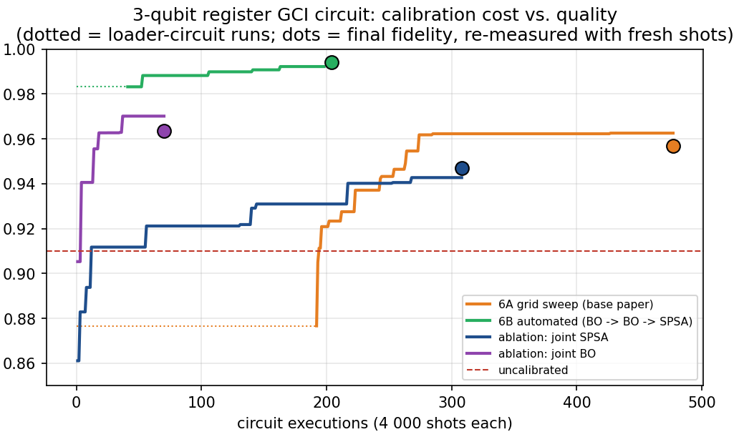
Results 1 — Calibration: Grid Sweep vs Automated Loop
Full GCI circuit on the noisy device — Hellinger fidelity against the noiseless reference, and the circuit runs spent to reach it
Register | Method | Circuit runs | F_H
2-qubit | Uncalibrated (Stage-4 angles) | 0 | 0.923
2-qubit | 6A grid sweep (base paper) | 347 | 0.939
2-qubit | 6B automated (proposed) | 204 | 0.982
3-qubit | Uncalibrated (Stage-4 angles) | 0 | 0.910
3-qubit | 6A grid sweep (base paper) | 477 | 0.957
3-qubit | 6B automated (proposed) | 204 | 0.994
Analysis
The automated loop reaches the higher fidelity for both registers while spending fewer circuit executions: 0.982 vs 0.939 (2-qubit) and 0.994 vs 0.957 (3-qubit), at 204 runs instead of 347 and 477.
3-qubit register: best fidelity found vs circuit executions
Inference — how to read this table
The grid sweep plateaus because θ₀ is never tuned: drift on the first qubit cannot be corrected however fine the grid is.
The ablations explain the 6B design — joint SPSA alone reaches 0.947 and joint BO alone 0.964 (purple, blue); hierarchically combined, 0.994.
The cost gap widens with the number of angles: grid points grow exponentially, while SPSA needs two runs per step for any dimension.
Dotted segments are runs spent on the stand-alone loader circuit; the dots are final fidelities re-measured with fresh shots.
Team 16 • 23AID302 Quantum Computing & Algorithms • Final Review
17
Notes:
This is the key novelty result: the automated loop is both more accurate and cheaper than the paper's grid sweep, for both register sizes. The figure shows the 3-qubit register: green (6B) climbs fastest and highest; orange (6A) plateaus.

Slide 18
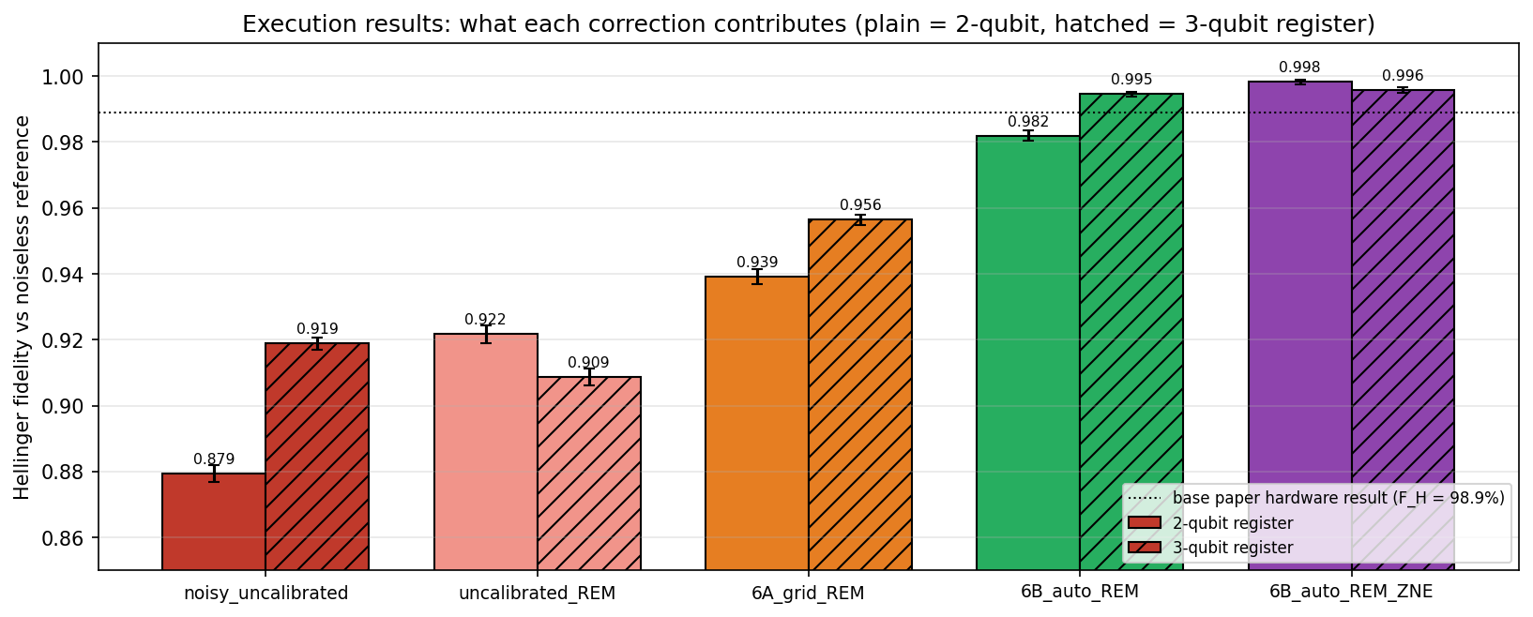
Results 2 — Execution & Error Mitigation
20 repetitions × 20 000 shots per variant — Hellinger fidelity against the noiseless reference, mean ± standard deviation
Variant | 2-qubit | 3-qubit
Uncalibrated, raw counts | 0.879 ± 0.003 | 0.919 ± 0.002
Uncalibrated + readout mitigation | 0.922 ± 0.003 | 0.909 ± 0.003
6A grid sweep + readout mitigation | 0.939 ± 0.002 | 0.956 ± 0.002
6B automated + readout mitigation | 0.982 ± 0.002 | 0.995 ± 0.001
6B + readout mitigation + ZNE | 0.998 ± 0.001 | 0.996 ± 0.001
Base paper — real chip, hand-tuned | 0.989 ± 0.003 | not run
Analysis
Fidelity by variant (plain 2-qubit, hatched 3-qubit)
Readout mitigation alone does not rescue the uncalibrated circuit — for the 3-qubit register it even lowers the fidelity, because drift and readout bias partly cancelled. Retuning moves the result; readout mitigation then removes what remains.
0.982 / 0.995
deployed pipeline (6B + readout mitigation) — the range of the paper’s 98.9 % hardware result
Inference — how to read this table
Each correction fixes a different error: retuning the coherent drift, readout mitigation the bit-flips, ZNE part of the remaining gate noise.
The deployed pipeline reaches 0.982 / 0.995 — the same range as the paper’s 98.9 % hardware result, here on an emulated device.
ZNE adds +0.016 (2-qubit) and +0.001 (3-qubit) but multiplies gate time by up to 9, so it is reported as an optional variant.
Error bars of ± 0.001–0.003 over 20 repetitions make every gap between the variants statistically clear.
Team 16 • 23AID302 Quantum Computing & Algorithms • Final Review
18
Notes:
Each correction fixes a different error. Point out that readout mitigation alone does not fix an uncalibrated circuit, and that the deployed pipeline lands in the range of the paper's hardware result.

Slide 19
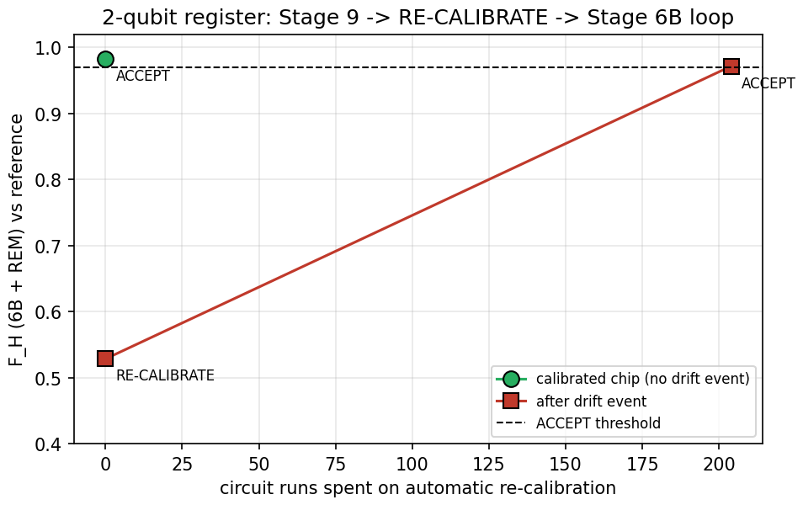
Results 3 — Risk Figures & Closed-Loop Recovery
The loss distribution the bank actually uses, and what happens when the device drifts after calibration
Variant | P(L ≤ 0) 2q / 3q | E[L] ($) 2q / 3q | VaR₀.₉₅
Noiseless circuit | 0.748 / 0.746 | 252.5 / 254.4 | $1000
Uncalibrated, raw | 0.826 / 0.809 | 174.1 / 190.7 | $1000
6A grid + mitigation | 0.755 / 0.738 | 244.7 / 262.5 | $1000
6B automated + mitigation | 0.727 / 0.739 | 272.9 / 261.3 | $1000
Classical discrete grid | 0.750 / 0.750 | 250.4 / 250.0 | $1000
Base paper (hardware) | ≈ 0.75 | — | $1000
Analysis
Every variant reports VaR₀.₉₅ = $1000, as in the paper: with one asset P(L = 0) ≈ 0.75 < 0.95, so VaR cannot separate a good circuit from a bad one. Expected loss can — uncalibrated, the default probability is underestimated by a quarter to a third.
2-qubit register: drift event and automatic re-calibration
Inference — how to read this table
After calibration the expected loss returns to within about ±10 % of the $250 classical value, and P(default | z) follows the Vasicek curve again.
Drift event (figure): yesterday’s angles fall to F_H = 0.53 / 0.68 → RE-CALIBRATE → 6B re-runs itself in 204 runs → 0.97 / 0.99 → ACCEPT.
A manual re-sweep would cost 347 / 477 runs and a person in the loop.
Honest caveat: for the 2-qubit register 6A lands closer on expected loss than 6B despite lower fidelity — the objective is distribution-level.
Team 16 • 23AID302 Quantum Computing & Algorithms • Final Review
19
Notes:
VaR is $1000 for every variant, exactly as in the paper — explain why that makes VaR a weak test here, and why expected loss and fidelity are the real evidence. Then the drift event in the figure: 0.53, RE-CALIBRATE, 0.97, ACCEPT.

Slide 20
Novelties & Contributions
Six contributions beyond the reproduction, each with its measured effect
Automated in-situ calibration (6B)
Mitigation-aware objective
1
BO → BO → SPSA replaces the manual grid sweep: F_H 0.982 / 0.994 with 204 runs, against 0.939 / 0.957 with 347 / 477.
2
J(x) = Hellinger distance on readout-corrected data, so retuning and readout mitigation never correct the same error twice.
Noise-emulated device
Error-mitigation benchmark
3
The paper’s three error sources — depolarizing, readout, coherent drift — on a laptop, with the drift hidden from every method.
4
Readout mitigation and ZNE quantified on top of retuning over 20 × 20 000 shots: what each one buys and what it costs.
Model-level validation
Closed ACCEPT / RE-CALIBRATE loop
5
P(default | z) recovered from the counts, plus four fidelities that separate hardware error from modelling error.
6
Drift is detected and repaired automatically: 0.53 → 0.97 and 0.68 → 0.99 after a simulated drift event.
Two supporting findings
The paper-style sweep reproduces the base paper’s hardware angle shift (θ₁ 195° → 234°; paper 224°–237°). The paper’s three-parameter star ansatz has an expressivity ceiling on the 3-qubit register (F_H ≈ 0.78 against the ideal Gaussian), which a chain entangler lifts (loss 0.049 → 0.0018).
Team 16 • 23AID302 Quantum Computing & Algorithms • Final Review
20
Notes:
These are the 'our addition' blocks of the architecture diagram. Contribution 1 is the headline; 2-6 make it trustworthy and repeatable.

Slide 21
Equation-Level Audit — Implemented Unchanged
Sixteen entries of the base paper are implemented exactly as printed
Eq. 1
Vasicek conditional default probability PD(z)
Eq. 11
MSE training loss L(θ)
Eq. 2
PD(z) ≡ P₁ = sin²(αz + β)
Eq. 12
Ry rotation matrix
Eq. 3
Rotation Ry(2(αz + β))
Eq. 13
CNOT amplitude swap (bell shape)
Eq. 4
Register-indexed rotation Ry(2(α̃·b + β̃))
Eqs. 14–17
Symmetry conditions → 6A sweep ranges
Eq. 5
Qubit count N = N_assets + Σ n_k
Shift rule
Exact parameter-shift gradient (unnumbered)
Eq. 6
Loader state Σ_b √p_b |b⟩
Adam
Optimiser update (unnumbered, ref. 28)
Eqs. 8–9
Born probabilities p_b(θ) = |⟨b|ψ(θ)⟩|²
Sec. IV-C
Bitstring → loss PDF → CDF post-processing
Eq. 10
Target Gaussian on the z-grid
VaR
VaR₀.₉₅ = min{ L : F(L) ≥ 0.95 }
Of the audited entries: 16 implemented unchanged (this slide), 4 modified with a documented reason, and 6 new equation groups added by this project. The modified and added equations follow on the next two slides, each with its measured effect.
Team 16 • 23AID302 Quantum Computing & Algorithms • Final Review
21
Notes:
Everything on this slide is replication: these equations are in the code exactly as the paper prints them.

Slide 22
Equation-Level Audit — Modified
Four places where this project departs from the paper’s procedure — what changed, and what it buys
Eq. / step | Base paper | This project | Effect
Supp. Eqs. 5–6 (α, β) | Slope and offset of the linearised PD(z) computed analytically | Least-squares fit of arcsin √PD(z) against z over 200 points | Max error 0.0065 vs Vasicek — the same encoding, simpler to reproduce
Transpilation (Sec. IV-C, Fig. 9) | Preset pass manager with approximate synthesis; a SABRE sub-circuit hand-replaced; −135° counter-phase Z gate | SABRE layout + routing, level 1, exact synthesis; asset angles kept as tunable parameters | No hand-crafted substitution needed — retuning absorbs what the substitution fixed
Angle retuning (Sec. IV) | Manual grid sweep, one or two angles at a time, θ₀ fixed | min_x J(x) = H(p_dev(x), p_ref) by BO → BO → SPSA over all n + 2 angles | F_H 0.939 → 0.982 (2q), 0.957 → 0.994 (3q); 204 vs 347 / 477 runs
Hellinger fidelity (ref. 37) | Reporting metric only: device output vs simulated circuit | Also the calibration objective, measured on readout-corrected data | One metric both drives and judges the calibration; no double correction
Rows 1–2 change how a quantity is computed, not what it means. Rows 3–4 are the core methodological change of this project: the paper’s manual, visual tuning becomes the minimisation of a measured objective.
Team 16 • 23AID302 Quantum Computing & Algorithms • Final Review
22
Notes:
Row 3 is the core modification: the manual sweep becomes the minimisation of J(x). Row 4 shows that the paper's reporting metric becomes the quantity the calibration optimises.

Slide 23
Equation-Level Audit — Added by This Project
Six new equation groups, each mapped to an ‘OUR ADDITION’ block of the architecture
Addition | Equation | Why it was added | Measured effect
Noisy device | ρ → (1 − p)ρ + p·I/d; per-qubit readout matrix; θ_real = (1 + ε_q)·θ + δ_q | Runs the paper’s hardware experiment on a laptop with its three error sources | Trained angles fall to F_H 0.88 / 0.92
Calibration optimisers | SPSA ĝ = [J(x + cΔ) − J(x − cΔ)]/(2c)·Δ; GP posterior μ, σ; EI = (J* − μ)Φ(z) + σφ(z) | Tune every angle from counts only, with few circuit runs | 0.982 / 0.994 in 204 runs
Readout mitigation | A_is = P(read i | prepared s); p̂ = argmin_{p ≥ 0} ‖A·p − m‖ | Undo measurement bit-flips — none applied in the paper | Deployed 0.982 / 0.995
Zero-noise extrapolation | U → U(U†U)ᵏ, λ = 2k + 1; p(λ) = a + bλ → p(0) = a | Remove part of the remaining gate noise — only discussed in the paper | +0.016 / +0.001 at up to 9 × gate time
Conditional-default check | P(default | z_b) = p(1, b) / P(z_b) | Test the financial model itself, not only a histogram | Calibrated curve follows Vasicek again
Acceptance gate | F_H ≥ 0.97 → ACCEPT; otherwise re-run 6B from the current angles | Detect drift and repair it without a human | 0.53 → 0.97 and 0.68 → 0.99
Together with the modified retuning step, these six groups are the complete set of equation-level contributions — every one is implemented in src/ and produces a reported number.
Team 16 • 23AID302 Quantum Computing & Algorithms • Final Review
23
Notes:
None of these are in the base paper. Each row gives the equation, why it was added, and the number it produced.

Slide 24
Overall Comparison with the Base Paper
Every metric and capability side by side — reproduced, replaced and newly added
Metric / capability | Base paper (Ahmad et al., 2026) | This project | Status
Platform | Contralto-D superconducting chip, 17 transmons | Qiskit Aer with emulated noise, laptop CPU | Different test bench
Hellinger fidelity, GCI circuit (2q register) | 98.9 ± 0.3 % — hand-tuned, no mitigation | 98.2 ± 0.2 % (6B + REM); 99.8 % with ZNE | Comparable
Loss CDF | P(L ≤ 0) ≈ 0.75, P(L ≤ 1000) = 1 | 0.748 noiseless, 0.727 calibrated; P(L ≤ 1000) = 1 | Reproduced
95 % VaR | $1000 | $1000 in every repetition | Reproduced
Hardware-optimal loader angle θ₁ | 224° – 237° on two qubit pairs | ≈ 234° from the 6A sweep | Reproduced
Angle retuning | Manual grid sweep | Automated BO → BO → SPSA, 204 runs | Replaced
3-qubit-register GCI circuit (4 qubits) | Not run | F_H 0.995 (6B + REM) | Newly added
Error mitigation | None — future work | Readout mitigation and ZNE, benchmarked | Newly implemented
Drift after calibration | Not addressed | Fidelity gate + automatic recalibration | Newly added
Reproducibility | One physical chip | Full pipeline in ≈ 75 s, fixed seeds | Extended
Reading the fidelity row: the paper’s 98.9 % is measured on real hardware, this project’s on an emulated device — the numbers are comparable in size, not a like-for-like hardware comparison.
Team 16 • 23AID302 Quantum Computing & Algorithms • Final Review
24
Notes:
Stress the note at the bottom: the paper's 98.9 % is real hardware and ours is an emulated device, so the numbers are comparable in size but not a like-for-like hardware comparison.

Slide 25
Limitations & Future Work
Reported plainly alongside the contributions, not buried
Simulation-only validation
1
No physical quantum processor; the device is an emulation with three error sources. Crosstalk, leakage and time-varying noise are not modelled.
A toy portfolio
2
One asset and one risk factor: VaR is $1000 for any reasonable distribution, so the fidelity carries the real information.
Loader expressivity
3
The paper’s star ansatz caps the 3-qubit register at F_H ≈ 0.78 against the ideal Gaussian; it is kept for faithfulness to the paper.
Distribution-level objective
4
Calibration optimises Hellinger fidelity, not expected loss — for the 2-qubit register 6A lands closer on expected loss despite lower fidelity.
Future work
Real IBM Quantum hardware — the loop needs only counts.
Quantum Amplitude Estimation on the calibrated loader.
2-asset / 2-factor portfolio (6–7 qubits) for a non-trivial VaR.
Task-aware objective that also weights the loss distribution.
A richer loader ansatz to lift the 3-qubit ceiling.
A learned noise model (digital twin) from calibration data.
Team 16 • 23AID302 Quantum Computing & Algorithms • Final Review
25
Notes:
State each limitation in one sentence and move to future work. The first future-work item is the natural next step: the calibration loop only needs counts, so it can run unchanged on real IBM hardware.

Slide 26
Conclusion — Beyond the Base Paper
Six respects in which the implementation goes past the published work
Replaces manual calibration with an algorithm
Adds the mitigation the paper left as future work
1
0.982 / 0.994 against 0.939 / 0.957, at 204 instead of 347 / 477 circuit runs.
2
Readout mitigation and ZNE, each with its measured gain and cost.
Closes the loop
Validates the financial model itself
3
Drift is detected and repaired with no human involved: 0.53 → 0.97, 0.68 → 0.99.
4
P(default | z) against the Vasicek curve — not only a histogram.
Runs anywhere
Reports its own weak points
5
The whole hardware experiment reproduced on a laptop in about 75 seconds.
6
Expressivity ceiling, VaR’s weakness as a test, and the expected-loss subtlety are stated, not hidden.
This project reproduces the base paper’s hardware-aware variational circuit for the GCI credit-risk model end to end, runs it on a noise-emulated device with the paper’s three error sources, and replaces its manual angle sweep with an automated, mitigation-aware calibration loop that reaches higher fidelity with fewer circuit executions — validated on the loss distribution and the 95 % VaR, and closed so that the system recalibrates itself when the device drifts.
Team 16 • 23AID302 Quantum Computing & Algorithms • Final Review
26
Notes:
Close with the summary paragraph — it is the one-sentence answer to 'what did you do?'.

Slide 27
References
IEEE format — base paper first, then the works the implementation relies on
[1] H. G. Ahmad et al., “Quantum circuit-based adaptation for credit risk analysis,” IEEE Trans. Quantum Eng., vol. 7, Art. no. 3103316, 2026, doi: 10.1109/TQE.2026.3691176.
[2] O. A. Vasicek, “The distribution of loan portfolio value,” Risk, vol. 15, no. 12, pp. 160–162, Dec. 2002.
[3] D. J. Egger, R. García Gutiérrez, J. C. Mestre and S. Woerner, “Credit risk analysis using quantum computers,” IEEE Trans. Comput., vol. 70, no. 12, pp. 2136–2145, Dec. 2021.
[4] A. Montanaro, “Quantum speedup of Monte Carlo methods,” Proc. R. Soc. A, vol. 471, no. 2181, Art. no. 20150301, Sep. 2015.
[5] S. Niu, A. Suau, G. Staffelbach and A. Todri-Sanial, “A hardware-aware heuristic for the qubit mapping problem in the NISQ era,” IEEE Trans. Quantum Eng., vol. 1, Art. no. 3101614, 2020.
[6] D. P. Kingma and J. Ba, “Adam: A method for stochastic optimization,” arXiv:1412.6980, 2014.
[7] J. C. Spall, “Multivariate stochastic approximation using a simultaneous perturbation gradient approximation,” IEEE Trans. Autom. Control, vol. 37, no. 3, pp. 332–341, Mar. 1992.
[8] D. R. Jones, M. Schonlau and W. J. Welch, “Efficient global optimization of expensive black-box functions,” J. Global Optim., vol. 13, no. 4, pp. 455–492, 1998.
[9] Z. Cai et al., “Quantum error mitigation,” Rev. Mod. Phys., vol. 95, no. 4, Art. no. 045005, Dec. 2023.
[10] E. Hellinger, “Neue Begründung der Theorie quadratischer Formen von unendlichvielen Veränderlichen,” J. Reine Angew. Math., vol. 1909, no. 136, pp. 210–271, 1909.
Team 16 • 23AID302 Quantum Computing & Algorithms • Final Review
27

