Slide 1
Urban Air Quality
Prediction Using IoT Sensor Data
BIG DATA + IOT + MACHINE LEARNING
Air-quality monitoring • Analytics • AQI prediction

Slide 2
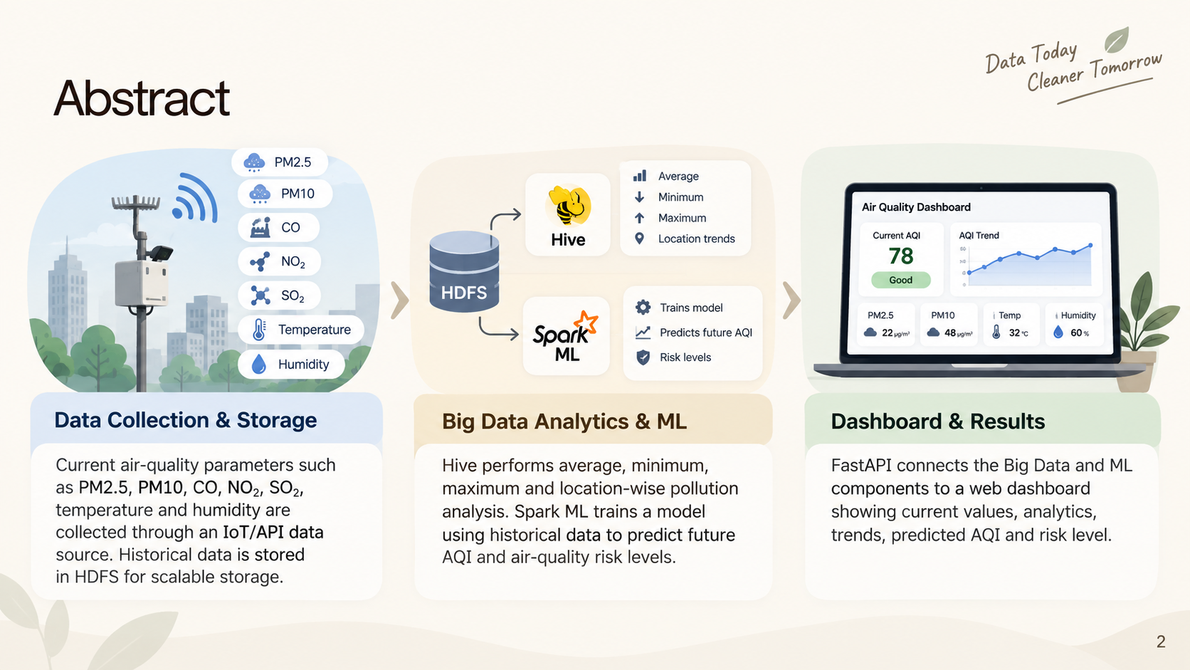
2

Slide 3
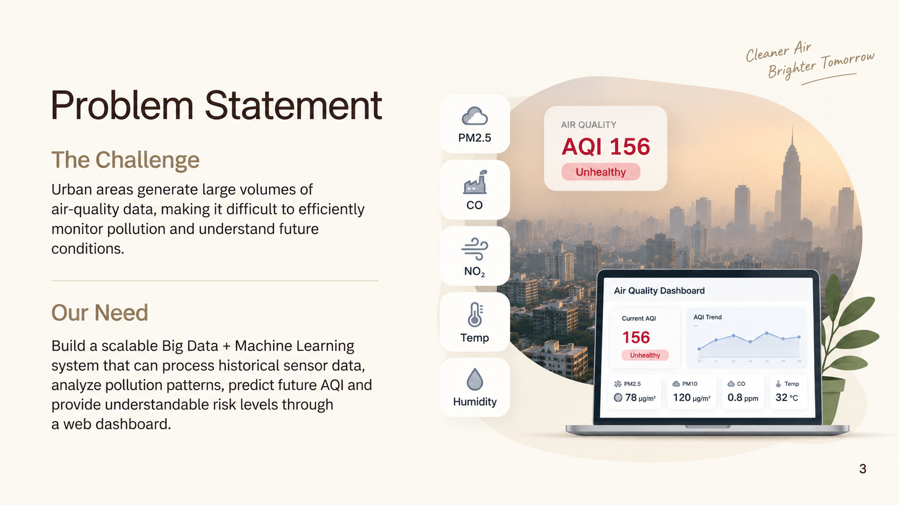
3

Slide 4
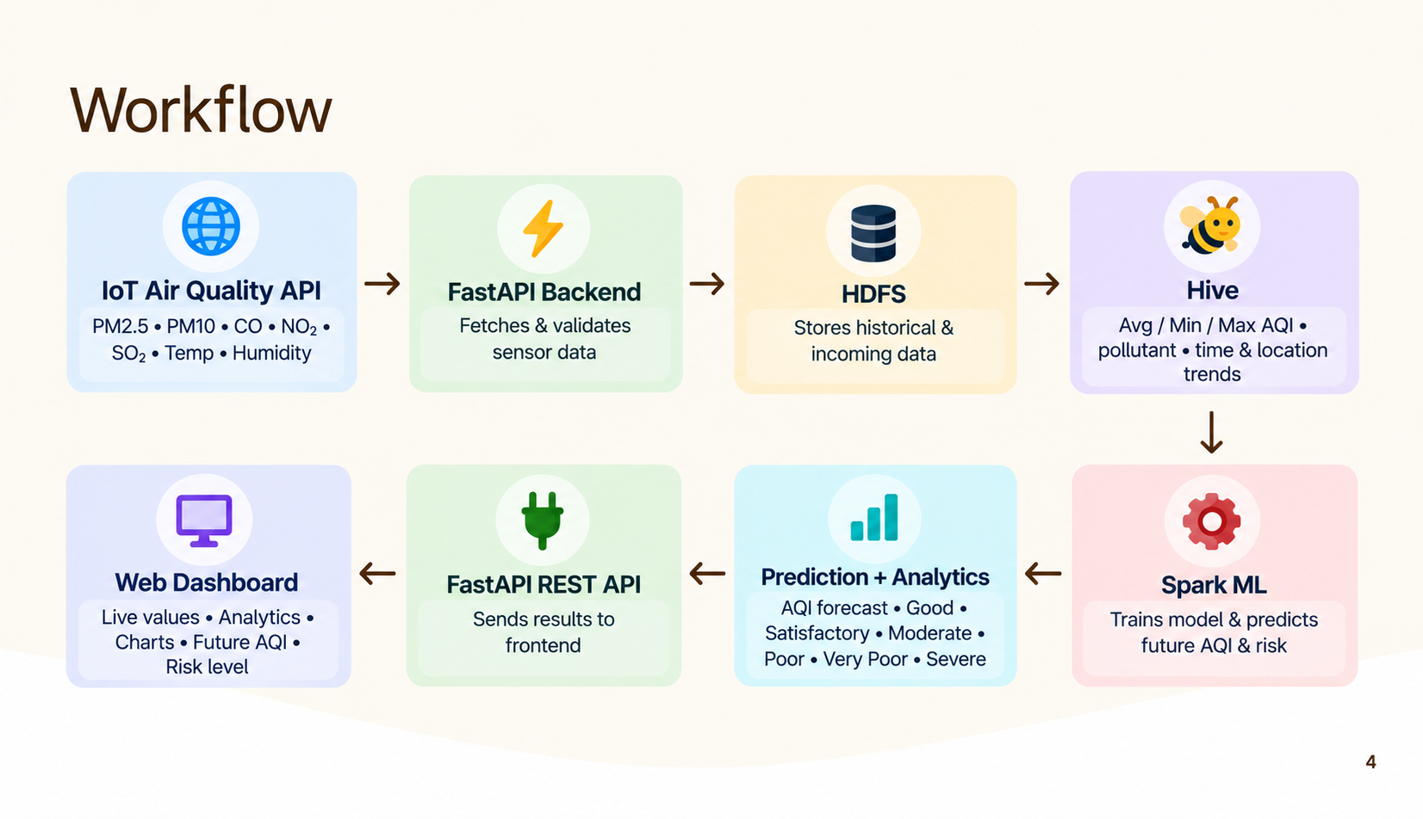
4

