Slide 1












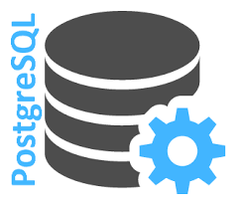

CXP Reference Architecture
Market Place High level Architecture
Customers
API
F5 (load balancer)
Market Place Portal
Static Web Content
Routing Details
Security Policies
CMS Content
API Gateway
Auth & Permission
Load Balancer
Security Policies
Micro Services
Project
Job
Security
System Monitoring
Logging & Auditing
Controllers
Bid Job
Validators
Notification Service
Service
Repo
Entity
Cache

